Slide 1
How to Diagnose the Struggling Learner
VADER
Miriam Robin, MD & Erin Biringen, MD
Internal Medicine Chief Residents 2024-2025
Notes:
~ 40 minutes

Slide 2
THINK ABOUT A TIME YOU STRUGGLED… - How did you feel? - What kind of support did you receive? - What went well? - What do you wish went differently?

Slide 3
How would you identify a struggling learner?

Slide 4
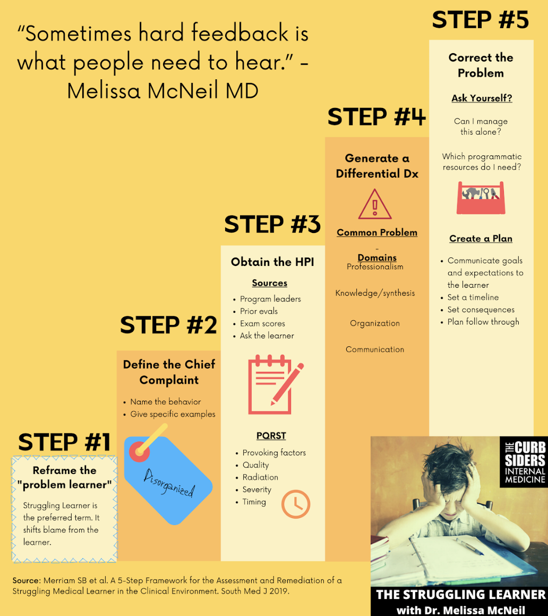
Struggling Learner Framework
Notes:
Sound familiar? Chief Complaint, HPI, Differential Diagnosis, Assessment, Plan

Slide 5
Chief Complaint
What is the specific behavior this learning is struggling with?

Slide 6
HPI
How did you recognize that this behavior was an issue?
Was there feedback from other team members, your own observations?
Note there can be bias/emotional response
Suggest using the OPQRST method
Notes:
Collect your data

Slide 7
Differential Diagnosis
In which domain does the learner need support?
Professionalism
Fund of knowledge
Communication
Clinical reasoning
Organizational Skills
Well-being
Systems Issues
Notes:
Professionalism
Confidence: does the learner have difficulty showing ownership over their patients?
Accountability: is the learner on time, engaged with rounding, following through on clinical tasks, responsive to feedback?
Interpersonal skills: respectful of colleagues, staff, peers, patients
Fund of knowledge: does the learner demonstrate gaps in knowledge necessary for their level of training or demonstrate difficulty in management decisions?
Communication: May have difficulty translating thought to clear and concise communication with patients, team members via oral presentations, or consult calls.
Clinical reasoning: does the learner struggle to create a differential diagnosis or recognize common illness scripts and utilize available data to strengthen leading differentials?
Organization: may have difficulty prioritizing competing tasks, completing tasks in a timely manner, or approaching administrative tasks in a timely manner
Well-being: does the learner demonstrate varying levels of performance at varying times? Is the learner showing new difficulty meeting program requirements?
Communication -->difficulty formulating questions or getting info on first pass
Confidence → difficulty advocating pt needs or acuity; great test scores but poor clinical performance
Clinical reasoning/synthesis→ workup is super broad, presentation includes EVERYTHING not just pertinent
Fund of Knowledge→ lower scores, issues in specific area (women’s health)
Accountability→ lack of follow up, everyone else’s fault
Well-Being → Is there something going on outside of work? Illness? Relationship issues?
Organizational Skills→ leaves late, notes completed later
Interpersonal Skills→ conflicts with team members on multiple teams, repeated issues with nursing staff
Self-Directed Learning→ asks questions first before trying to figure out the answer for themselves, less familiar with a patient’s management over time than would be expected
Systems Issues→learner states they have never gotten this feedback before, Multiple learners have the same performance issue in the same rotation or task area

Slide 8
Assessment includes answering these questions:
Has the learner been receptive to feedback in the past?
Does the learner have insight?
Is this a recurrent issue?
Should additional support such as chief or faculty be involved?

Slide 9
Plan: actionable ways to address challenges
Professionalism
Fund of knowledge
Communication
Clinical reasoning
Organization
Well-being
Notes:
Professionalism: confidence, accountability, interpersonal skills
Discuss one-on-one with the learner what has specifically felt like a barrier to answering questions, communicating urgency of patient issues to other staff or team members, or with team management: time pressure, performance anxiety?
In addressing unprofessional behaviors (punctuality issues, not completing assigned tasks, conflict with staff), ask the learner if they have thoughts about barriers to these issues to elicit reflective learning
Can discuss your own challenges with accountability in the past and how you have addressed them
Professionalism issues may be a sign of mental health concerns
Fund of Knowledge
Encourage self-directed learning
Write one clinical question at end of each day, look up one topic and discuss with the team on a specified day of the week in a 5 minute chalk talk
Identify learner goals at the start of a rotation together: what topic do they want to improve their knowledge on?
Offer resources for independent learning: curbsiders, internet book of critical care, icu one pager, core IM
Communication
Role-play challenging communication with the learner: ask them to describe what they thought went well, what could be improved, then observe the learner doing the same and ask for self-feedback
Review the components of a strong consult call and have the learner develop the “consult script.” Have the learner reflect on what went well and what can be improved after the consult call.
Clinical reasoning
Encourage use of mnemonic to generate differential (VINDICATE, VITAMINS)
Create differential from each component of a chief complaint
Work with learner to generate pertinent positive/negative questions for each chief complaint
Organization
Review time limit expectations for a task (ie how long should it take to complete notes, when to prioritize inpatient note-writing)
Offer a plan of how to pre-round emphasizing consistency to increase efficiency
Review how they keep notes of important tasks: check-boxes, colors differentiating importance of tasks/completed tasks, etc
Well-being
Be clear your role as team lead includes being invested in team morale and well-being

Slide 10
Simulation!

Slide 11
Questions?
Miriam Robin, MD & Erin Biringen, MD
410-830-1070 303-261-2146

