Slide 1
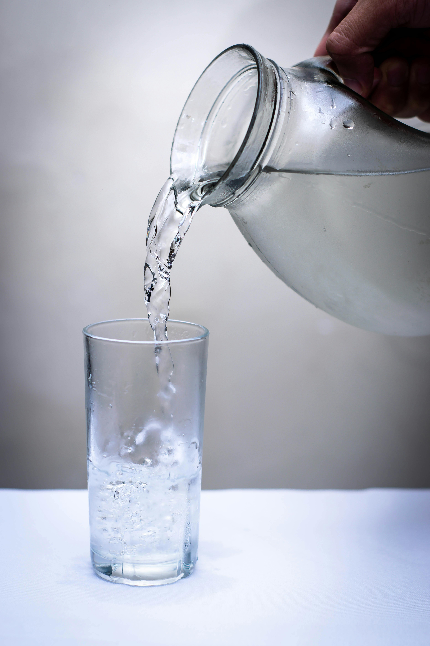
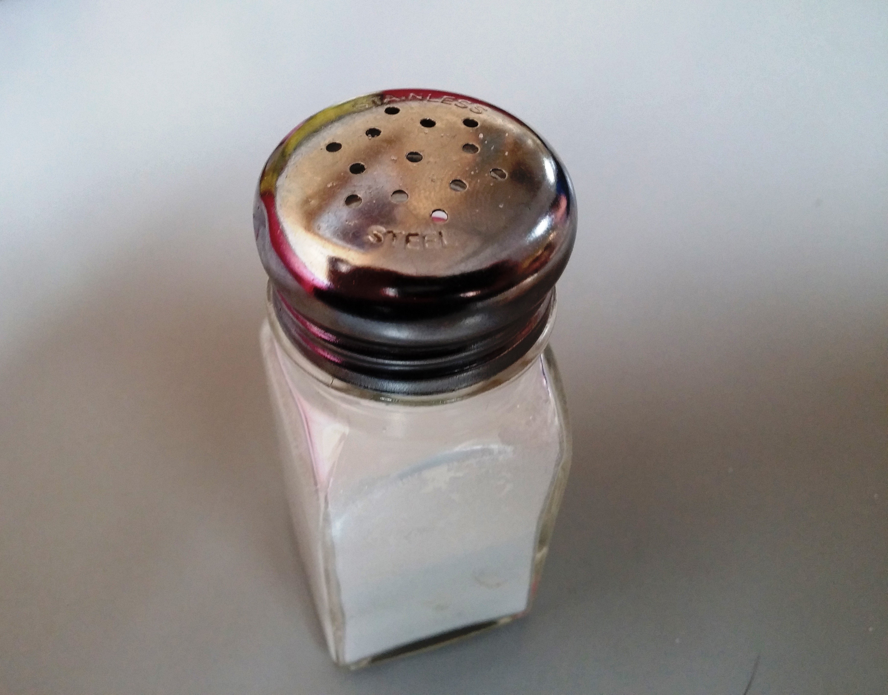
Dysnatremias: Is it All About the Salt?
Dr. Bindu
Chaparalla
SKI Nephrology
October 8, 2024

Slide 2
Learning Objectives
Describe the evaluation and management of the patient who presents with symptomatic severe hyponatremia.
Describe the evaluation of a patient who presents with asymptomatic hyponatremia of unknown duration.
Know the differential diagnosis for hyperosmotic hyponatremia, isosmotic hyponatremia, and hypoosmotic hyponatremia.
Describe the evaluation and management of a patient with hypervolemic hypoosmotic hyponatremia, euvolemic hypoosmotic hyponatremia, and hypovolemic hypoosmotic hyponatremia.
In a patient with hypernatremia, calculate a free water deficit, describe the type of fluid and rate of fluid per hour IV to correct the deficit. Know the safe parameters of correction to avoid complications such as osmotic demyelination.

Slide 3
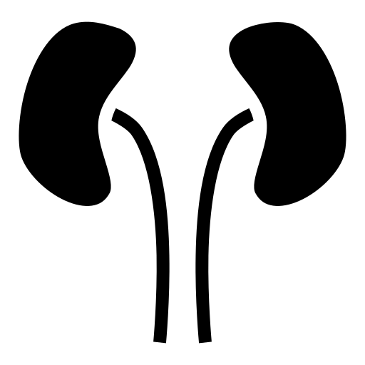
Dysnatremias: Key Principles
In general, disorder of water balance, not sodium balance…
Volume status is tied to total body sodium content
Sodium concentration (ie hypo or hypernatremia) determined by proportion of total body sodium to water
The kidneys regulate sodium and water balance independently

Slide 4
Case 1
A 46-year-old man is evaluated in the emergency department because of a 1-day history of nausea, vomiting, and confusion. He has depression, for which fluoxetine was initiated 17 days ago. He weighs 70 kg.
On physical examination, blood pressure is 138/78 mm Hg without orthostatic changes. Other than confusion, the remainder of the physical examination is normal. While you are seeing him, he has a generalized tonic-clonic seizure.
Laboratory studies:
Creatinine: 1.0 mg/dL
Sodium: 123 mEq/dL
BUN: 9 mg/dl
Glucose: 85 mg/dL
Which of the following is the most appropriate next step?
Serum osmolality stat
100 cc of 3% saline stat
1 amp sodium bicarbonate stat
1 liter normal saline IV bolus stat
Ativan 2 mg IV stat
B or C

Slide 5
Symptoms of Hyponatremia
Mild
Nausea/Vomiting
Weakness
Headache
Mild neurocognitive deficits
Moderate/Severe
Delerium
Confusion
Impaired consciousness
Ataxia
Seizures
Brain herniation/death
Acute symptomatic hyponatremia requires urgent treatment to correct the sodium by 4-6 mEq/L in the first couple of hours
Treatment should not be delayed while pursuing a diagnostic etiology
3% saline requires pharmacy preparation- an alternative is giving an amp of sodium bicarbonate which is available on the code carts (1 amp bicarb = 100 cc/3% saline)
Goal to increase sodium by 4-6 meq in 2-4 hours

Slide 6
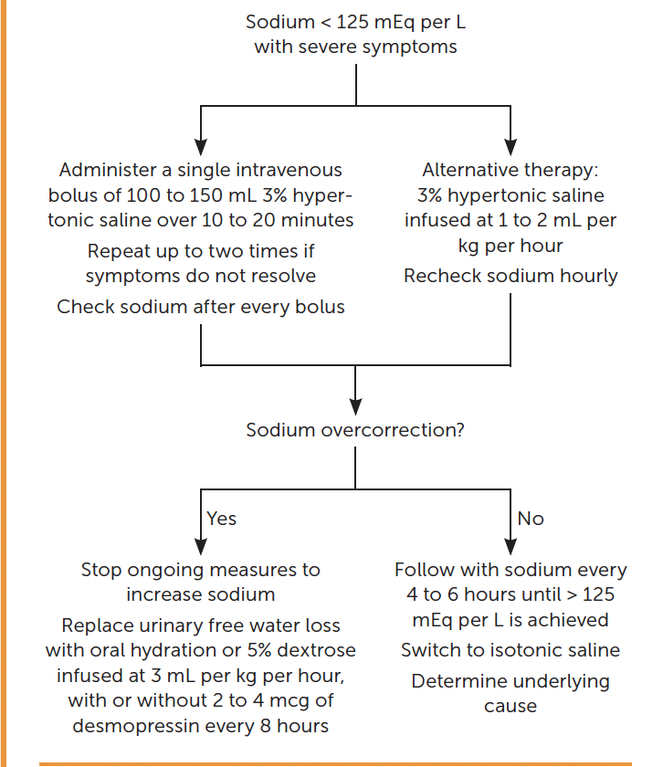

Slide 7
Sodium deficit:
Male patient
Normal weight 70 kg
Current sodium 123 mEq/L; Desired sodium 140 mEq/L
Sodium deficit: 714 mEq
Infusion rate of 3% saline :
Increase by 1 mEq/ hour in first 3 hours (123 mEq/L to 126 mEq/L)
Male
Adult
Normal weight 70 kg
Rate: 110 cc/hour
:

Slide 8
Case 1
Calculation of 3% saline
To raise serum Na by 8 meq/L over 24h assuming pt is 70kg, TBW=42L
Na needed is 336meq. Volume needed is around 650cc of 3% or a STARTING rate of 27cc/hr.
I would stop when pts symptoms ceased or when sodium >124
Close monitoring is essential

Slide 9
Normal Physiologic Water Losses
Obvious Fluid Losses
Stool
200cc/day
Urine losses
500cc/ day (electrolyte free water loss)
Insensible losses
Skin
500cc/ day (possibly more in hospitalized patients)
Respiratory
400cc/ day (more in hospitalized patients)
All water losses result in increase in plasma osmolality
Question:
How does being on the ventilator affect respiratory fluid losses?

Slide 10
Physiology of water regulation: Response to increase in plasma osmolality
Increase in ADH
Increased Thirst
Vasopressin receptor
A. V1
B. V2
Aquaporins open in collecting duct
Water moves down concentration gradient and urine becomes concentrated
Notes:
V1 volume
V2 tonicity

Slide 11
ADH physiology
Notes:
Principal cells
Apical
Basolateral

Slide 12
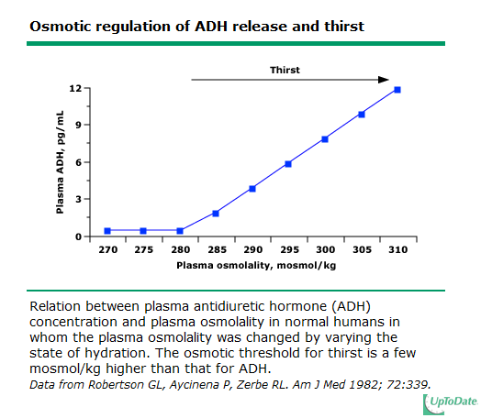

Slide 13
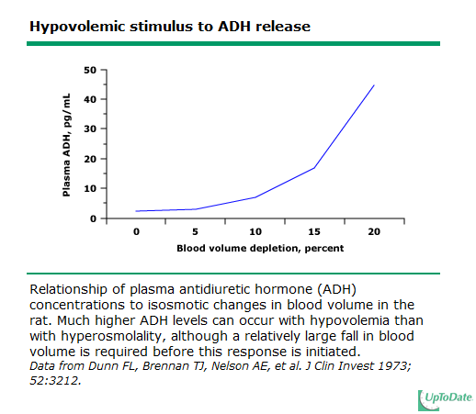

Slide 14
Hyponatremia Develops in TWO situations
1. Water intake which overwhelms excretory capacity (rare, such as severe psychogenic polydypsia)
2. Intake of a water load which cannot be excreted due to low GFR or persistent effects of ADH

Slide 15
Case 2
A 65-year-old man is evaluated for a 7-week history of increasing fatigue and poor appetite. Medical history is otherwise unremarkable. He takes no medications.
Physical examination findings, including vital signs, are normal.
Laboratory studies:
Hematocrit: 28%
Albumin 3.0 g/dL
Calcium 10.4 mg/dL
Creatinine 1.6 mg/dL
Electrolytes:
Sodium 130 mEq/L
Potassium 3.6 mEq/L
Chloride 99 mEq/L
Bicarbonate: 23 mEq/L
Osmolality: 290 mOsm/kg H20
Total protein: 9.8 g/dL
Laboratory studies continued:
Urine osmolality: 240 mOsm/kg H20
Urine sodium: 45 mEq/L
Which of the following is the most likely cause of this patient’s hyponatremia?
Hypercalcemia
Multiple myeloma
Poor solute intake
Psychogenic polydipsia
Syndrome of Inappropriate Antidiuretic Hormone secretion

Slide 16
Most cases of hyponatremia are hypotonic (low serum osmlolality)
A serum osmolality is the FIRST step in determining the cause of the hyponatremia and the next steps in the evaluation.
A glucose > 400 requires a different correction factor than a glucose <400 (see below)

Slide 17
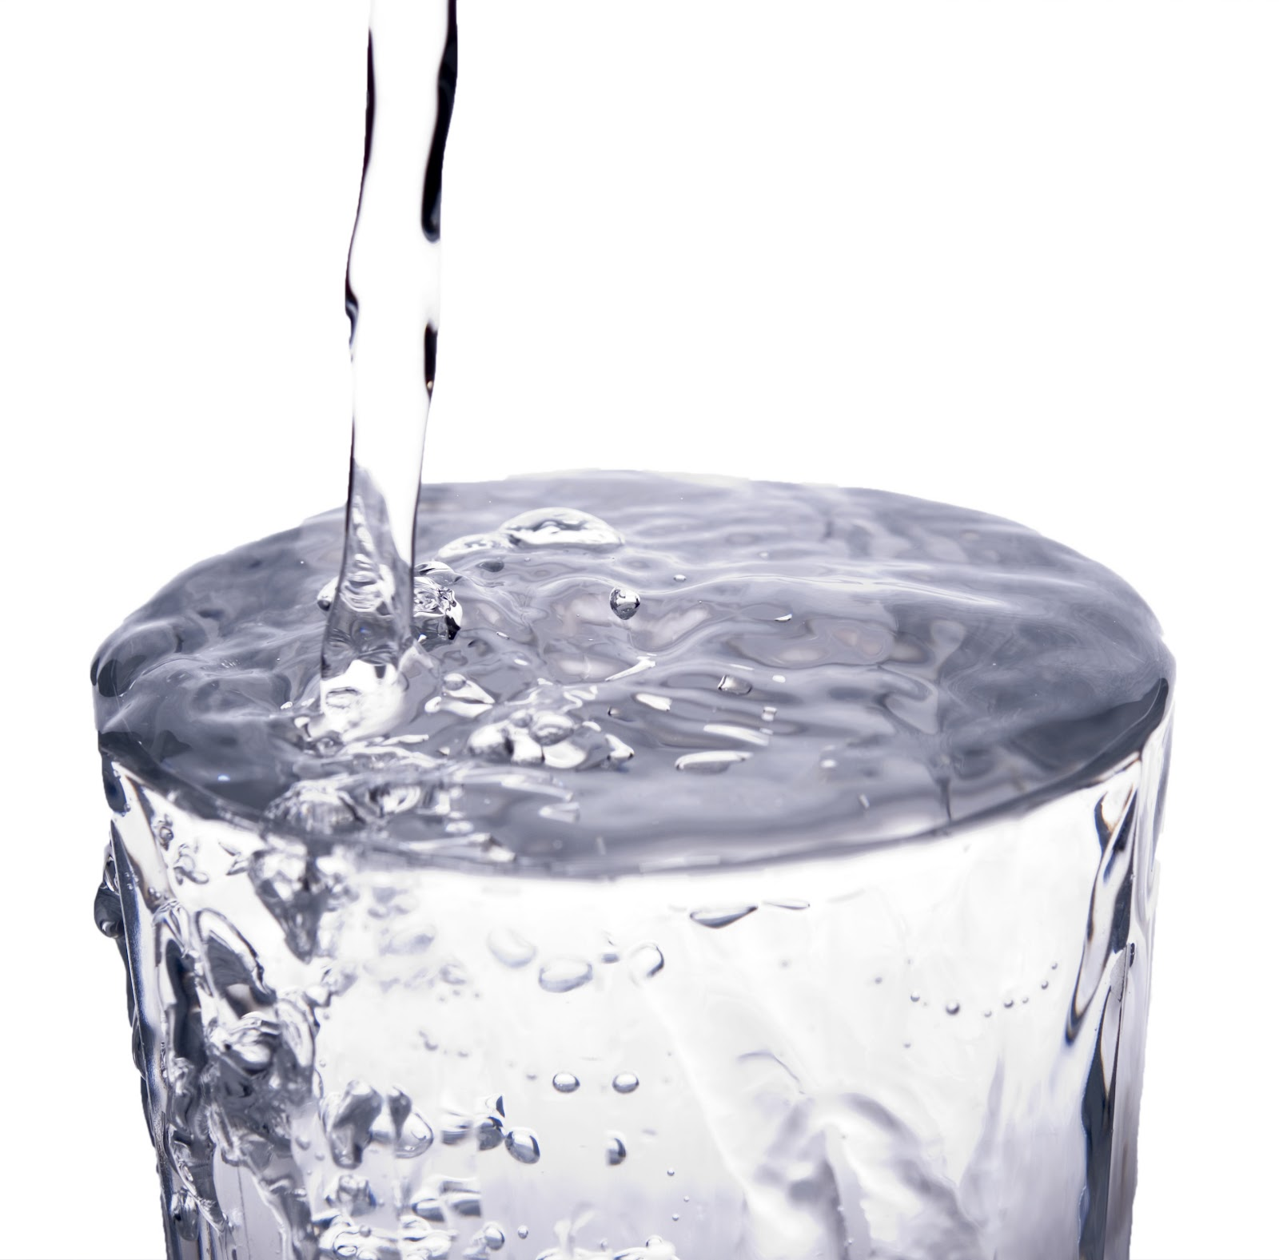
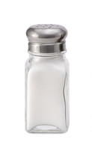
Hypoosmotic Hyponatremia: Divide into Volume Status
Hypovolemic hyponatremia
Total body water decreased
Volume (total body sodium) decreased MORE
Euvolemic hyponatremia
Total body water increased
Volume (total body sodium) no change
Hypervolemic hyponatremia
Total body water increased MORE
Volume (total body sodium) increased

Slide 18
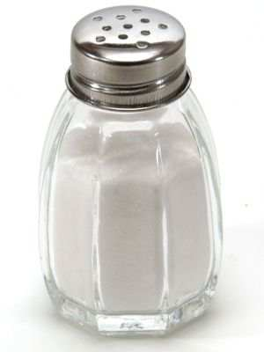
Differential Diagnosis Based on Volume Status
Hypovolemic hyponatremia
Total body water decreased
Volume (total body sodium) decreased MORE
DD: GI losses (N/V/D), small bowel obstruction, burns, diuretics, primary adrenal insufficiency, salt-losing nephropathy
Euvolemic hyponatremia
Total body water increased
Volume (total body sodium) no change
DD: Primary polydipsia, decreased solute intake, cortisol deficiency, hypothyroidism, SIADH (drugs vs malignancy vs pulmonary or CNS process)
SIADH is diagnosis of EXCLUSION
Hypervolemic hyponatremia
Total body water increased MORE
Volume (total body sodium) increased
DD: Heart failure, renal failure, cirrhosis, nephrotic syndrome

Slide 19
Hyponatremia
My steps in evaluating hyponatremic disorders…
How much time do I have-- ie is pt symptomatic?
Hypo-osmolar (Osm <275)? Rule out----
pseudohyponatremia (hyperproteinemia/hyperlipidemia rare nowadays)
Hypertonic (hyperglycemia)
Isotonic (mannitol)
Volume status?
Signs of volume depletion?
Signs of volume excess?
If euvolemic, reason for SIADH?
Rule out thiazide diuretics, severe hypothyroidism, adrenal insufficiency
Rule out poor solute intake (“beer potomania” or “tea and toast diet”)
Working diagnosis
Treatment plan and monitoring frequency

Slide 20
Case 3
57-year-old woman with PMH of hypothyroidism presents w/ a 1 week history of upper resp symptoms along w/ n/v. Very little intake other than trying to “hydrate.” Brought to ER by family for progressive confusion. The time is noon. The ED orders stat labs and gives the patient 2 liters of normal saline bolus.
Weight 70 kg BP 100/54 HR 101, confused, no edema.
NOON LABS:
Na: 120 mEq/L
K: 3.4 mEq/L
BUN: 5 mg/dL
Creatinine: 0.4 mg/dL
Serum Osm: 250
Glucose: 130 mg/dL
TSH: normal
URINE LABS AT 6 PM:
Urine Osm: 141
Urine Na: 36
Urine SG: <1.005

Slide 21
Case 3
She sits in the ED overnight because there are no beds the overnight hospitalists are “slammed.”
You are the hospitalist assigned to admit her at 6 am.
Her 4 am morning labs have returned and her sodium is now 140 meq/L.
The patient is awake and alert and feels “much better”.
Question:
What are you worried about?
What is your management of the patient at this time?
Can she be discharged?

Slide 22
Osmotic demyelination syndrome
Acute hyponatremia causes brain edema
Adaptation begins immediately and is complete around 48hrs
Loss of water, sodium, intracellular potassium, organic solutes
Rapid correction can result in ODS
Usually in pts w/ serum sodium <120 on presentation
At risk pts: cirrhosis, alcoholism, malnourished, OLTx
Current rate of correction recommendations:
No more than 8 mEq/L in 1st 24h and 16mEq/L in 1st 48h

Slide 23
Case 3
Weight x 0.5 (female) = TBW
70 x 0.5 = 35 liters
TBW x ((Current sodium/Desired sodium) – 1) = Free water deficit
35 x ((140/128) – 1) =
35 x .09375 = 3.28 liters
3280 cc free water / 48 hours
1640 cc / 24 hours = 68 cc/hour
The sodium increased by 20 meq in 16 hours!
Goal increase: 8 meq in 24 hours
Free Water Deficit equation can be used
Notes:
Ddavp. Would decrease to around 128. Delta of 12.
Water deficit equation- 70kg x 0.45= 37.5 and 140/128-1 x 37.5 = 3.1L without ongoing losses

Slide 24
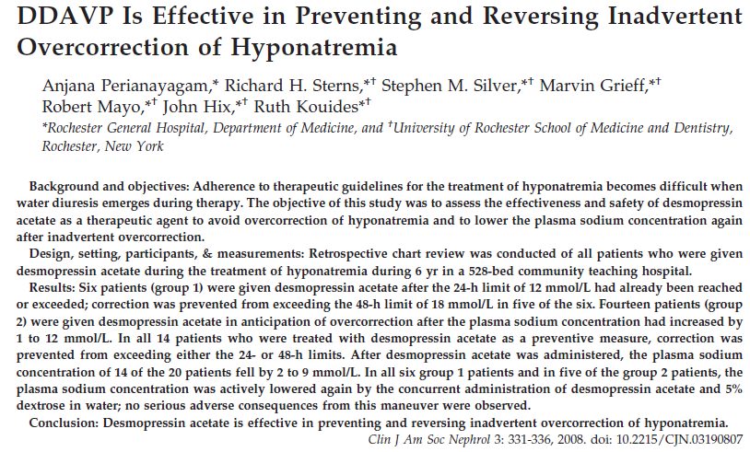
Case 3

Slide 25
Case 4
A 48-year-old man with smoking history presents with confusion and drowsiness. Meds include combivent.
BP 130/84 HR 70, JVP 4cm, clear lungs, no edema.
CXR shows COPD changes.
The family is concerned that he “smokes and drinks beer all day” and eats very little.
Laboratory studies:
Sodium 117 mEq/L
Potassium 3.6 mEq/L
Serum osm 240 mOsm/kg H20
Urine sodium: 90
Urine osm: 662
Questions:
Symptoms?
Volume status?
Differential diagnosis?
What other labs or imaging would you order?

Slide 26
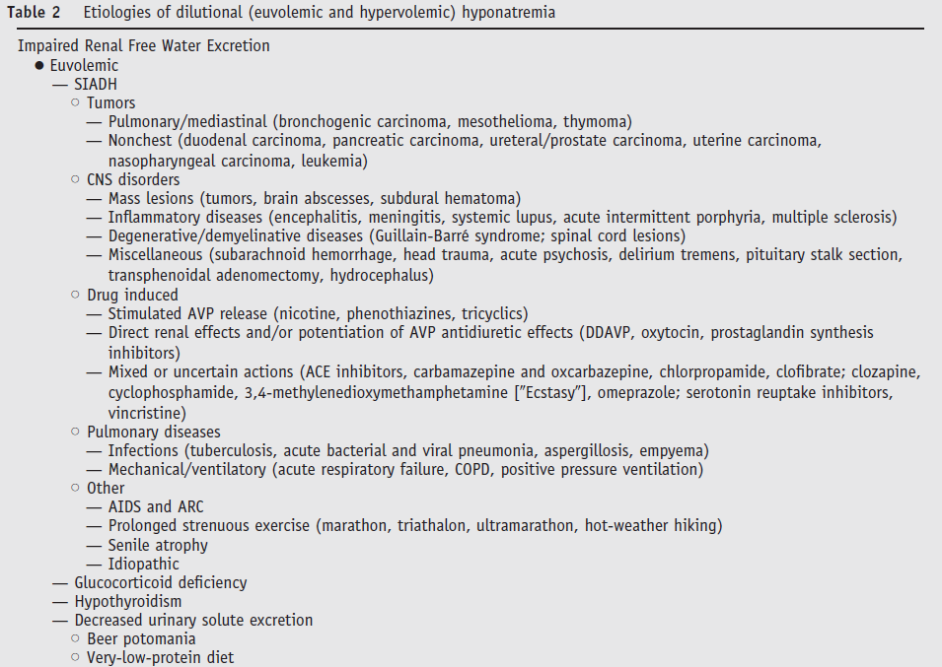
DDx for Hypoosmotic Euvolemic Hyponatremia

Slide 27
Case 4
Diagnosis of SIADH:
Decreased serum osmolality (< 275 mOsm/kg of water)
Urine osmolality > 100 mOsm/kg during hypotonicity
Clinical euvolemia
Urine sodium > 40 mmol/liter with normal dietary salt intake
Normal thyroid and adrenal function
No recent use of diuretic agents
Question:
How would you treat this patient?
A. 3% saline
B. Fluid restriction
C. Salt tabs and lasix
D. Tolvaptan

Slide 28
Case 4
3% saline
Rate
To raise serum Na by 8 meq/L over 24h assuming pt is 70kg, TBW=42L
Na needed is 336meq. Volume needed is around 650cc of 3% or a STARTING rate of 27cc/hr.
I would stop when pts symptoms ceased or when sodium >124
Close monitoring is essential

Slide 29
Case 5
A 58-year-old woman with a history of ischemic cardiomyopathy admitted with pulmonary edema.
Meds include metoprolol, spironolactone, furosemide, lisinopril.
BP 97/54 HR 85, alert and oriented, JVP 9cm, lungs w/ diffuse crackles, 1+ LE edema
Laboratory studies:
Sodium: 121 mEq/L
Potassium: 3.5 mEq/L
BUN 45 mg/dL
Creatinine 1.1 mg/dL
Urine Na: 15
Urine Cl: < 5
Urine Osm: 210 (6 hours after the last diuretic dose)
Question:
Symptoms?
Volume?
Other workup?
Treatment options?

Slide 30
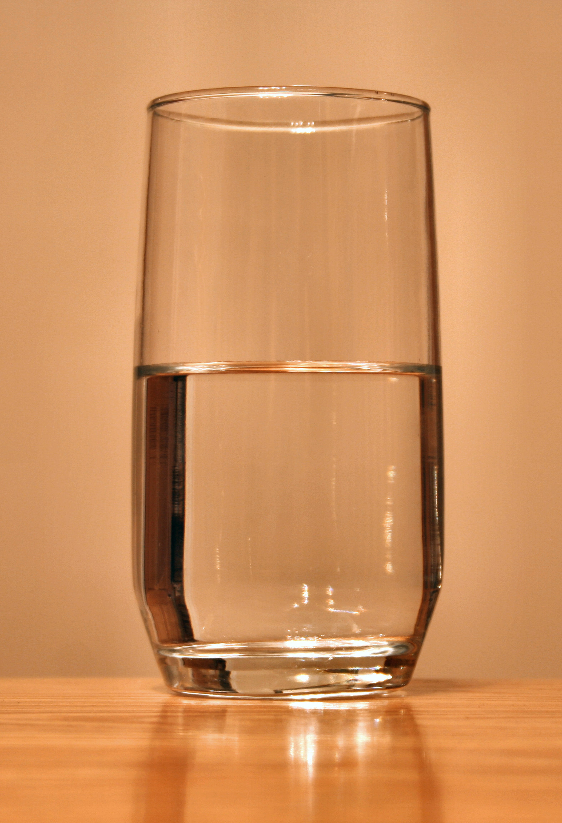
Case 5
Treatment:
Fluid restriction
Fluid restriction
Fluid restriction
Diuretics
A word about cirrhotic patients

Slide 31
Vasopressin receptor antagonists
Disadvantages
Hospitalization
Cost
Rapid correction
Thirst
Black Box Warnings
Advantages
Addresses underlying issue
Efficacy
Allows less strict fluid restriction
Notes:
30 days
No pts w/ liver disease

Slide 32
Case 6
A 35-year-old man has been in the surgical ICU for 3 weeks after a motorcycle accident. You are asked to assume care after he is transferred to the floor.
Hospital course:
Multiple trips to OR for orthopedic surgeries
Prolonged vent requirements
s/p VAP with sepsis
On several antibiotics mixed in saline
Receiving tube feeds with free water flushes 100 cc/ 4 hours
On Exam:
Normotensive, pulse 95, decreased breath sounds, + anasarca. External fixators present on lower extremities.
Mucous membranes dry, patient complains of thirst
Laboratory studies:
Na 165 mEq/L
Creatinine 1.2 mg/dL
BUN 105 mg/dL
Question:
What do you do next?
What is his volume status?
Does he have too much salt or too little water?

Slide 33
Case 6
Free Water deficit calculation:
H2O deficit= TBW x (current Na/140 - 1)
TBW= 45-60% of lean body wt in kg (0.6 male, 0.5 female, decrease 0.05 for elderly)
Data: current wt 110kg IBW 85kg
Goal decrease in sodium
10meq/L in 1st 24h max
16-18meq/L in 1st 48h
Question:
How much free water needed?
How would you administer it?
What monitoring is needed?
You decide about 3 L is needed
Water flushes increased to 125cc/hr
Call parameters given to RN
Next AM you open chart
Serum sodium is 170
What happened?
Notes:
85x0.5=42.5L
7.5L deficit
165→155? 3 L needed using 150 as numerator

Slide 34
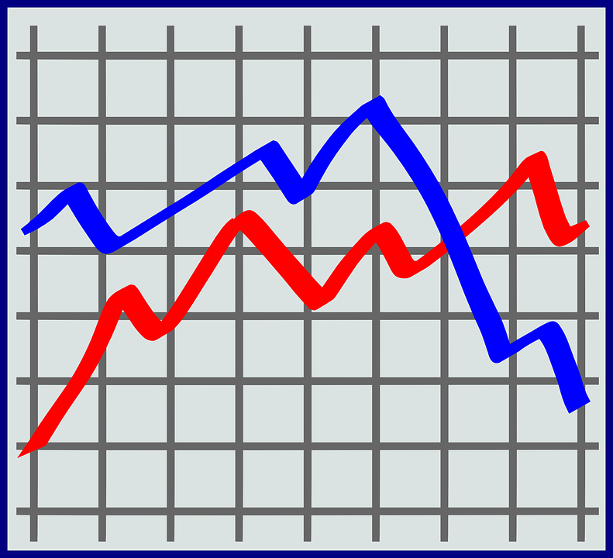
Case 6
You study I/O and med list a bit further…
Cardiology has started pt on lasix (polydoctoring)
Intake was 4L, output was 6.5L (drains, urine output, diarrhea from TF)
Ongoing adjustment is needed to account for ongoing water losses. Impossible to quantify in most cases
In general replacement rate will underestimate amount of water needed (ie will see undercorrection)

Slide 35
Summary: Dysnatremias
In general, disorder of water balance, not sodium balance…
Volume status is tied to total body sodium content
Sodium concentration (ie hypo or hypernatremia) determined by proportion of total body sodium to water
The kidneys regulate sodium and water balance independently

