Slide 1
ICU as a Senior Resident
Dylan McCreary
Esa Rayyan
Yusef Esparza

Slide 2
Outline
Discuss the general flow of nights in the Banner ICU
Review the members of your team and how to best work together
Review helpful quick references and common key order sets

Slide 3
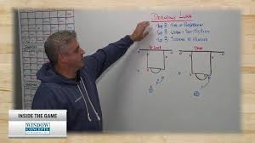
A Night at Banner

Slide 4
A Night At Banner
5-7 PM – Review the current patients, cross cover, possibly see a new admission with the long call attending, work with the long call fellow
7ish PM – Move to the 5th floor office for the night, check in with night fellow, attending, NP, extenders
Early Night – Round with the fellow on patients (quick check in with nursing staff)
Later Night – Cross cover, admissions, staff as you go
5ish AM – Run the list with fellow/attending, make sure patients are assigned to day teams
6AM – Sign out and GTFO

Slide 5
A Night at Banner

Slide 6
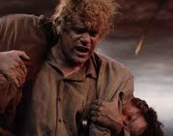
Your Team
Night Pulmonary Critical Care Fellow
Changed the schedule so there will not be a month without a fellow on nights, there will be some months with only one fellow, so half of nights will not be covered, there will be advanced notice to get extra extenders for these nights

Slide 7
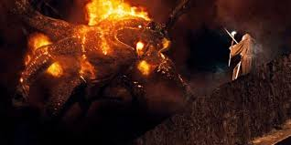
Your Team
2) Attending
Dr. O'Hea, Dr. Shamsid-Deen, Dr. Sher, Dr. Esparza
Always open to help with questions, especially if fellow is busy

Slide 8
Your Team
3) Night NP's and Extenders
Will always be 1-2 people covering teams 3 and 4
Can always help you answer any questions and are experts with efficient orders and other tips and tricks

Slide 9
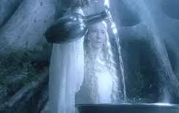
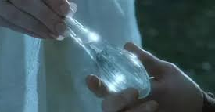
Your Team
4) ICU Nurses
They are the first one to see and know what is happening with your patients and will "be your light in dark places when all other lights go out"
Seriously though the more you communicate and get their thoughts the quicker you will be to address problems before they grow

Slide 10
Your Team
5) ICU Respiratory Therapists
They are experts with all the respiratory devices/modes (BiPAP, AVAPS, ventilator, HFNC) and can help with trouble shooting any alarms or other issues
They are also your person to ask if you need a blood gas drawn

Slide 11
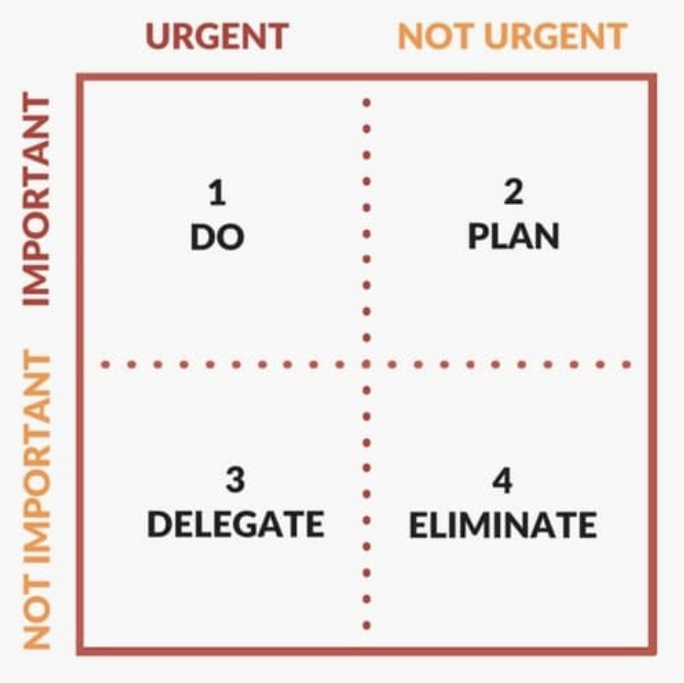
Triaging Cross Cover
Escalate +
Go Bedside
Do or Ask/ Check Box
Do /
Nurse Order
Acknowledge

Slide 12
Triaging Cross Cover
When in Doubt Ask/Escalate!!

Slide 13
Key Order Sets at Banner
"ICU"
General admission order set, also contains all the other order sets
"Vasoactive Medications"
All your pressors as well as antihypertensives
Always order the "double concentration" of norepinephrine
"Ventilator Therapy"
Order for everyone on a ventilator, has stress ulcer prophylaxis, oral care
Make sure to check the box for daily CXR
Make sure to order the "Ventilator Therapy Blood Gas" and check all 3 options
"ICU Analgesia and Sedation"
All the sedation drips for the ICU

Slide 14
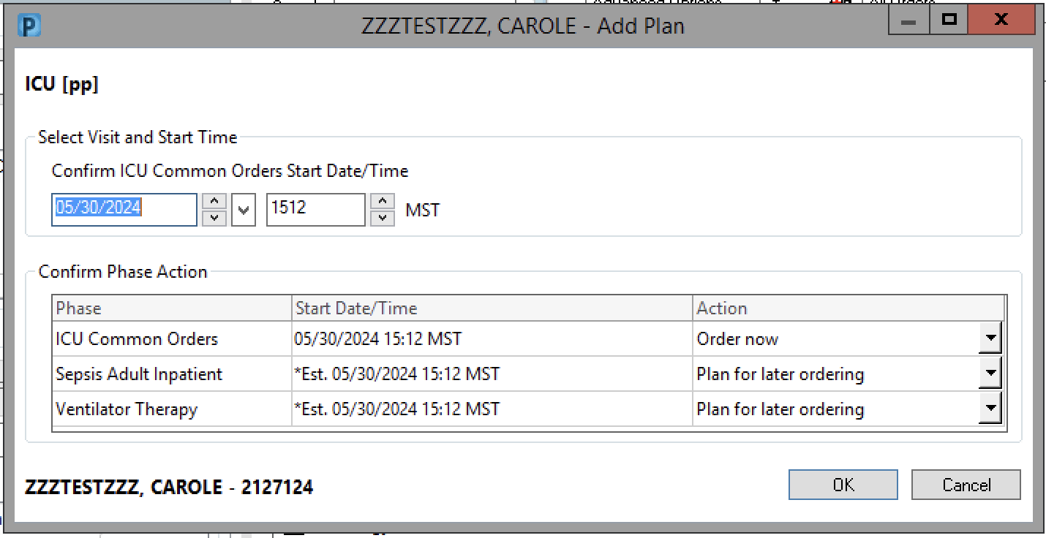
"ICU"

Slide 15
"ICU"

Slide 16
"Vasoactive Medications"

Slide 17
"Vasoactive Medications"
For antihypertensive drips need to specify what the blood pressure goals are in the comments box

Slide 18
"Ventilator Therapy"
Stress Ulcer Prophylaxis
Can choose famotidine – note need to dose adjust for CKD
Can also use Pantoprazole, not in the order set

Slide 19
"Ventilator Therapy"
Top order is used for daily AM CXR which we order on every intubated patient, can put number of days to be 10
Bottom order is used for CXR to confirm ETT placement (want 3-5 cm from carina)

Slide 20
"Ventilator Therapy"
Enter the RR, Tv, PEEP, FiO2

Slide 21
"Ventilator Therapy"

Slide 22
"Ventilator Therapy Blood Gas Orders"

Slide 23
"Ventilator Therapy"

Slide 24
"ICU Analgesia and Sedation"
Need to put in a RASS goal for the patient
0 to –2 is the standard, awake but calm to sleeping but easily arousable
May need more sedation in various other scenarios like severe ARDS, etc.

Slide 25
"ICU Analgesia and Sedation"
Propofol – typically first choice for intubated
Precedex (dexmedetomidine) - only drip that can be used for non-intubated

Slide 26
Differences Between Banner and the VA
Banner
A lot larger, total census amongst all 4 teams 40-60
See everything from DKA to ECMO
Always fellow and attending in house
The VA
Total number of beds 20 split amongst 4 residents (1 on nights, 3 on days), typically census 2-12
Generally lower disease severity (Not your job sole job to determine need)
Fellow and attending available by phone overnight, can also call telehealth provider for the ICU overnight

Slide 27
Helpful Resources
Internet Book of Critical Care
https://emcrit.org/ibcc/toc/
Great reference for bullet point digestible descriptions of all things ICU related
ICU One Pager
https://onepagericu.com/
One slide references for various ICU topics

