Slide 1
Edematous States and Diuretics
Academic Half Day
October 22, 2024
Katharine Dahl, MD
kdahl1@email.arizona.edu

Slide 2
Learning Objectives
Describe the mechanism of each of the following classes of diuretics and know where they work in the nephron: carbonic anhydrase inhibitors, loop, thiazide, ENac blockers, mineralocorticoid receptor blockers, and SGLT-2 inhibitors.
Strategize ways to overcome challenges with diuresis such as electrolyte abnormalities, metabolic alkalosis and diuretic resistance
Understand the underlying mechanisms for development of edema

Slide 3
Summary
Pathophysiology of volume regulation and edema
Causes of volume overload
CHF
Cirrhosis
Nephrotic syndrome
Treatment of volume overload
Diuretics
Mechanism
Causes of diuretic resistance
Enhancing efficacy

Slide 4
Heart vs. Kidney
Heart sends ¼ of all blood to the kidney
125ml/minute of water is poured into tubules, then 99% must be absorbed again.
In 1 day the kidney reabsorbs:
170 liters of water
½ pound of glucose
3 pounds of sodium chloride
Notes:
Because of the way that the kidney has evolved, it is a highly inefficient organ. Out of the approximately 125ml/minute of water pumped into the tubules by the heart, 99% must be prevented from escaping. Thus the heart is working hard to pump a large quantity of water out of the body, and the tubules are working equally hard to “defeat” the heart by preventing 99% of this water from escaping. The kidney is doing the most work when it excretes the least amount of urine. If it did not do this work, it would make 170 liters of urine per day.

Slide 5
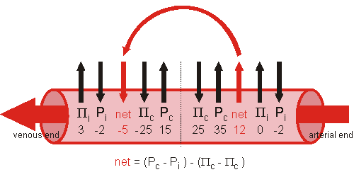
Starling Model of Fluid Distribution
Hydrostatic pressure pushes water out of the capillary.
Oncotic pressure pulls it back in.
The difference in these pressures decides whether water leaves the capillary or is pushed back in.
This model assumes that capillaries are fenestrated, providing a semipermeable membrane.
Notes:
Hydrostatic pressure pushes water out of the capillary, while oncotic pressure pulls it back in. Each of these pressures can be measured. The difference between the measured pressures decides whether water leaves the capillary, or is pulled back in to it. The fluid pushed out of the capillary wall by hydrostatic pressure is called filtrate.

Slide 6
Distribution of Water to Each Body Compartment is Determined by Membrane Permeability and Osmotic Pressure: Each Component has an Active Solute
albumin
sodium
potassium
Notes:
Distribution of water to each compartment is determined by osmotic pressure. Each component has its active solute that is primarily limited to that compartment and acts to pull water into that compartment. Sodium and potassium movement between intracellular and interstitial space is determined by Na-K-ATPase pumps. Sodium can freely move between interstial and intravascular spaces because capillary wall is permeable to sodium, so sodium is an ineffective osmole. Larger plasma proteins such as albumin cannot cross, so they are the primary effective solutes in the plasma. Why does the water not continue to move from interstitial space to intravasc space down its gradient? Hydrostatic pressure pushes it out.

Slide 7
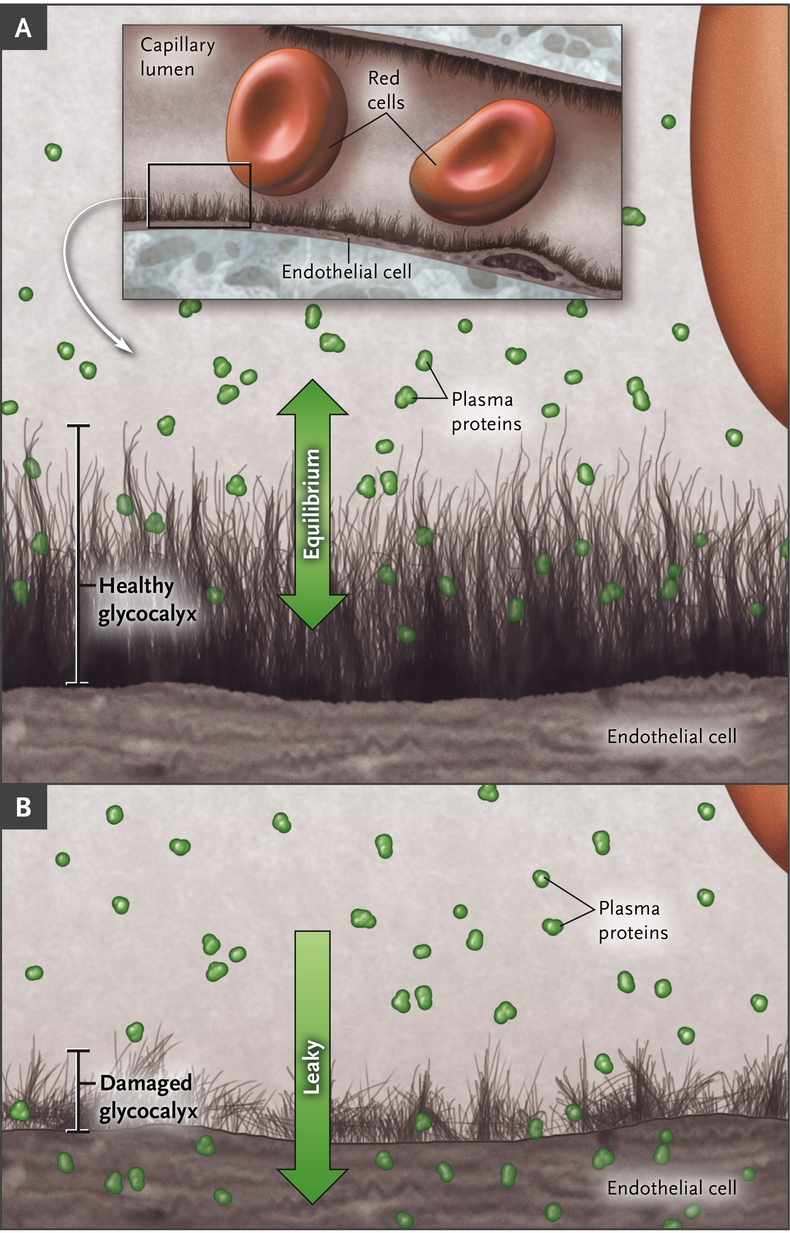
Role of the Endothelial Glycocalyx Layer
Web of membrane-bound glycoproteins and proteoglycans on luminal side of endothelium in both continuous and fenestrated microvessels throughout the body
Subglycocalyx space produces a colloid oncotic pressure
Acts in concert with clefts or fenestrae, basement membranes and pericytes to reduce permeability
Inflammatory conditions (sepsis, post-surgery, trauma, diabetes, ischemia-reperfusion) cause damage to endothelial glycocalyx layer leading to increased permeability and development of interstitial edema and proteinuria
Aggressive fluid resuscitation increases natriuretic peptides which cleave the glycoproteins and proteoglycans of the glycocalyx
Myburgh JA, Mythen MG. N Engl J Med 2013;369:1243-1251.
Salmon AH, Satchel HC. J Pathology 2012 Mar;226(4):562-74
Notes:
Figure 1 Role of the Endothelial Glycocalyx Layer in the Use of Resuscitation Fluids. The structure and function of the endothelial glycocalyx layer, a web of membrane-bound glycoproteins and proteoglycans on endothelial cells, are key determinants of membrane permeability in various vascular organ systems. Panel A shows a healthy endothelial glycocalyx layer, and Panel B shows a damaged endothelial glycocalyx layer and resultant effect on permeability, including the development of interstitial edema in some patients, particularly those with inflammatory conditions (e.g., sepsis). In both continuous and fenestrated microvessels, this endothelial glycocalyx provides resistance to the transcapillary escape of water and macromolecules, acting as an integral component of the multilayered barrier provided by the walls of these microvessels (ie acting in concert with clefts or fenestrae across endothelial cell layers, basement membranes and pericytes).

Slide 8
Volume Regulation
Volume regulation is a function of sodium content regulation
Too much sodium leads to edema
Too little sodium leads to volume depletion
Sodium intake varies widely
Sodium balance is determined by sodium excretion

Slide 9
Osmoregulation vs. Volume regulation
 | Osmoregulation | Volume Regulation
What is sensed? | Plasma osmolality | Effective tissue perfusion
Afferent limb | Hypothalamic osmoreceptors | Juxtaglomerular apparatus Carotid sinus Atria
Efferent limb | ADH (vasopressin) Thirst | Renin ADH (vasopressin) ANP Sympathetic Nervous Syst.
What is changed? | Urine osmolality Water intake | Urinary sodium Thirst
Notes:
Osmoregulation: ADH reduces water excretion and thirst increased water intake. Only 1 receptor because plasma osmolality constant.
Volume regulation: juxtaglomerular cells release renin leading to activation of RAS in response to hypotension or vol depletion in the absence of hypotension. Beta-adrenergic innervation also stimulates renin release in response to same stimuli. Prostaglandins, low plasma K, and increased sodium delivery to macula densa also stimulate renin release. Renin converts AT to AT-I, which ACE converts to AT-II. ATII causes peripheral vasoconstriction and decreases sodium excretion by both proximal and distal mechanism

Slide 10
Renin-Angiotensin Aldosterone System
Renin
Angiotensinogen → Angiotensin I
Angiotensin I → Angiotensin II
Proximal mechanism Distal mechanism
Constricts efferent arteriole Stimulates zona glomerulosa
↑ glom. hydrostatic pressure to secrete aldosterone.
& ↓ renal blood flow ↑ Na channels in distal &
Filtration fraction↑ (FF=GFR/RPF) collecting tubules
↑ Na reabsorption Stimulates Na-K-ATPase pump at basolateral membrane
Notes:
GFR maintained or increased, RPF always down; increased FF leads to increased peritubular oncotic pressure, which increases the driving force for sodium reabsorption. Even when there is a decline in GFR, filtration fraction is elevated because decline in plasma blood flow is more severe than decline in GFR.

Slide 11
Atrial Natriuretic Peptide (ANP)
Released from granules stored in the right & left atria
Release stimulated by volume overload with atrial distention or after atrial tachyarrhythmias
Actions
Inhibits renin release
Inhibits aldosterone production
Increases GFR which increases the amount of sodium available for excretion
Directly inhibits tubular reabsorption of sodium in the terminal collecting duct
Cleaves the glycoproteins and proteoglycans of the glycocalyx, causing increased endothelial membrane permeability
Notes:
A

Slide 12
Renal Nerves
Sympathetic nerves directly increase afferent and efferent arterial tone
↓ both RPF & GFR, favoring sodium retention
Directly stimulate proximal tubules and thick ascending limb segments
Stimulation of sympathetic nerves results in proximal sodium resorption even when filtration rate and renin/angiotensin levels unchanged
Notes:
Stimulation of sympathetic nerves results in increase in proximal sodium absorption even when the filtration rate and renin and angiotensin levels were not changed. Therefore, likely a direct role.

Slide 13
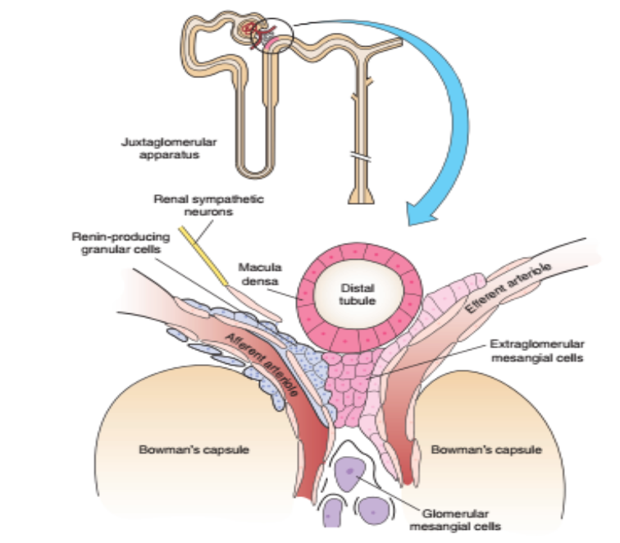
Role of the Macula Densa
Afferent arteriolar vasodilation induced by low distal tubular NaCl (tubuloglomerular feedback)
Production and release of renin. Renin release induced by 3 things:
Hypotension – sensed by the juxtaglomerular cells in the afferent arteriole
Sympathetic nerves – causing renin release from the juxtaglomerular cells
Low tubular NaCl – sensed by the macula densa cells in the distal convoluted tubule
Image from: Renal Pathophysiology, Helmut Rennke

Slide 14
Causes of Volume Overload
Congestive Heart Failure
Cirrhosis
Nephrotic Syndrome

Slide 15
CHF: Cardiorenal Syndrome (underfill theory)
Decrease in filling of the arterial tree
Baroreceptor activation
↑ sympathetic activity
renin-angiotensin system activation
Efferent vasoconstriction → peritubular capillary pressure is lower than normal
Elevated filtration fraction → peritubular albumin concentration (oncotic pressure) higher than normal
These factors together favor increased proximal tubular sodium reabsorption
Aldosterone stimulates distal sodium reabsorption
Natriuretic peptides cleave the glycoproteins and proteoglycans of the glycocalyx, leading to edema
Notes:
In severe heart failure, GFR reduced, and severe decline in renal plasma flow. Filtration fraction is elevated because decline in plasma blood flow is more severe than decline in GFR.

Slide 16
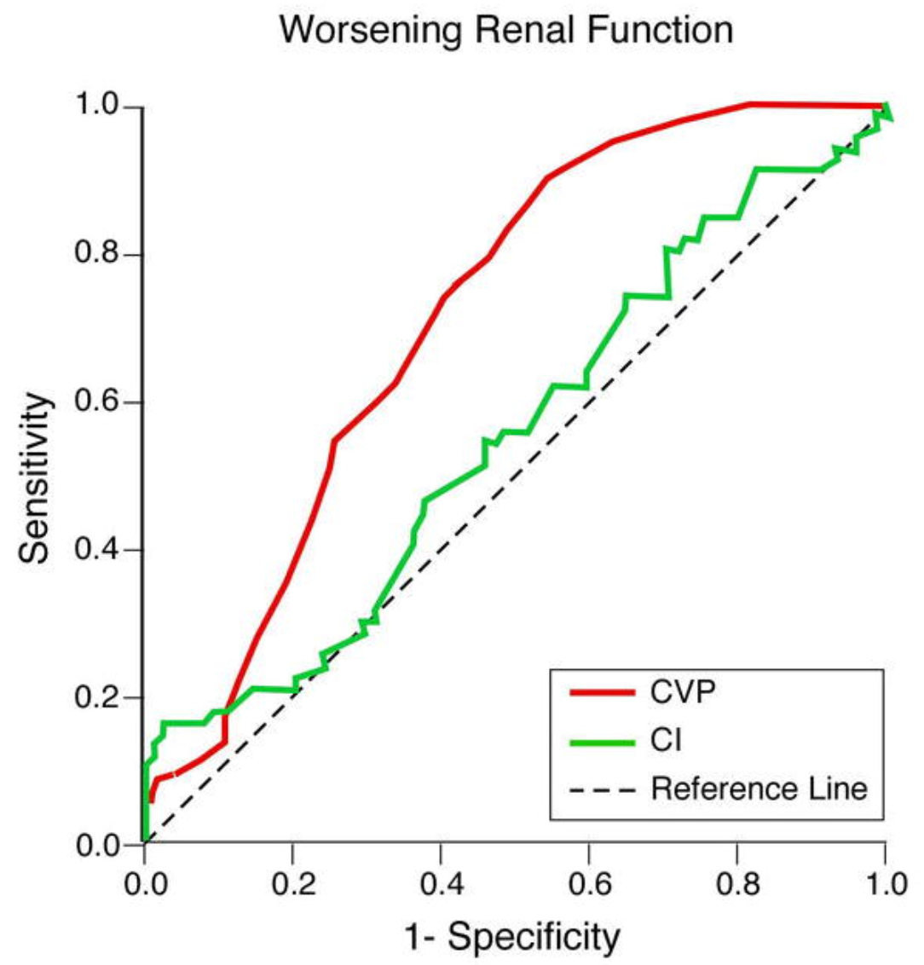
Cardiorenal Syndrome (overfill theory)
Increased back pressure on the venous side of the kidney appears to be more important than decreased arterial pressure
Mullens W, Abrahams Z, et al. J AmColl Cardio 2009 Feb 17;53(7) 589-596.

Slide 17
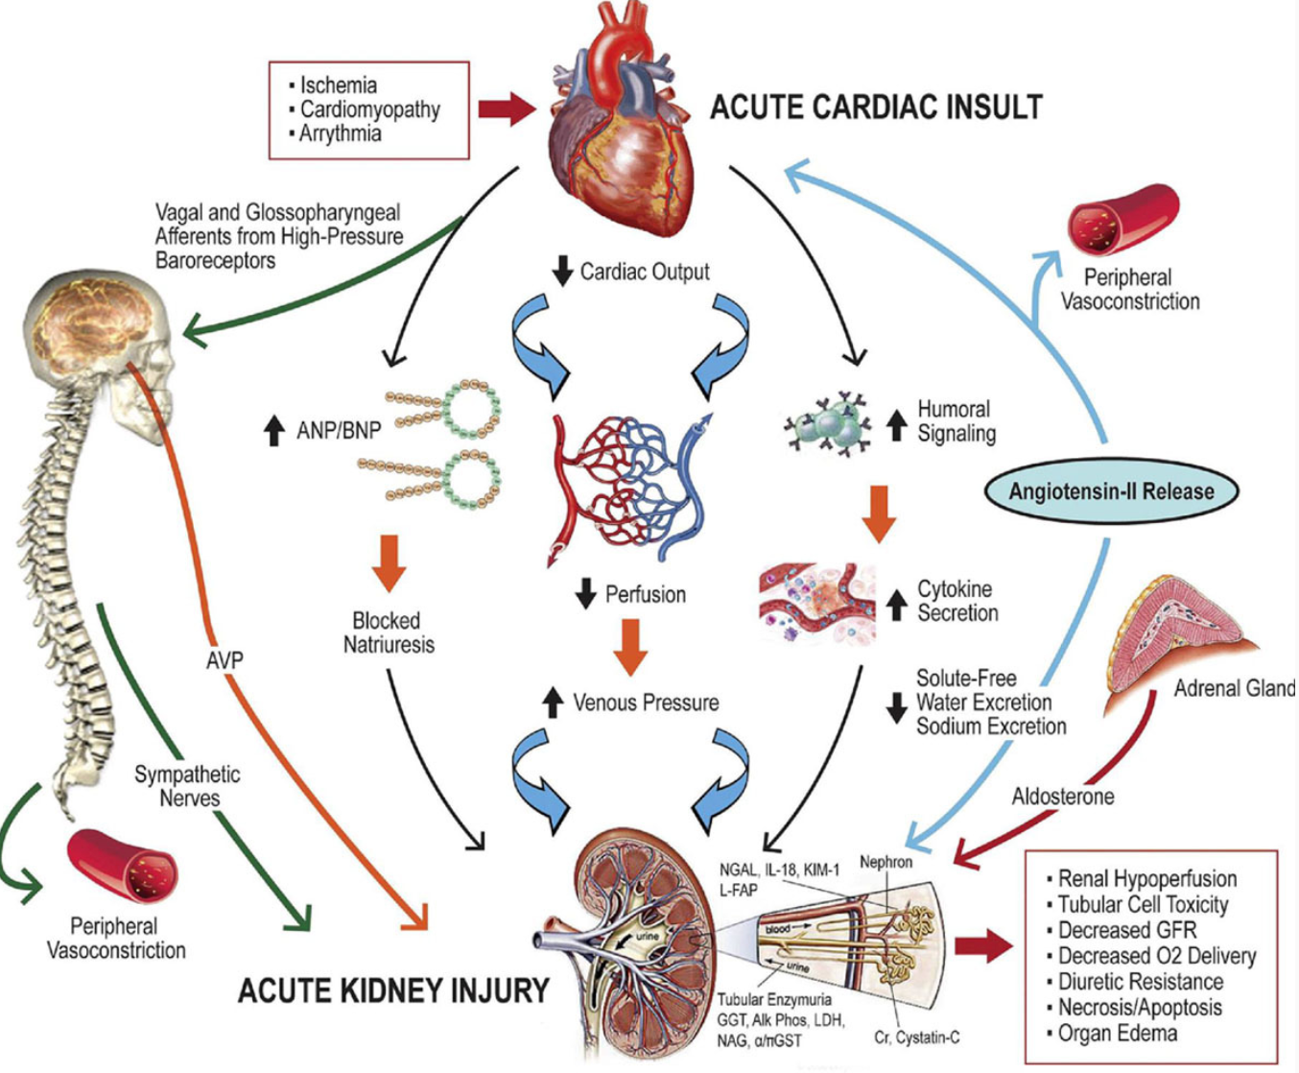
Neurohormonal & Inflammatory Pathways in Cardiorenal Syndrome
Rangaswami J, Bhalla V, et al. Circulation 2019; 139 e840-e878.

Slide 18
Congestive Heart Failure: 2 phases
Phase 1: Salt-retaining, high-renin, high-angiotensin and high aldosterone state
Extracellular volume will continuously expand
Phase 2: Normal renin-angiotensin-aldosterone axis
higher than normal extracellular volume
external salt balance (low salt diet + diuretics)
Severe heart failure patients will remain in phase 1

Slide 19
Cirrhosis
Disruption in the architecture of the liver
Portal blood flow obstruction → portal hypertension
Hepatic sinusoidal pressure → “signals” kidney to retain salt and water
Portal HTN → transudation of fluid into peritoneum (ascites)
Splanchnic vascular bed is vasodilated
Extrasplanchnic plasma volume is effectively depleted
Low oncotic pressure → transudation of fluid into interstitium
All of these factors lead to RAS activation and proximal reabsorption and stimulate aldosterone leading to collecting duct reabsorption.

Slide 20
Nephrotic Syndrome
Immunologic injury to the glomerulus leads to nephrotic syndrome
Heavy proteinuria >3g/day
Hypoalbuminemia
Edema
Hyperlipidemia
Conversion of plasminogen to plasmin in the urine ->plasmin removes the inhibitory domain on the ENaC causing primary sodium retention in the collecting tubule
Low albumin alone is not responsible for edema
reduction of proteinuria with steroids in minimal change disease leads to increased sodium excretion and resolution of edema while plasma albumin remains low.
Likely this is due to repair of the endothelial glycocalyx layer everywhere
Notes:
Animal models in which glomerulonephritis is induced in 1 kidney by injecting puromycin onto 1 renal artery. This kidney develops salt retention. The contralateral normal kidney excretes salt normally. Micropuncture studies show similar delivery of sodium to distal tubule, so sodium reabsorption must be occuring distally.

Slide 21
Conversion of plasminogen to plasmin in the urine stimulates the ENaC
Siddal EC, Radhakrishnan J. Kidney International. Volume 82, Issue 6, 2 September 2012, Pages 635-642

Slide 22
TREATMENT OF EDEMATOUS STATES Diuretics

Slide 23
Physiologic characteristics of diuretics
Site of action | Examples | Carrier, molecule or channel inhibited | Percent of filtered sodium excreted
Proximal Tubule | Carbonic Anhydrase Inhibitors SGLT-2 Inhibitors | Carbonic Anhydrase SGLT-2 | Unclear
Loop of Henle | Furosemide Bumetanide Torsemide Ethacrynic acid | Na⁺-K⁺-2Cl⁻ carrier | Up to 25%
Distal Tubule | Hydrochlorothiazide Chlorthalidone Metolazone | Na⁺-Cl⁻ carrier | Up to 3-5%
Collecting Tubule | Amiloride Triamterene Mineralocorticoid Receptor Blockers | Na⁺ channel | Up to 1-2%
Addapted and updated from Rose,DR and Post TW. Clinical Physiology of Acid-Base and Electrolyte Disorders, p. 448

Slide 24
General Principles
All diuretics that work proximal to the ENaC cause hypokalemia
Increased sodium delivery to the distal nephron
All diuretics except mineralocorticoid receptor blockers and mannitol are secreted in the proximal tubule
Mannitol is filtered in the glomerulus
Mineralocorticoid Receptor blockers are the only diuretics that work on the basolateral side

Slide 25
Acetazolamide
Sulphanilamide derivative developed in 1950s
Traditionally used for glaucoma and prevention of altitude sickness
Short acting carbonic anhydrase inhibitor
Inhibits proximal tubular reabsorption of bicarbonate, sodium and chloride
Efficacy limited by
distal nephron reuptake of sodium
metabolic acidosis caused by acetazolamide decreases the diuretic action
Notes:
Cell model of proximal tubule NaHCO3 reabsorption. The secretion of H+ into the proximal tubule lumen involves an Na+/H+ antiporter and an H+ ATPase. Apical membrane H+ secretion generates OH–, which reacts with CO2 to form HCO3– and CO32– and these exit with an Na+ on the basolateral membrane Na+/HCO3–/CO32– cotransporter. The Na+ absorbed by the Na+/H+ antiporter exits the cell on the basolateral membrane Na+/K+ ATPase and the Na+/HCO3–/CO32– cotransporter. The K+ that enters the cell on the Na+/K+ ATPase exits on a basolateral membrane K+ channel. Carbonic anhydrase catalyzes the conversion of HCO3– to CO2 and OH– in the lumen, and the reverse reaction in the cell. Electrogenic H+ secretion generates a small lumen–positive voltage that generates a current flow across the paracellular pathway.

Slide 26
Carbonic Anhydrase Inhibitors

Slide 27
Adding Acetazolamide to Loop
ADVOR Study Group. N Engl J Med 2022;387:1185-1195

Slide 28
SGLT-2 Inhibitors
Inhibits SGLT-2 Na/glucose cotransporter in the proximal tubule
Decreases reabsorption of glucose from 100% to about 30%
Also decreases proximal reabsorption of sodium

Slide 29
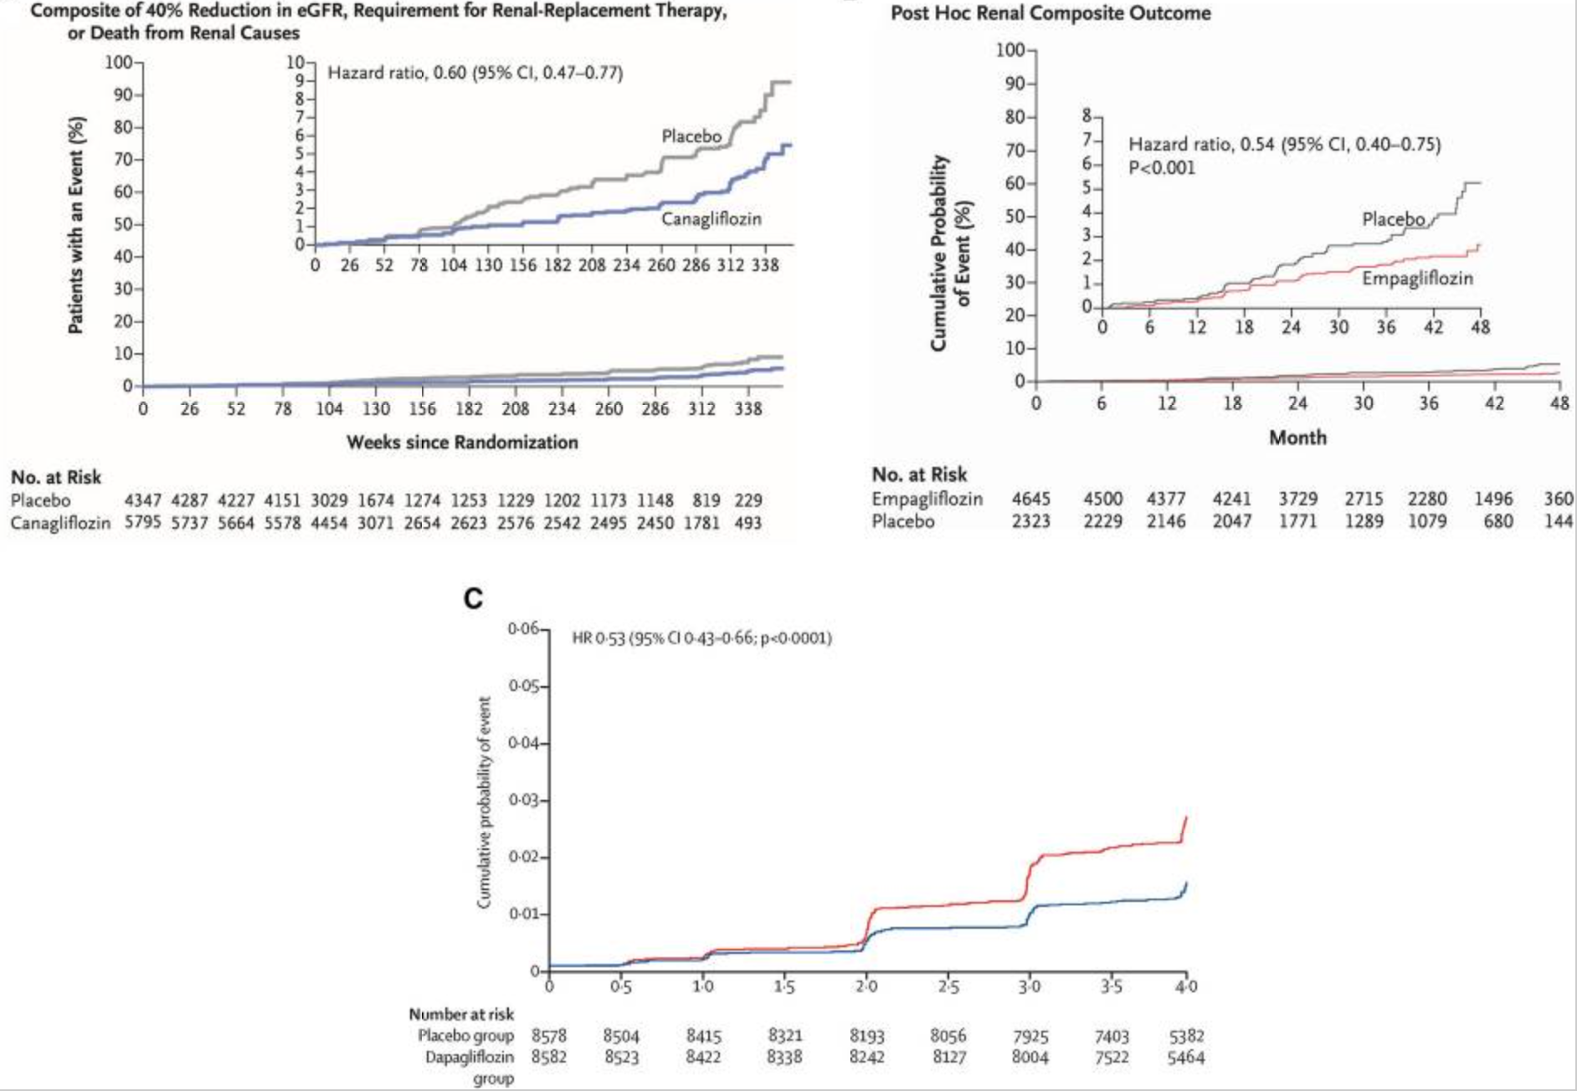
SGLT2 Inhibitors reduce progression of kidney disease
Wheeler DC, James J, et al. Diabetes Ther. 2020 Dec; 11(12): 2757–2774.

Slide 30
SGLT-2 Inhibitors

Slide 31
SGLT-2 Inhibitors: activate TG Feedback Loop Diuretics: inhibit TG feedback

Slide 33
Dapagliflozin and Metolazone are similar at decreasing congestion in patients with diuretic resistance, but Dapagliflozin is better tolerated
Eur Heart J, Volume 44, Issue 31, 14 August 2023, Pages 2966–2977.

Slide 34
Loop Diuretics
At maximum dose can lead to the excretion of 20-25% of the filtered sodium
Act in the medullary and cortical thick ascending limb of the loop of Henle
Compete for the chloride site on the Na⁺-K⁺-2Cl⁻ carrier
Cause calcium loss into the urine
Calcium reabsorption in the loop of Henle is passive, driven by gradient created by NaCl transport via a paracellular pathway
Inhibiting reabsorption of NaCl leads to a parallel reduction in calcium reabsorption
Thus, loop diuretics are used for treatment of hypercalcemia

Slide 35
Loop diuretics compete with chloride site on this transporter

Slide 36
Bioavailability & Half Life of Loop Diuretics
Graphic by Joel Topf @kidney_boy

Slide 37
Torsemide vs Furosemide: Does Half Life and Bioavailability Matter?
Transform HF Trial: Mentz RJ et al. JAMA Jan 17;329(3):214-223. doi: 10.1001/jama.2022.23924.

Slide 38
Thiazide-Type Diuretics
At maximum dose can lead to the excretion of 3-5% of the filtered sodium
Thus, when used alone, they are more effective for hypertension than edema
Act in the distal tubule
Compete for the chloride site on Na⁺-Cl⁻ cotransporter
Cause calcium reabsorption
Chloride exit into the lumen causes hyperpolarization of the cell, leading to increased activity of voltage-gated luminal calcium channels, favoring calcium uptake.
Sodium exit into the lumen creates a gradient for sodium entry via the basolateral membrane, which causes Calcium reabsorption via the basolateral sodium-calcium exchanger
Thus, thiazide diuretics are used for treatment of kidney stones to reduce hypercalciuria

Slide 39
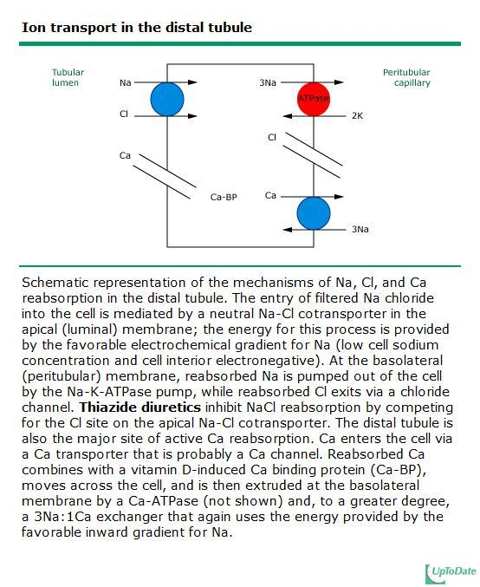
Thiazides compete with chloride site on this transporter

Slide 40
Chlorthalidone vs HCTZ
Adapted in NephJC from Carter BL et al. Hypertension 2004 Jan;43(1):4-9.

Slide 41
Chlorthalidone vs HCTZ: CV Outcomes

Slide 42
Potassium-sparing Diuretics
At maximum dose can lead to the excretion of 1-2% of the filtered sodium
Act in the principal cells in the collecting tubule
Amiloride and triamterene directly decrease the number of open sodium channels
Spironolactone/Eplerenone/Finerenone compete with aldosterone, thus reducing the number of open sodium channels and the number of Na-K ATPas pumps.
Primarily used in combination with loop or thiazide diuretics to reduce distal sodium reuptake or to reduce potassium loss.
Spironolactone has a potent effect in patients with ascites and cirrhosis
Amiloride can be used to treat lithium-induced nephrogenic diabetes insipidus
Lithium accumulates in the collecting tubule cells by movement through the sodium channels. Blocking these channels slows lithium entry into the cells.
Triamterene can be nephrotoxic – leading to crystalluria and cast formation; even stones can form

Slide 43
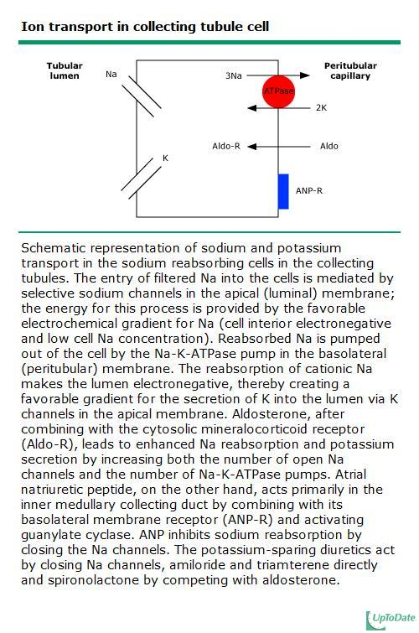
Amiloride and triamterene directly close sodium channels
Spironolactone competes with aldosterone

Slide 44
Nonsteroidal Mineralocorticoid Blockers: is there a real difference?

Slide 45
Nonsteroidal Mineralocorticoid Blockers: is there a real difference?
Spironolactone trials were pragmatic trials, more inclusive and did not involve aggressive management of potassium – so high dropout rates
Fineronone trials excluded patients with hyperkalemia and aggressively managed the hyperkalemia

Slide 46
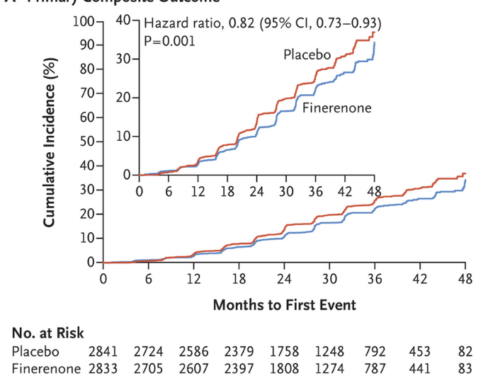
Mineralocorticoid Receptor Blockers
Finerenone reduced incidence of composite outcome of kidney failure, 40% decrease in GFR, or death from renal causes
Bakris GL, Agarwal R, et al. N Engl J Med 2020; 383:2219-2229

Slide 47
Aquaretics Vasopressin Antagonists – “Vaptans”
Competitively bind to V2 receptors in the kidney leading to closing of aquaporin channels
Used for SIADH (Syndrome of Inappropriate Anti-Diuretic Hormone)
RCT comparing urea powder and vaptans showed similar efficacy
Potential treatment of heart failure patients with hyponatremia
EVEREST Trial: Tolvaptan did improve edema, dyspnea and hyponatremia, but did not affect long-term mortality or cardiovascular morbidity
Image from: Danziger J , and Zeidel M L CJASN doi:10.2215/CJN.10741013
Konstam MA. JAMA. 2007:297(12):1319-31.

Slide 48
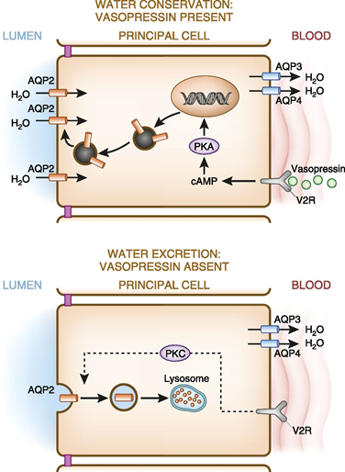
Effect of ADH on the Kidney
Binds to the V2 receptor on the basolateral membrane of the principal cells in the collecting tubule which causes apical membrane insertion of aquaporin-2 channels
Non-renal effects
Binds to V1 receptors (vasculature, myometrium, platelets)
Binds to V3 receptors (in the pituitary)
Negative feedback loop: stimulates prostaglandins (prostaglandin E2 and prostacyclin) in the TAL, CT, medullary interstitium, which counteract both the vascular and antidiuretic effects of vasopressin
Metabolized by vasopressinases in the liver and kidney
Half life is 20-30 minutes
Image from: Danziger J , and Zeidel M L CJASN doi:10.2215/CJN.10741013

Slide 49
Osmotic Diuretics/Aquaretics
Mannitol
non-reabsorbable polysaccharide
Acts as osmotic diuretic in the proximal tubule and loop of Henle
Water is lost in excess of sodium and potassium
Used to increase serum osmolality in brain trauma patients to prevent brain swelling
Urea
Urea powder has been used to treat SIADH (Syndrome of Inappropriate Anti-Diuretic Hormone) by inducing an osmotic aquaresis

Slide 50
Diuretic Potency
Dose
Depends on GFR for diuretics which work on luminal side
loop and thiazide-type have receptors on luminal side
Site of action
Percent of filtered sodium that can be excreted at each segment
Loop of Henle > distal tubule > collecting tubule
Level of reabsorption at distal segments
Thiazide-type and potassium-sparing diuretics are more potent when used in combination with a loop diuretic because more sodium is being delivered to the distal segments

Slide 51
Diuretic Resistance: Braking Phenomenon
NEJM

Slide 52
Diuretic Resistance
Due to reabsorption at other segments
Increased sodium delivery to distal tubule causes hypertrophic response and increased distal sodium reabsorption
Decreased tissue perfusion leads to:
stimulation of renin angiotensin system → proximal tubular reabsorption
Stimulation of aldosterone secretion → collecting tubule reabsorption

Slide 53
Adding albumin to furosemide: rationale
Colloid promotes redistribution of fluid from edematous peripheral tissues back into vascular component
Furosemide is heavily protein-bound, so in hypoproteinemic patients there is increased volume of distribution and lower concentrations in the loop of Henle
Only 2 randomized controlled trials have evaluated this

Slide 54
2 RCT comparing Albumin + furosemide to furosemide alone
Population | Intervention | Results
30 Vented patients with CHF | 250mg furosemide diluted in 12.5g 25% albumin vs furosemide infusion alone at 0.1mg/kg/hr | No difference in UOP or fluid balance at 24hrs
40 vented patients with ARDS | 100ml 25% albumin q8h vs placebo; furosemide infusion | Improved oxygenation, greater net negative fluid balance, better maintenance of hemodynamic stability

Slide 55
Diuretic resistance: strategies
Sequential nephron blockade
SGLT-2 Inhibitor
Increase dose
Consider albumin in patients with nephrotic syndrome (Minimal Change Disease)
Dialysis

Slide 56
Chloride Depletion (not contraction) Metabolic Alkalosis
In chloride depletion, fewer chloride ions are available to be exchanged with bicarbonate and the ability of the kidneys to excrete excess bicarbonate is impaired
Chloride repletion in the setting of volume contraction, potassium and sodium depletion completely corrects alkalosis in rats and humans
Nephron segment studies suggest the corrective response is in the collecting duct - likely via pendrin, a luminal Cl/HCO3 exchanger
Luke RJ et al. J Am Soc Nephrol. 2012 Feb;23(2):204–207. doi: 10.1681/ASN.2011070720

Slide 57
Managing Metabolic Alkalosis after Diuresis: Aggressive Potassium Replacement: goal potassium > 4.5
Mechanism | Explanation
Reduces bicarbonate reabsorption | Hypokalemia reduces the activity of pendrin, which decreases the amount of bicarbonate reabsorbed by beta-intercalated cells in the cortical collecting duct.
Increases hydrogen secretion | Hypokalemia stimulates the apical H+/K+ ATPase in the collecting duct, which increases the secretion of hydrogen ions.
Increases bicarbonate generation | Hypokalemia increases ammoniagenesis in proximal tubule cells, which leads to the generation of new bicarbonate.
Increases bicarbonate uptake | Hypokalemia increases the uptake of ammonium ions (NH4+) via the Na+/K+/2Cl- cotransporter of TAL.
Increases bicarbonate concentration | Hypokalemia causes a transcellular shift of potassium from cells toward the plasma, which leads to hydrogen entering the cells.

