Slide 1
Transplantation
Amandeep Khurana
Transplant Nephrologist
Southwest Kidney Institute

Slide 2
Learning Objectives
Describe the benefit to patients who obtain a well-timed renal transplant before the need for initiation of dialysis.
List the immunosuppression drugs required for successful transplantation and know the side effects of each of these medications.
Understand the diagnosis, the pathophysiology, and the management of patients with acute cell-mediated rejection and antibody mediated rejection.

Slide 3
You have been on dialysis for 3 years, a cadaver transplant is offered to you. Do you accept?
No, because I’m used to dialysis now
Yes, because I dislike dialysis
Yes, because I’ll live longer

Slide 4
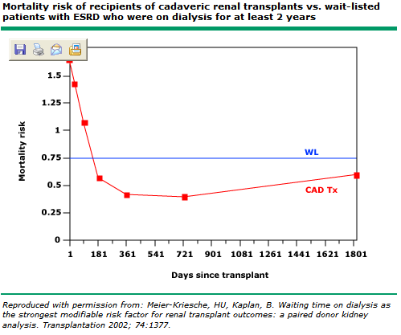

Slide 5
If you were getting a transplant, at what point would you like to get it?
No dialysis
HD x 6 months
HD x 1 yr
HD x 5 yr

Slide 6
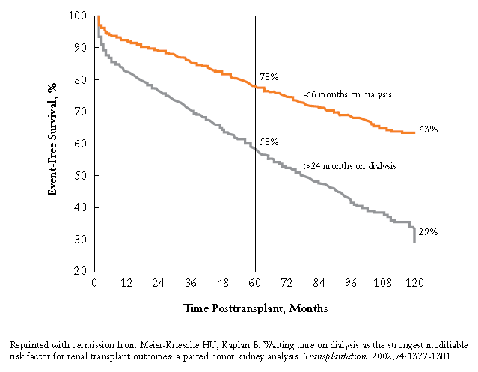

Slide 7
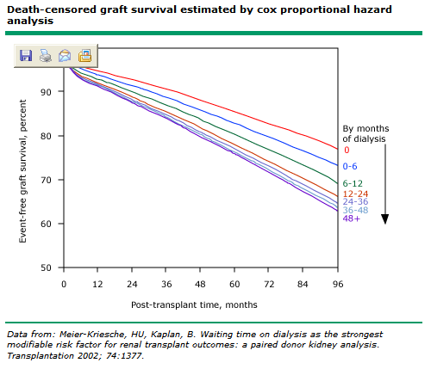

Slide 8
If your life expectancy was 6 months, and you were offered a transplant, would you accept?
Yes
No

Slide 10
If you were given the option between taking a living donor kidney versus a deceased donor kidney, which one would you pick?
Living donor
Deceased donor
Doesn’t matter
Dialysis

Slide 11
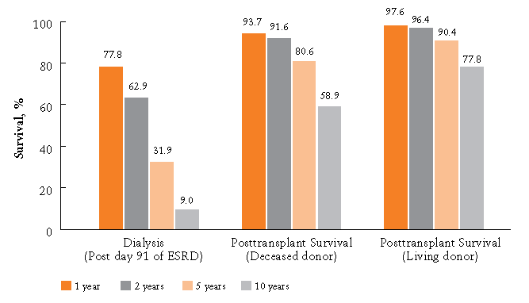

Slide 12
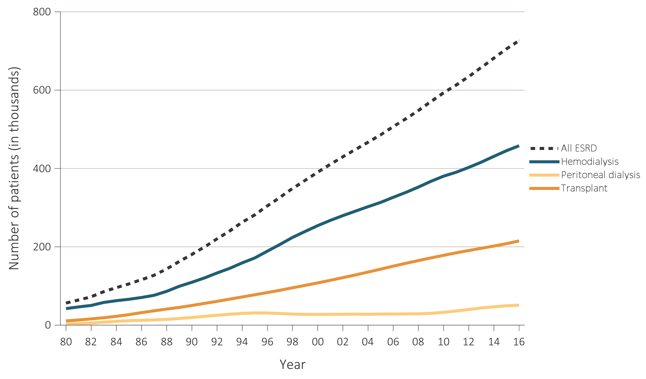
Trends in the number of ESRD prevalent cases, by modality, in the U.S. population,
1980-2016
Data Source: Reference Table D1 and special analyses, USRDS ESRD Database. Abbreviation: ESRD, end-stage renal disease. Persons with “Uncertain Dialysis” were included in the “All ESRD” total, but are not represented separately.

Slide 13
The average annual total (medicare) expenditure for an HD patient is 90K. What’s the average for a transplant patient?
100K
75K
50K
35K
10K

Slide 14
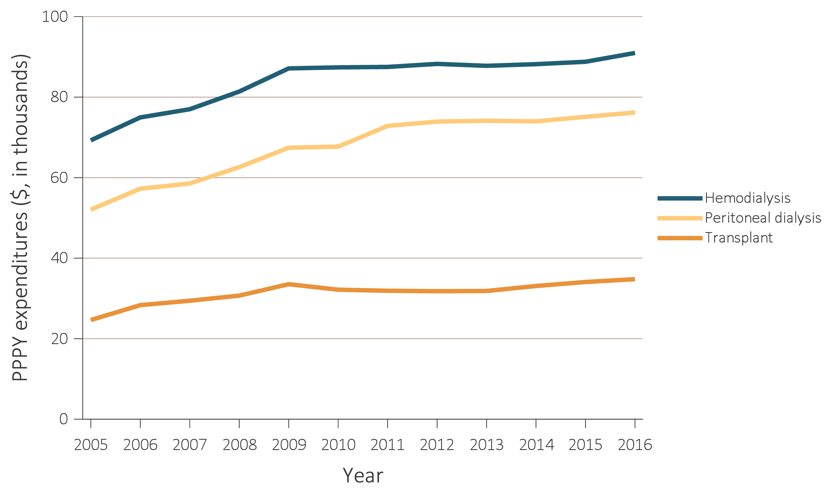
Total Medicare ESRD expenditures per person per year, by modality, 2004-2016
Data Source: USRDS ESRD Database; Reference Tables K.7, K.8, & K.9. Period prevalent ESRD patients; includes all claims with Medicare as primary payer only. Abbreviations: ESRD, end-stage renal disease; PPPY, per person per year.

Slide 15
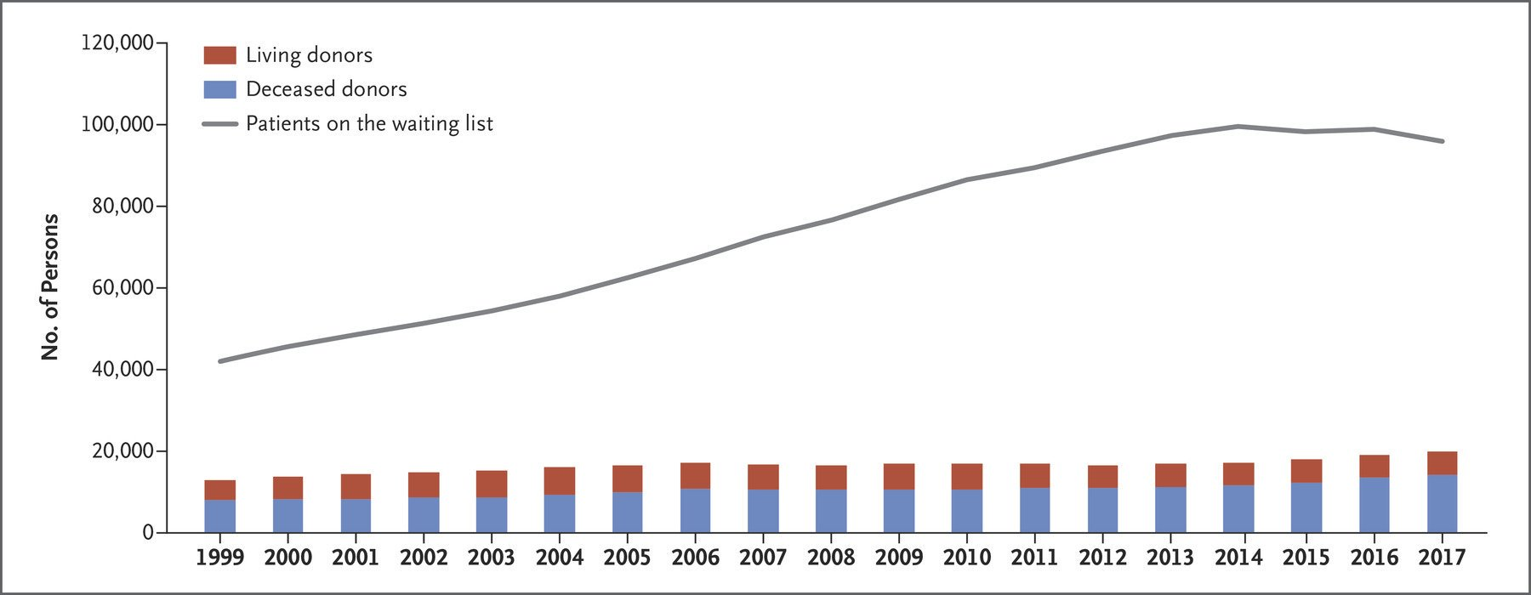

Slide 16
Which organ has the longest wait time?
Liver
Heart
Lung
Kidney

Slide 17
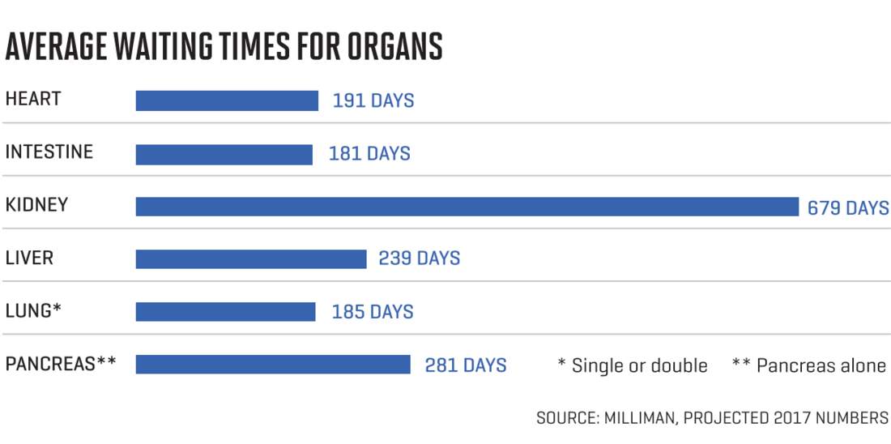

Slide 18
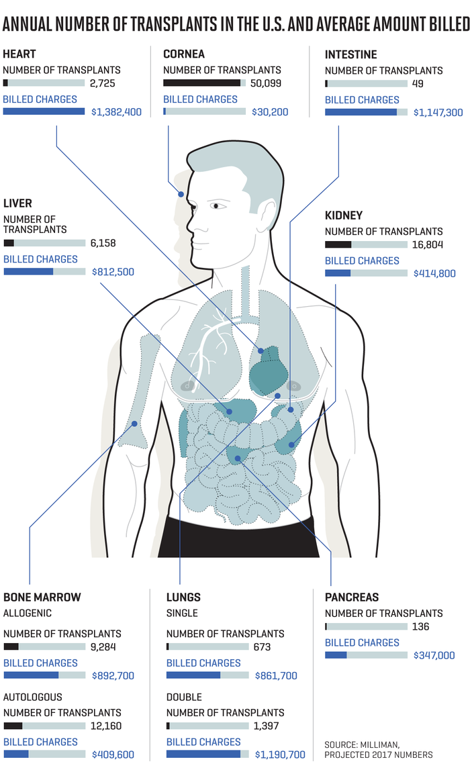

Slide 19
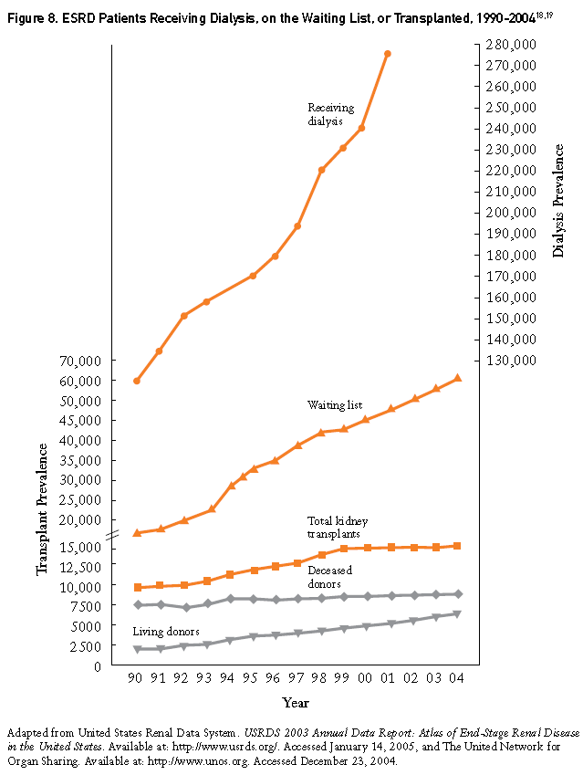

Slide 20
The KDPI is simply a mapping of the KDRI, a measure of relative risk, to a cumulative percentage scale. The KDPI is
calculated to the nearest integer percentage value and ranges from 0% to 100%.

Slide 21
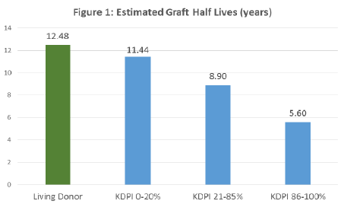

Slide 23
You have the option of remaining on HD or taking a 80% KDPI kidney…..which one would you pick?
HD
80% KDPI kidney
Either

Slide 24
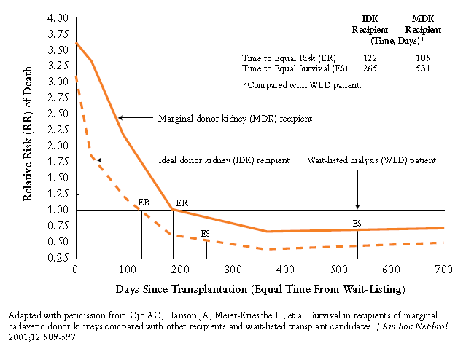

Slide 25
Transplant Immunology for
non-transplant nephrologists

Slide 26
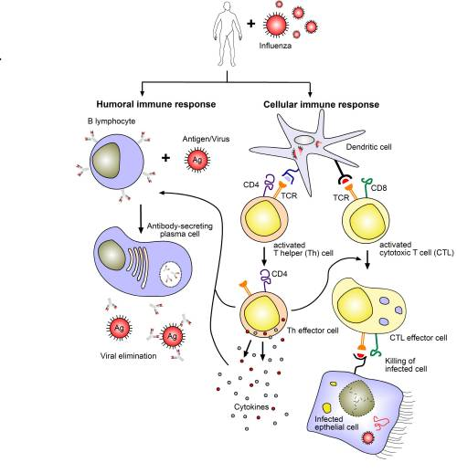

Slide 27
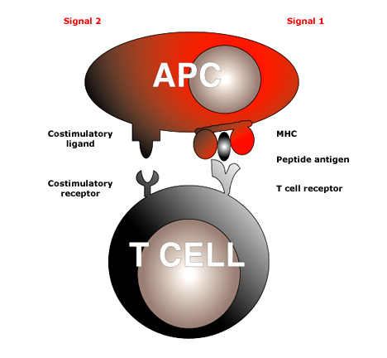
STEP 1 = Ag + APC meets T cell
antigen
Notes:
T cells require two separate signals before activation occurs. The first signal is antigen specific and is provided by the interaction of T cell receptor with peptide antigen presented within the antigen binding groove of MHC molecules. The second (costimulatory signal) is provided by the interaction of T cell surface molecules with their ligands on antigen-presenting cells. The provision of signal 1 in the absence of signal 2 may lead to T cell inactivation or anergy, or to failure of a Th1 response with promotion of a Th2 response.

Slide 28
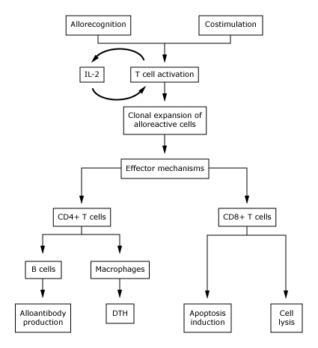
STEP 2 = T cell activation

Slide 29
STEP 3 = Acute Rejection
  Acute Humoral rejection: B
  Acute Cellular rejection: T

Slide 30
How can you diagnose acute rejection?
Rising Cr
Pain over transplant site
Elevated donor specific antibodies
Elevated cell free DNA
Biopsy

Slide 31
STEP 3 = Acute Humoral rejection: B

Slide 32
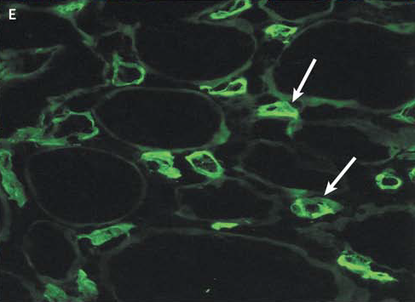
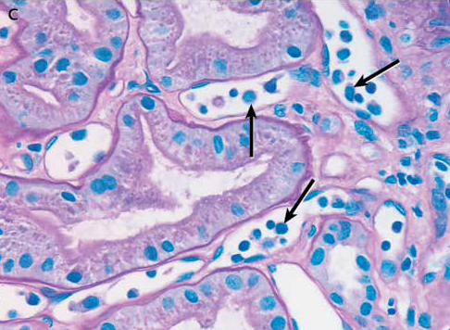
STEP 3 = Acute Humoral rejection: B

Slide 33
Haas M et al. The Banff 2017 Kidney Meeting Report: Revised diagnostic criteria for chronic active T cell-mediated rejection, antibody-mediated rejection, and prospects for integrative endpoints for next-generation clinical trials. Am J Transplant. 2018 Feb;18(2):293-307. doi: 10.1111/ajt.14625.

Slide 34
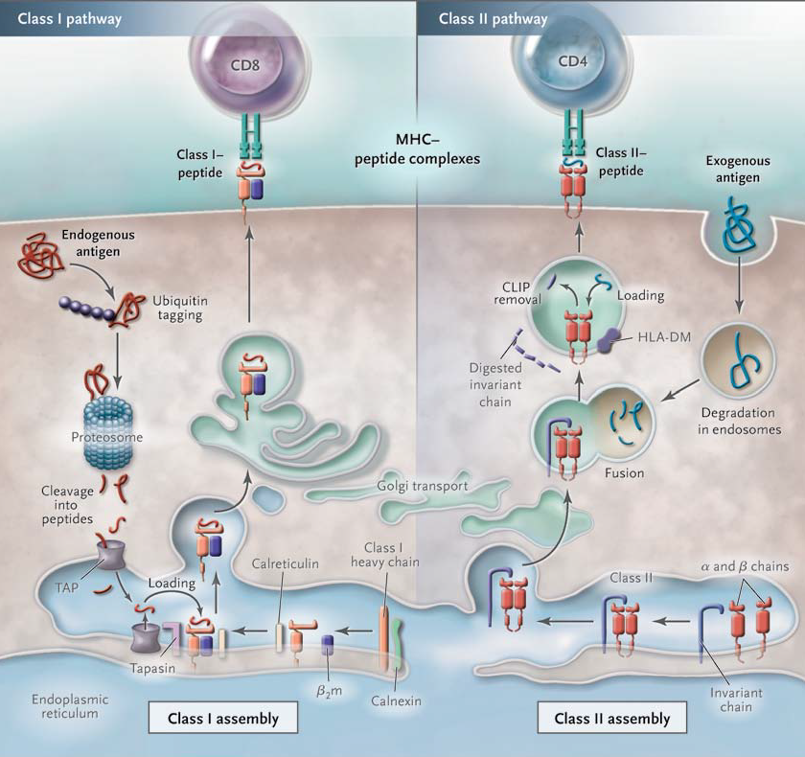

Slide 35
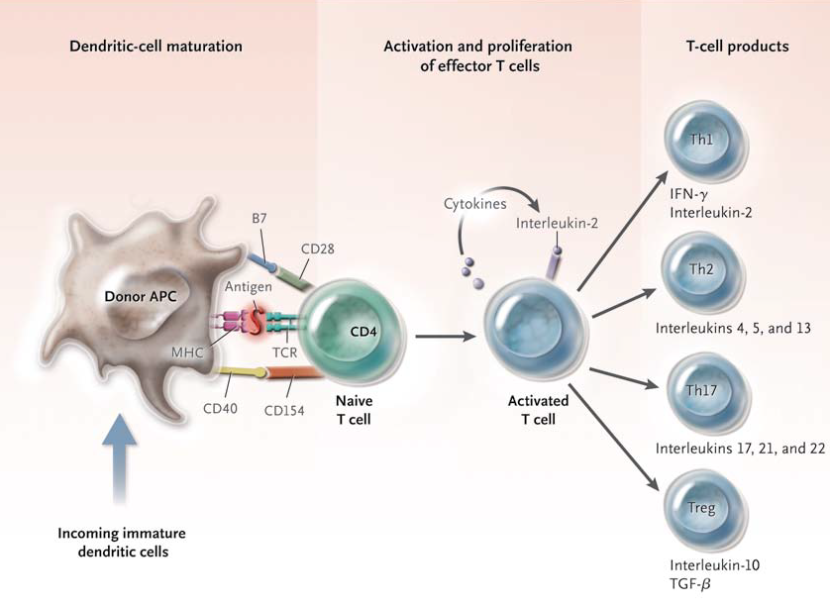

Slide 36
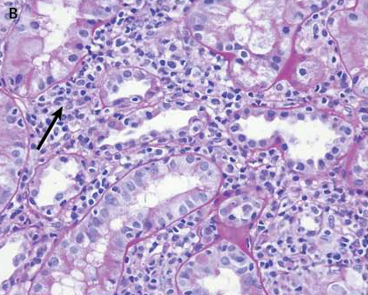

Slide 37
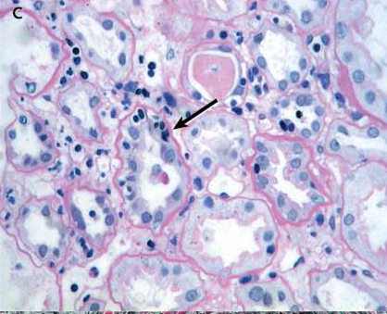

Slide 38
Haas M et al. The Banff 2017 Kidney Meeting Report: Revised diagnostic criteria for chronic active T cell-mediated rejection, antibody-mediated rejection, and prospects for integrative endpoints for next-generation clinical trials. Am J Transplant. 2018 Feb;18(2):293-307. doi: 10.1111/ajt.14625.

Slide 39
STEP 1 = Ag + APC meets T cell
antigen
Notes:
T cells require two separate signals before activation occurs. The first signal is antigen specific and is provided by the interaction of T cell receptor with peptide antigen presented within the antigen binding groove of MHC molecules. The second (costimulatory signal) is provided by the interaction of T cell surface molecules with their ligands on antigen-presenting cells. The provision of signal 1 in the absence of signal 2 may lead to T cell inactivation or anergy, or to failure of a Th1 response with promotion of a Th2 response.

Slide 40
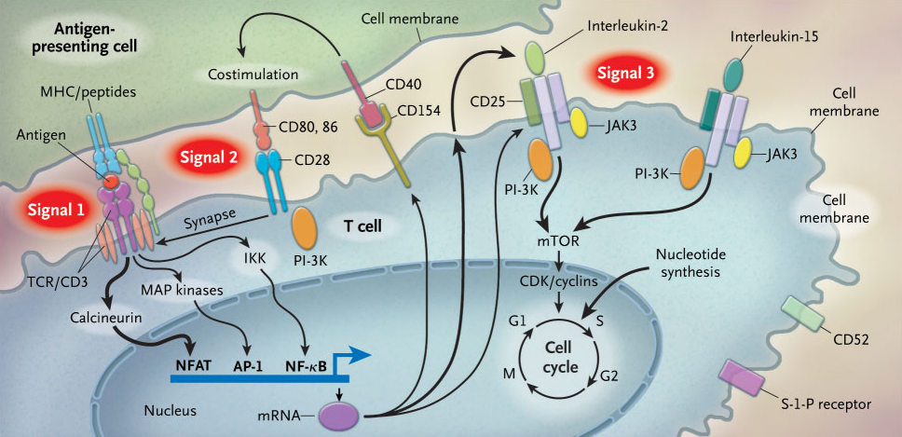

Slide 41
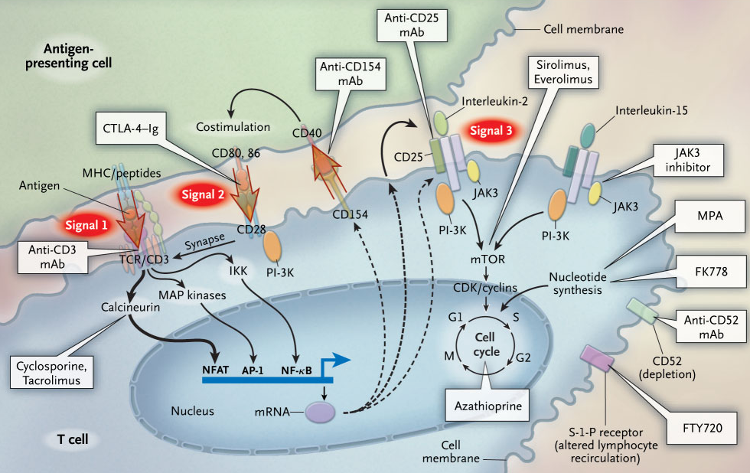

Slide 42
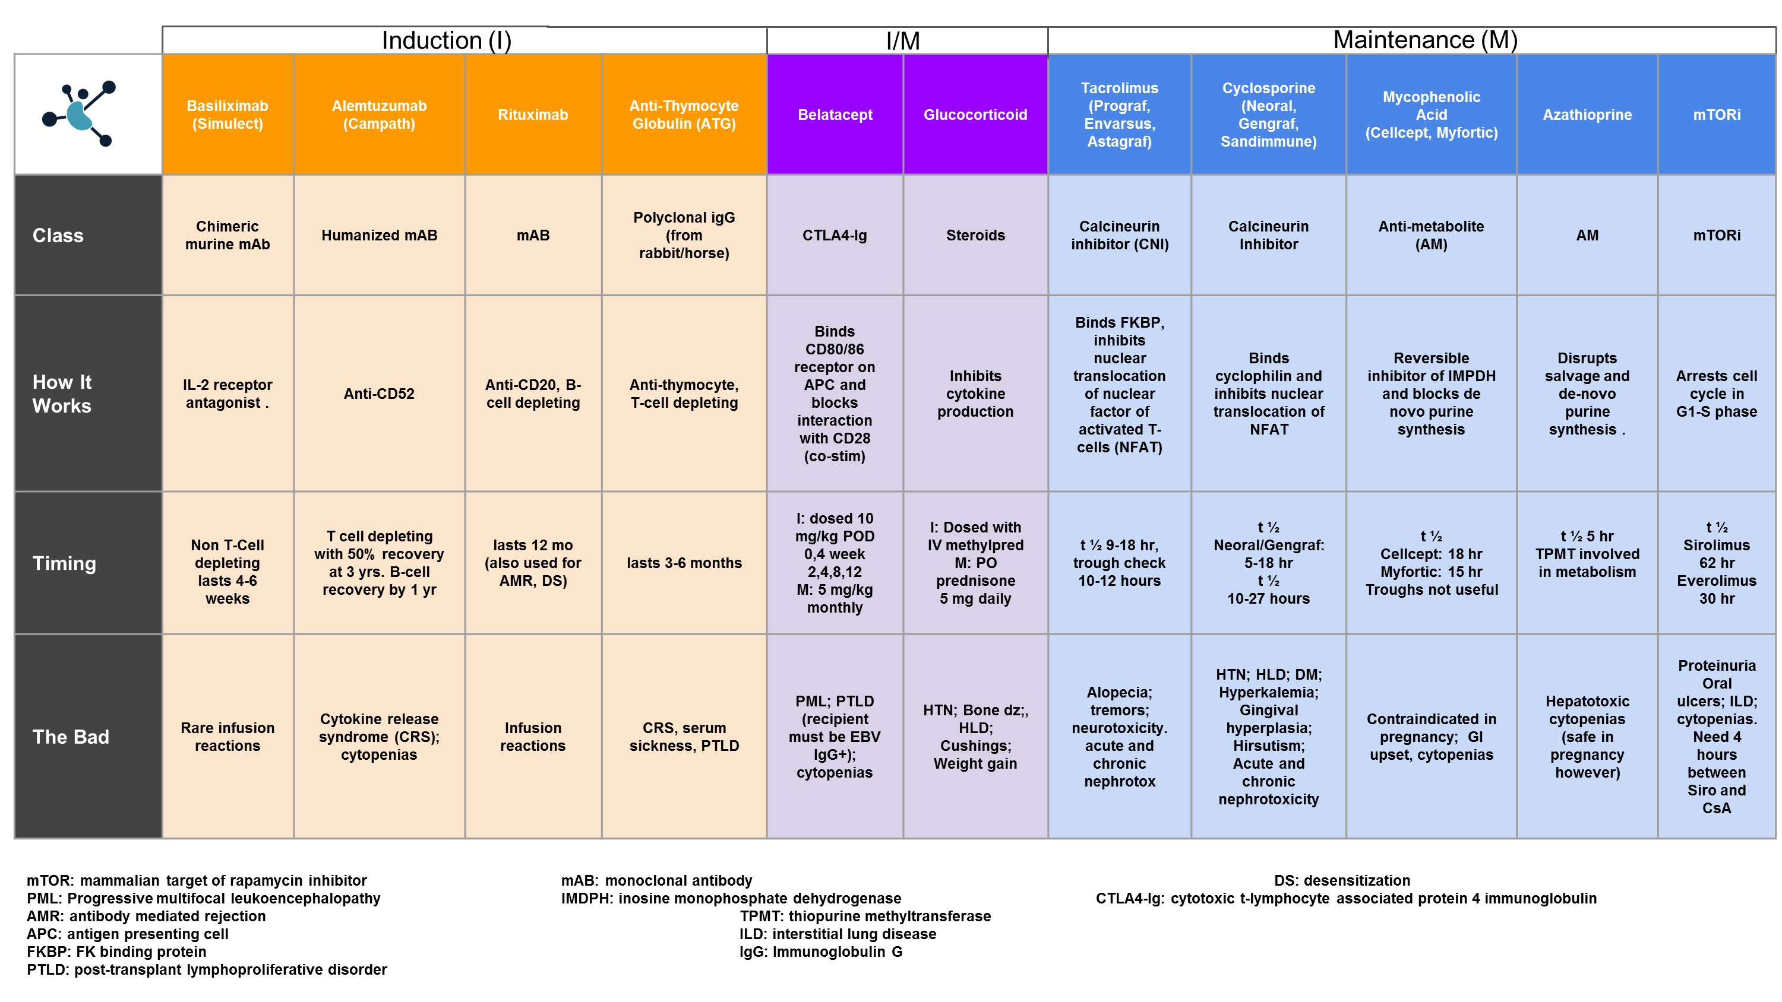

Slide 44
Maintenance
Cellcept 1g BID
Prograf
Steroid free

Slide 45
How do you treat ACR Banff IIa? Pick all options that apply
FK
MMF
Steroids
Thymoglobulin
Plasmapheresis
IVIG

Slide 46
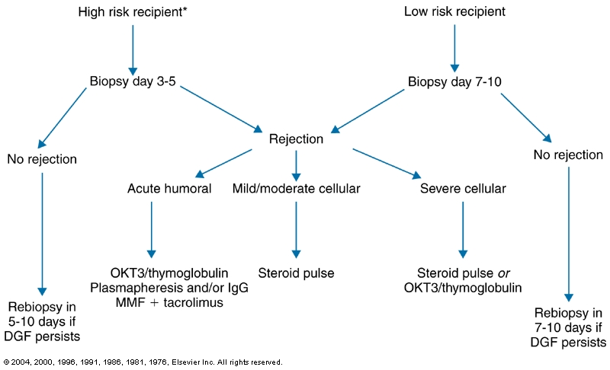

Slide 47
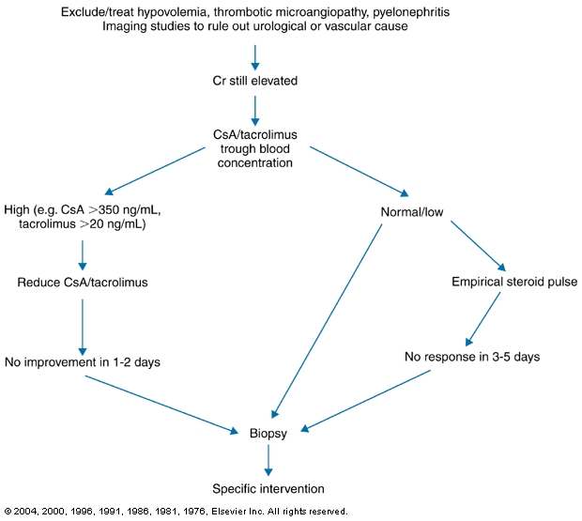

Slide 48
After 10 years of a living kidney transplant, how many are still functioning?
20
38
58
77
98

Slide 51
Hariharan S, Israni AK, Danovitch G. Long-Term Survival after Kidney Transplantation. N Engl J Med. 2021 Aug 19;385(8):729

Slide 52
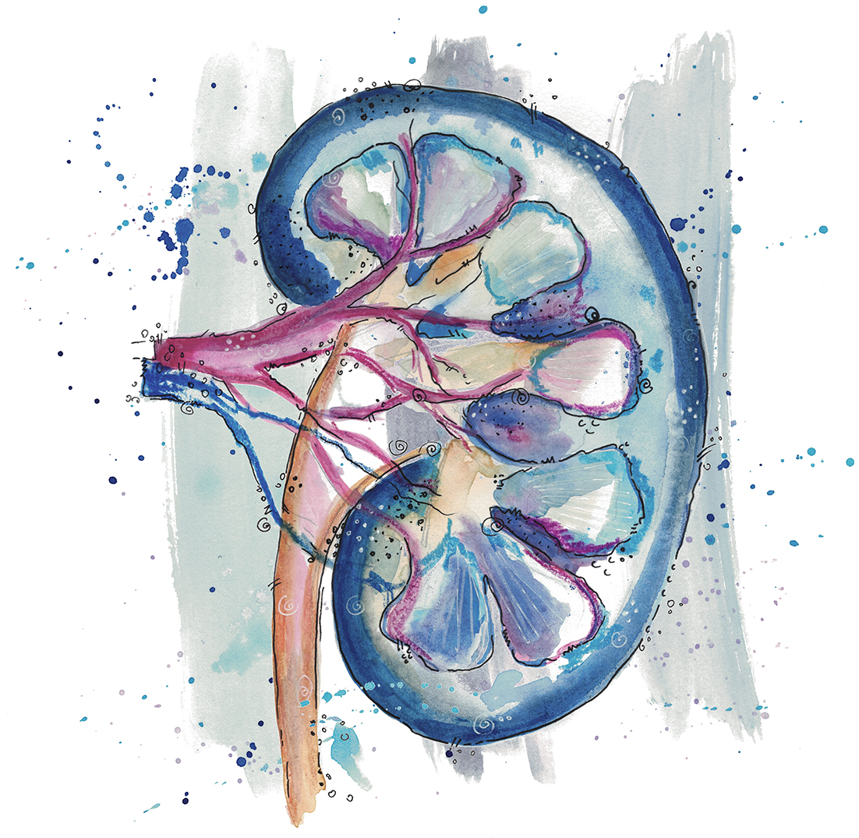
Questions?
Dominique Couck

