Slide 1
Shock Talk
3 July, 2024
Erin Biringen

Slide 2
Objectives
Review the four main categories of shock
Discuss first steps in managing septic shock
Discuss the most common indications for ICU admission

Slide 3
MKSAP #35
An 84-year-old man living in a nursing home is evaluated in the emergency department for recent onset of unresponsiveness and fever. He has Alzheimer dementia.
Vitals: T 39.3 °C (102.7 °F), BP 88/50 mm Hg, Pulse 106/min, RR 18/min, O2 sat 95% on room air
Exam: responsive only to physical stimuli, cardiopulmonary examination reveals normal heart and lung sounds. Abdominal examination is normal. A 6 × 6 cm necrotic sacral decubitus wound is present.
Laboratory data are pending. Blood cultures are obtained.
Think, pair, share:
Is this patient in shock? Why/why not?
What additional information would you like?
What are the four main categories of shock? Where would this patient fit if they are in shock?
Notes:
Patient is in shock
Septic shock because:
- probable source of infection
- hypotension, altered mentation
- inadequate perfusion

Slide 4
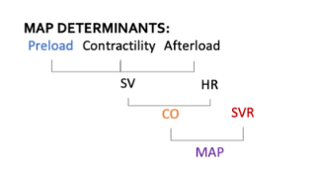
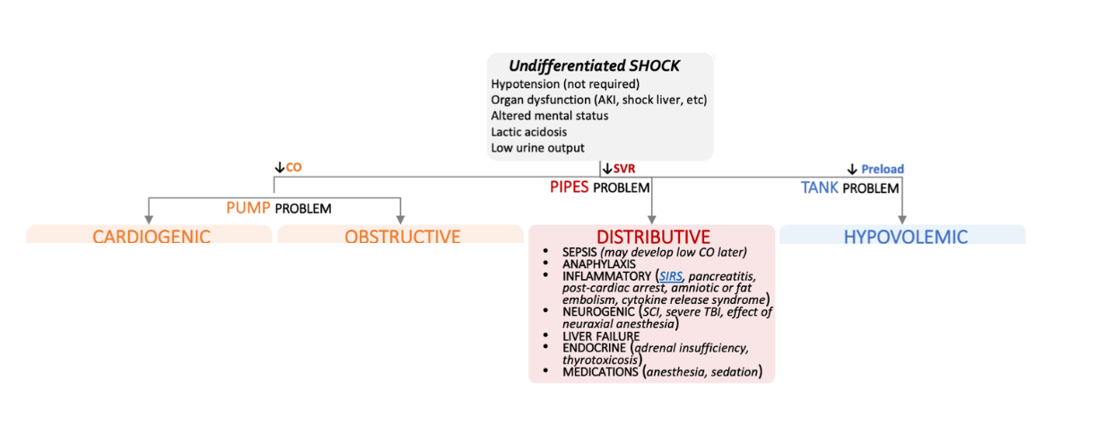
Notes:
First, we can review what shock is:
- state of inadequate blood flow and oxygen delivery or systemic hypoperfusion, causing end organ damage, w/ or w/o hypotension
- We use the MAP as a gauge for perfusion: this is actually what a BP cuff measures rather than separate systolic and diastolic pressures
- the MAP = 2/3 diastolic + 1/3 systolic pressure
- Target a MAP of 65 in resuscitation efforts
- the MAP depends on several hemodynamic measurements, including preload, cardiac output, and systemic vascular resistance; these are also ways to help us categorize or create a differential for undifferentiated shock patients
- our patient does have septic shock and we’ll talk about this in a little more detail in a couple slides but to briefly review the other main categories:

Slide 5
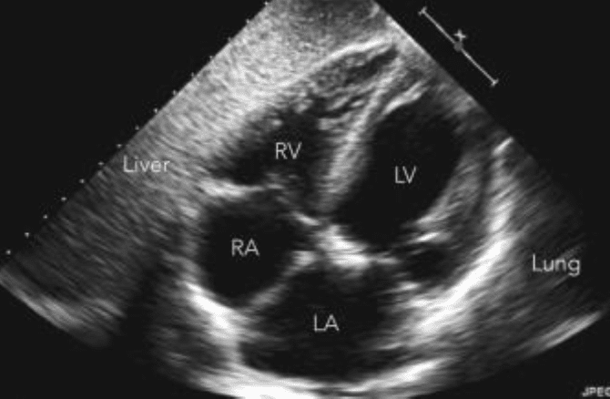
Evaluating Undifferentiated Shock
Labs | Imaging
CBC, CMP, Lactic acid | POCUS!!!
Infectious workup: blood cx, UA, sputum, procalcitonin | EKG
BNP, Troponin | CXR
TSH, random cortisol | +/- CT
Notes:
Back to undifferentiated shock and the initial workup: labs and imaging you would get

Slide 6
Notes:
Sepsis is a clinical SYNDROME
Using SOFA as a severity tool
Note that lactic elevation doesn’t = shock, normal lactic doesn’t mean NO shock

Slide 8
MKSAP #35
An 84-year-old man living in a nursing home is evaluated in the emergency department for recent onset of unresponsiveness and fever. He has Alzheimer dementia.
Vitals: T 39.3 °C (102.7 °F), BP 88/50 mm Hg, Pulse 106/min, RR 18/min, O2 sat 95% on room air
Exam: responsive only to physical stimuli, cardiopulmonary examination reveals normal heart and lung sounds. Abdominal examination is normal. A 6 × 6 cm necrotic sacral decubitus wound is present.
Laboratory data are pending. Blood cultures are obtained.
Which of the following is the most appropriate resuscitative treatment?
5% albumin solution
150mEq bicarbonate in 5% dextrose
Hydroxyethyl starch
Lactated Ringer solution

Slide 9
MKSAP #35
An 84-year-old man living in a nursing home is evaluated in the emergency department for recent onset of unresponsiveness and fever. He has Alzheimer dementia.
Vitals: T 39.3 °C (102.7 °F), BP 88/50 mm Hg, Pulse 106/min, RR 18/min, O2 sat 95% on room air
Exam: responsive only to physical stimuli, cardiopulmonary examination reveals normal heart and lung sounds. Abdominal examination is normal. A 6 × 6 cm necrotic sacral decubitus wound is present.
Laboratory data are pending. Blood cultures are obtained.
Which of the following is the most appropriate resuscitative treatment?
5% albumin solution
150mEq bicarbonate in 5% dextrose
Hydroxyethyl starch
Lactated Ringer solution

Slide 10
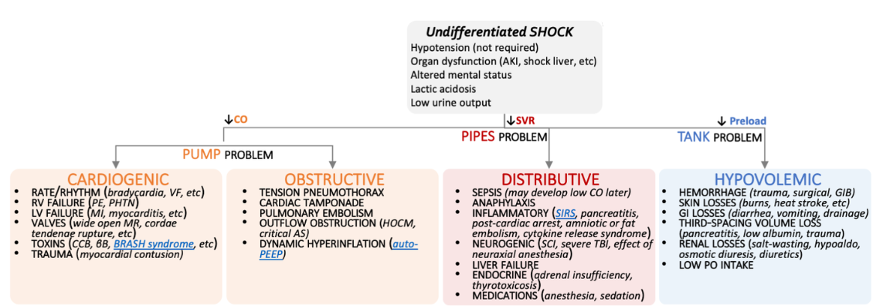
Take 3 minutes:
Create a list of differentials for the four categories of shock:

Slide 11
Take 3 minutes:
Create a list of differentials for the four categories of shock:

Slide 12
Take 3 minutes:
Create a list of differentials for the four categories of shock:

Slide 13
Take 3 minutes:
Create a list of differentials for the four categories of shock:

Slide 14
Take 3 minutes:
Create a list of differentials for the four categories of shock:

Slide 15
Reasons to Upgrade to the ICU
Titratable drips (vasopressors, insulin drip)
Need for invasive hemodynamic monitoring (arterial line)
Initiation of BiPap or CPAP (VA)
Inability to protect airway, indication for invasive mechanical ventilation
Notes:
To wrap things up, there are times when patients on the ward will definitely need to go to the ICU
Can anyone should out common reasons that we would need to upgrade someone to ICU level care?

Slide 16
Resources
Critical Care Medicine (lww.com)
Approach to shock & refractory shock - EMCrit Project
Surviving Sepsis Campaign Guidelines 2021 | SCCM
Sepsis - The Curbsiders

