Slide 1
High Yield Clinic (T2DM, Htn, Hld)

Slide 2
Agenda
Screening for and Prevention of Complications of Type 2 Diabetes
Type 2 Diabetes Treatment Options
Diagnosis of hypertension
Hypertension Treatment Options
Hyperlipidemia Risk Stratification
Hyperlipidemia Treatment

Slide 5
Recommended Annual Preventative Care for Patients with Type 2 Diabetes
A 45 year old female comes to your clinic for new diagnosis of type 2 diabetes. She went to a screening booth at a county fair and had a random blood glucose checked, which was elevated to 250. She has had symptoms of polyuria and polydipsia. A fasting BG in your office is elevated to 160 and you diagnose her with type 2 diabetes.
So now what do we do now to screen for and prevent complications of her type 2 diabetes?

Slide 6
45 Year old female new diagnosis of T2DM, no prior anything done.
Lab Test
Referral
Lipid Panel
Eye Exam
Lab Test
Physical Exam
Hemoglobin A1c
Foot Exam
Lab Test
Lab Test
BMP (Cr)
Urine Microalbumin
Vaccine
Medication
PCV-20
Mod intensity statin

Slide 7
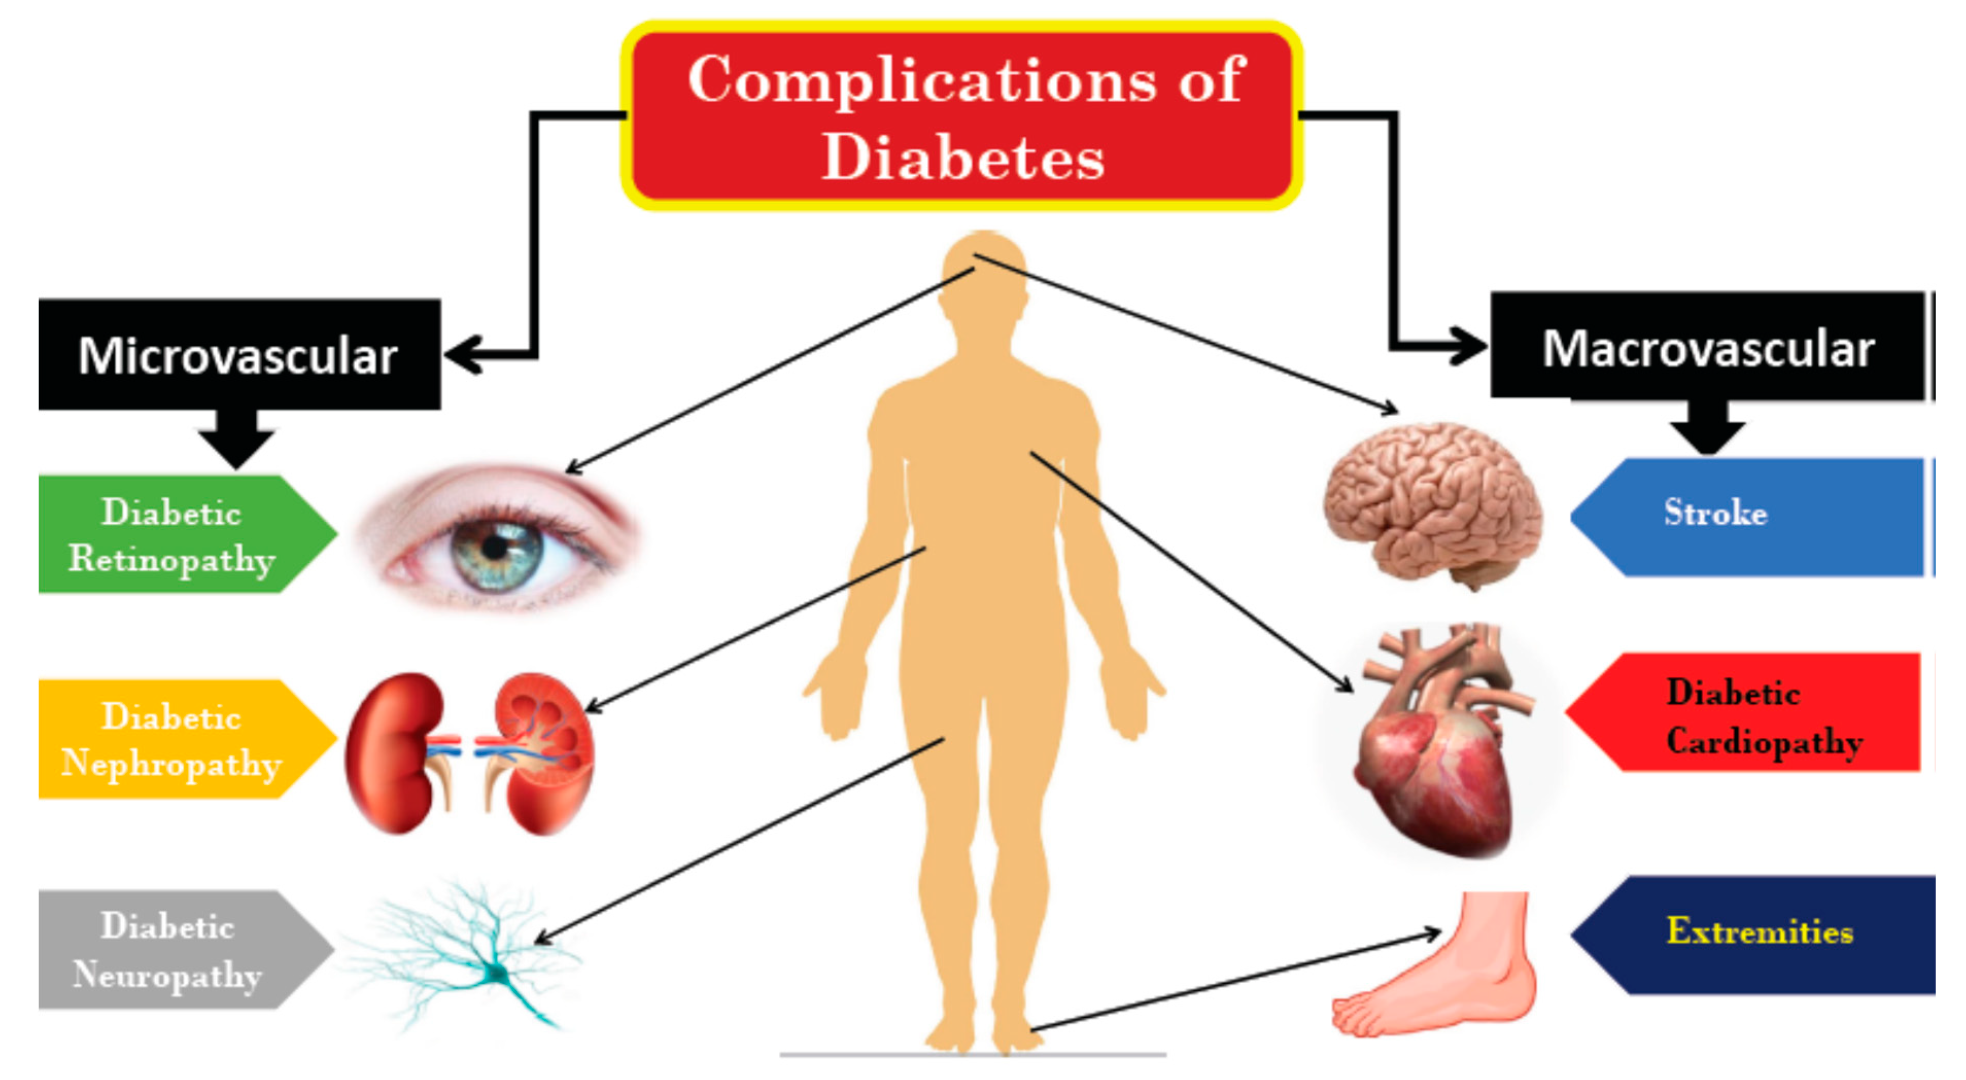
Recommended Annual Preventative Care for Patients with Type 2 Diabetes
Auto-Text Dylan McCreary $t2dmplan

Slide 8
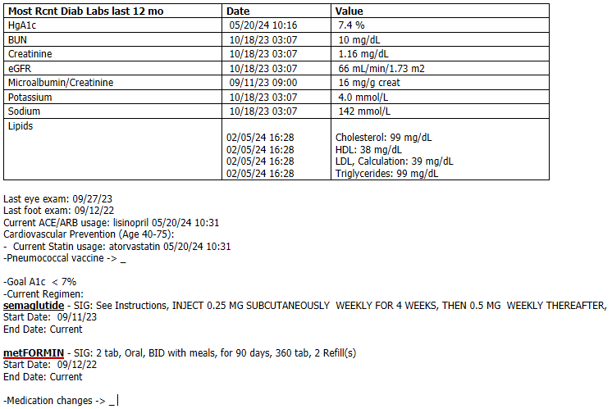
Auto-Text Dylan McCreary $t2dmplan

Slide 9
45 Year old female new diagnosis of T2DM, treatment options
Everyone
CHF/CKD w/ protein
Metformin
SGLT2 inhibitor
ASCVD/Obesity
A1c > 10%
GLP1 agonist
Insulin
ASCVD lower cost
Lower cost
DPP4 inhibitor
Pioglitazone
Lower cost
Sulfonylurea

Slide 10
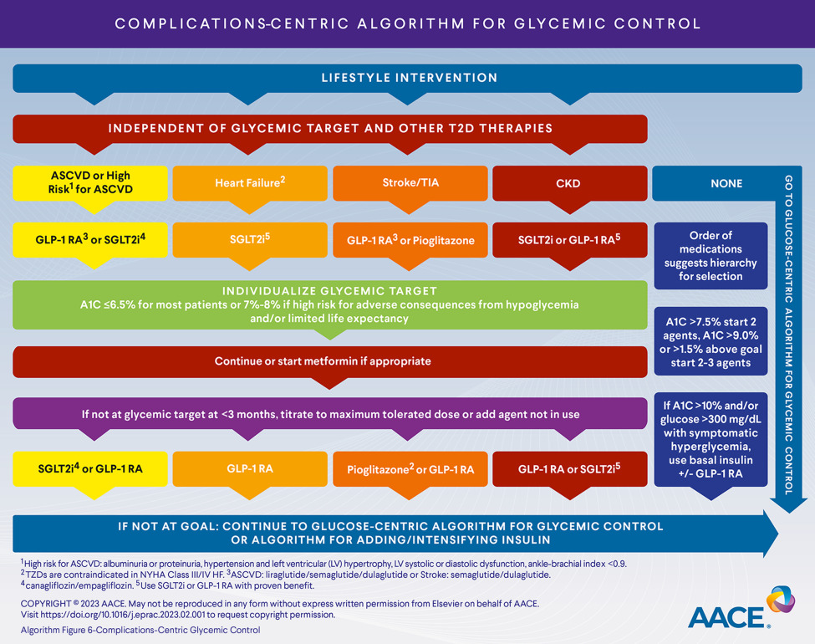
Type 2 Diabetes Treatments: Comorbidity Guided

Slide 11
Type 2 Diabetes Treatments: Glucose/SDH Guided

Slide 12
Management of Hypertension
Your patient comes back to clinic and has an elevated BP of 145/90. The BP is rechecked in the office and is 142/88. She has no history of hypertension or elevated BP in the past.
Does this patient have hypertension?

Slide 13
Management of Hypertension
Not yet!!

Slide 14
Management of Hypertension
She comes back to clinic after checking her BP at home, which averaged 145/90 taken at the same time each day with good technique.
So now what do we do?

Slide 15
45 Year old female new diagnosis of HTN, treatment options and side effects
1st Line
1st Line
ACE/ARB
CCB
1st Line
Resistant
Thiazide Diuretic
Aldo antagonist
CHF/CAD
2nd Line
Beta-blocker
Hydralazine
2nd Line
2nd Line/ESRD
Clonidine
Terazosin

Slide 16
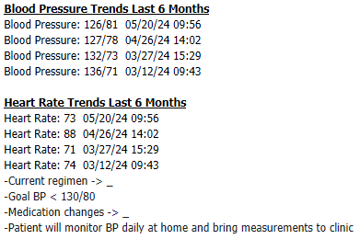
Auto-Text Dylan McCreary $htnplan

Slide 17
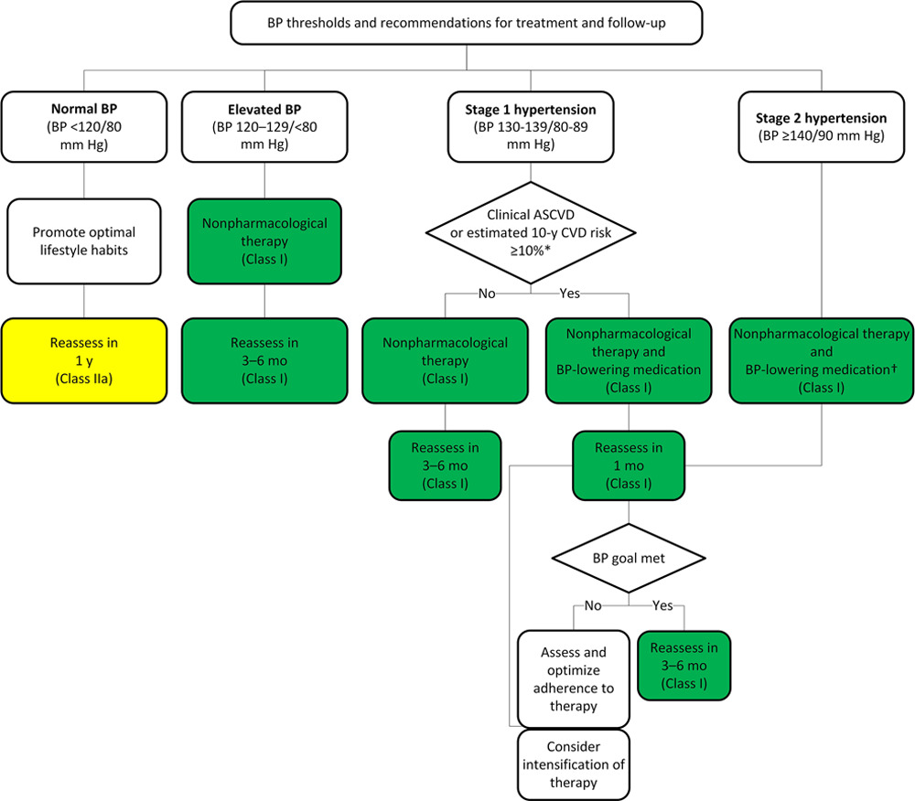
Hypertension Treatment Algorithm
Auto-Text Dylan McCreary $htnplan

Slide 18
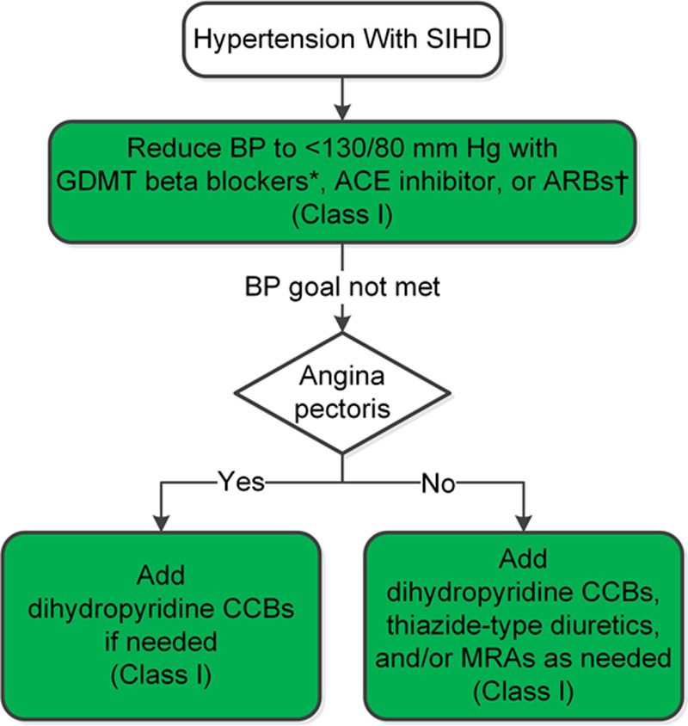
Hypertension Treatment Algorithm Focus on Comorbidities
Auto-Text Dylan McCreary
$htnplan

Slide 19
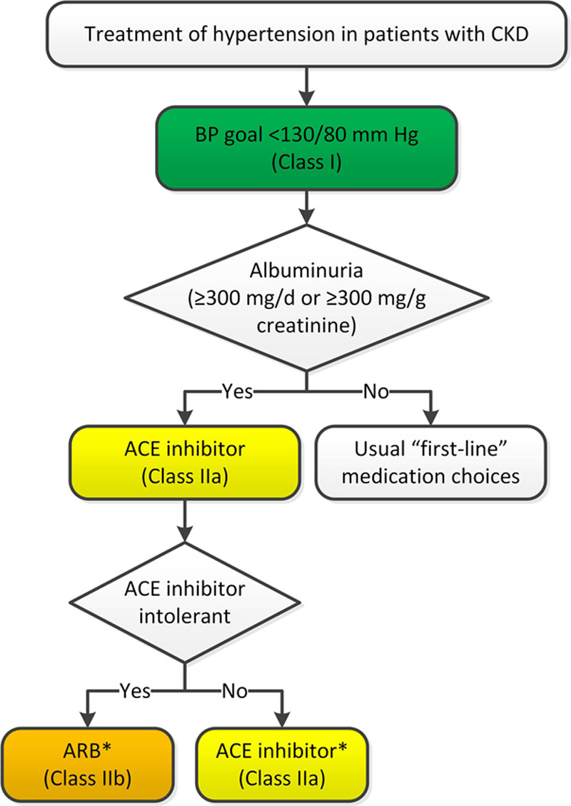
Hypertension Treatment Algorithm Focus on Comorbidities
Auto-Text Dylan McCreary $htnplan

Slide 20
Management of Hyperlipidemia
A new 50 year old patient presents to the office for follow up of high cholesterol. He was talking with his friend who just received excellent guideline directed therapy of her hypertension and diabetes from you and wanted to know if he should do something about his cholesterol. It was elevated when he had it checked most recently and he is not sure what he should do about it.
How can we figure out what to do about it?

Slide 21
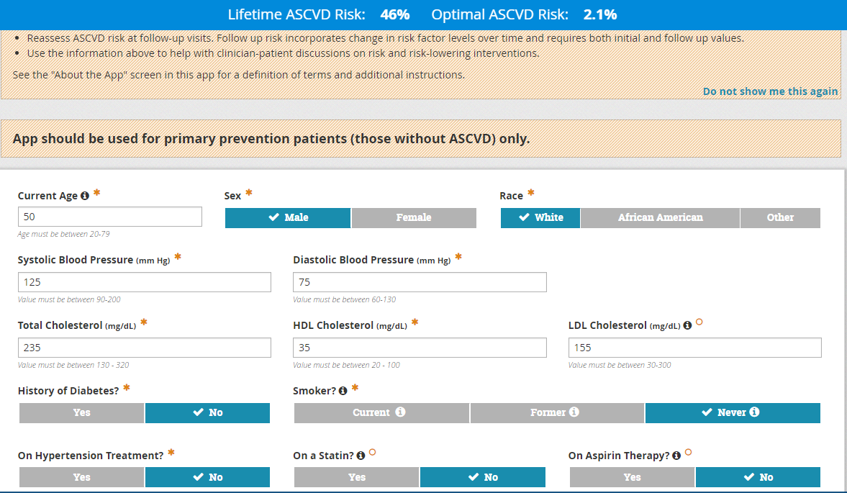
Management of Hyperlipidemia

Slide 22
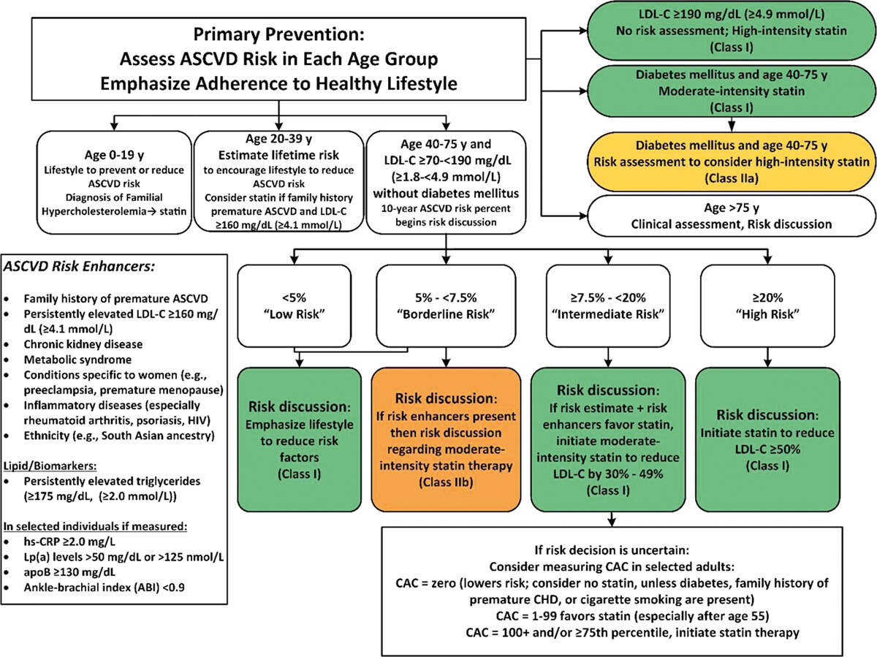
Labs
Imaging Test
Auto-Text Dylan McCreary $hldplan

Slide 23
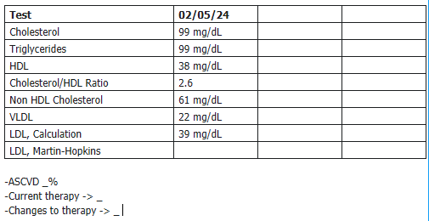
Auto-Text Dylan McCreary $hldplan

Slide 24
Summary
Screenings for T2DM annually
Treatment of T2DM everyone gets metformin, then treatment guided by comorbidities
Hypertension diagnosed primarily on non-office BP
Treatment of htn guided by comorbidities
Hyperlipidemia -> 10 year ASCVD
Look at risk modifiers for borderline cases

