Slide 1
Cognitive Impairment Evaluation and Neurodegenerative Diseases
Maya Gattupalli, PGY-4

Slide 2
Objectives
Definitions and diagnostic criteria of MCI and Dementia
Standard Evaluation including history, labs, cognitive testing, imaging
Differential of Neurodegenerative diseases

Slide 3
Case #1
A 77-year-old male, retired physician (practiced for 35 years) and his wife both report cognitive difficulties for about 10 months including the following:
Difficulty with recall/retaining information, per wife has a lot of “slip ups”
Word finding difficulty; close acquaintances and friends now often called “that person”
He is aware that he repeats himself – i.e. looking for his travel bag over and over before a trip; insecure if he’s not packed a cell phone charger
Has made a wrong turn driving, can correct quickly
Fears he will lose ability to manage finances
He is overall independent and knows how to compensate for himself
Physical/Neurological Exam: Normal
Lab Work: CMP, CBC, TSH, B12 normal
MoCA score 21; trail of numbers/letters, delayed recall, clock drawing

Slide 4
Case Question:
What is the diagnosis:
A. Mild Cognitive Impairment
B. Anxiety
C. Alzheimer’s Disease
D. Vascular Dementia

Slide 5
Answer: A
Mild Cognitive Impairment

Slide 6
Cognitive Changes with Aging
Memory changes: decline in rate of learning information but not retention
Difficulty with multitasking (difficulty with attention)
Word finding (mild)
Compensation strategies for ADD/depression becoming more difficult with age
Notes:
Significant declines in cognitive function do not represent normal aging
Decline in rate of learning new information but not in memory retention (rate of information processing slows, occasional “information overload”)

Slide 7
Functional Symptoms
Occupational
Social
iADLs: housework, shopping, using the telephone, medications, managing money, transportation
Basic ADLs: functional mobility, bathing/showering, dressing, grooming and hygiene, toileting
Notes:
Occupational – can they do their job?
Social – do they remember people?, how do they
What we mean for decline
iADLs – usually affected earlier in dementias
Basic ADLS – usually later

Slide 8
Mild Cognitive Impairment
Cognitive decline from a previous level of performance that is more than expected for normal aging
This does not impair everyday activities (work, iADLS, ADLs)
Does not occur exclusively during course of delirium
Not accounted by another disorders (depression, schizophrenia, etc)
Notes:
DSM V- Minor neurocognitive disorder

Slide 9
Categories of MCI
Amnestic vs. Nonamnestic
Amnestic: Memory significantly impaired, other cognitive functions spared
Nonamnestic: Memory remains intact, one or more domains of cognitive abilities are impaired
Single domain vs. multi-domain
Domains include language, visuospatial skills, executive functioning
Notes:
Amnestic – Alzheimers thought to be a cause of amnestic MCI
Nonamnestic MCI – other types of dementias
More domains affected – 20-30%, vs. 10% in single domain
Other cognitive functions = visuospatial, language, calculations

Slide 10
Etiologies
No single cause of MCI
Symptoms may remain stable for years, improve over time, or progress to dementia
Imaging can show early mesial temporal/hippocampal volume loss on MRI
Notes:
Hippocampus = area of memory ?

Slide 11
Etiologies
Reversible:
Depression
Severe Stress (anxiety, occupational burnout)
OSA
Metabolic disturbance: low B12, hypothyroid
Alcohol
Other toxins
Infection
Irreversible
Alzheimer’s Disease
Vascular Dementia
Lewy Body Dementia
Parkinson’s Dementia
Frontotemporal Dementias
PSP/CBD/MSA, CJD, NPH, Amyloid angiopathy

Slide 12
Prognosis
Progresses to dementia at a rate of 10-15% per year
Amnestic MCI, single domain has a less chance of progressing annually, compared to multi-domain
Progression to dementia will likely occur within first 5 years
Notes:
2008 – meta-analysis of 15 studies total number of pt who had progressed to a dementia in studies lasting less than 5 years was 27.4%, while the total number of patients who progressed to dementia by the end of studies lasting up to 10 years was 31.4%
After 5 years, rate will drop

Slide 13
Case #2
An 87-year-old woman with a history of hypertension and hyperlipidemia presents to your clinic.
Reports gradually progressive symptoms over the past 3 years of difficulty recalling recent information/events, and a tendency to repeat herself is increasing in frequency.
Her son is helping her more with finances. He has also set up a pill organizer for her 3 medications – one needs to be taken in the morning.
She has lost her ability to play cards as well as she used to. She also stopped driving one year ago after getting lost several times

Slide 14
What is the most likely Diagnosis?
A. Frontotemporal Dementia
B. Alzheimer’s Disease
C. Lewy Body Dementia
D. Parkinson’s Dementia

Slide 15
Answer: B
Alzheimer’s Dementia

Slide 16
Dementia
Cognitive decline from previous level of performance
Cognitive impairment will impair everyday activities (work, iADLs, ADLs)
Does not occur exclusively during course of delirium
Not accounted for by another mental disorder (depression, schizophrenia, etc)
Notes:
DSM V-Major Neurocognitive disorders

Slide 17
Evaluation of Cognitive Impairment
History
Examination
Laboratory Testing
Imaging
Cognitive Testing

Slide 18
History
Ideally patient brings a companion to the appointment to corroborate history
Onset, symptoms, and progression
Specific Cognitive Symptoms
Memory, Language, Attention, Mood symptoms
ADLs/iADLs
Associated Symptoms:
Sleep, Autonomic Symptoms, Motor
Social History and Family History
Notes:
Memory – types of memory
Language – word finding difficulty
Attention – multitasking, staying present in a conversation
Mood sx – depression, anxiety, hallucinations
ADLs/iADLs
Autonomic instability
Motors – falls, slower than normal

Slide 19
Types of Memory and localization
Procedural Memory – Basal Ganglia, Cerebellum
Performing tasks (tying shoes, riding a bike)
Episodic Memory – Papez circuit
Autobiographical events
Working Memory – Prefrontal cortex and visual association areas
“short term memory”
Semantic Memory – Inferior Temporal Cortex
Common knowledge / non personal information
Notes:
Procedural memory
Associated with implicit memory of how to perform certain tasks such as tying shoes or riding a bike.
Damage to the basal ganglia and cerebellum can lead to procedural memory problems.
Episodic memory
Memory that is specific to autobiographical events (i.e. times, names, and places).
Deficits localize to the Papez circuit (hippocampus, fornix, mammillary bodies, anterior thalamus, cingulate, entorhinal cortex)
Deficits in episodic memory are typical of Alzheimer’s disease (AD).
Working memory
Also considered “short term memory”, it is the cognitive system responsible for storing temporary pieces of information.
Phonologic working memory involves the prefrontal cortex, Broca’s, and Wernicke’s areas. An example is remembering a phone number “in your head” before dialing.
Spatial working memory Involves the prefrontal cortex and visual associated areas. An example is following a route to the end of a maze.
Semantic memory
Semantic memories do not tend to come from personal experience.
Deficits of semantic memory lead to the loss of “common knowledge” things such as names of colors, and other basic life facts.
Semantic deficits may be related to the temporal lobe pathology, specifically the inferior temporal cortex.

Slide 20
Examination
Vital signs
Sight and Hearing
Neurologic Exam
Hypomimia, rigidity, bradykinesia, postural instability, gait, other abnormal movements (chorea, hemiballismus etc.)
Notes:
orthostatic vitals, autonomic dysregulation
Sight and hearing can impact the testing results – can talk about hearing loss
MoCA – strand of letters
Exam – different diagnosis

Slide 21
Laboratory Testing
Basic Labs – CBC, CMP
TSH level, reflex to T4/T3
Vitamin B12 level
RPR, not routinely done (only increased risk)
Selectively: HIV, MMA (if B12 level is intermediate, FTA&CSF CDRL/cell count if suspected neurosyphilis)

Slide 22
Imaging
Brain MRI
Assessing structural changes
CT is okay if MRI is unable to be completed

Slide 23
Screening Metrics
MMSE
Normal: > 27
Mild cognitive impairment: 21-26
Moderate Cognitive impairment: 11-20
Severe Cognitive impairment < 10
Montreal Cognitive Assessment
Normal: 26-30
Mild Cognitive Impairment: 18-25
Moderate Cognitive Impairment: 10-17
Severe Cognitive Impairment: under 10
Notes:
MCI – MoCA is 90% sensitive/specific for MCI, MMSE is 18%

Slide 24
Neuropsychological Testing
3-5 hour testing
Provides a baseline for future testing
Aids with diagnosis
Identifies specific domains patients have difficulty with
Can identify if mood and other behaviors are contributing to impairment
Notes:
Simple vs. complex
Helps with understanding how to rehab the patient/compensate

Slide 25
Other Types of Test:
Stroop Test – executive function/attention (color/number test)
Digit Span Test – working memory (number sequence recall)
Wisconsin Card Sorting Test – prefrontal cortex lesion (conceptualization/ problem solving/abstract reasoning)
California Verbal Learning Test – episodic memory (word recall)
Trail Making Test – executive function (speed of processing, mental flexibility)
The Wechsler Adult Memory Scale (WAIS-IV) – comprehension/reasoning/working memory, processing speed
Go/No-Go test – frontal lobe dysfunction (tap test)
Notes:
Stroop test: Subjects are presented with names of colors written in colors other than the one spelled out (i.e. the word “red” written in green ink) and are then asked to repeat the color of the word back to the examiner. This is a test used specifically to evaluate executive function, most specifically attention.
Digit span test: Subjects are read or asked to read a sequence of numbers and then recall them in the same order. This test is used to analyze working memory.
Wisconsin Card Sorting Test: Assesses visual conceptualization, problem solving, and abstract reasoning which may be deficient in prefrontal cortex lesions.
California Verbal Learning Test: In this test of episodic memory, subjects are read a list of 16 nouns out loud five times and after each trial, the subject is asked to recall as many as they can in order.
The Trail Making Test: Used to evaluate executive functioning, speed of processing, and mental flexibility.
The Wechsler Adult Memory Scale (WAIS-IV): A comprehensive cognitive test that evaluates a subject’s verbal comprehension, perceptual reasoning, working memory, and processing speed.
The Boston Naming Test: Examiners go through several images individually and ask the subject to identify the word. Those with aphasia or other language disturbances will struggle with this test as it evaluates confrontational word retrieval.
Clock-Drawing Test: Evaluates visuospatial function, attention, and executive function.
Go/no-go Test: Patients are instructed to tap once in response to a single tap by the examiner and to withhold a response for two taps. Assesses for disinhibition and frontal lobe dysfunction.

Slide 26
Neurodegenerative Diseases
Alzheimer’s Diseases
Parkinsonism etiology:
Lewy Body Dementia
Parkinson’s disease dementia
Parkinson’s plus syndromes – PSP, MSA, CBD
Vascular Dementia
Frontotemporal Dementia
Normal Pressure Hydrocephalus
CJD
Mixed Etiology
Notes:
Tauopathy vs. synucleinopathy – pathology

Slide 27
Alzheimer’s Disease
Most common form of dementia
Risk factor: age
Neurotransmitter involved: Acetylcholine
Genetics:
Apo-E4 allele increases risk of developing Alzheimer’s disease
Presenilin 1 (Chromosome 14): MC single-gene cause of AD
Presenilin 2 (Chromosome 1)
Amyloid Precursor (APP) (Chromosome 21)
Testing:
CSF: elevated phosphorylated tau, decreased amyloid
Notes:
Tauopathy
The degree of memory loss usually correlates with the severity of the loss of cholinergic neurons in the nucleus basalis of Meynert, which has cholinergic projections to the cerebral cortex.
Other NT affected include glutamate, NE, 5-HT, and others
People with Down syndrome (trisomy 21) have a higher risk of Alzheimer’s disease due to the overproduction of APP.
Apo-E2 (also chromosome 19) decreasis risk
CSF studies: Can be more sensitive than cognitive testing to predict conversion to AD from MCI.
Elevated total and phosphorylated tau levels due to dying and damaged neurons
Decreased beta-amyloid 1-42 due to an accumulation of amyloid in plaques.
Progressive neurodegenerative disorder, eventually destroys brain cells
5% of people with disease are < 65 years
Microscopic changes begin long term before first signs of memory loss (preclinical phase)

Slide 28
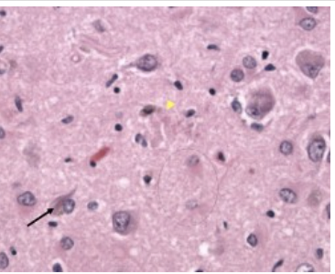
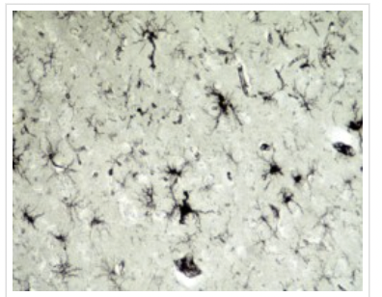
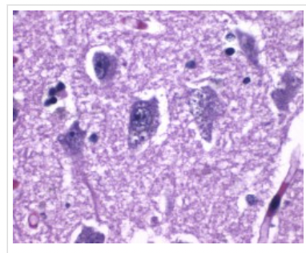
AD Pathology
Amyloid Neuritic plaques
Neurofibrillary Tangles
Granovacuolar Disease
Notes:
Intracellular neurofibrillary tangles, Hirano bodies, neuronal granulovacuolar degeneration, and the deposition of amyloid in the walls of blood vessels can also be seen.
Neurofibrillary tangles: Flame-shaped intracellular inclusion bodies of phosphorylated tau protein.
Hirano bodies: Intracellular aggregates of actin and actin-associated proteins, which are not specific to Alzheimer’s disease.
Granulovacuolar degeneration: Intraneuronal accumulation of large (up to 5 µm diameter) double membrane-bound vacuoles harboring a central granule.

Slide 29
Imaging:
MRI Brain:
Generalized atrophy
Microhemorrhages (amyloid deposition)
Hippocampal/temporal and parietal atrophy
FDG PET
Areas of frontal, temporal, parietal cortices are hypometabolic
Notes:
Beta-amyloid PET
Binding to amyloid-beta protein
Temporal/parietal lobes, then move frontally for atrophy
CT/MRI - widening of cortical sulk + enlargement of the lateral ventricles
Micro hemorrhages - 2/2 amyloid antipathy
Hippocampal and high parietal atrophy
FDG PET - hypo metabolism
MCI - parietal cortex and posterior cingulate gyrus; AD has this + temporal/parietal cortices
B- amyloid - binds to beta amyloid

Slide 30
Presentation of AD
Impairment of memory and and least one other area of cognition
Symptoms:
Difficulty remembering events or acquiring new information
Disorientation
Difficulty with complex cognitive function
Motor symptoms are not typical of AD and should lead you to a different diagnosis
Notes:
Memory – repeating, loss of recent events, information, conversations, misplacing items
Behavior – depression, anxiety, withdrawal

Slide 31
Treatment
Acetylcholinesterase Inhibitors - mild/moderate AD
Donepezil (Aricept)
Rivastigmine (Exelon) - butyrylcholinesterase antagonist
Galantamine (Razadyne) - nicotinic modulator
Side effect: Nausea/vomiting, Diarrhea, Bradycardia
NMDA Antagonist – moderate/severe AD
Memantine (Namenda)
New anti-amyloid monoclonal Ab (FDA approved 2023)
Lecanemab
Notes:
Ach inhibitors – mild to moderate Alzheimers disease and off label use for LBD
Rivastigmine also approved for PDD
Mechanisms of action:
Rivastigmine: Acetylcholinesterase and butyrylcholinesterase antagonist
Donepezil: Acetylcholinesterase inhibitor
Galantamine: Acetylcholinesterase inhibitor and nicotinic modulator
Side effects: Nausea. vomiting, diarrhea, symptomatic bradycardia, and syncope,
It can also possibly worsen depression symptoms.
Avoid use in patients with AV block and sick sinus syndrome.
Relative contraindications: bleeding ulcers, seizures, asthma, or COPD.
m
NMDA – memantine – moderate to severe AD
Antipsychotics – can induce NMS; quetiapine/clozapine preferred
PD-related psychosis – pimavanserin (Inverse agonist and antagonist of serotonin 5-HT receptors.)

Slide 32
Lecanemab (Leqembi)
New FDA approved anti-amyloid agent for MCI or mild dementia in Alzheimers disease
Needs confirmed diagnosis of AD (Biomarker + PET or CSF)
Attacks Amyloid Beta Protofibrils
IV infusion q2 weeks
MRI surveillance at 5th, 7th, 14th week
Side effects: Infusion reactions and ARIA
Thrombolytics and anticoagulants are a contraindication
Shown to slow the progression of the disease
Notes:
- review this data
- Approved in 2023 after a phase 3 trial
- to use this, need a confirmed dx of AD
- reduces amount of plaque build up
- MRI for ARIA – amyloid related imaging abnormality – amyloid causing inflammation, hemorrhage; ApoE4 association
Sx or asx - sx = seizures hemorrhage etc
Cannot use AC or thrombolytic

Slide 33
Frontotemporal Dementia
Onset is typically < 65 years
Group of disorders with behavioral/language dysfunction
Genetic: C9ORF72 gene, MAPT gene
Pathology:
Tau subtype (MC) – Pick bodies (intraneuronal cytoplasmic inclusions)
Tau negative – TDP-43, DPR, FUS
Imaging
Atrophy of frontal and temporal lobes
FDG-PET hypometabolism in these regions
Variants: Behavioral Variant and Primary Progressive Aphasia (2 subtypes)
Notes:
C9ORF72 gene: Pathology related to this noncoding hexanucleotide repeat is the most common cause of familial FTD and familial ALS.
Microtubule-associated protein tau gene (MAPT) gene: Located on chromosome 17, pathology to this gene leads to FTD with parkinsonian symptoms.

Slide 34
Behavioral Variant
Most common
Slow, insidious progression
Personality changes, lack of insight
Abulia, apathy, poor hygiene, hyperphagia, disinhibition
Often associated with Kluver-Bucy Syndrome
Notes:
Due to involvement of the bilateral anterior temporal lobes, FTD is often associated with Kluver-Bucy syndrome: hyperorality, hypersexuality, and a blunted affect.
Approximately 15-20% develop concurrent amyotrophic lateral sclerosis (ALS).

Slide 35
Language Variant - PPA
Progressive non-fluent aphasia
Expressive aphasia
Difficulty with grammar
Speech apraxia
Semantic Dementia
Fluent speech
Inability to understand or follow commands
Notes:
Significant anomia in semantic dementia
Sounds like broca and wernickes but these worsen over time as opposed to stroke

Slide 36
Case #3
A 62 year-old male presents to your clinic with the following symptoms:
4-5 years of violent dream enactment, usually dreaming that he would escape from jail. His wife has witnessed this
2-3 years ago he began losing balance when walking, without vertigo, and falls have increased in frequency this year
Rest tremor has also been observed
He has worse days and better days of focus/concentration
He has misplaced items and has stopped driving due to difficulty with navigation

Slide 37
Case #3 continued
Lab tests and Brain MRI are normal
Exam:
Cognitive: MoCA 13/30
some psychomotor slowing, fluctuation in attention
Hypophonic
Mild bradykinesia, loss of amplitude and rhythm with rapid alternating movements
Gait: reduced speed with slightly less arm swinging of L arm

Slide 38
Case #3
Assuming this is a degenerative dementia, what is the most likely etiology?
A. Alzheimer’s Disease
B. Parkinson’s Disease Dementia
C. Dementia with Lewy Bodies
D. Frontotemporal Dementia

Slide 39
Answer
C. Dementia with Lewy Bodies

Slide 40
Parkinson’s Disease and Dementia
Presentation:
Resting tremor, cogwheel rigidity, bradykinesia
Symptoms are typically asymmetric
RBD, constipation, anosmia can occur prior
Motor symptoms are present one year prior to cognitive
Pathology: Alpha-synuclein inclusions/Lewy Bodies – SN/Locus Coeruleus
Notes:
Remember the 1 year rule
Parkinsonism is bradykinesia + rigidity or rest tremor

Slide 41
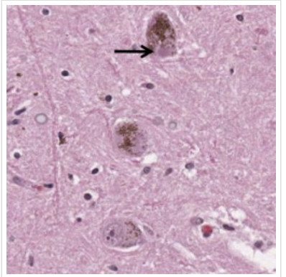
Lewy Body Dementia
Second most common Dementia
Pathology:
Alpha-synuclein deposition inside nerve cells
Imaging:
Occipital Hypometabolism
Diagnosis – 4 Core Clinical Features:
(1) Fluctuations in:
Cognition and levels of alertness
(2) Visual Hallucinations:
Occur early in the disease
(3) Parkinsonism:
Bradykinesia, gait disorder, limb rigidity
Usually more symmetric than PD and often without tremor
(4) RBD (REM-Sleep Behavior Disorder)
Dream enactment and vocalizations
Usually occur early in course of the disease
Notes:
Pathology: Eosinophilic cytoplasmic inclusions composed of alpha-synuclein/Lewy bodies. Spongiform changes in the temporal lobes may also be present
Visual hallucinations are associated with high densities of Lewy bodies in the temporal lobes.

Slide 42
Supportive features of LBD
Severe sensitivity to anti-psychotic agents
Autonomic dysfunction
Repeated falls and postural instability
Hallucinations
Apathy, anxiety, depression
Notes:
Usually, patients with parkinsonian symptoms will partially respond to levodopa but dosing is limited to psychiatric side effects.

Slide 43
Parkinson’s Plus Syndromes
Progressive Supranuclear Palsy (PSP) - tauopathy
Early falls, Impairment of vertical gaze, difficulty with eye movements
Postural instability
Multiple System Atrophy (MSA) – synucleinopathy
Autonomic dysfunction early on
MSA-A, MSA-P, MSA-C variants
Corticobasal degeneration – tauopathy
Limb apraxia
FTD with parkinsonism
Parkinsonism with early behavioral/personality changes (MAPT, Chr 17)
Notes:
Not very responsive to L-dopa
They have parkinsonism (bradykinesia + rigidity or tremor), Symmetric parkinsonism
PSP – midbrain atrophy, hummingbird sign
MSA- parkinsonism, cerebellar dysfunction, pyramidal tract signs, and autonomic dysfunction (typically begins with bladder and erectile dysfunction, with prominent orthostasis
CBD – focal/parietal lobe dysfunction, rigidity, agraphesthesia, aphasia
FTD – MAPT gene – chromosome 17 , AD
Tauopathies

Slide 44
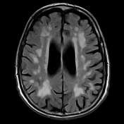
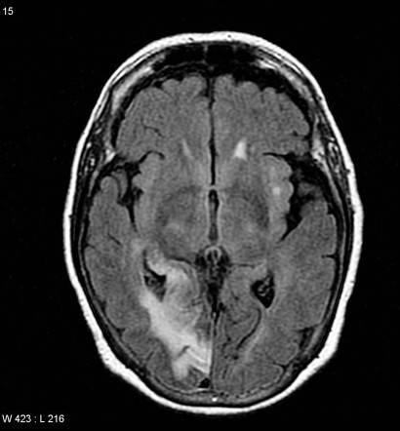
Vascular Dementia (Binswanger’s Disease)
Underlying cerebrovascular disease causing a step-wise decline
Presentation
Abnormal executive functioning
Personality/Behavioral changes
Pseudobulbar palsy
Psychomotor slowing
Gait disturbance
Urinary symptoms, unexplained by urologic disease
Mechanisms:
Uncontrolled risk factors (DM/HTN) – risk factors for stroke
Notes:
Binswanger’s disease

Slide 45
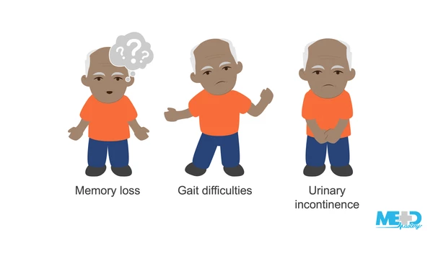
Normal Pressure Hydrocephalus
Triad:
Cognitive difficulties, gait disturbance, urinary incontinence
MRI with enlarged ventricles
Evans index (0.3), sulcal crowding at vertex, DESH, etc
Testing:
Gait assessment prior to and after a lumbar puncture
Treatment:
Shunting (most responsive)
Notes:
DESH – disproportionately enlarged SAH hydrocephalus

Slide 46
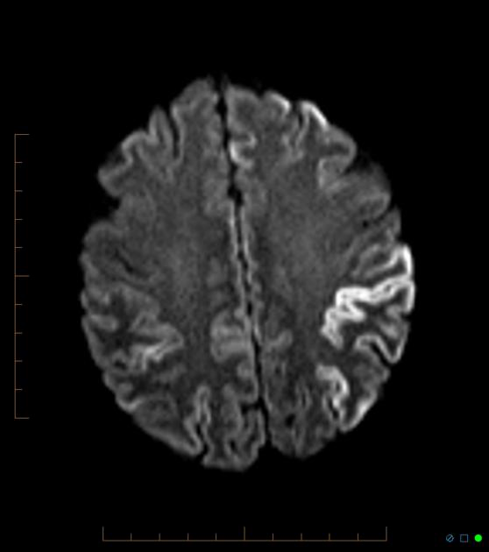
CJD
Presentation
Rapid progressive dementia, cerebellar ataxia, myoclonus
hyperekplexia
Age: 50-70
Most cases are sporadic but there are some genetic associations
Pathology: misfolding of PrP → alpha helical to B-pleaded sheets
Imaging: Cortical ribboning, hyperintensities of the caudate/putamen/thalamus
CSF: 14-3-3; RT-QuIC test
EEG: 0.5-1 Hz generalized periodic discharges
Notes:
Gerstmann-Sträussler-Scheinker disease
Fatal insomnia

Slide 47
Other Dementias
Reversible Causes
Chronic Traumatic Encephalopathy
Huntington’s disease
Alcohol
HIV
Anoxia

Slide 48
Mixed Dementia
Co-occurrence of 2 diseases
Can be difficulty to distinguish which process is more ‘important’
1/3 of patients diagnosed with VaD will have AD at autopsy
Notes:
Usually see AD and VaD; many with DLB have mixed pathology with AD

Slide 49
Thank you for listening!

Slide 50
Sources
Much of this lecture is adapted from Dr. Wiedman’s Lecture in 2021 and Now You Know Neuro!

