Slide 1
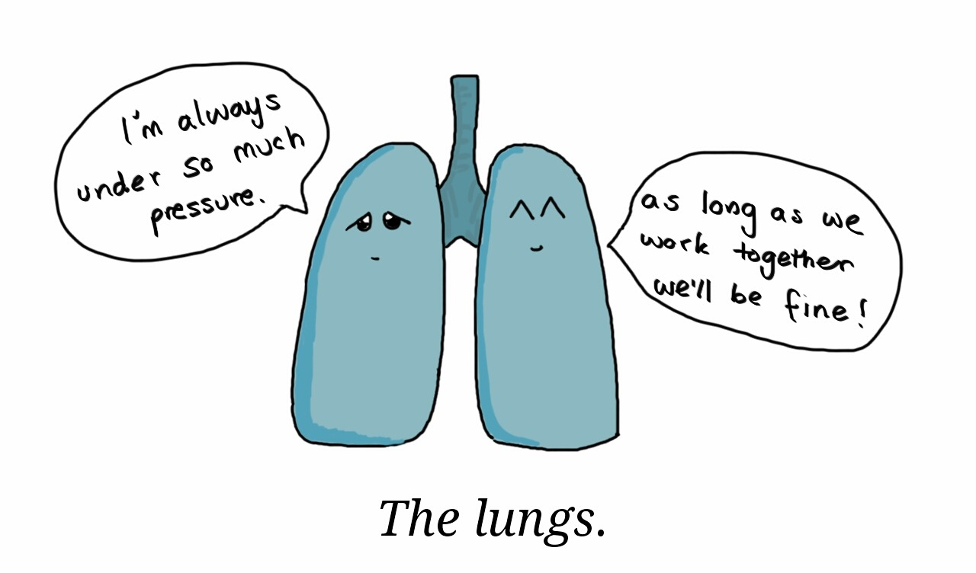
Intern bootcamp: Hypoxia 6/27/24 Carolyn HofmeisteR, MD Chief Resident

Slide 2
objectives
Define hypoxia/hypoxemia
Understand how oxygen content carrying equations & A-a gradient equations are applicable clinically
Understand differences between varying supplemental oxygen delivery systems
Discuss differential for hypoxemia
Discuss clinical outline to approaching a hypoxemic patient
Apply knowledge to case example

Slide 3
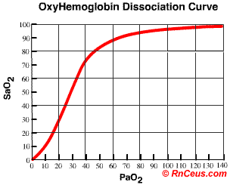
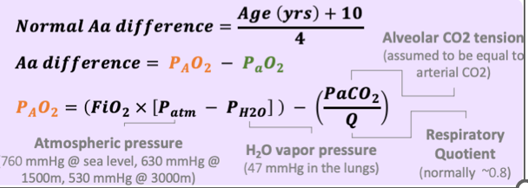
Definitions
Hypoxemia: Low oxygen in the blood, measured with a pulse oximeter or blood gas.
Hypoxia: Low levels of oxygen at the tissue level. Tissues unable to meet demands and will have end organ damage.
Ex: elevated lactic acid, chest pain, altered mental status
CaO₂ (arterial oxygen content) = (1.34 x Hgb x SaO₂)+(0.003 x PaO₂)
Oxygen delivery (i.e. how much oxygen is making it to the tissues): DO₂ = CaO₂ x CO
A-a gradient:
Notes:
Hypoxemia is low oxygen in the blood while hypoxia is the end result of this, low oxygen levels at the tissue level. You may see signs of this as an elevated lactic acid, chest pain, or altered mental status for example.
Just to review some of the important equations, not that you need to memorize these at this time but I just wanted to highlight a couple of things:
Notably it is important to remember that our amount of oxygenated Hgb plays a large role in our oxygen carrying capacity, much larger than the partial pressure of oxygen dissolved in the blood. So when we are measuring the peripheral arterial oxygen saturation via a pulse oximeter as a surrogate for arterial oxygen saturation…….
Also important to remember that our cardiac output also plays a large role in the amount of oxygen that gets delivered to the tissues. So someone with a very low EF may hypoxia.
CaO₂ (arterial oxygen content) = (1.34 x Hgb x SaO₂)+(0.003 x PaO₂)
Hgb: Hemoglobin
SaO₂: Arterial oxygen saturation
PaO₂: Partial pressure of oxygen in arterial blood (oxygen dissolved in blood)

Slide 4
Case example
65 y/o M with history of HFrEF (20%) secondary to ischemic cardiomyopathy, COPD, CKD stage III, HTN, and DM who is admitted to the hospital for sepsis secondary to a pneumonia. Given IVF and started on ABX for treatment of sepsis.
As the night intern covering for the patient you get a page from RN stating:
“Patient with SpO2 of 85%”
What steps are you going to take?

Slide 5
Step 1: evaluate patient and check stability
What are the vitals?
BP 157/81 HR 112 RR 16 SpO2 85%
See patient bedside and perform exam, make sure at appropriate level of care
What are some signs of respiratory distress?
Tripoding, accessory muscle use, altered mental status, not protecting airway (i.e. not clearing secretions, severely altered and at high risk of aspiration, etc.)
How hypoxemic are they? Are they having signs of hypoxia?
*Clinical Pearl*: Check the waveform and ensure getting accurate readings
Notes:
For this patient he is NOT showing any signs of respiratory distress other than some mild tachypnea. Not having evidence of chest pain. On physical exam patient has normal heart sounds without murmur. Noted to have decreased breath sounds in the bases bilaterally with crackles. Currently on 6L supplemental oxygen. Patient has 2+ pitting edema of bilateral lower extremities.

Slide 6
Step 2: supplemental oxygen
Don’t wait to treat, give your patient supplemental oxygen!

Slide 7
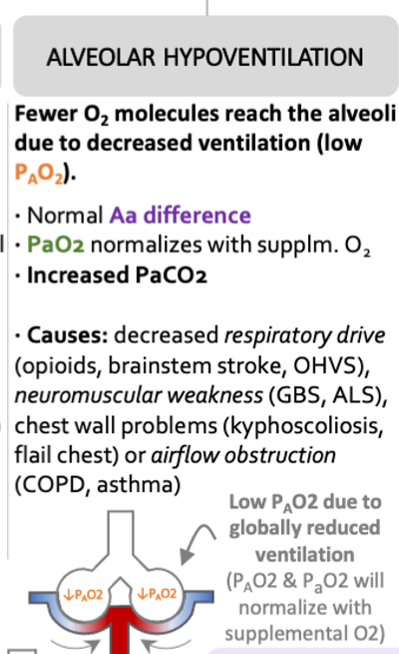
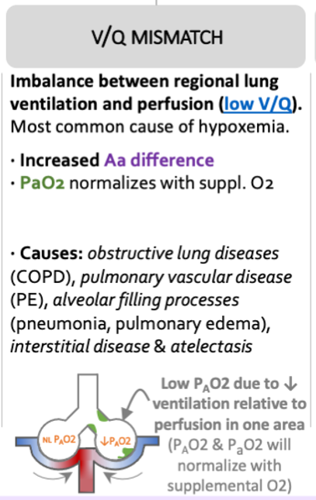
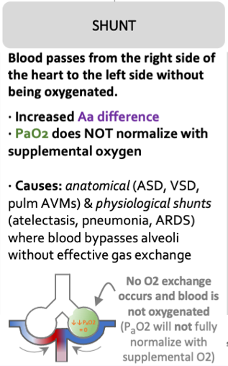
Differential for hypoxemia

Slide 8
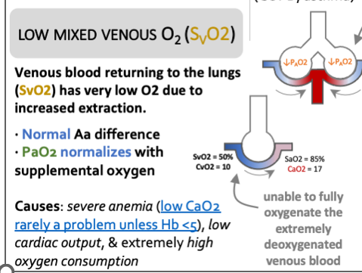
Differential for hypoxemia

Slide 9
Step 3: consider further work-up
Let’s pair/share!
Question 1: What labs and imaging are appropriate to obtain for a hypoxemic patient?
Question 2: What specific labs/imaging are we going to consider for this particular patient?
Reminder:
65 y/o M with history of HFrEF (20%) secondary to ischemic cardiomyopathy, COPD, CKD stage III, HTN, and DM who is admitted to the hospital for sepsis secondary to a pneumonia. Given IVF and started on ABX for treatment of sepsis.
PE: BP 157/81 HR 112 RR 16 SpO2 85% on 6L NC. Normal S1/S2, no m/r/g. Decreased breath sounds in bilateral lung bases. Bilateral 2+ pitting edema.

Slide 10
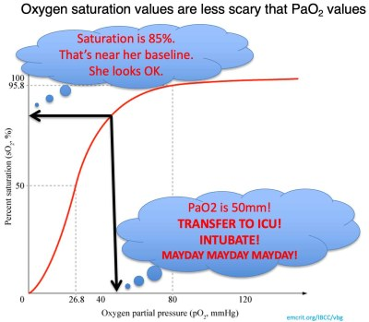
Types of Interventions | Potential Management Options | Selected Management for this Patient
Labs | ABG/VBG, BNP, CBC, lactic acid, troponin, blood Cx | BNP, CBC
Imaging | CXR, CTA chest, CT chest, EKG, Bedside POCUS, TTE +/- with bubble study | CXR, Bedside POCUS
Medications & Interventions | Lasix, Heparin, Antibiotics, Steroids, Breathing treatments, tPA, chest tube, needle decompression, bronchoscopy, intubation | Lasix
*Clinical Pearl*: ABG NOT required for every hypoxemic patient. Consider if do not trust pulse ox reading and need accurate O2 reading, need to calculate A-a gradient, or have other indication to obtain ABG (i.e. hypercapnia, acidosis, etc.).
CaO₂ (arterial oxygen content) = (1.34 x Hgb x SaO₂)+(0.003 x PaO₂)

Slide 11
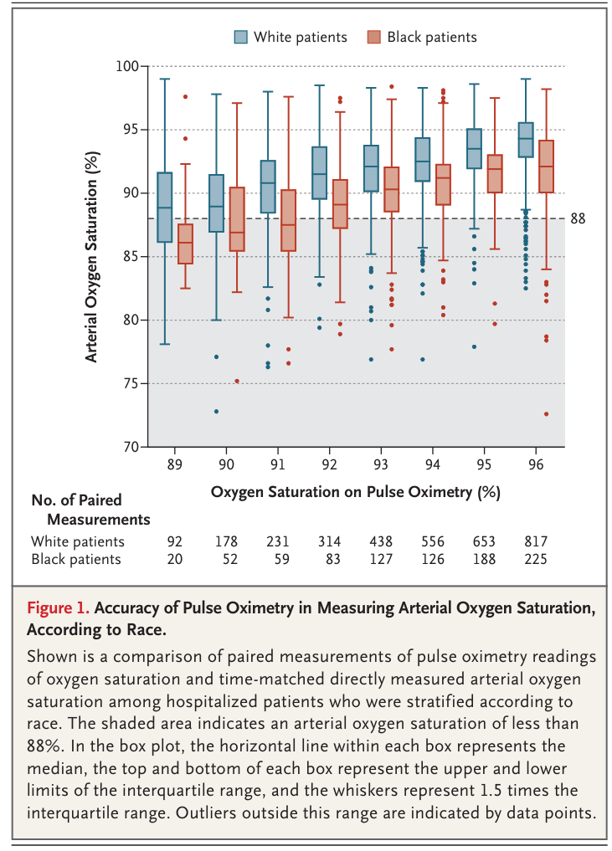
Things that can affect pulse ox readings
Probe and positioning
Nail polish and skin tone
Low flow states
Abnormal hemoglobin – i.e. methemoglobinemia
Lower accuracy at low SpO2 readings
Hyperoxemia
Pulse ox lag time
Medication effects – i.e. methylene blue, isosulfran blue

Slide 12
Summary
Take a deep breath and stay calm
Obtain complete set of vitals, evaluate patient bedside, and ensure stability
Decide appropriate type of supplemental oxygen that patient needs and treat immediately
Work with team to decide further work-up
Continue to check in with patient/bedside RN to ensure patient improving

Slide 13
References & resources
The Curbsiders Internal Medicine: #350 Rapid Response Series: Acute Hypoxemia
ICU One Pager: Hypoxia & Hypoxemia
ICU One Pager: Pulse Oximetry
NEJM Racial Bias in Pulse Oximetry
The Internet Book of Critical Care

