Slide 1
Hyperkalemia
Lise Harper, MD/MPH
October 1, 2024

Slide 2
Objectives
Describe the ECG changes seen with progressively increasing hyperkalemia and the sensitivity of the ECG in manifesting these changes.
Define hyperkalemic emergency and describe the patient who needs rapid acting therapy.
Understand the treatment of hyperkalemic emergency including the medications used, their mechanisms of action, and the duration of action of rapid acting therapies.
Describe the drugs used to remove potassium from the body and their potential side effects.

Slide 3
Potassium physiology
Total body potassium stores are approximately 3000 mEq or more (50 to 75 mEq/kg body weight)
Primarily an intracellular cation (98%)
Intracellular potassium concentration is approximately 140 mEq/L
4 to 5 mEq/L extracellular
Serum K⁺ is 2% of total body K⁺; 98% intracellular
K⁺ homeostasis largely maintained in the kidneys (~90% renal excretion), GI tract (~10% fecal excretion)
Ratio of K⁺ concentration in ECF/ICF determines resting membrane potential across cell membrane -> generation of action potential which is essential for normal neural and muscle function
Notes:
The ratio of the potassium concentrations in the cells and the extracellular fluid is the major determinant of the resting membrane potential across the cell membrane, which sets the stage for the generation of the action potential that is essential for normal neural and muscle function. Thus, both hyperkalemia and hypokalemia can cause muscle paralysis and potentially fatal cardiac arrhythmias.
Really important point that the extracellular concentration is only ~2%, so small shifts from intra to extracellular, can lead to significant change in the serum level.

Slide 4
Potassium physiology
Elevated serum K⁺ > 5.0 or 5.5 mEq/L
Plasma K⁺ concentration determined by:
Intake
Distribution between cells and ECF
Urinary excretion
Regulation of excretion:
Increase in plasma K⁺ concentration and/or intake
Increase in aldosterone secretion
Enhanced delivery of sodium and water to distal potassium secretory sites
Notes:
In normal individuals, dietary potassium is absorbed in the intestines and largely excreted in the urine
If the balance is off, such as increased intake (food, enteral feeds, K supplementation) or impaired secretion, hyperK cam result

Slide 5
RFs for development of hyperkalemia
Most important RFs:
Renal failure
DM
Adrenal disease
Use of ACEis, ARBs or potassium-sparing diuretics

Slide 6
Case #1
68 y/o F with hx of HTN and CLL presents to the ED with abdominal pain and nausea. Work-up in the ED is notable for a WBC count of 150,000/microL. BMP with Cr level of 1.0 mg/dL, K of 6.5 mmol/L and glucose of 110 mg/dL. Abdominal imaging reveals large stool burden c/w constipation.
Medication list includes ibrutinib for her CLL and amlodipine for HTN
What would be the next best step in her management?
A. Emergent HD
B. Insulin/Dextrose
C. Calcium gluconate
D. Get an EKG
E. Check an iStat BMP

Slide 7
Case #1
68 y/o F with hx of HTN and CLL presents to the ED with abdominal pain and nausea. Work-up in the ED is notable for a WBC count of 150,000/microL. BMP with Cr level of 1.0 mg/dL, K of 6.5 mmol/L and glucose of 110 mg/dL. Abdominal imaging reveals large stool burden c/w constipation.
Medication list includes ibrutinib for her CLL and amlodipine for HTN
What would be the next best step in her management?
A. Emergent HD
B. Insulin/Dextrose
C. Calcium gluconate
D. Get an EKG
E. Check an iStat BMP
Notes:
Reasonable to get an EKG in this case, and we will talk about the utility of EKGs a bit later

Slide 8
Pseudo hyperkalemia
Pseudo hyperkalemia is common; suspect it when there is no apparent cause of the hyperK⁺
Causes:
Technique of blood draw (mechanical trauma during venipuncture or fist clenching)
Thrombocytosis
Leukocytosis (WBC > 120,000/microL) such as in CLL
Notes:
Accurate assessment of the potassium concentration with severe leukocytosis can be achieved by allowing clotting to separate serum (plasma without the clotting factors) from cells before centrifugation; fibrin clot protects fragile leukemic cells, minimizing lysis
I had a patient in the hospital who many of you may know, she had pseudohyperkalemia due to severe leukocytosis (trauma to the WBCs during centrifugation) and when checked on a POC test, like an istat or blood gas, it is always normal

Slide 9
Case #2, Question #1
48 y/o F with ESRD missed her last 2 HD sessions due to transportation issues presenting with shortness of breath.
Her VS are stable. Exam is significant for bilateral crackles.
Labs are significant for a Cr of 5.6 mg/dL and a potassium level of 7.2 mmol/L.
What is the most appropriate initial management of this patient?
A. Emergent HD
B. Insulin/Dextrose
C. Calcium gluconate
D. 1 amp sodium bicarb
E. High dose albuterol SVN
F. Get an EKG

Slide 10
Case #2, Question #1
48 y/o F with ESRD missed her last 2 HD sessions due to transportation issues presenting with shortness of breath.
Her VS are stable. Exam is significant for bilateral crackles.
Labs are significant for a Cr of 5.6 mg/dL and a potassium level of 7.2 mmol/L.
What is the most appropriate initial management of this patient?
A. Emergent HD
B. Insulin/Dextrose
C. Calcium gluconate
D. 1 amp sodium bicarb
E. High dose albuterol SVN
F. Get an EKG

Slide 11
Case #2, Question #2
What would you like to do next?
A. Emergent HD
B. Insulin/Dextrose
C. D. 1 amp sodium bicarb
E. High dose albuterol SVN
F. Get an EKG
G. Give Lokelma

Slide 12
Case #2, Question #2
What would you like to do next?
A. Emergent HD
B. Insulin/Dextrose
C. D. 1 amp sodium bicarb
E. High dose albuterol SVN
F. Get an EKG
G. Give Lokelma

Slide 13
Case #2, Question #3
Is there anything else you would like to do?
Notes:
Calling the nephrologist, regardless of time. HD session could be lifesaving and the effects of your stabilizing treatments are short-lived. If a patient makes decent urine, consider lasix. Can add lokelma as well. But bottom line, the patient needs HD.

Slide 14
Calcium
Antagonize the membrane actions of hyperK⁺
Effect begins within minutes, but short-lived (30-60 min)
Calcium gluconate vs. calcium chloride
Calcium chloride is 3 times more potent, but caustic (irritates veins, can extravasate and cause tissue necrosis)
Usual dose is 1000 mg infused over 2-3 minutes
Can be repeated
Notes:
We do not give this as a monotherapy due to the short lived effects and should be given with meds that drive the K intracellularly.
Central line or deep line preferred if giving calcium chloride
Calcium does not effect the serum K level. Effect is measured by normalization of EKG changes.

Slide 15
Insulin/glucose
Expected reduction in serum K⁺ by 1 mEq/L
How long does the effect last?
What labs will you check and when?
Enhances activity of the Na-K-ATPase pump, driving potassium into cells
10 units of regular insulin IV + dextrose (50 mL of 50% dextrose)
Unless BG level ≥ 250 mg/dL (can skip the dextrose)
Notes:
Effect begins within 10 to 20 minutes

Slide 16
Insulin/glucose
Effect of insulin on K⁺ begins within 10 to 20 minutes; peaks at 30 to 60 minutes; lasts 4 to 6 hours
If there is a delay in ability to remove K⁺ from the body, monitor level and consider repeating in ~4 hours
Avoid hypoglycemia!!
Notes:
Some recommend checking q30 minutes for 4-6 hrs, esp in patients with CKD

Slide 17
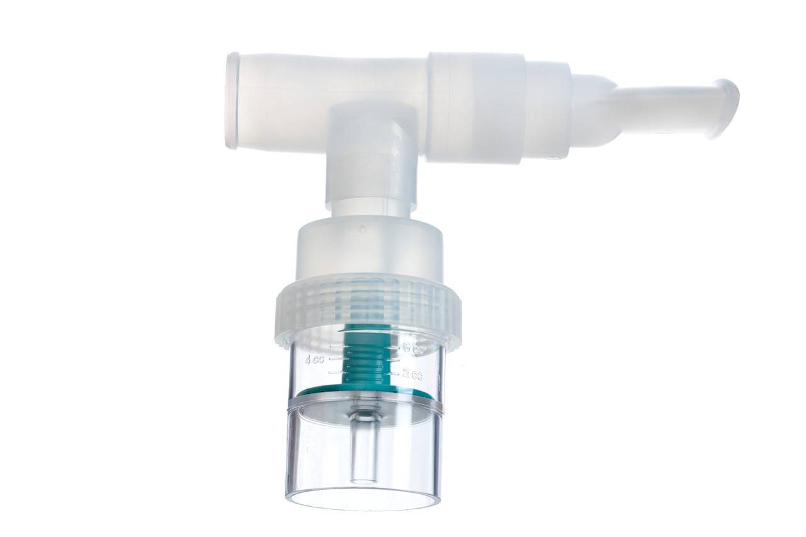
β-2-adrenergic agonists
Expected reduction in serum K⁺ by 1 mEq/L
How long does the effect last?
What labs will you check and when?
Albuterol nebulizer given as 10 to 20 mg in 4 mL of saline over 10 minutes
Additive effect with insulin, reducing the serum K⁺ concentration by 1.2 to 1.5 mEq/L
SEs of tachycardia and induction of angina in susceptible patients (avoid in patients with active coronary disease)
Notes:
Can be used along with Ca and insulin/glucose, but should not be used alone
Effect begins within 10 to 20 minutes

Slide 18
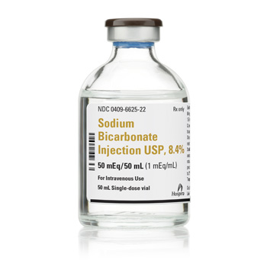
Sodium bicarbonate
Expected reduction in serum K⁺ by 1 mEq/L
How long does the effect last?
What labs will you check and when?
Raises systemic pH -> results in hydrogen ion release from the cells -> potassium moves into the cells to maintain electroneutrality
Only use if the patient is acidotic
Administer as an isotonic solution (150 mEq in 1L of 5% dextrose in water over 2 to 4 hours)
Notes:
Limited efficacy in tx of hyperkalemia

Slide 19
Determining the urgency of therapy
Urgency depends on presence/absence of signs or symptoms of hyperkalemia
Severity of elevation
Cause of the hyperkalemia

Slide 20
Hyperkalemic emergency
Patients with clinical signs or symptoms of hyperK⁺
Muscle weakness or paralysis
Cardiac conduction abnormalities
Arrhythmias
Typically K⁺ > 7 mEq/L with chronic hyperkalemia; possibly at lower levels in pts with acute rise in serum K⁺
K⁺ >6.5 mEq/L, especially if there is concurrent tissue breakdown or GI bleeding (even in the absence of symptoms)
Patients with moderate hyperK⁺ who have significant impairment in kidney function and marked ongoing tissue breakdown (rhabdo or crush injury, TLS, severe GI bleed or significant NAGMA or respiratory acidosis)
Notes:
Tissue breakdown can release large amounts of potassium from cells leading to rapid increases in serum potassium levels
IV calcium should be given to all patients as the first step if sxs of hyperK

Slide 21
Clinical manifestations of hyperkalemia
Cardiac conduction alterations and arrhythmias
Muscle weakness, including paralysis of diaphragm
Acute vs. chronic
Chronic, typically K⁺ > 7.0 mEq/L
Acute, manifestations at lower levels
Notes:
Characteristic EKG changes: tall peaked T wave with a shortened QT interval is the first change, progressive lengthening of the PR interval and QRS duration, the P wave may disappear and ultimately the QRS widens further to a sine wave.
Hyperkalemia can cause an ascending muscle weakness that begins in the legs and progresses to the trunk and arms. It can progress to a flaccid paralysis, mimicking guillan barre. Rarely you can have respiratory muscle weakness. Resolves with treatment of the hyperkalemia.

Slide 22
Hyperkalemic emergency

Slide 23
Should I get an EKG?

Slide 24
K⁺ level and EKG changes
Study found that only 39% of patients with K⁺ levels of 7 to 9 mEq/L had T wave abnormalities; the probability of EKG changes increased with increase in K⁺ levels, but was insensitive; under 50% of patients who developed dangerous arrhythmias or death had dangerous EKG changes
Notes:
The progression and severity of EKG changes does not correlate well with the serum potassium concentration

Slide 25
TWDFNR

Slide 26
Review of Cases #1 and #2
Exclude pseudohyperkalemia
Hyperkalemia emergencies need stabilizing medications
Recognize the duration of action of stabilizing medications
Repeat therapies
Monitor levels closely
Urgent therapy for patients with clinical manifestations, K⁺ >6.5 and moderate hyperK⁺ if significant impairment in kidney function and marked ongoing tissue
Management often doesn’t change based on the EKG findings (or absence of EKG findings)

Slide 27
Case #3
58 y/o M with CAD, HTN, HFpEF and CKD presents with shortness of breath. On arrival to the ED, T 37.5, BP 142/84, HR 90, RR 18, O2 sats 93% on RA. Appears well and in NAD. He has bibasilar crackles on exam and trace LE pitting edema. Labs notable for Cr of 1.4 mg/dL (b/l ~1.2 – 1.3) and K of 5.6 mmol/L.
In addition to reviewing the patient’s medication list, how will you manage the hyperkalemia?
A. Calcium, insulin/dextrose, Lokelma
B. Calcium, Lokelma
C. IV Lasix
D. IV Lasix (along with isotonic saline infusion)
E. Kayexalate
F. Get an EKG to help guide next steps

Slide 28
Case #3
58 y/o M with CAD, HTN, HFpEF and CKD presents with shortness of breath. On arrival to the ED, T 37.5, BP 142/84, HR 90, RR 18, O2 sats 93% on RA. Appears well and in NAD. He has bibasilar crackles on exam and trace LE pitting edema. Labs notable for Cr of 1.4 mg/dL (b/l ~1.2 – 1.3) and K of 5.6 mmol/L.
In addition to reviewing the patient’s medication list, how will you manage the hyperkalemia?
A. Calcium, insulin/dextrose, Lokelma
B. Calcium, Lokelma
C. IV Lasix
D. IV Lasix (along with isotonic saline infusion)
E. Kayexalate
F. Get an EKG to help guide next steps

Slide 29
Potassium removal from the body
Loop diuretics
In patients with normal or mild to moderate kidney impairment, loop diuretics will increase potassium loss in the urine
In hypervolemic patients, diuretics alone
In hypo or euvolemic patients, in conjunction with isotonic saline
GI cation exchangers
Patiromer or sodium zirconium cyclosilicate (SZC)
Hyperkalemic emergency dose:
SZC 10 gm TID x 48 hours
Patiromer 8.4 gm daily as needed
SZC preferred, as more rapid-acting (within 1 hour)
Sodium polystyrene sulfonate (SPS)
Do not use if other GI options are available
Do not give in post-op patients of with ileus, SBO, constipation or underlying bowel disease (risk for intestinal necrosis)
Notes:
Effect of SZC can be seen within 1 hour, with a mean reduction in serum potassium of 0.37 mEq/L within 4 hours
SPS really should only be used if: patient with potentially life threatening hyperlalemia, HD not readily available in appropriate patient, newer cation exchangers are not available, other therapies to remove potassium (diuretics) have failed or cannot be used

Slide 31
Patients who need prompt therapy or slow lowering
Prompt lowering of potassium – within 6-12 hours
HD patients who present outside of regular HD hours
Patients with marginal kidney function or marginal Uop
Patients who need to be optimized for surgery
Slow lowering
Chronic, mild (≤ 5.5 mEq/L) or moderate (5.5 to 6.5 mEq/L) elevations due to CKD and/or use of RAAS inhibiting medications

Slide 32
Case #4
52 y/o F with HTN, type 2 DM and ESRD on HD MWF presents to the ED with dyspnea, nausea and volume overload. She missed her HD sessions on Wednesday and Friday as she was not feeling well and comes in Saturday evening. She does not make urine. Medications include insulin, losartan and sevelamer. Labs are notable for Cr of 6.6 mg/dL, Na 127 mmol/L, K 6.8 mmol/L, CO2 of 19 mmol/L and BG of 175 mg/dL. CXR shows small b/l pleural effusions.
How would you manage her hyperkalemia and kidney dysfunction?
A. Calcium, insulin/dextrose and Lokelma
B. Calcium, insulin/dextrose, albuterol, Lokelma and call nephrology first thing in the am
C. Calcium, insulin/dextrose, albuterol, sodium bicarb, Lokelma and call nephrology first thing in the am
D. Calcium, insulin/dextrose, Lokelma and call nephrology now

Slide 33
Case #4
52 y/o F with HTN, type 2 DM and ESRD on HD MWF presents to the ED with dyspnea, nausea and volume overload. She missed her HD sessions on Wednesday and Friday as she was not feeling well and comes in Saturday evening. She does not make urine. Medications include insulin, losartan and sevelamer. Labs are notable for Cr of 6.6 mg/dL, Na 127 mmol/L, K 6.8 mmol/L, CO2 of 19 mmol/L and BG of 175 mg/dL. CXR shows small b/l pleural effusions.
How would you manage her hyperkalemia and kidney dysfunction?
A. Calcium, insulin/dextrose and Lokelma
B. Calcium, insulin/dextrose, albuterol, Lokelma and call nephrology first thing in the am
C. Calcium, insulin/dextrose, albuterol, sodium bicarb, Lokelma and call nephrology first thing in the am
D. Calcium, insulin/dextrose, Lokelma and call nephrology now

Slide 34
Dialysis
Indicated in the hyperkalemic patient with severe kidney function impairment
Urgent nephrology consultation
Preferred due to fast rate of removal
Rebound increase in K⁺ level will occur after HD
Notes:
In an HD patient with functioning vascular access and if it can be performed without significant delay, preferred over GI cation exchangers.
Reduction in serum potassium during dialysis creates a gradient for potassium movement out of the cells; in addition, the pre-HD therapies for acute hyperK ware off; so in many patients it is important to check post-HD K levels (but not right after HD - a few hours at least)

Slide 35
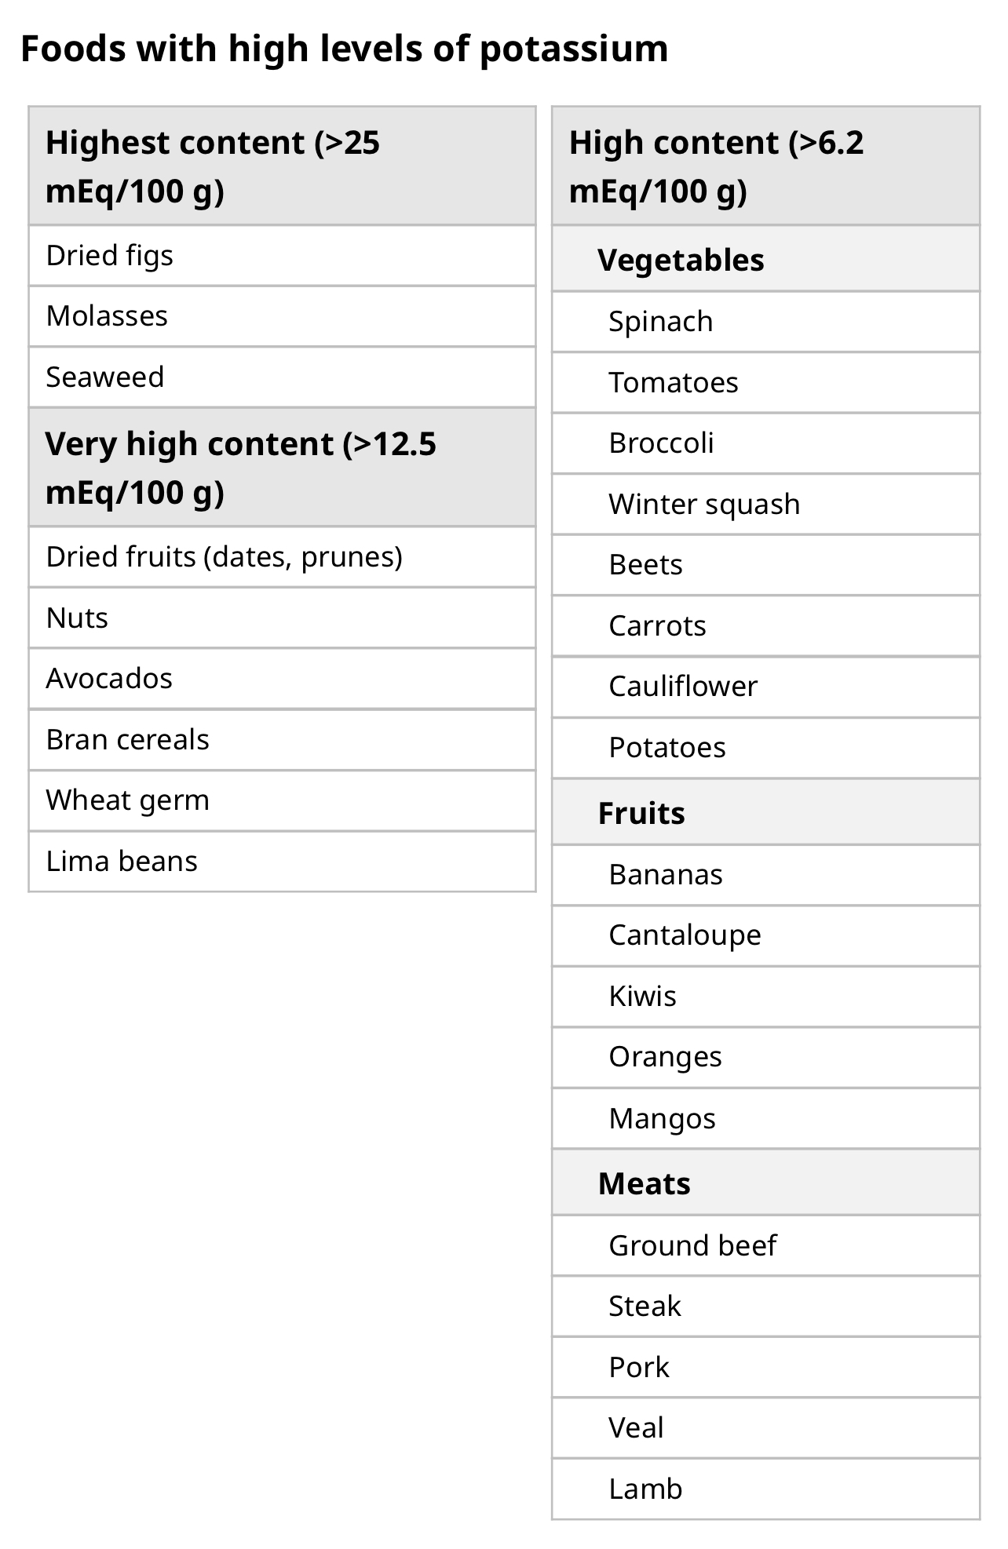
Chronic hyperkalemia
Dietary modification
Diuretics in patients with HTN or hypervolemia
If hyperK⁺ persists following dietary modification and diuretics, treat with GI cation exchangers (patiromer, SZC)
Mineralocorticoids
d/c or reduce doses of drugs that cause hyperkalemia

Slide 36
Case #5
58 y/o F with hx of CKD and HTN is hospitalized for diverticulitis and underwent surgical resection of the sigmoid colon. Medications include amlodipine, heparin, topiramate and PRN IV morphine. Her am BMP was notable for a potassium level of 5.6 mEq/L. Cr is 1.6 mg/dL (baseline is 1.5 mg/dL). BG is 120 and remainder of BMP is wnl.
Which of the following is the most likely cause of the patient's hyperkalemia?
A. AKI
B. Hyperglycemia
C. Heparin
D. Topiramate
E. Metabolic acidosis

Slide 37
Case #5
58 y/o F with hx of CKD and HTN is hospitalized for diverticulitis and underwent surgical resection of the sigmoid colon. Medications include amlodipine, heparin, topiramate and PRN IV morphine. Her am BMP was notable for a potassium level of 5.6 mEq/L. Cr is 1.6 mg/dL (baseline is 1.5 mg/dL). BG is 120 and remainder of BMP is wnl.
Which of the following is the most likely cause of the patient's hyperkalemia?
A. AKI
B. Hyperglycemia
C. Heparin
D. Topiramate
E. Metabolic acidosis

Slide 38
Notes:
Transplant patients

Slide 39
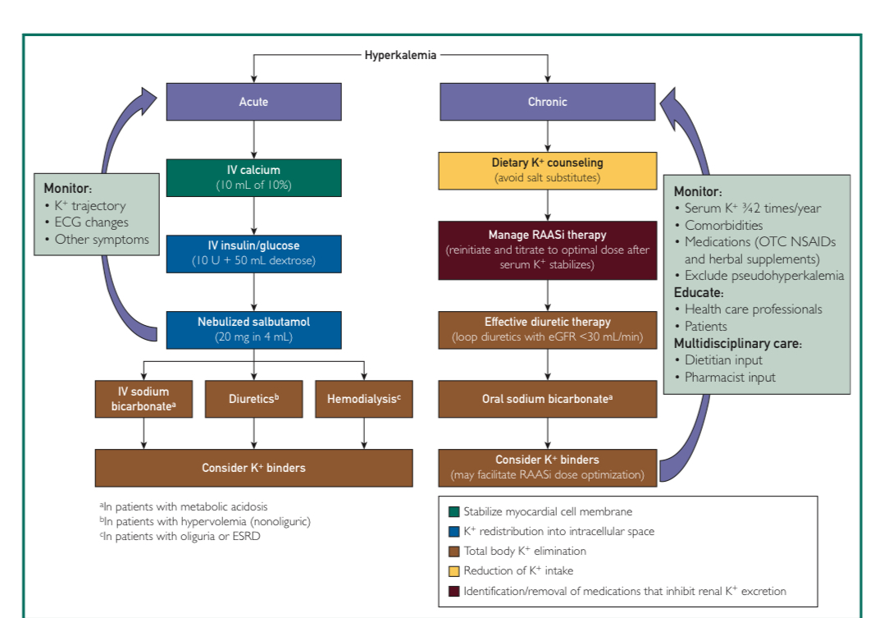
Notes:
Mayo clinic proceedings

Slide 40
Take home points
Exclude pseudo hyperkalemia
Think about how urgently you need to treat
EKG is specific, but not very sensitive
Following acute transient treatments, monitor closely until able to remove potassium from the body; recognize the duration of action of the acute treatments
Review medications, including common meds we use in the hospital

Slide 41
References
Clinical Management of Hyperkalemia. Mayo Clin Proc. March 2021;96(3);744-762
Treatment of hyperkalemia. Kidney international (2016) 89. 566-554
Up to Date
The curbsiders episode #137. Hyperkalemia master class with Dr. Joel Topf
Dr. Nimri’s recent AHD lectures on hyperkalemia

