Slide 2
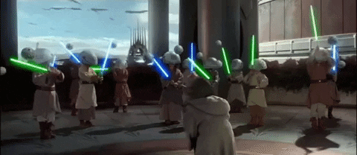
CONGRATULATIONS on finishing intern year! NOW WHAT?!?
Notes:
Ask them to think about their favorite residents and their least favorite residents.

Slide 3
Outline
Day in the life of a senior resident
How to stay organized as a senior resident
How to be a good night float resident
Breakout sessions
Setting expectations
Q&A

Slide 4
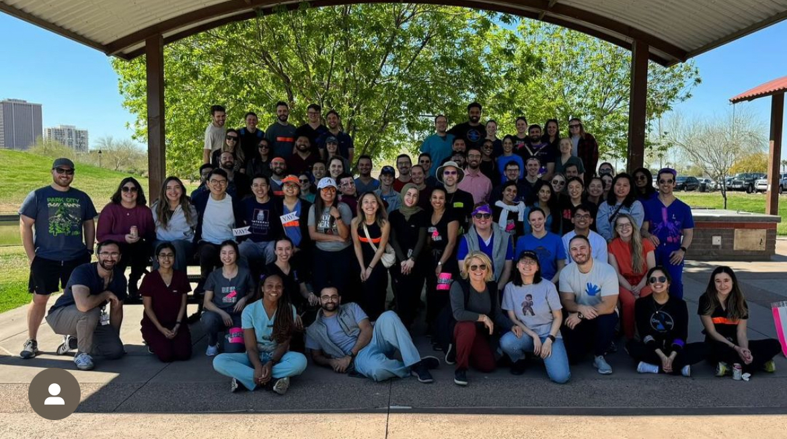

Slide 5
What do you think makes a good senior resident?
Notes:
Carolyn and Jake

Slide 6
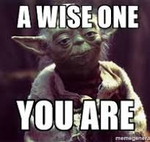
What makes a good senior resident?
Dependable, approachable, and organized
Setting clear expectations for your team
Communication, communication, communication
Modeling the behavior you want to see on your team
Knowing the call, NF, conference schedules, and have your team there on time
Learning to delegate
Asking questions – accepting admissions from the ED or outreach and distributing can be difficult!
Don't guess. Ask.
Notes:
Carolyn

Slide 7
Roles of a senior resident
Team Introductions
1
Set expectations and define individual roles
2
Become the “manager” of your team
3
Find time to teach throughout the day
4
Provide feedback frequently
5
Notes:
Carolyn
avoid being the “super-tern”
Learn to become a delegator
“Senior residents should serve in a supervisory role of junior residents in recognition of their progress toward independence, based on the needs of each patient and the skills of the individual resident.” (RC-IM VI.D.4.c.) Residents are responsible for the day-to-day management of the patient care team under the attending physician's supervision. On some services that do not have interns, the resident may be primarily responsible for the care of patients under the guidance and supervision of the attending physician and more senior trainees. They may serve as part of a team providing consultative services, or care for patients in the inpatient or outpatient setting or emergency department under the supervision of senior trainees and Medical Staff. These residents may coordinate the actions of the team, as well as interact with nursing and other administrative staff. Along with the attending physician they provide for the educational needs of any interns and students.

Slide 8
Pre-round
Arrive at 6AM (duh?)
Get sign out on new admits and cross cover from NF senior, check census of other teams (can form senior group chat)
Get call pagers if on call
Meet with team and go over night events
Triage patients to see who needs to be seen now (sick patients) and who is likely to be discharged. Make sure all members of the team have your contact information.
Prepare notes and planned discharges, go over plans prior to rounding so that your students or interns can feel confident about presenting
Call urgent consults
Communicate with your attending – you will be a primary point of contact!
Notes:
Carolyn

Slide 9
rounding
Listen to all presentations!
Create checklists
Bring up relevant imaging or documents to supplement your intern's presentation
Help rounding stay on track (sometimes a little nudge goes a long way)
Provide real-time teaching if relevant and if time allows
Determine which patients to round on bedside to improve resident education, patient care, and feedback opportunities to your team
Throughout rotation be giving your intern more autonomy/teaching how to place orders, etc.
Notes:
Carolyn

Slide 10
Post rounds
Run your list!
Take time for teaching.
One Minute Preceptor: 5 Microskills
Give feedback!
Pick a high yield topic to teach to your team. Use your patient's conditions as examples!
Don’t have one? Pick a MKSAP topic, find some time to do questions together
Look up next week’s AHD topic and go over teaching points
Notes:
Jake
Run your list often – because your interns are going to be frantically trying to get their notes completed, figure out which tasks are most important to complete now, which can wait, and what you can take on to offload the team (e.g., calling consults, family discussions, etc)
You are the safety net to making sure when you run the list later in the day with your attending that most or all of your items have been completed
Teaching is also an important aspect of being a senior to help you solidify your knowledge and management of basic medical problems while also helping the interns learn and grow.
This can be a dynamic process throughout the year that you can do more or less of depending on how busy your service is.
The most important piece of advice I have about this is to be intentional about it

Slide 11
Let’s admit someone!
Get admission orders in!
A good med rec sets you up for an easy stay and easier discharge, avoid those late-night pages for a home med the patient says they aren’t getting.
This is a good time to delegate!
Use your med students to call pharmacies if your patient doesn’t know their medications.
Easy teaching points
Ex: calculating insulin doses, holding parameters for: blood pressure meds, narcotic meds, bowel care, etc.
Notes:
Jake
Make sure to get your med recs done at the time of admission just to set yourself up for success around discharge. You can delegate this task if needed.
One pearl I remember from med school is that if you notice your intern or medical student is struggling to come up with a problem list for their patients, use their home medications as a guide
Make sure to get your admission and teach orders in! Everyone does this differently, I tend to put prelim orders in as I'm chart stalking just so they start the process of getting a bed, then complete the admit orders after I've seen the patient.
If you guys need or have any questions or concerns about this just reach out and we are happy to help.

Slide 12
DISCHARGE
Discharge planning starts at admission. Thorough social history on admission important!
Anticipate discharge – look for potential difficulties early (SNF?, IV ABx?, Ride?, DME?)
Don’t forget about PRIOR AUTHS, this can hold up your patient’s discharge
Read your PT/OT/Wound recs for DME supplies to avoid pages before discharge
Case managers are your helpful friends!
Notes:
Jake
I can't emphasize enough to start getting in the habit of discharge planning shortly after you've admitted someone.
Invariably you will get to a call day where you have 4 or 5 discharges (some planned, some not) and the call pager is being super unrelenting with admit after admit. Your life wil be a lot easier if most of the discharge is already complete and only the DC order needs to be signed
Make sure you get your prior auths in (we will provide a list of meds at some point that require prior auths) - pharmacy can be helpful here if you have questions

Slide 13
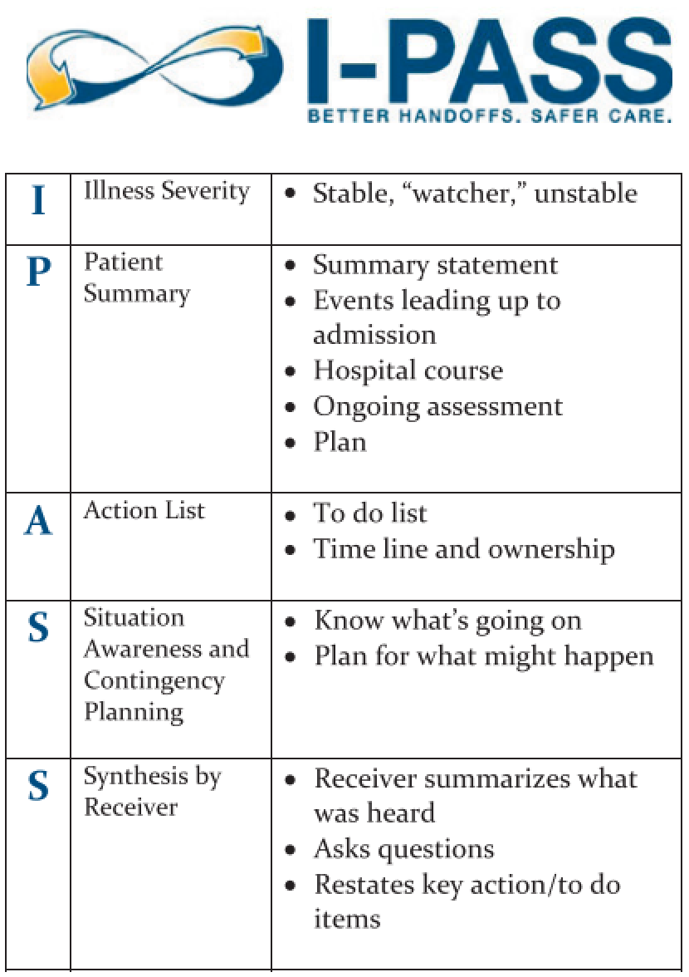
A word about Sign out
Check for consultant recommendations
Check that everyone has appropriate labs for the morning
Run the list one more time – discuss sign out with interns
Observe intern sign out (iPASS), highlight any concerns to the NF senior
Notes:
Jake

Slide 14
An example of organization scheme
Chart
Orders
Sign-Out
AM Labs
Notes:
Pierce

Slide 15
Check-boxes
Notes:
Pierce

Slide 16
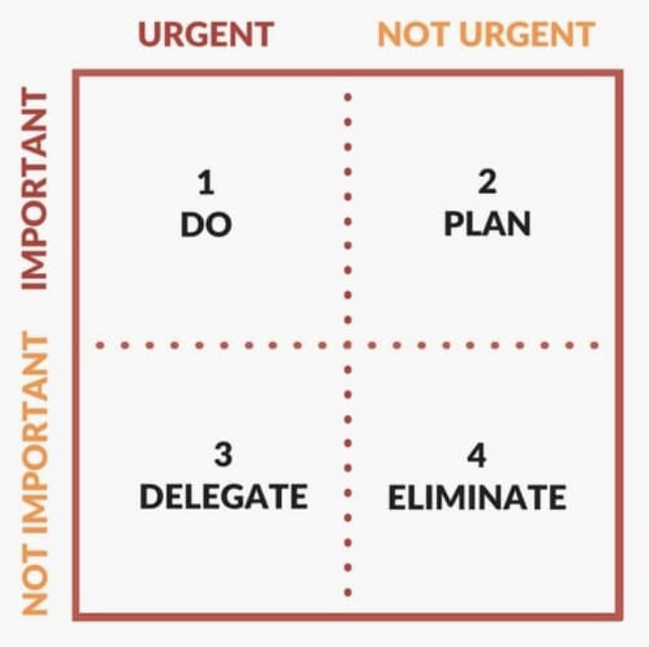
Triage by Urgency/Importance
Escalate +
Go Bedside
Do or Ask/ Check Box
Do /
Nurse Order
Acknowledge
Notes:
Pierce

Slide 17
Triage by Time of day
Pre-Rounds 6-9 AM
See all patients and check in with all bedside RNs (especially early on as PGY2, give interns more independence later in year)
Unstable -> New admits -> anticipated discharges -> stable follow-ups
Call consults and place orders that you feel cannot wait for rounds (must rely on clinical judgement and usually involves unstable patients)
Run the list with interns 20-30 mins prior to rounds
During Rounds 9-12PM
Orders, orders, orders (especially as early PGY2) - non-urgent orders can be good opportunities for interns after rounds
Consults (especially those requiring possible procedures – cards, GI)
Listen to plan during rounds and make your checklist
Sign discharge orders
Prior to Sign out 12-5 PM
Run the list once more with interns at about 2PM
Procedures (paracentesis, LPs, etc...)
Identify potential discharges for the next workday – prepare dc instructions and orders
Notes:
Pierce

Slide 18
HOW TO BE AN EXTRAORDINARY RESIDENT ON NIGHTFLOAT
AY 24-25

Slide 19
THINGS TO KEEP IN MIND
It is a tough job. (remember this when you are DAY TEAM – always have grace!)
Taking care of yourself has never been more important.
We are here to help.
Jake Hillyer 425-533-6823 Dr. Holland 602-363-2301
Carolyn Hofmeister 623-205-2696 Dr. Mallin 602-717-5872
Dylan McCreary 612-598-6284 Dr. Crawford 602-369-8420
Elle Newcome 651-276-5392
Erin Biringen 303-261-2146
Fadi Khoury 831-277-4343
Miriam Robin 410-830-1070

Slide 20
1. KNOW WHO YOUR “GO-TO” PEOPLE WILL BE.
Review the AMION schedule
ICU resident/Fellow in-house (remember when upgrading to the ICU to page the ICU admit/attending pager and NOT the ICU call pager)
Cardiology Fellow in-house
Night hospitalist
BUMCP - Nightfloat Attending / LC Attending
You can check Amion for the Cardiology fellow in-house, GI on call, and Endocrine on call

Slide 21
2. INTAKE OF PATIENTS
Review patient chart quickly prior to returning page. Review to ensure they are going to the correct team (our service vs family med vs ICU).
Speak to the transferring doctor whenever possible. Be respectful Get the information you need to take care of the patient - have antibiotics been given? Current vitals? Other interventions completed (CT scan results, blood transfusions, etc). Sometimes the chart doesn’t arrive with them as planned.
At BUMCP, if a patient is coming for sub-specialist care – ask the transfer service if that sub-specialty has been contacted (this is not always possible for certain specialties)
Determine the most appropriate place for the patient (telemetry, med-surg, ICU). If in doubt, discuss with the attending (long call attending before 10 pm/BUMG night doc after 10 pm)
Distribute patients & assign to teams (do this as they arrive or as a group but make sure this occurs by 5 am and add them to each team list)
Goal daily census for all teams is ~15 — (Orange team goal ~ 12 & they take non - GI patients if their census is low when all other teams are 12 or above.) MAXIMUM IS 20 PER TEAM (this is the ACGME rule)
At BUMCP, we take our bounces, Cystic Fibrosis pts, clinic patients and ‘special requests’ even if teams are at or above goal daily census.

Slide 22
3. MAKE SURE THE TEAM’S NOTES ARE TEMPLATED TO CAPTURE COMPLETELY THE WORK THAT IS NECESSARY.
HPI should tell the story chronologically & contain pertinent positives and negatives; (should be able to have a DDX in mind after just the HPI)
Include PQRST when appropriate
All notes must include: patient name, MRN & DOB, chief complaint
Translator , chaperones use must be documented
Med student intern/resident addendum
Need 11 organ ROS and PE (CANNOT SAY “NEGATIVE”)
If unable to obtain information, MUST document why—”patient altered”, “family could not be contacted” – including this, complex billing can still be supported.
FAMILY HX - document what was asked (DO NOT SAY NON-CONTRIBUTORY)
ICU downgrades need ICU Accept Note (progress note format) with ICU course summarized at start of note
Assign the note to the daytime attending of the team the patient is being assigned to (not the night float attending)

Slide 23
4. IMPORTANT DOCUMENTATION TIPS
Include MPOA name/number, specify if family was present or if contact with them was made (or attempted)
Document important conversations with patient, family, consultants, etc (these are important for day team to know about) → especially code status conversation (elaborate briefly ~1 sentence on DNR/DNI)
Include signature block at the bottom of ALL your notes: name, position (MS, intern, resident), service, and pager number
Pre-charting via notepad on the computer can help make you more efficient for note writing on busy nights. Screenshot the medication list and print it out rather than handwriting all the medications – this will make your med rec easier/faster
Cross-cover notes are very important – write one when you go to bedside to evaluate a patient, transfer to the ICU, or anything major happens overnight. These notes are invaluable to the day teams, attending & all others seeing the pt.

Slide 24
Required addendum for Medical student notes
“I, the resident, was present with the medical student during the visit. I personally performed an exam, made the assessment and developed the care plan (e.g. medical decision making) as documented above. I have verified the student’s documentation and agree with the student’s findings.”

Slide 25
5. MAKE SURE ORDERS ARE ACCURATE.
TEACH ORDER – this determines how the nurses contact the appropriate provider with important updates or questions. This is especially important as the NF team transitions on Sunday – TEACH orders must be updated by 0600. (Teach order must be placed before 0600 or provider list (how nurses call us) will be incorrect for the entire day)
When you are the senior on Saturday night, you MUST change every teach order before 6am on Sunday so that the nurses know which team to page on Sunday!!
MAKE SURE ALL PTS ARE ASSIGNED TO TEAMS WITH TEACH ORDERS BEFORE 0500– variability in census works itself out over the course of the day
CODE STATUS – discussions clarifying code status are important to document. CODE STATUS ORDERS SHOULD BE ACCURATE FROM DAY ONE.
Review admit order sets with the interns and show them how to complete the med rec

Slide 26
6. CONSULTING OTHER SERVICES
Call when patients arrive if urgent
Otherwise notify accepting services of patient arrival: GI, academic Cards, ENT locums, neurology, all surgery services (GI and academic Cards have fellows that will help triage urgency of procedures that may need to occur)
Make it clear:
Why we are requesting them to see the patient
Urgency of their evaluation
Clarify when the patient will be seen and how to reach you for coordination of care afterwards.
Documentation in chart should be clear: “spoke to GI, they will see pt tonight”, “will notify GI service in am”, “spoke to GI, Dr. Z recommends …”
If you are having difficulty reaching them and need to talk to them, continue to call & discuss with your attending (long call or direct care)

Slide 27
7. CONSULTING NIGHTIME HOSPITALISTS
There is always someone listed as the go-to person for both BUMCP & the VAMC. If you need an attending to lay eyes on someone or need in person help, they are there to help you.
If you admit a patient that will go to the OR in the AM —patient needs to be staffed at night with one of the night hospitalists (this is the Direct Care Attending listed on Amion call page).
If you need help with overnight procedures, sick patients, disruptive patients, concerns about patients leaving AMA, appropriate placement of patients in the hospital (ICU vs floor vs ? home)
If you are having difficulty getting help from consultants

Slide 28
8. TAKE CARE OF YOURSELF SO YOU CAN LEAD THE TEAM WITH COMPASSION
Prepare for NIGHTS in advance-
Do laundry, go to grocery store, fill up your gas tank - before the week starts; pay bills, limit other tasks to do while you prioritize sleeping during the day
Prioritize good sleep:
Ask family/friends to limit phone calls and visits during your sleep hours.
Keep your room cool & use blackout blinds.
Limit caffeine to the beginning of your shift.
Avoid bright light on the way home from work (make use of sunglasses)
DRIVE HOME SAFELY - take a nap in a call room or call a taxi/uber and email receipt to Debra
Realize that lack of sleep does not bring out the best in people; be patient with your team, your patients, families. Assume positive intent.

Slide 29
“Compassionate leaders seek influence, not authority. They don't demand, they encourage. They lead with hope. They guide, acknowledge and support team members to combine their efforts, skills, insights, passion, enthusiasm and commitment to work together for the greater good.”
LEADING WITH COMPASSION IS ESSENTIAL TO CREATE A SAFE & HEALTHY LEARNING ENVIRONMENT. AT UACOMP, WE PRIORITIZE TEAMWORK, GROWTH & WELL-BEING OF EVERYONE IN THE PROGRAM

Slide 30
Expectations Y'all have for your class?
Notes:
I included the project list from last year if you want to print a few copies to circulate ☺
This would be a good time to speak with a 3rd year if you see a project that they are working on that you want to take over from them and get their project planning worksheet

Slide 31
Our EXPECTATIONS for PGY2/PGY3 next year
Show up on time to wards/ICU (6am or 5pm), clinic (by 8am), and education sessions (12:15pm for noon reports, 8am for grand rounds, 9:15am for academic half day)
Inbox management
Ensure everyone has an opportunity to eat lunch!
Ensure med students have good learning patients
Help divide tasks on inpatient so interns are not left staying > 30 minutes later than rest of team
Do not leave work unfinished at end of inpatient days; stabilize sick patients, wrap up time-sensitive tasks
Make sure sign outs are updated with rooms and updated context/plans
Seniors should orient medical students
Seniors should supervise signout for interns and Sub-I, especially at the beginning of the year!
Feedback at end of rotation
Setting up away messages at the VA/ seniors holding pagers during noon reports and grand rounds
Notes:
Ahsan

Slide 32
Our Goals for next year:
Have fun!
Be present to residents (and approachable!)
?funding for snacks
Solicit feedback during HSC (and respond)
How else can we serve you next year?

Slide 33
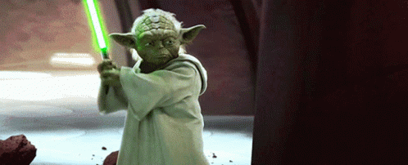
Questions?
Ready, you are
Notes:
Tara

Slide 34
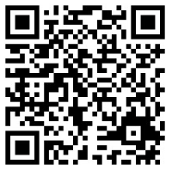
Feedback form

