Slide 1
Renal Replacement Therapy
Katharine Dahl, MD
Academic Half Day
October 22, 2024
kdahl1@arizona.edu

Slide 2
Learning Objectives
Describe the indications for urgent/emergent dialysis.
Understand the importance of the timing of dialysis initiation in patients with CKD.
Describe the differences between SLED, CRRT and intermittent HD in the ICU setting.
Understand the causes and consequences of cardiovascular disease, metabolic bone disease, and anemia in ESRD patients.
Identify the best BP medications to use for patients with ESRD

Slide 3
Acute Indications for RRT
Acidosis
Electrolyte abnormalities
Ingestions
Overload
Uremia
Refractory to medical management

Slide 4
Can Starting RRT “Prophylactically” Help?
In theory early initiation of dialysis could improve outcomes by avoiding
Fluid overload
Acid base complications
Metabolic complications

Slide 6
Mechanisms of Dialysis Clearance
Diffusion: molecules in a solvent pass freely across a semipermeable membrane across concentration gradient
Convection: solutes pass across a semipermeable membrane with water due to a transmembrane pressure gradient.

Slide 7
Types of CRRT
Continuous Veno-venous Hemofiltration (CVVH)
Continuous Veno-Venous Hemodialysis (CVVHD)
Continuous Veno-Venous Hemodiafiltration (CVVHDF)

Slide 8
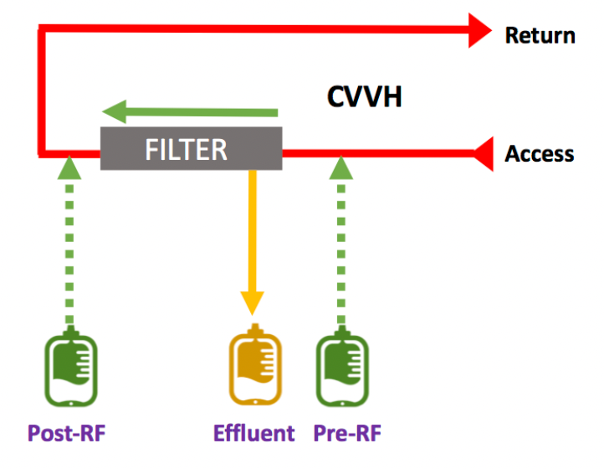
CVVH
Uses convection
Replacement fluid is given to maintain euvolemia and dilute the plasma concentration of solutes (i.e. urea nitrogen, creatinine)

Slide 9
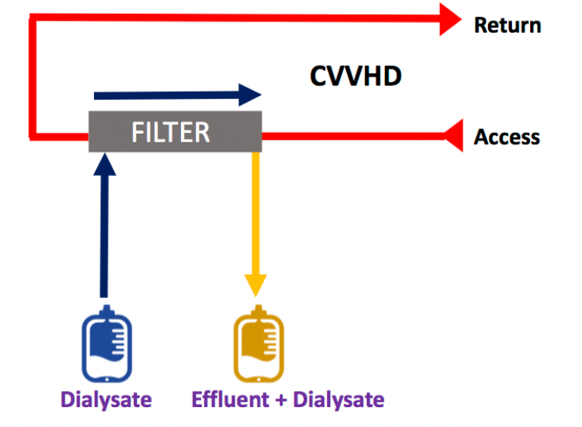
CVVHD
Uses diffusion and convection.
Replacement fluid is not used in CVVHD

Slide 10
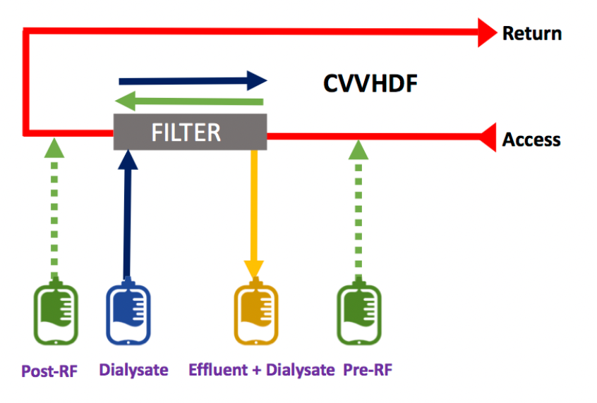
CVVHDF
Uses both convection and diffusion.
Replacement fluid is also used to maintain euvolemia as in CVVH.

Slide 11
Dose of CRRT
Dose estimated by the effluent flow rate (mL/kg/hr)
Calculated as the ultrafiltration rate in CVVH, delivered dialysate flow rate in CVVHD, and a combination of both for CVVHDF.
KDIGO guidelines: effluent volume of 20-25ml/kg/hr (delivered dose – not prescribed dose)

Slide 12
SLED
Sustained Low-Efficiency Dialysis
Hybrid form or RRT between iHD and CRRT
Blood and dialysate flow rates are lower than iHD and session is longer than iHD
Efficient clearance of small solutes (like iHD)
Good hemodynamic tolerability (like CRRT)
Cheaper than CRRT

Slide 13
CRRT vs SLED
30-day Mortality, RRT Dependence and Early Clinical Deterioration by RRT Modality
Kitchlu, A., Adhikari, N., Burns, K.E.A. et al. BMC Nephrol 16, 127 (2015).

Slide 14
Renal Recovery Rate & Mortality: meta-analysis
No difference in mortality
CRRT may have improved renal recovery compared to iHD
Crit Care Explor. 2021 May 12;3(5):e0399.

Slide 15
ESRD

Slide 16
Preventing Comorbidities in ESRD

Slide 17
Renal Osteodystrophy
Decreased phosphorus excretion
Decreased calcitriol
Secondary hyperparathyroidism
Renal osteodystrophy

Slide 18
Roles of Hormones - PTH
Increases calcium reabsorption in the distal tubule
Increases calcium and phosphorus exit from bone
Increases 1^{α} hydroxylase in the proximal tubule
Increases calcitriol
Increases phosphorus excretion
Inhibits sodium phosphate cotransporter in the proximal tubule
Negative feedback: stimulates FGF-23 which inhibits PTH
Helmut G. Rennke, Bradley M. Denker. Renal Pathophysiology: The Essentials
Linda Costanzo.

Slide 19
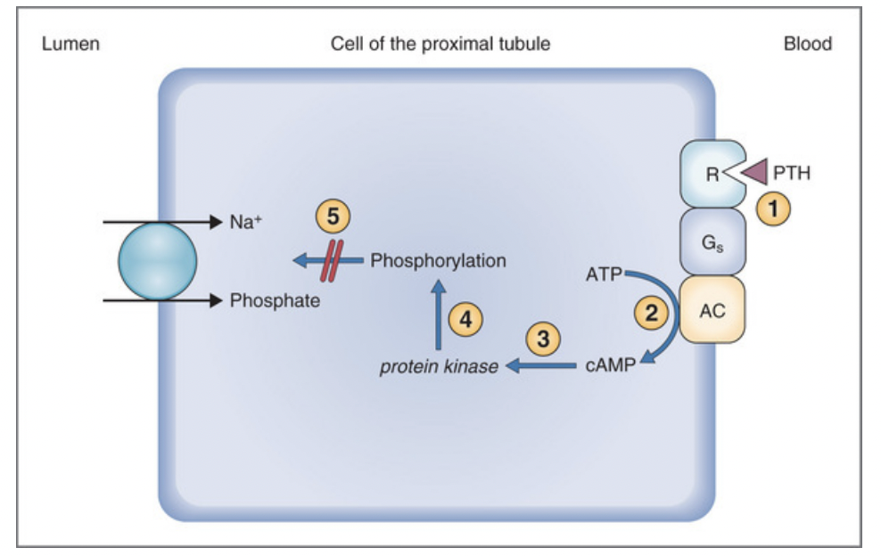
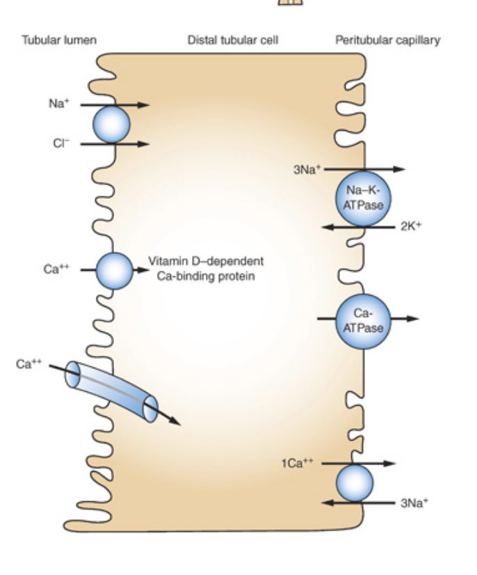
Roles of Hormones - PTH
Increases 1^{α} hydroxylase in the proximal tubule
Increases calcitriol
Increases phosphorus excretion
Inhibits sodium phosphate cotransporter in the proximal tubule
Stimulates FGF-23
Increases calcium reabsorption in distal tubule
Helmut G. Rennke, Bradley M. Denker. Renal Pathophysiology: The Essentials
Linda Costanzo. Physiology

Slide 20
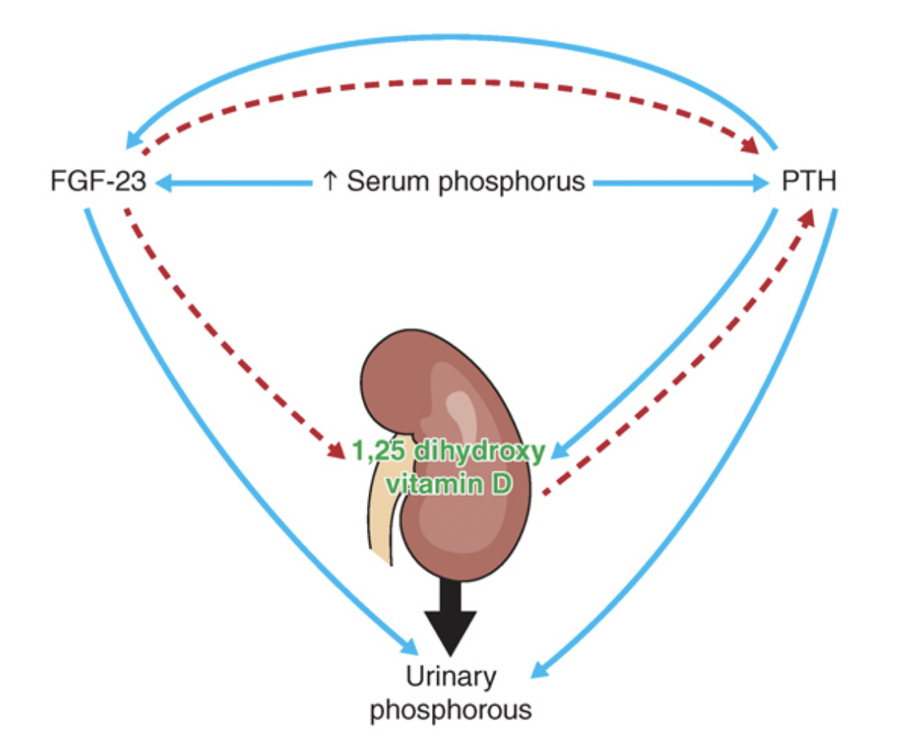
Roles of Hormones – FGF-23
Secreted by osteocytes & osteoclasts
Stimulated by PTH and phosphorus
Inhibits sodium-phosphate cotransporters in proximal tubule
-->increased phosphate secretion
Negative feedback:
Inhibits calcitriol
Inhibits PTH
Helmut G. Rennke, Bradley M. Denker. Renal Pathophysiology: The Essentials

Slide 21
Roles of Hormones - Calcitriol
Increases GI calcium and phosphorus absorption
Promotes osteoclast maturation, increased Ca and phosphate release from bone
Decreases renal phosphate excretion
(negative feedback) Decreases PTH transcription via Vitamin D receptor (VDR) in the parathyroid gland
Helmut G. Rennke, Bradley M. Denker. Renal Pathophysiology: The Essentials

Slide 22
Hormonal Derangements in Renal Failure
Helmut G. Rennke, Bradley M. Denker. Renal Pathophysiology: The Essentials

Slide 23
Model for Development of Secondary Hyperparathyroidism
GFR drops
Phosphorus increases, calcium decreases
PTH increases to help phosphorus and calcium return to normal
Homeostasis achieved until GFR drops more
Cycle repeats
Helmut G. Rennke, Bradley M. Denker. Renal Pathophysiology: The Essentials

Slide 24
Consequences of Secondary Hyperparathyroidism
Osteitis Fibrosa Cystica
PTH stimulation of osteoclasts and increased osteoblasts leads to increased osteoid surfaces (unmineralized bone)
Helmut G. Rennke, Bradley M. Denker. Renal Pathophysiology: The Essentials

Slide 25
Consequences of Secondary Hyperparathyroidism & Hyperphosphatemia
Vascular calcifications
Calcium phosphate precipitates out of the blood stream and deposits in the tissues
Usually when calcium x phosphorus product > 60-70
Image from Dr. Kristina Bostrom, UCLA
Helmut G. Rennke, Bradley M. Denker. Renal Pathophysiology: The Essentials

Slide 26
Treating Hyperphosphatemia
Phos >3.5-4 is associated with increased mortality
Goal phosphorus normal (2.5-4.5mg/dL)
Role of assessing total phosphorus burden (FGF-23)
Low phosphorus diet
Phosphate binders
Sevelamer
Lanthanum
Sucroferric oxyhydroxide
Calcium acetate
Restrict calcium-based binder if hypercalcemic, presence of arterial calcifications, or adynamic bone disease

Slide 27
Treating Secondary Hyperparathyroidism
Replace 25 hydroxy vitamin D
Control phosphorus
Low phosphorus diet
Phosphate Binders
Generally, the following are not recommended in patients with CKD not on dialysis (only for dialysis patients)
1,25 dihydroxy vitamin D replacement (unless hyperparathyroidism severe and progressive in CKD 4-5)
Calcitriol, Paricalcitol, Doxercalciferol
Calciumimetics – bind to calcium sensing receptor on parathyroid gland to reduce PTH production
cinacalcet

Slide 28
Managing Comorbidities: Renal bone mineral disorder
Changing trends over past 20 years: previously predominantly high bone turnover disease, now 40-70% low turnover

Slide 29
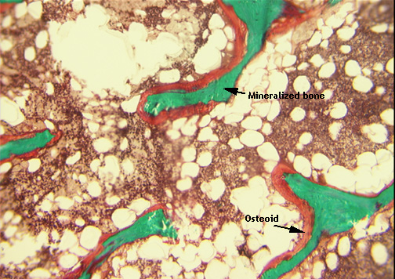
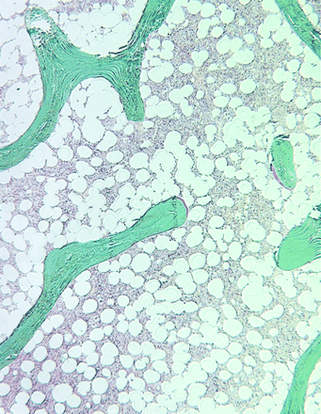
Other forms of bone disease with CKD
Adynamic Bone Disease
Decreased rate of bone formation without mineralization
Decreased number of osteoclasts and osteoblasts
Excess calcium and vitamin D leading to decreased PTH
Osteomalacia
Defective mineralization caused by:
Aluminum toxicity
Vitamin D deficiency
Metabolic acidosis
Hypophosphatemia

Slide 30
Managing Comorbidities: Diabetes
Glycemic control: large RCTs have not shown reduction in cardiovascular events or death from renal disease with aggressive glycemic control (A1C <7); risks outweigh benefits

Slide 31
Managing Comorbidities: Anemia
Erythropoietin levels do not appropriately rise in response to anemia in patients with CKD
Helmut G. Rennke, Bradley M. Denker. Renal Pathophysiology: The Essentials

Slide 32
Managing Comorbidities: Anemia
Tissue hypoxia -> chronic inflammatory damage to the peritubular fibroblasts in the renal cortex where erythropoietin is produced
Koury M, et al. Nature Reviews 2015

Slide 33
Managing Comorbidities: Anemia
Synthetic erythropoietin is available for replacement (erythrocyte stimulating agents)
Evidence of increased thrombosis and cardiovascular events with higher hgb levels
Erythropoietin also causes hypertension
KDIGO recommendations:
Consider iron replacement if Tsat<30% and ferritin <500
Consider ESA if hgb <10
Singh AK et al.; CHOIR Investigators. N Engl J Med. 2006;355(20):2085-2098.
Drüeke TB et al.; CREATE Investigators. N Engl J Med. 2006;355(20):2071-2084.
Pfeffer MA, et al.; TREAT Investigators. N Engl J Med. 2009;361(21):2019-2032

Slide 34
Managing Comorbidities: HTN
• ABPM is the gold standard for the diagnosing hypertension in HD patients. If ABPM is not available, home BP recordings can be a good alternative for accurate BP measurements.
• An average home BP ≥ 135/85 mmHg or ambulatory BP ≥ 130/80 mmHg is considered high BP in HD patients, and in general, the target of self-measured home BP is less than 130/80 mmHg.
• If neither ABPM nor home BP measurements are available, in-office BP measurements outside of the dialysis unit or median midweek peridialytic BP may be acceptable.
• Increased pulse pressure/arterial stiffness may be another determinant in predicting adverse CV outcomes.
• There may be a time-varying effect between high BP and mortality, suggesting the need for long-term follow-up data to predict mortality.
• Intradialytic BP pattern should also be considered to avoid serious complications of HD.

Slide 35
HTN Treatment
ACE-ARB: high RAAS activation
Beta-Blockers: sympathetic overactivity
Dihydropyridine CCBs – all CCB are not removed on dialysis
Mineralocorticoid Receptor Blockers – Dialysis Outcomes Heart Failure Aldactone Study – Spironolactone reduced CV death and hospitalization
Volume removal on dialysis
Be careful about intradialytic hypotension

Slide 36
Clinical Manifestations of CKD: when to start HD
Most people have no symptoms until kidney function is very low
Problem is discovered on blood or urine tests done for other reasons
Even in advanced kidney failure, many people still make a normal amount of urine

Slide 37
Clinical Manifestations of CKD
In advanced kidney failure, people may develop symptoms of uremia
Nausea or vomiting
Taste disturbances
Poor appetite
Confusion, drowsiness
Fluid buildup and inflammation around the heart (pericarditis)
Fluid retention
Leg swelling
Shortness of breath

Slide 38
Clinical Manifestations of CKD
In less-severe kidney disease patients may not have symptoms, but can have other complications
High blood pressure
Anemia
Bone disease from vitamin D deficiency and secondary hyperparathyroidism
Blood chemistry abnormalities (high potassium, high phosphorus)
Cardiovascular disease (from high phosphorus, secondary hyperparathyroidism, hypertension)

Slide 39
When to Start Dialysis
No benefit to starting dialysis at GFR 10-14 vs 5-7ml/min
Decision should be made based on quality of life and uremic symptoms

Slide 40
Principles of Dialysis
Hemodialysis uses Diffusion
Hemofiltration uses convection
Movement of solutes across a larger bore hemofiltration drags along solutes that are dissolved in the water that is crossing
Thus fluid removal is required for solute clearance
Peritoneal dialysis uses Diffusion and Convection
Solute moves across the peritoneal membrane from diffusion and convection
Fluid moves across the peritoneal membrane due to osmotic gradient

Slide 41
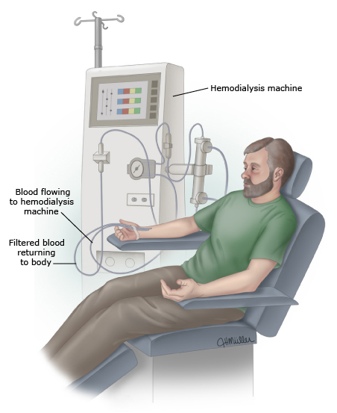
Hemodialysis
2 needles are placed in an “access” in the arm
Blood flows to the dialysis machine, is filtered and is returned to the body
3-5hours, 3-7 times per week

Slide 42
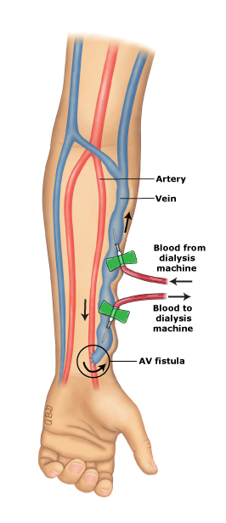
AV fistula
AV graft
Central Venous Catheter

Slide 43
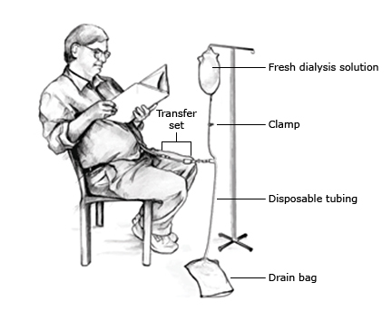
Peritoneal Dialysis
Fresh dialysis solution flows into the person’s belly
It stays there for a period of time and then is drained into a drain bag
A transfer set connects the catheter in the person’s belly to the dialysis equipment

Slide 44
Transplant
New kidney is put in the lower part of the belly
Ureter is hooked up to the bladder
Usually, the old kidneys are left in place

Slide 45
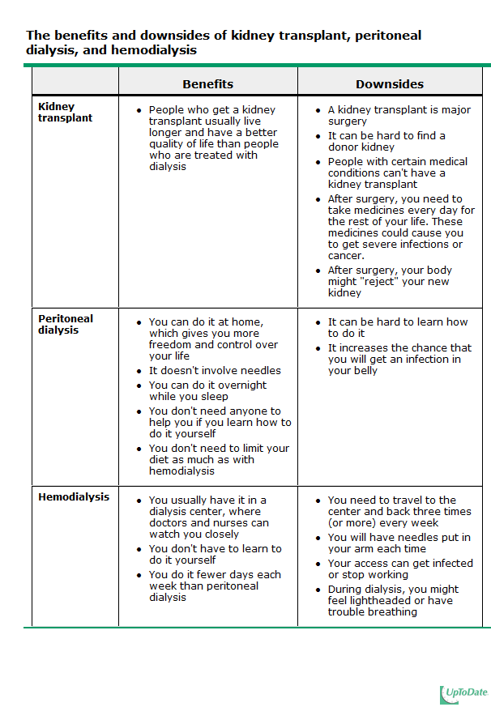

Slide 46
Mortality & Vascular Access
% Survival in diabetics (top) and non-diabetics (bottom)
AVF has significantly less mortality
Dhingra, RK et al. Kidney International (2001) 60, 1443–1451

Slide 47
Patients of Minority Status have a Lower Rate of Starting Dialysis with an AV Fistula

Slide 48
Mortality in ESRD
Hull, AR, Parker, TF III, Am J Kidney Dis 1990; 15:375, and Charra, B, Calemard, E, Ruffet, M, et al, Kidney Int 1992; 41:1286.
Notes:
Five year patient survival rates after the institution of maintenance hemodialysis in the United States (from the US Renal Data System), Europe (from the European Dialysis and Transplant Association), Japan, and Tassin, France. Survival was lowest in the United States and highest in nondiabetics and in Tassin where the patients were more intensively dialyzed.

Slide 49
Mortality in ESRD
Cardiovascular diseases 50%
Infection 15-20%

