Slide 1
URINALYSIS
ACADEMIC HALF DAY
8 October, 2024
Erin Biringen, MD
Erin.Biringen@bannerhealth.com

Slide 2
Objectives
1. Describe the appropriate urine specimen collection and storage in ambulatory patients and hospitalized patients with Foley catheters in order to accurately interpret the urinalysis.
2. List the possible causes of urine that is cloudy, orange, brown, or red.
3. Predict how the urinalysis will appear in disorders of volume and tonicity.
4. Describe the conditions associated with the following urine casts: Hyaline, Erythrocyte, Leukocyte, Epithelial, Granular, Fatty.

Slide 3
Specimen Collection
Avoid exercise 72 hours prior – trauma increases proteinuria and hematuria
Avoid contamination
Males – retract foreskin
Females – separate labia and cleanse periurethral area with sterile wipe
Midstream “clean catch” collection or bladder catheterization
Avoid culture of bag specimen

Slide 4
Specimen Processing
Prompt processing – should be tested within 1 hour of voiding to minimize breakdown of formed elements
Macroscopic exam – color and clarity
Chemical exam - dipstick
Microscopic exam
Centrifuge at 3000rpm for 3-5 minutes
Pour off supernatant
Place sediment on slide for microscopic exam

Slide 5
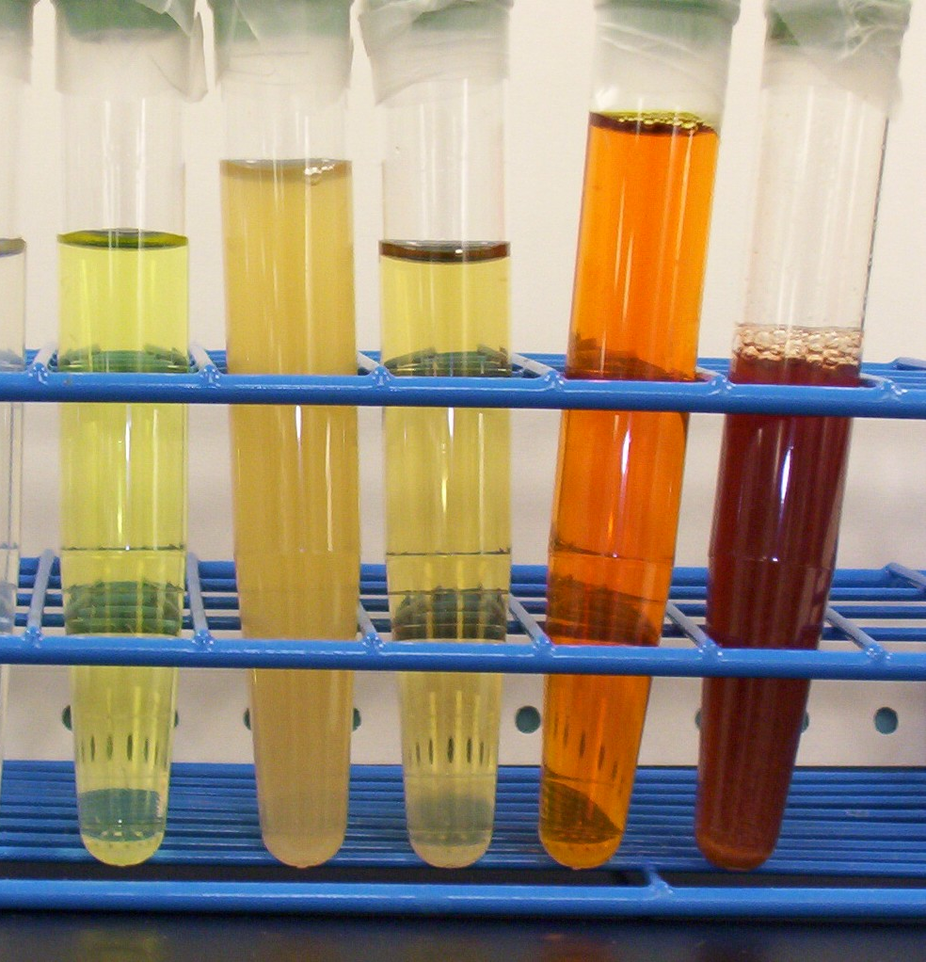
Macroscopic Exam
Color
Lighter: dilute
Darker: concentrated
White: pyuria, lipids, phosphate crystals
Green/blue: methylene blue, amitriptyline, biliverdin
Brown/black: bile pigments, stool from fistula, porphyria, flagyl, macrobid
Red: hemoglobinuria, myoglobinuria, hematuria

Slide 6
Macroscopic Exam: Clarity
Normally clear
Cloudy
Infection
Precipitated phosphate crystals: alkaline urine
Foamy
Proteinuria

Slide 7
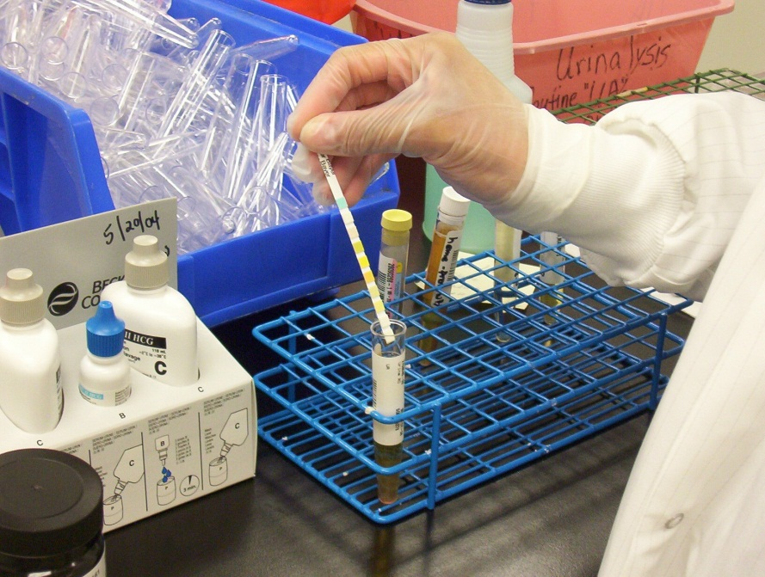
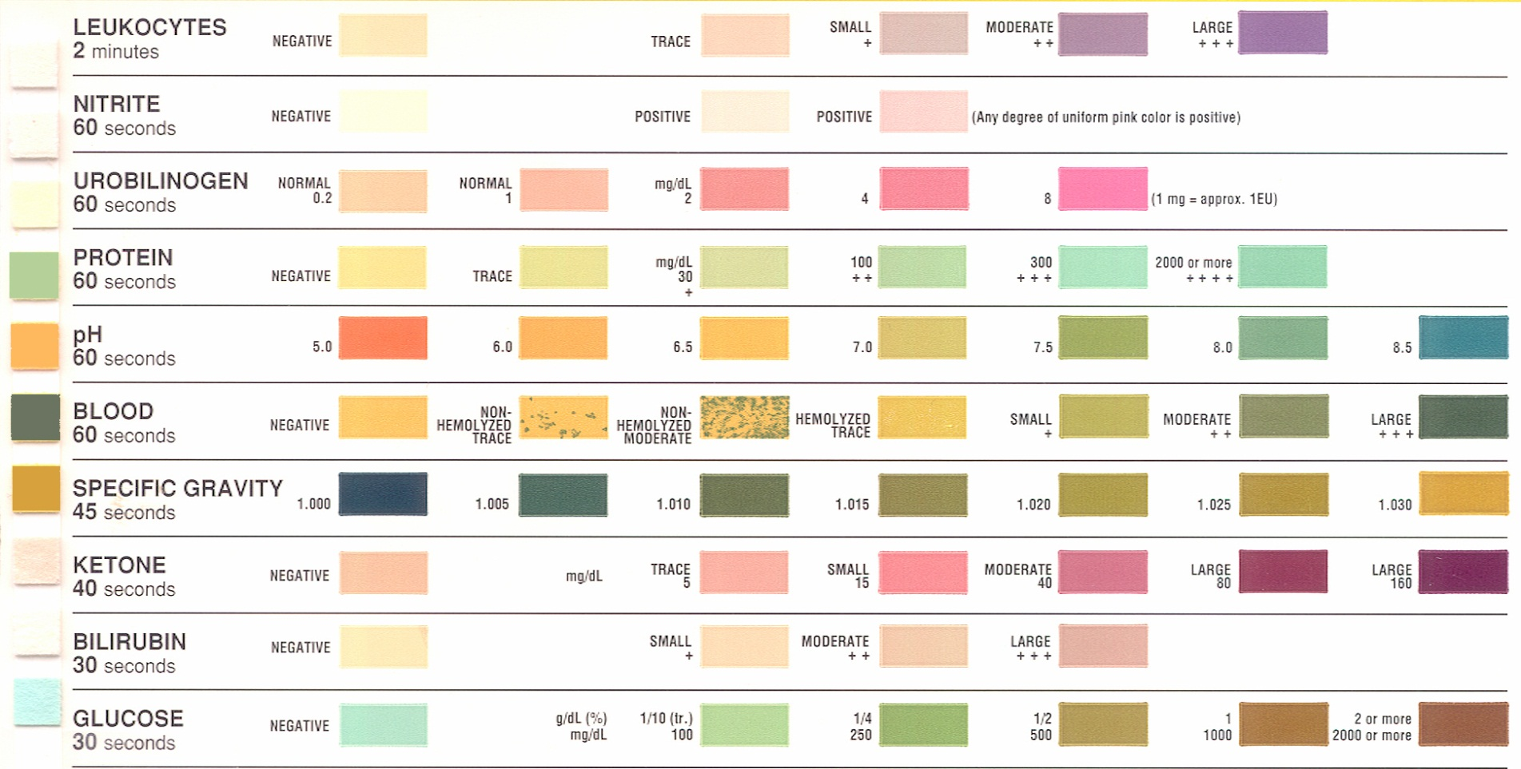
Chemical Exam: Dipstick
Test strip is dipped in urine
The chemical reaction occurs, results in a color change.
Color change is compared against a reference color chart

Slide 8
Components of Urine Dipstick
 | Reference Range | Comments
Specific gravity | 1.005-1.030 | Low: dilute High: concentrated or hypertonic product excretion
pH | 5.5-6.5 | Low: high protein diet High: RTA 1, urease-splitting organisms
Blood | None | Glomerular disease, stones, UTI, tumor
Protein | None | Detects albumin only Glomerular, tubular disorders, UTI
Glucose | None | DM, pregnancy, SGLT2i
Ketones | None | DM, ketosis (starvation) Doesn’t detect acetone or beta-hydroxybutyrate
Nitrites | None | UTI
Leukocyte esterase | None | UTI, STI, inflammatory process Positive if > 5 leukocytes/hpf
Notes:
Need to add

Slide 9
Urine Microscopy
 | Reference Range | Comments
Erythrocytes | 0-3/hpf | Need to evaluate erythrocyte morphology
Leukocytes | 0-3/hpf
Casts | None or hyaline | Hyaline – suggest poor renal perfusion Non-hyaline casts – suggest intrinsic injury
Crystals | None | Occur when urine is supersaturated with a specific substance

Slide 10
CASE 1
You are asked to see a 25-year-old male with head trauma after a motor vehicle accident for evaluation of hypernatremia. He is making 5L of urine per day. Serum sodium 159. You suspect he has central diabetes insipidus. What do you expect his urine specific gravity to be?
1.005
1.010
1.015
1.020

Slide 11
CASE 1
You are asked to see a 25-year-old male with head trauma after a motor vehicle accident for evaluation of hypernatremia. He is making 5L of urine per day. Serum sodium 159. You suspect he has central diabetes insipidus. What do you expect his urine specific gravity to be?
1.005
1.010
1.015
1.020
Central DI
Lack of ADH production
No insertion of aquaporin channels into the apical membrane of the principle cells in the collecting duct.
Water is not reabsorbed
Urine osmolality and urine specific gravity are low.

Slide 12
Specific Gravity
Osmolality
Ratio of the weight of urine to an equal quantity of water
Normal 1.010
Can use to estimate urine osmolality
1.010 correlates with urine osmolality ~ 300mOsm/kg H2O
To maintain plasma osmolality (# of particles/unit mass) near 285 mOsm/kg the kidney varies urine osmolality from 50 to 1200 mOsm/kg
Urine osmolality is useful when correlating it with the clinical state of the patient
Falsely elevated: high glucose, toxins

Slide 13
CASE 2
A 54-year-old woman with Sjogren Syndrome comes to the office for evaluation of nephrolithiasis. Her potassium is 3.2, bicarbonate 12.
What is a possible diagnosis?
What do you think her urine pH will be?
4.5
5.0
7.5

Slide 14
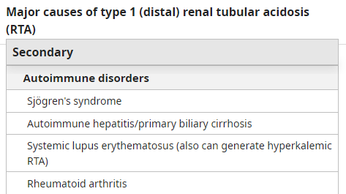
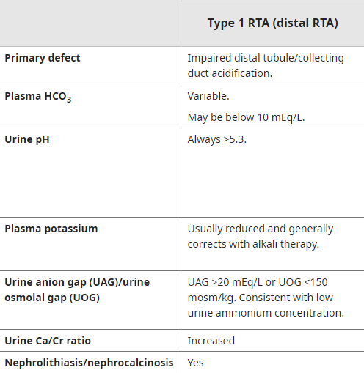
CASE 2
A 54 year old woman with Sjogren Syndrome comes to the office for evaluation of nephrolithiasis. Her potassium is 3.2, bicarbonate 12. What is a possible diagnosis? What do you think her urine pH will be?
4.5
5.0
7.5

Slide 15
Urine pH
Normal may vary, usually 5.5-6.5
Low pH (acidic)
5.0-6.0
Uric acid, cystine, calcium oxalate stones
Acidemia, methenamine
Volume depletion
Alkaline pH (>7.0)
Strict vegetarians can have alkaline urine
Type 1 (distal) RTA
Infections caused by urease-splitting organisms (Proteus and Pseudomonas species)
Alkalemia
Carbonic anhydrase inhibitors

Slide 16
CASE 3
A 70 year old male with a diagnosis of Multiple Myeloma comes to see to you for evaluation of proteinuria. His serum glucose is normal and his urine glucose is elevated.
UA shows proteinuria, negative urine anion gap, and normal pH.
Serum bicarbonate is 14 , K is 3.2, phosphorus is 1.8, and uric acid is low.
Dysfunction of which part of the nephron causes these lab results?
Glomerulus
Proximal tubule
Loop of Henle
Distal tubule
Collecting tubule

Slide 17
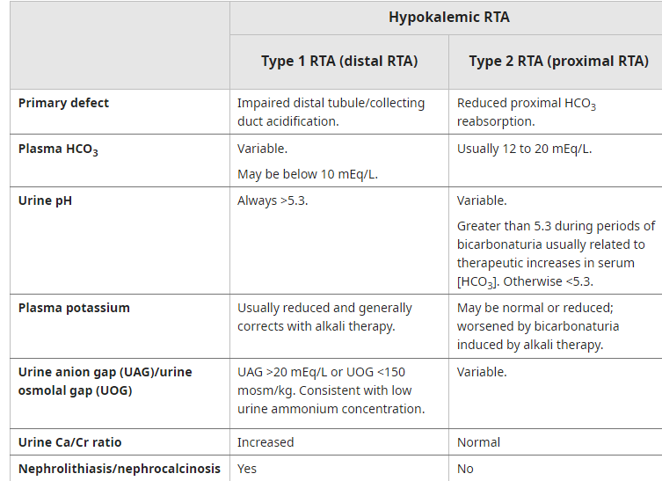
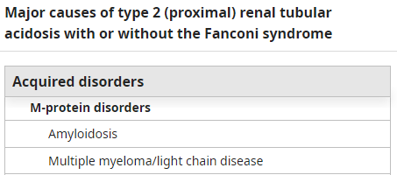
CASE 3
A 70 year old male with a diagnosis of Multiple Myeloma comes to see to you for evaluation of proteinuria. His serum glucose is normal and his urine glucose is elevated.
UA shows proteinuria, negative urine anion gap, and normal pH.
Serum bicarbonate is 14 , K is 3.2, phosphorus is 1.8, and uric acid is low.
Dysfunction of which part of the nephron causes these lab results?
Glomerulus
Proximal tubule
Loop of Henle
Distal tubule
Collecting tubule
Notes:
When blood glucose is >180mg/dL, absorptive capacity of the proximal tubule is exceeded
Fanconi Syndrome – proximal tubular dysfunction (RTA 1)
Glucosuria without hyperglycemia
Low serum phosphate, uric acid, amino acids and bicarbonate

Slide 18
Ketones
Dipstick detects acetoacetate but not beta-hydroxybutyrate
Positive with:
Starvation
Alcoholic ketoacidosis (but sometimes negative when only ketone is beta-hydroxybutyrate)
Diabetic ketoacidosis (dipstick underestimates total ketone excretion, because the main ketone is beta-hydroxybutyrate)
Salicylate toxicity
Isopropyl alcohol poisoning
False positive
Drugs with sulfydryl groups: captopril

Slide 19
CASE 4
A 25-year-old female presents to the hospital with confusion and bruising on her arms and legs. Two days prior she had a diarrheal illness. Labs reveal hemoglobin of 7.5, platelets 16. Peripheral smear shows schistocytes. CK is normal. Creatinine is 3.7.
UA shows no protein, 3+ blood, + urobilinogen, and microscopy shows no erythrocytes.
What is her diagnosis?
Rhabdomyolysis with myoglobinuria
Thrombotic thrombocytopenic purpura with hemoglobinuria
Membranoproliferative glomerulonephritis
Obstructive jaundice

Slide 20
CASE 4
A 25-year-old female presents to the hospital with confusion and bruising on her arms and legs. Two days prior she had a diarrheal illness. Labs reveal hemoglobin of 7.5, platelets 16. Peripheral smear shows schistocytes. CK is normal. Creatinine is 3.7.
UA shows no protein, 3+ blood, + urobilinogen, and microscopy shows no erythrocytes.
What is her diagnosis?
Rhabdomyolysis with myoglobinuria
Thrombotic thrombocytopenic purpura with hemoglobinuria
Membranoproliferative glomerulonephritis
Obstructive jaundice
Hemolytic anemia and TTP
Secondary to diarrheal illness (e. coli)
Schistocytes → hemolysis
UA with blood but no RBC → hemoglobinuria
Heme pigment is toxic to tubular cells -→ ATN

Slide 21
Blood
Dipstick measures peroxidase activity and free heme pigment
>3 erythrocytes/hpf needed for positive result
Blood without erythrocytes
Myoglobinuria (rhabdomyolysis)
Hemoglobinuria (intravascular hemolysis)
False positives
Peroxidase activity: Enterobacter, staph, strep
Chloroquine
False negatives
Ascorbic acid

Slide 22
Hematuria
> 3 erythrocytes/hpf
Microscopic vs macroscopic
Usually nonglomerular and should be investigated further
Glomerular: proteinuria, erythrocyte casts, increased Cr

Slide 23
CASE 6
A 30-year-old man presents to the hospital with severe total body aches after a day of playing basketball outside in Phoenix. His creatinine is 5.6, potassium is 5.9. Hemoglobin is normal. CK is 12,000 . UA shows 3+ blood and no erythrocytes.
What is the most likely diagnosis?
Rhabdomyolysis with myoglobinuria
Consumption of too many beets
Acute renal colic from nephrolithiasis
Renal cell carcinoma
Lupus nephritis

Slide 24
CASE 6
A 30-year-old man presents to the hospital with severe total body aches after a day of playing basketball outside in Phoenix. His creatinine is 5.6, potassium is 5.9. Hemoglobin is normal. CK is 12,000 . UA shows 3+ blood and no erythrocytes.
What is the most likely diagnosis?
Rhabdomyolysis with myoglobinuria
Consumption of too many beets
Acute renal colic from nephrolithiasis
Renal cell carcinoma
Lupus nephritis
Rhabdomyolysis: breakdown of muscle
UA with blood, no erythrocytes → rhabdo or hemolytic anemia
High CK → rhabdo
Myoglobin is filtered by the kidneys → toxicity to renal tubules → ATN
Cellular lysis from muscle injury: hyperK, hyperPhos

Slide 25
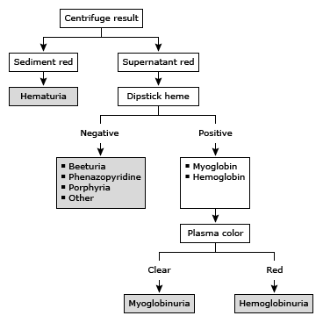
Evaluation of Red/Brown Urine

Slide 26
Leukocyte Esterase and Nitrites
Leukocyte Esterase
Produced by lysed neutrophils
Positive when >5 leukocytes/hpf present
False negative: concentrated urine, proteinuria, glucosuria
Nitrites
Presence of gram-negative bacteria which convert nitrates → nitrites
Escherichia coli, Klebsiella pneumoniae, Proteus
Does not detect UTI’s caused by nonconverting bugs: enterococcus, staph, strep, haemophilus
+Leukocyte esterase and + nitrites on urine dipstick highly suggestive of UTI
Absence of BOTH has high negative predictive value for UTI

Slide 27
Bilirubin
Formed from the breakdown of hemoglobin in the spleen; bound to albumin transported to liver via blood (unconjugated, insoluble can’t be filtered by kidney)
Bilirubin then is conjugated in liver and excreted via bile duct in duodendum
Very small amount of conjugated bilirubin may be reabsorbed and filtered by the kidney if plasma levels are high.

Slide 28
Bilirubin
Conjugated bilirubin should not be found in urine when serum bilirubin is normal
Severe liver disease (early sign, even if serum bilirubin is normal)
Obstructive jaundice

Slide 29
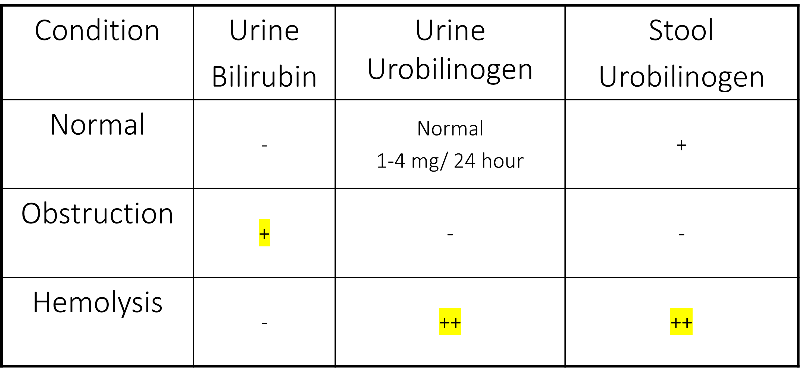
Urobilinogen
Produced in the gut from metabolism of bilirubin → urobilinogen
Urobilinogen absorbed via portal circulation, traced amounts excreted in urine
Elevated level in urine and stool: hemolytic anemia
Decreased level in urine and stool: biliary obstruction, severe cholestasis (because bilirubin does not reach the bowel to be metabolized into urobilinogen)

Slide 30
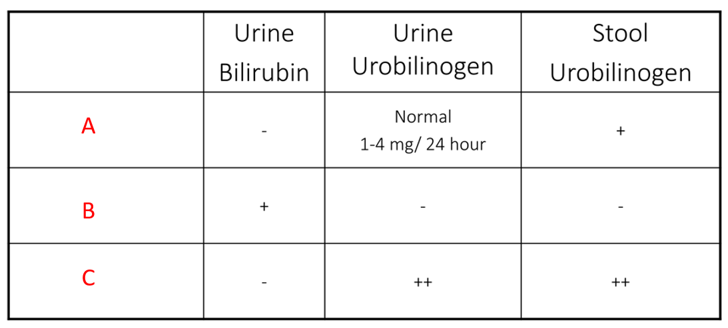
Match the scenario to the expected results
Gallstone obstructing the common bile duct
Liver cirrhosis
Hemolytic anemia after a diarrheal illness

Slide 31
Match the scenario to the expected results
Gallstone obstructing the common bile duct
Liver cirrhosis
Hemolytic anemia after a diarrheal illness

Slide 32
Match the scenario to the expected results
Gallstone obstructing the common bile duct
Liver cirrhosis
Hemolytic anemia after a diarrheal illness

Slide 33
Match the scenario to the expected results
Gallstone obstructing the common bile duct
Liver cirrhosis
Hemolytic anemia after a diarrheal illness

Slide 34
Match the scenario to the expected results
Gallstone obstructing the common bile duct
Liver cirrhosis
Hemolytic anemia after a diarrheal illness

Slide 35
Match the scenario to the expected results
Gallstone obstructing the common bile duct
Liver cirrhosis
Hemolytic anemia after a diarrheal illness

Slide 36
Urine Microscopy

Slide 37
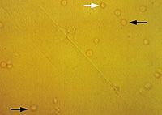
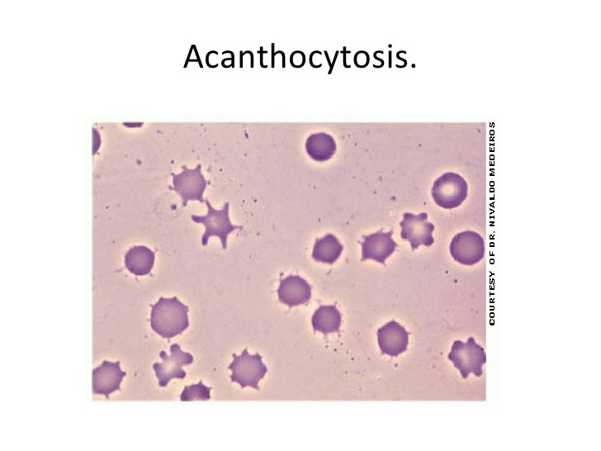
Erythrocytes
Causes:
Glomerular injury
Genitourinary tract bleeding
Isomorphic– urologic process
Dysmorphic – glomerular process
Notes:
Isomorphic: urologic process
Stone
Tumor
Infection

Slide 38
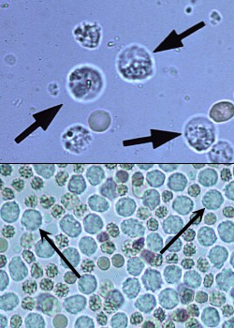
Leukocytes
Pyuria: > 5 leukocytes/hpf
Sterile pyuria: leukocytes in the urine with negative urine bacterial culture
Acute Interstitial Nephritis
Vaginitis, cervicitis, prostatitis
Stones
Renal transplant rejection
UTI due to chlamydia, myobacterium, ureaplasma

Slide 39
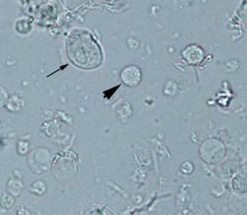
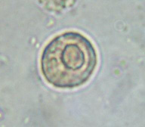
Epithelial Cells
Renal tubular epithelial cells
Large central nuclei
1.5-3 x larger than leukocytes
ATN
Transitional epithelial cells
Larger than tubular epithelial cells
Originate anywhere from renal pelvis to proximal urethra
Squamous epithelial cells
Large and irregular with small central nuclei
Originate from distal urethra or external genitalia
Suggests urine contamination

Slide 40
Eosinophils
Causes
UTI
Allergy
Atheroembolic disease
Small vessel vasculitis
Rapidly progressive glomerulonephritis
Parasitic infections – urinary schistosomiasis
Poor sensitivity and specificity limit its utility

Slide 41
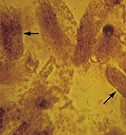
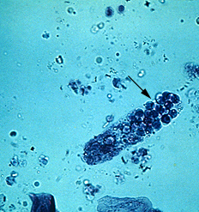
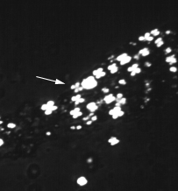
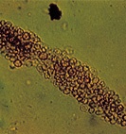
CASE 5
A 14-year-old boy comes to your office for evaluation of periorbital edema and leg swelling. Creatinine is 0.5. Urinalysis has 4+ protein and no blood. The urine is foamy.
On microscopy, which casts are you most likely to see?
Notes:
This patient has nephrotic syndrome with high grade proteinuria from Minimal Change Disease. Nephrotic syndrome causes hyperlipidemia and lipiduria. Fatty casts formed by the breakdown of lipid-rich epithelial cells are seen with nephrotic syndrome. Fatty casts have a Maltese Cross appearance under polarized light.

Slide 42
Casts
Made of Tamm-Horsfall protein, cells or cellular debris, or lipoprotein droplets
Cylindrical: form in distal tubular lumen

Slide 43
Hyaline casts
Not indicative of disease
Seen with diuretic therapy or with small volumes of concentrated urine

Slide 44
Red Blood Cell Casts
Diagnostic of glomerulonephritis or vasculitis

Slide 45
Leukocyte Casts
Seen with AIN or acute pyelonephritis

Slide 46
Muddy Brown Casts (pigmented/granular)
Tubular cell debris (ATN)

Slide 47
Fatty Casts
Nephrotic syndrome
Maltese Cross appearance under polarized light.

Slide 48
Crystals
Type | Morphology | Comment
Calcium Oxalate | Envelope Dumbell | Not pH dependent Ethylene glycol ingestion
Uric Acid | Amorphous Rosettes Needles | Acid urine, pH <5.8 Polarize light
Calcium Phosphate | Amorphous | Alkaline urine Resemble amorphous uric acid
Triple phosphate (Magnesium ammonium phosphate) | Coffin lid | Alkaline urine Struvite stones
Cystine | Hexagonal plates | Acidic urine Cystinuria
Indinavir | Needle

Slide 49
Calcium Oxalate Crystals
More likely to be formed in acidic urine (pH 4.5-5.5)
Seen with ethylene glycol ingestion
Monohydrate-dumbell
Dihydrate-letter envelope
Polarized monohydrate

Slide 50
Uric Acid Crystals
Are seen in an acidic urine pH 5.4-5.8
Polarize light

Slide 51
Calcium Phosphate Crystals
Form in alkaline urine
Polarize light

Slide 52
Calcium Phosphate Crystals-Amorphous
Only form in a relatively alkaline urine (6.2-7.0)
Do not polarize light
Resemble amorphous uric acids but don’t polarize light

Slide 53
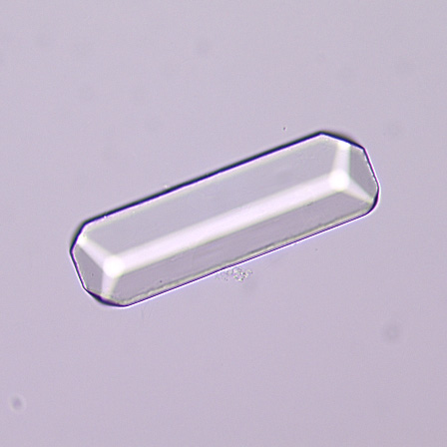
Triple Phosphate Magnesium ammonium phosphate
Crystals of triple phosphate
colorless, “coffin-lid” prism
Only form in alkaline urine (pH >7.0)
Component of struvite stones

Slide 54
Struvite
Magnesium ammonium phosphate crystals — (struvite)
Normal urine
undersaturated with ammonium phosphate
Stone formation – 2 requirements
1. struvite stone formation occurs only when ammonia production is increased
2. the urine pH is elevated to decrease the solubility of phosphate.
Both of these requirements may be met when urinary tract infection occurs with a urease-producing organism, such as Proteus or Klebsiella.

Slide 55
The Cystine crystals
Are diagnostic of Cystinuria
Precipitate in acidic urine (pH <6.0)

Slide 56
Crystals Due to Drugs
Amoxicillin Crystal Indinavir Crystal

