Slide 1
Welcome to the Academic PACT!
Medical Director: Alvin Gibson Wong, MD
Staff: E. Paul Cherniack, MD
Chief Residents of Quality & Patient Safety: Ahsan Kamal, MD
PACT RN: Mary Viana, Stephanie Bowles
PACT LPN: Lizzette Mills, Joshua Otis
PACT MSA: Andrey Hansen

Slide 2
Orientation Objectives
Pick up a VA-issued laptop (if not done already)
Meet you PACT Team
Describe the general clinic flow and best practice
Describe a typical clinic day
Describe who to notify if you are late or calling out
Use CPRS for a regular clinic visit
Use GUI to check schedules
Explain the concept of Secure messaging and how to respond
Start a Phone and a Video Clinic Visit

Slide 3
Orientation Agenda
12:00-1:00
Lunch/Meet & greet in 4S Pod C Area
01:00-02:00
4 South conference room 4C-115, 4C-116
Orientation slide show
2:00-2:15
Break
2:15-2:45
32nd St Clinic Tour
2:45-4:00
In Groups of 3-4 go through the checklist
Dr. Wong
Dr. Hofmeister
Dr. Khoury
Dr. Biringen

Slide 4
Orientation Checklist
Look at the orientation checklist

Slide 5
What is PACT?
PACT = Patient Aligned Care Team
Who is on the PACT Team?
RN = Danielle Garcia, Stephanie Bowles
LPN = Lizette Mills, Joshua Otis
MSA = Audrey Hansen
PCMHI = Primary Care Mental Health Integration = Team of social worker, RN, psychologists & psychiatrists, first place to discuss mental health for your vet!
Leader: Dr Brendt Parrish
APACT PCMHI lead: Ashley Fanara
Team Pharmacist = Dr Celyna Koopmann
Pharmacist for Dr. Cherniack = Dr. Alexandra Stich
Social worker = Dwayne de la Pena
Nutritionist = Nora Hall
AND YOU!

Slide 6
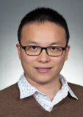
Who's Who?
Dr Alvin Gibson Wong
Academic PACT Director
Director of Quality Improvement and Patient Safety
TBD
Supervising Attending

Slide 7
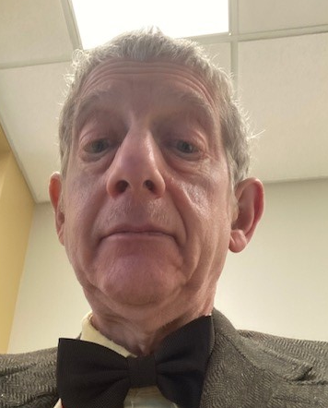
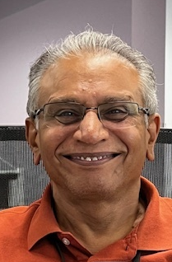
Who's Who?
Dr Paul Cherniack
Supervising Attending
Dr Kirit Patel
Supervising Attending

Slide 8
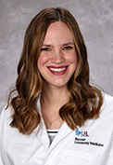
Who's Who?
Dr. Carolyn Hofmeister
Supervising Attending
Traditional Chief Resident

Slide 9
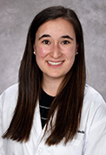
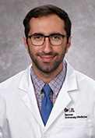
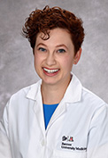
Who's Who?
Dr. Erin Biringen
Supervising Attending
Chief Resident of Quality and Patient Safety
Dr. Fadi Khoury
Supervising Attending
Chief Resident of Quality and Patient Safety
Dr. Miriam Robin
Supervising Attending
Chief Resident of Quality and Patient Safety

Slide 10
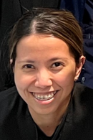
Who's Who?
RN Danielle Garcia
RN Stephanie Bowles
LPN Lizette Mills

Slide 11
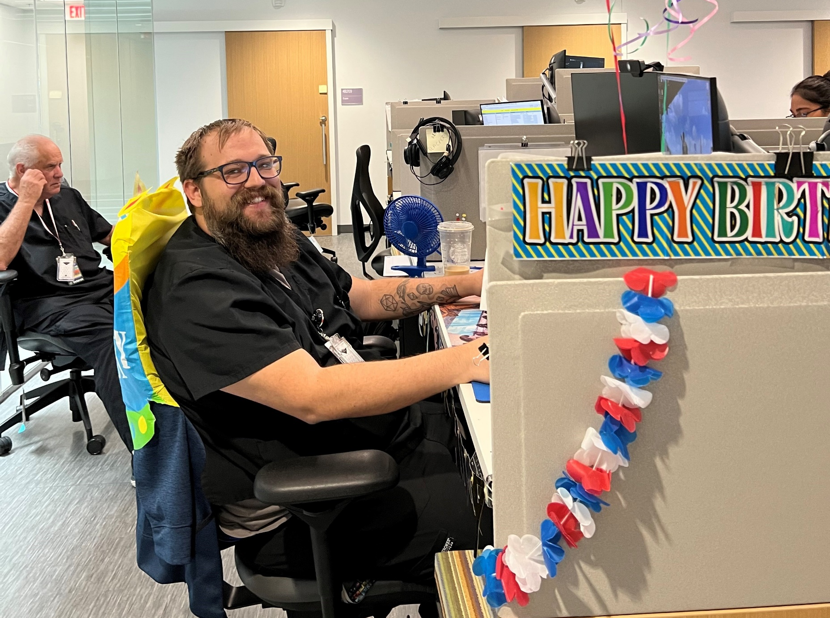
Who's Who?
LPN Joshua Otis

Slide 12
Who's Who?
MSA – Audrey Hansen

Slide 13
Who’s Who?
Dr. Celyna Koopmann – PACT/WH Clinical Pharmacist
Conditions pharmacy manages:
DM, HTN, HLD, smoking cessation, weight loss medications, COPD, gout, hypothyroid, women’s health (pregnancy, contraception, etc.)
How to alert pharmacy to follow up with a patient:
Add as additional signer to CPRS note
Teams message

Slide 14
Who's Who?
APACT Social Worker: Dwayne de la Pena
What is a Social Worker? What do they do?
Resource broker- i.e., housing, placement, financial, community/VA benefits or services, legal, end-of-life planning including Goals of Care discussions, creation of Advance Directives/Living Wills
How to contact: Microsoft Teams!
If social work services are desired, please alert via CPRS (addendum to your note specifically detailing what is being asked of SW is helpful).
Consults for social work can be placed but I do prefer just a regular alert/cosign.
Do: Feel free to teams SW with questions or to staff a Veteran. SW is always happy to answer questions for providers. We are a team.
Don’t: Make promises to Veterans that “social worker can help this.” A more appropriate thing to say might be “Can I place a referral to our social worker, who may have some resources to assist you?”

Slide 15
A Track | B Track | VA Clinic Day
MA1 – Dr. Matthew McClintock | MB1 – Dr. Anurag Borah | Mondays all day
MA11 – Dr. Austin Huang | MB11 – Dr. Jay Wegman
MA22 – Dr. Stephanie (Nguyen) Pham | MB22 – Dr. Elizabeth Cogdell
MA3 – Dr. Daniel Windschill | MB3 – Dr. Ahsan Ahmad
WA1 – Dr. Austin Nickell | WB1 – Dr. Diwanshu Soni | Wednesdays all day
WA2 – Dr. Majd Aboona | WB2 – Dr. Giovanni Sassano
WA22 –Dr. Hayley Specht | WB22 – Dr. Katherine Hersom
WA3 – Dr. Jasmine Gill | WB3 – Dr. Victoria Ramirez
RA1 – Dr. Irina Adao | RB1 – Dr. Courtney Civelli | Thursdays all day
RA2 – Dr. Nicole Boardman | RB2 – Dr. Allen Yu
RA3 – Dr. Aaron Flegenheimer | RB3 – Dr. Ralph Mendez
FA1 – Dr. Meagan Hanson | FB1 – Dr. Mark Betonio | Fridays all day
FA2 – Dr. Leith Ghani | FB2 – Dr. Alec Barlett

Slide 16
Attendings
A Track | B Track
MA1 – Dr. Matthew McClintock | MB1 – Dr. Anurag Borah | Dr Patel (Team 1)
MA11 – Dr. Austin Huang* | MB11 – Dr. Jay Wegman*
MA22 – Dr. Stephanie (Nguyen) Pham | MB22 – Dr. Elizabeth Cogdell
MA3 – Dr. Daniel Windschill | MB3 – Dr. Ahsan Ahmad
WA1 – Dr. Austin Nickell | WB1 – Dr. Diwanshu Soni | Dr. Cherniack (Team 2)
WA2 – Dr. Majd Aboona | WB2 – Dr. Giovanni Sassano
WA22 – Dr. Hayley Specht | WB22 – Dr. Katherine Hersom
WA3 – Dr. Jasmine Gill | WB3 – Dr. Victoria Ramirez
RA1 – Dr. Irina Adao | RB1 – Dr. Courtney Civelli | Dr. Wong (Team 3) [* = work under Dr Cherniack]
RA2 – Dr. Nicole Boardman | RB2 – Dr. Allen Yu
RA3 – Dr. Aaron Flegenheimer | RB3 – Dr. Ralph Mendez
FA1 – Dr. Meagan Hanson | FB1 – Dr. Mark Betonio | May staff with Chief Residents
FA2 – Dr. Leith Ghani | FB2 – Dr. Alec Barlett

Slide 17
Typical Clinic Day
Expectation is that you are at your desk and logged in before 8am to review that day's patients - looking at the charts the night before also helps! Find a workspace in the team area, connect your VA-issued laptop to the hub, and please sign into Microsoft Teams!
0800-0845: Review your schedule, patients' charts & prep your notes (if not already done); process view alerts (if you are logging in 3x/week this shouldn't be too many day of); clear mailbox

Slide 18
Typical Clinic Day
0845: Clinic Huddle (in person)
VA/Residency updates, review your patients and ask your attending any questions with about the day
1-2 MKSAP Questions
0900-1200: Seeing patients
You will have a mix of F2F and virtual appointments
1200-1300: Lunch, alerts, notes, didactics
1300-1600: Seeing patients
1630: Wrapping up
notes, staffing etc, be sure to place your completed paperwork in the fax or scan folder, check out with your attending to communicate and ensure all work done for the day!
Please make sure that you leave the clinic by 18:30 (or the gate will be locked!)

Slide 19
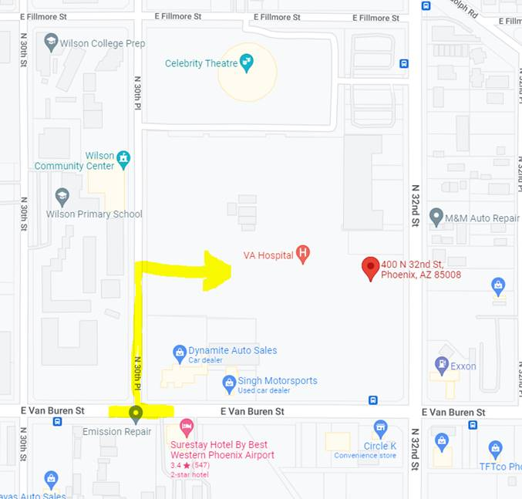
P32VAC Onsite Parking

Slide 20
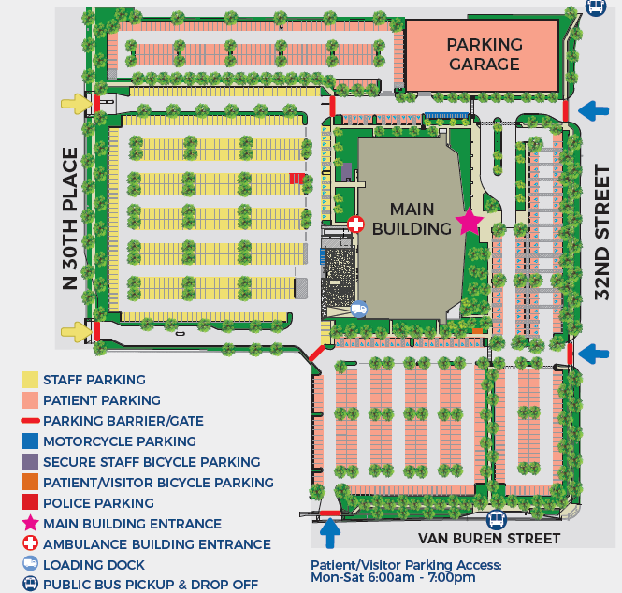
P32VAC Onsite Parking

Slide 21
View from 30th Place

Slide 22
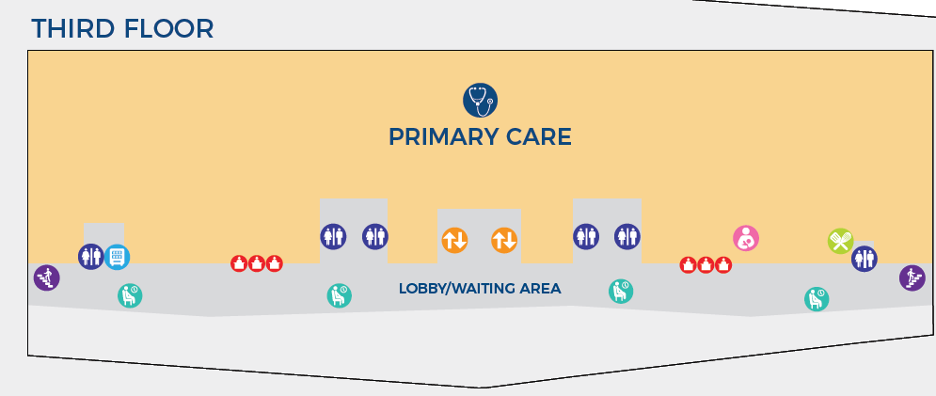
P32VAC Interior Wayfinder
N
4 South/4 Charlie

Slide 23
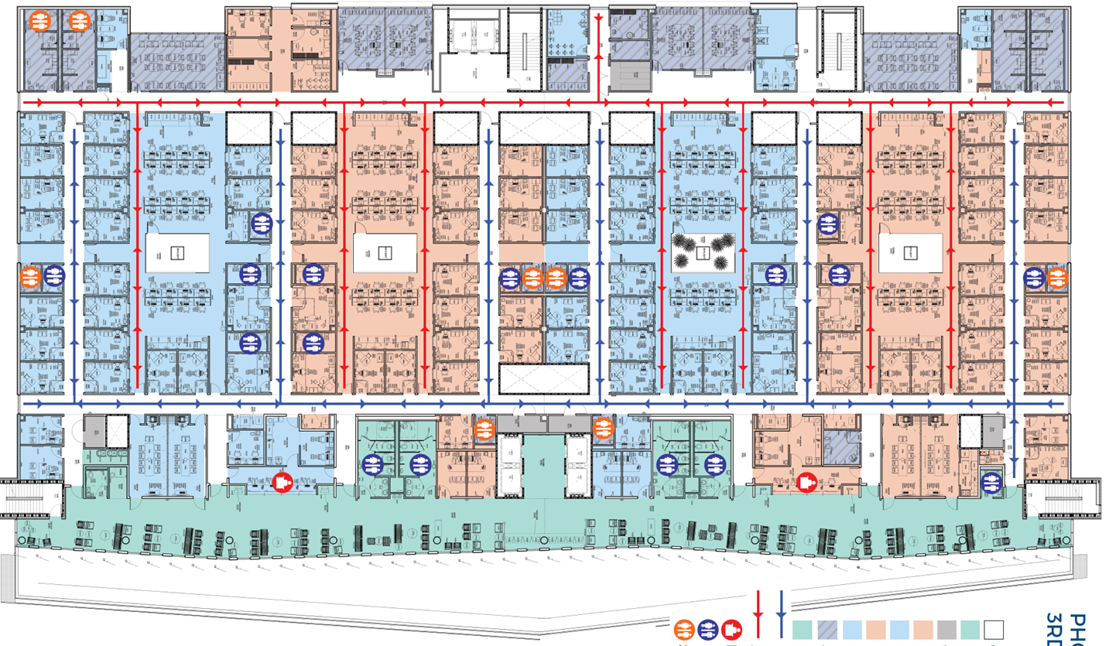
Interior Wayfinder
N

Slide 24
Patient flow
Patient arrives to the front desk
MSA – checks-in patient at the front desk
LPN – check vitals, gives vaccines, complete clinical reminders and room patient to an available room
LPN will alert resident through Microsoft Teams or in-person where the patient is roomed
Resident sees the patient promptly

Slide 25
Patient flow
Residents staff with attending (PGY-1, first 6 months)
Attending sees patient and verifies history and physical
Residents review plan with patient including timing of next visit
Residents check GUI for open clinics slots, enters all orders and Return to Clinic (RTC) order before patient leaves. Please make sure patient RTC has correct resident clinic. Ex: PHX-32ST PACT ACA Res RB1
MSA to schedule patient for follow up
Attempt to have orders completed prior to leaving so after visit summary is updated

Slide 26
Remember to place RTC orders!

Slide 27
If your patient is no-show...
Call your patient twice
If your patient picks up the phone
If clinically appropriate, you can ask if your patient would like to switch the appointment to a phone appointment
If you can’t connect with your patient
Leave a secured VM to their voicemail to encourage them to reschedule
Please sign a "missed appointment note"
Tag the MSA on CPRS asap so the MSA can mark the visit as "No show"

Slide 28
During a Patient Encounter
See patient
Staff with your attending
Your attending comes into the clinic room with you to confirm the H&P with your patient, and discuss with your patient about the modifications to your plan
Discuss with your patient when you would like your patient to return for follow-up
Confirm with your patient which modality you would like your follow-up visit – face-to-face, video or phone (with GUI)
Avoid bringing your patient back just for lab/imaging follow-up (unless it is a significant result). You can send an automated lab letter or write an imaging results letter to your patient if the result is normal
Try to document as much while talking to the patient as you can. However, if your next patient has arrived, put in the orders for your current patient and then move on to your next patient.
Complete clinical reminders
You can finish your note at the end of clinic day

Slide 29
Clinical Reminders

Slide 31
Must Do Clinical Reminders
+PTSD/Depression
+EtOH use
Toxic Exposure Screening
+Suicide Risk
Teratogenic Medications
Lactation Status

Slide 32
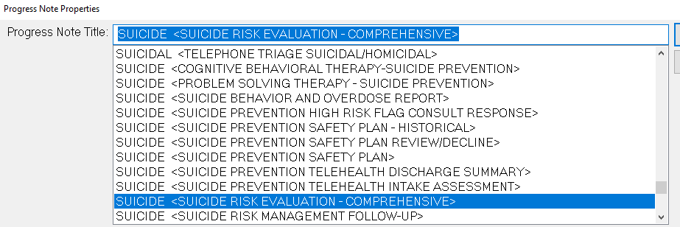
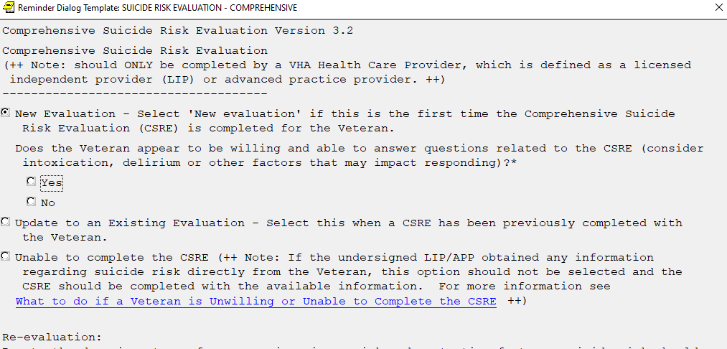
Patient who has screened positive for SI
New Note ->

Slide 33
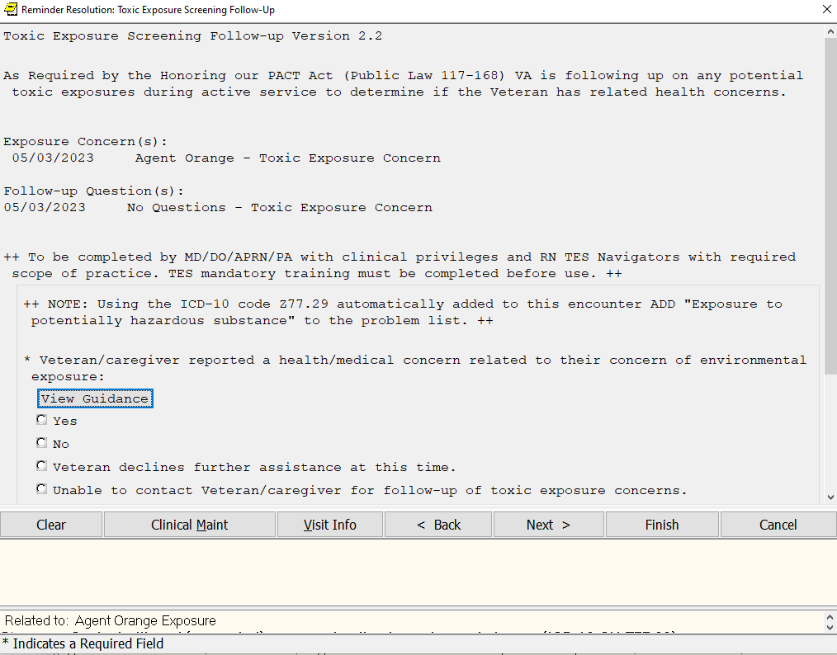
Patients who is positive for TES

Slide 34
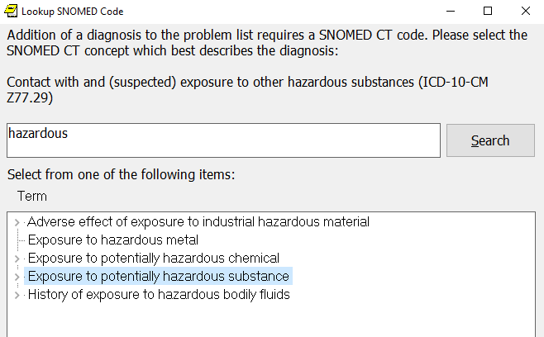
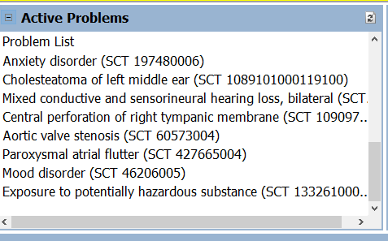

Slide 35
Patient Self Referral/Direct Scheduling
Nutrition
Audiology
Eye Clinic
Podiatry
Social Work
Wheelchair
MOVE!
Physical Therapy
Smoking Cessation
Social Work
Amputee
Your patients need to call the VA themselves to set up an appointment. No consults are needed.
The number they will call is:
602-277-5551 extension 5314

Slide 36
Traveling Veteran Coordinator Consult
If your patient is traveling elsewhere in the country for an extended period of time, and while they are traveling, they need medical care at another VA (labs, consults, PCP appt)
Tips: you can always conduct a phone visit or a VVC visit with your patients while they are traveling within the US Territories. It’s much easier to manage your own patients than a provider who doesn’t know your patient at all and having limited record taking care of them
Place a TVC consult
You will need your patient’s destination address, phone number, and their dates of their stay

Slide 37
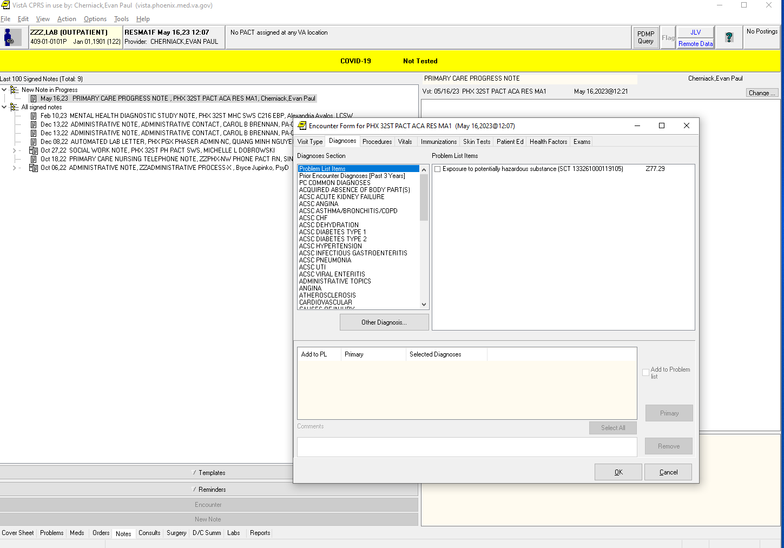
Documentation-Include a diagnosis
Coding

Slide 38
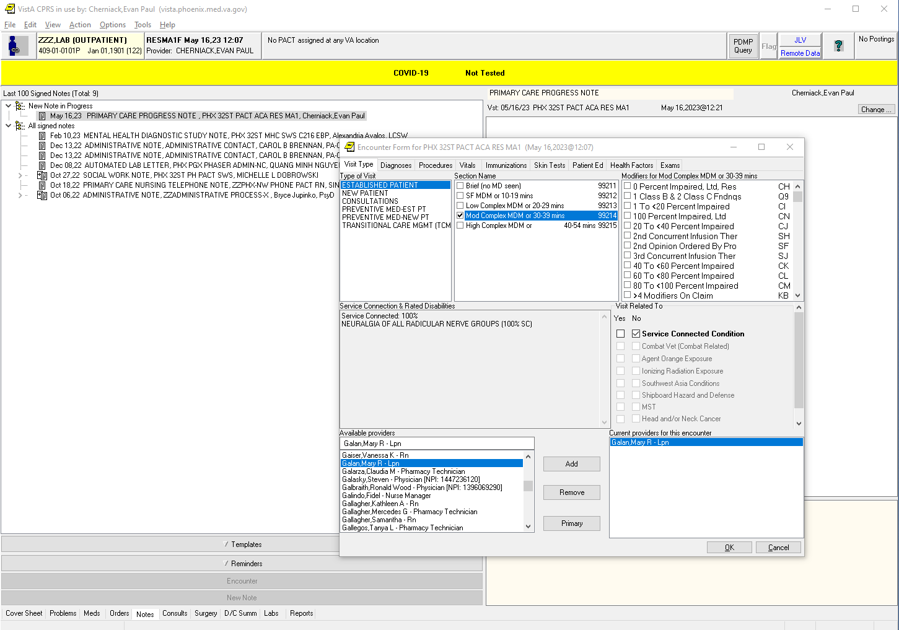
Documentation: Add a provider, visit type and CHECK BOX for service-connected queries
Coding

Slide 39
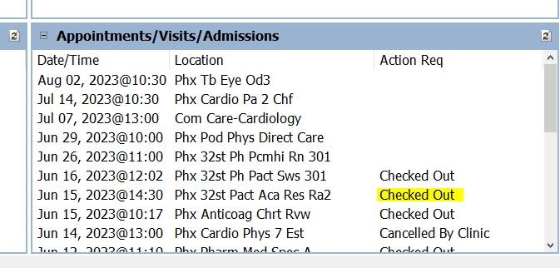
Closed Encounter
Action Required

Slide 40
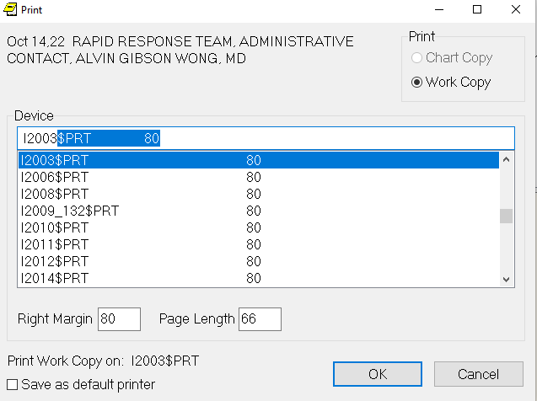
Communicating Test Results
Mammogram
Use “Mammogram Review Results” note
PAP Test
Use “PAP Review Results” note
Tele-eye (coming)
Use “Automated Tele-eye Letter”
Lab results
Sign automated lab letters
Ok to add comment
Letter to Patient
File -> Print -> select i2003

Slide 41
Before leaving the clinic...
Please complete your notes on the same day of the clinic visit
Please complete all the clinical reminders of your patients
If you need to leave before you finish your notes
please close all the encounters before you leave and complete your notes within 24 hours
Confirm on CPRS the coversheet shows each encounter is “CHECKED OUT”
this means you completed the billing and coding
CPRS alerts should be empty of alerts

Slide 42
Before leaving the clinic...
If you are switching rotations or going on a vacation, please discuss with your attending about your notification management plan
Make your practice partner your surrogate
Sign out to your practice partner either verbally or in through email about things to follow-up on
Check out with your attending before you leave for the day
You are expected to stay until at least 4pm regardless of your afternoon clinic schedule
If you have some down time, please work on your alerts, patient panel management, QI project or your PEAC modules

Slide 43
Responsibilities of a Resident PCP
YOU are your patient’s PCP!
Own all aspects of patient care for YOUR patient!
Your attendings are here to help
Practice agenda setting
Practice motivational interview
Educate your patients
Be sensitive to your patients’ right not to take your advice
Develop your OWN assessment/plan prior to staffing
You will get better as you continue to make educated guesses
When it doubt, please ask!

Slide 44
Responsibilities of a Resident PCP
Follow up important tasks*:
Test results
If you ordered a test, you are responsible for communicating it to your patient
If you can’t call your patient, you will need to find another way to communicate the results
The I-2003 printer
Automatic lab letters
Secure messages (via LPN)
Assign a team member to assist
Sick patients who did not show up for visit & or recently hospitalized
Get help from your staff!
Coordinate care with your PACT!
Log in to CPRS at least 3x/week to clear clinical alerts

Slide 45
When you have a schedule change
We are trying our best to set up your schedules, but mistakes can still happen
It is YOUR job to make sure your clinic schedules are accurate (on AMION and GUI)!
Especially you are coming off from night float the last day of your last rotation
When you make plans, there may be potential schedule conflicts that may affect your clinic. They must be approved by the your clinic attending and the chief residents in advance*!
*SPECIAL REQUEST FORM—when in doubt, fill it out!
All vacation and schedule change requests, per local Phoenix VA policy, must be submitted at least 45 days in advance

Slide 46
When you have an unexpected schedule change (or discover a schedule error)
Contact Chief Residents ASAP (email for non-urgent sick phone for urgent):
Example – you are post-call on the day of your clinic
You are not scheduled to be in the clinic when you are on a non-ward month
If you need to call out emergently and miss clinic on the same day
Page the chief resident through the sick pager
Contact your attending via Phone Text Messages
Contact your clinic attending when you are
Feeling sick or having a family emergency
Being pulled for back-up
Planning a vacation/interview/conference/professional exam

Slide 47
Attendings’ Phone Number
Attending | Phone Number
Dr. Kirit Patel | 480-241-3965
Dr Paul Cherniack | 786-859-3314
Dr Alvin Wong | 612-600-5804

Slide 48
Special Clinic Schedule during a Ward month
You may have 1-2 inpatient months on your schedule during a clinic month in which you only have afternoon clinics
They will be listed as "Wards (C)-VA" or "Wards (C)-BU" on AMION
Discuss with your wards team this first day of the month that you have weekly afternoon clinics, and establish a PLAN for managing pagers, Teams messages related to Wards and admissions while you are at the clinic!
You DO NOT need to return to the wards after your finish your clinic

Slide 49
No VA clinics on the following federally observed holidays
2024
07/04/2024, Thursday, Independence Day
09/02/2024, Monday, Labor Day
10/14/2024, Monday, Columbus Day
11/11/2024, Monday, Veterans Day
11/28/2024, Thursday – Thanksgiving Day
12/25/2024, Wednesday – Christmas Day
2025
01/01/2025, Monday, New Year's Day
01/20/2025, Monday, Martin Luther King Jr. Day
02/17/2025, Monday, President's Day
05/26/2025, Monday, Memorial Day
06/19/2025, Thursday, Juneteenth
Important!
The highlighted days are VA-only holidays; if you are on service at Banner, you will go to your rotation instead to the clinic. There will be a make-up clinic on Friday of the same week

Slide 50
File a JPSR if you learn about a Patient Safety Event

Slide 51
Notes:
Name as well as when and where the event occurred

Slide 52
644
Notes:
Name as well as when and where the event occurred

Slide 53
Notes:
Event description
Event related to HER
Classification of event (eg near miss)
Event related to Community Care
Was a patient involved?

Slide 54
File a Disruptive Behavior Report if you experienced a disruptive behavior

Slide 55
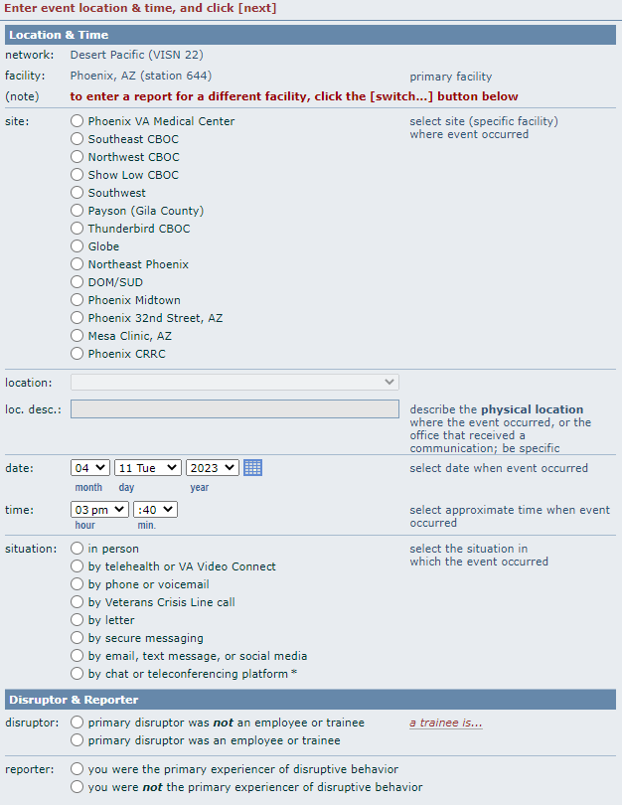
Notes:
Event description
Event related to HER
Classification of event (eg near miss)
Event related to Community Care
Was a patient involved?

Slide 56
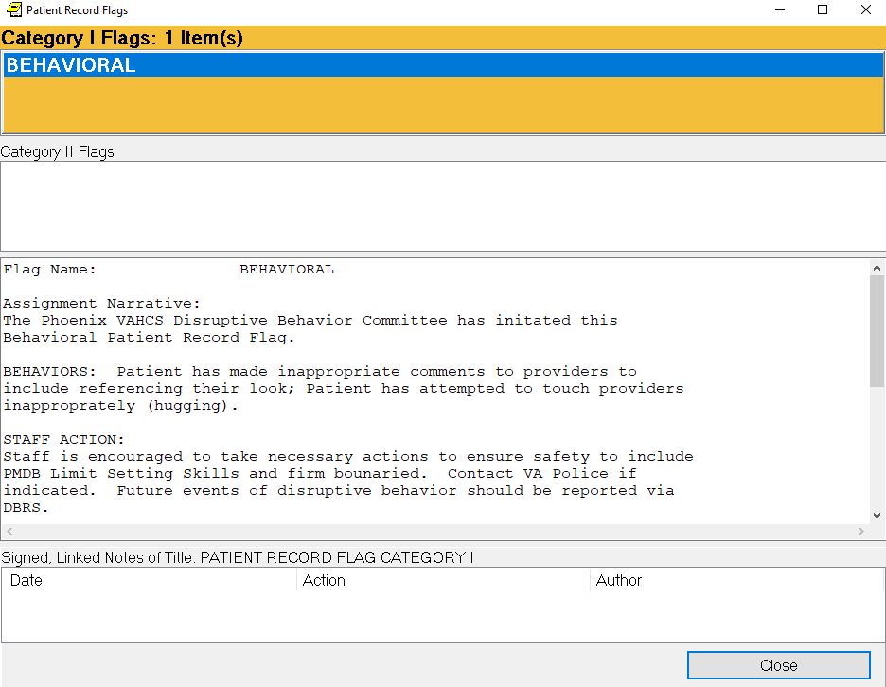
Please read and do exactly what the Patient Record Flag says
Notes:
Event description
Event related to HER
Classification of event (eg near miss)
Event related to Community Care
Was a patient involved?

Slide 57
VA-issued Laptops
If you haven’t signed up for remote access…
https://vaww.ramp.vansoc.va.gov/pages/dashboard.aspx and then click on "Self Service Portal" or...
https://vaww.ramp.vansoc.va.gov/SelfService/Pages/RAUserDetails.aspx?val=UZb1bDIki3NqZqlYX7SMhA==
You will be expected to check your alerts remotely 3x/week - we will get you up to speed during your first clinic month.
Please update your VA-issued laptops once a week (to ensure your computer will continue to work)
We will announce critical updates (if there's any)

Slide 58
Updating your VA-issued Laptop

Slide 59
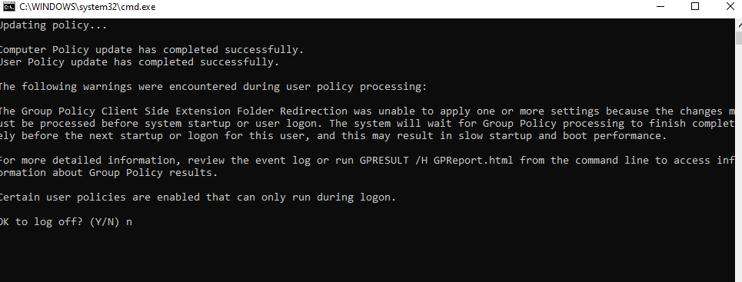
Updating your VA-issued Laptop 1

Slide 60
Updating your VA-issued Laptop 2

Slide 61
Updating your VA-issued Laptop 3

Slide 62
Updating your VA-issued Laptop 4

Slide 63
Questions?

