Slide 1
Hematuria & Nephrolithiasis
Katharine Dahl, MD
kdahl1@arizona.edu
October 22, 2024

Slide 2
Learning Objectives
Define microscopic hematuria and gross hematuria.
Describe the appropriate evaluation for a patient with hematuria.
Understand the risk factors for calcium stones, uric acid stones, struvite stones, and cysteine stones.
Describe the initial evaluation for a patient that presents with a possible kidney stone to make the diagnosis. Understand the indications for urologic interventions.
Describe the medical evaluation for recurrent nephrolithiasis and the medications and dietary changes the may be beneficial to reduce the risk of future events.

Slide 3
Urinalysis
Chemical exam: dipstick

Slide 4
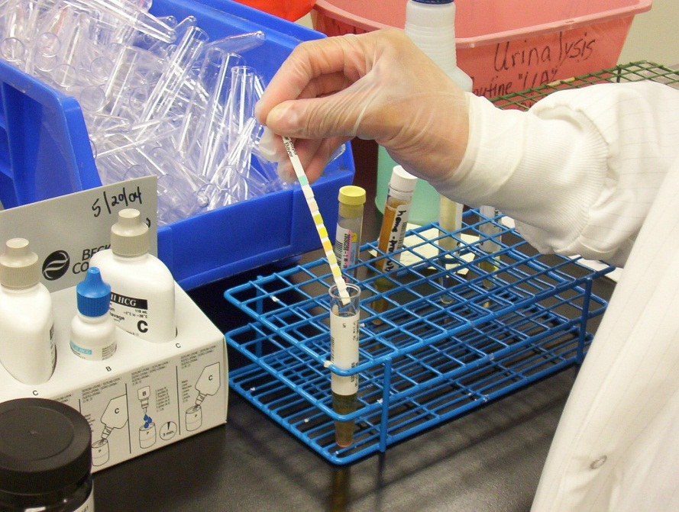
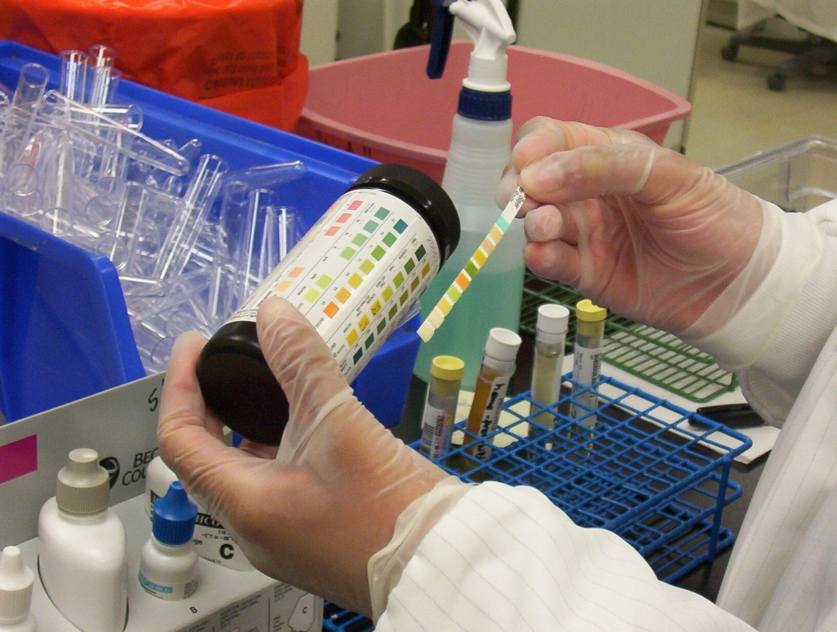
Chemical Exam
Test strip dipped in urine
Reagents activated and a chemical reaction occurs causing color change

Slide 5
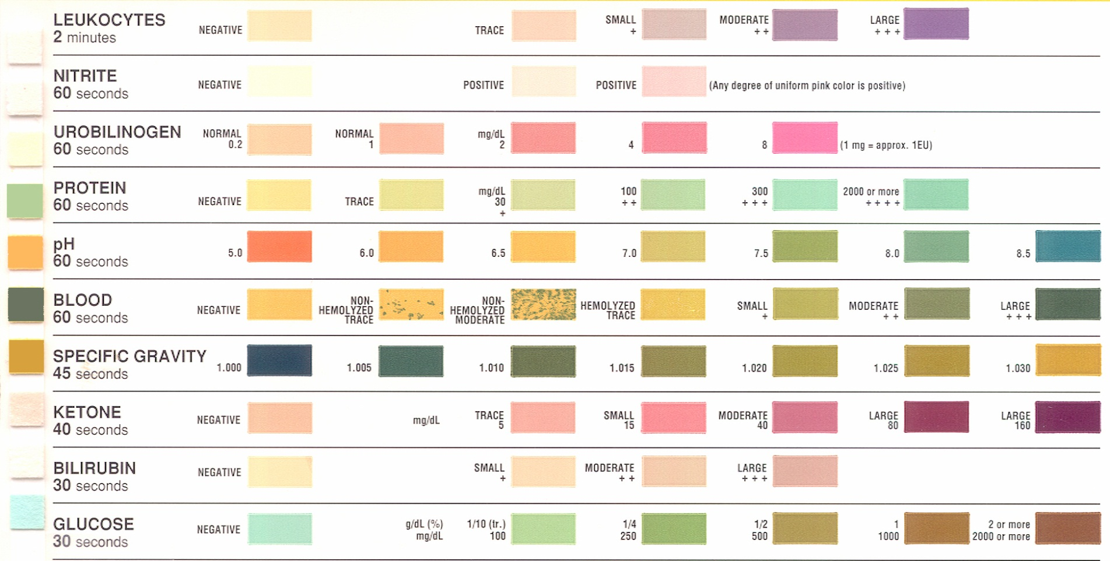
Chemical Reaction Chart

Slide 6
Urine Dipstick
 | Reference Range | Comments
Specific gravity | 1.005-1.030 | Low with dilute, high with concentrated or with hypertonic product excretion
pH | 5.0-6.5 | High with inability to excrete acid load (renal tubular acidosis), urease-splitting organisms
Blood | None | False positives: myoglobin, hemolysis
Protein | None | Dipstick detects albumin, not other proteins False positives: concentrated urine False negative: non-albumin protein
Glucose | None | Positive when plasma glucose >180mg/dL, pregnancy, Fanconi syndrome, SGLT-2 inhibitor
Ketones | None | Detects acetoacetic acid Doesn’t detect acetone or beta-hydroxybutyrate
Nitrites | None | Nitrites converted dietary nitrate by bacteria
Leukocyte esterase | None | Positive if > 3 leukocytes/hpf

Slide 7
Urine Microscopy
 | Reference Range | Comments
Erythrocytes | 0-3/hpf | Need to evaluate erythrocyte morphology - dysmorphic RBCs (glomerulonephritis)
Leukocytes | 0-3/hpf
Casts | None or hyaline | Hyaline – suggest poor renal perfusion Non-hyaline casts – suggest intrinsic injury - RBC casts (glomerulonephritis) - WBC casts (interstitial nephritis, pyelonephritis)
Crystals | None | Occur when urine is supersaturated with a specific substance

Slide 8
Hematuria
Presence of blood or intact cells in the urine
RBC can enter the urine anywhere from the glomerulus to the urethra
Greater than 2 RBC/hpf considered abnormal

Slide 9
Hemoglobinuria
Myoglobinuria
Presence of myoglobin in the urine due to rhabdomyolysis
Small molecular weight heme protein of striated muscle
Reacts to same reagent for hemoglobin
Presence of free hemoglobin in the urine due to intravascular hemolysis
Both heme pigment and myoglobin may cause kidney injury with acute tubular necrosis
Blood on urine dipstick with No RBCs on microscopy raises suspicion for:
Hemolysis
Rhabdomyolysis

Slide 10
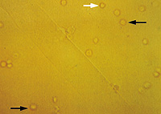
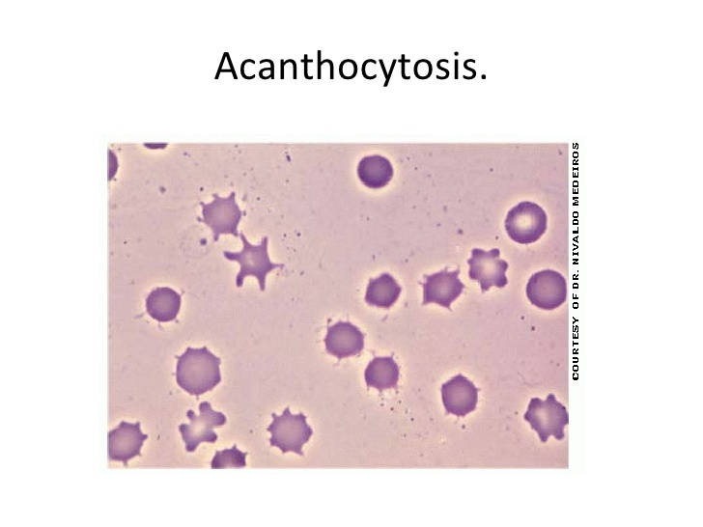
Microscopy: Erythrocytes
Causes:
  Glomerular injury
  Genitourinary tract bleeding
Isomorphic– urologic process
  Stone
  Tumor
  Infection
Dysmorphic – glomerular process
  Acanthocytes – have vesicle-shaped protrusions – highly specific for glomerulonephritis

Slide 11
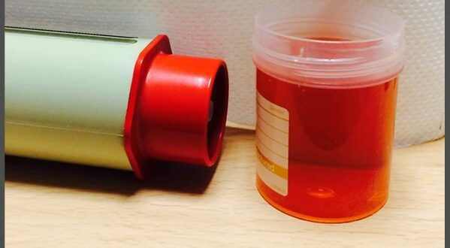
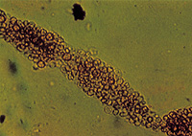

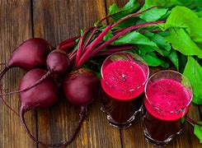
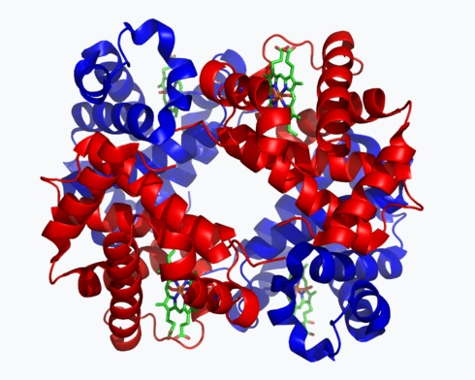
Red Urine Workup
centrifuge
Red sediment
hematuria
Supernatant red
Dipstick heme
negative
Beeturia
Phenazopyridine
porphyria
Dipstick heme
positive
Myoglobin
hemoglobin
Plasma color
Clear:
myoglobin
Red:
hemoglobinuria

Slide 12
HEMATURIA: differential diagnosis
PP ON THIS (with 4 Ts)
  P – prostate (prostatitis, prostate cancer, BPH)
  P – period (cyclic pseudohematuria)
  O – obstructive uropathy
  N – nephritis
  T – trauma
  T – tumor (renal, urothelial, prostate, urethral)
  T – tuberculosis
  T – thrombosis (renal vein thrombosis)
  H – hematologic (anticoagulation, bleeding disorders, sickle cell disease)
  I – infection/inflammation (cystitis from radiation, infection, cyclophosphamide)
  S - stones

Slide 13
NEPHRITIC SYNDROME – Urine findings
Proteinuria (nephrotic or non-nephrotic range)
Hematuria (microscopic or macroscopic) – dysmorphic RBCs, +/- RBC Casts
Pyuria

Slide 14
NEPHRITIC SYNDROME
Endothelial cell damage
Upregulation of adhesion molecules
Release of chemotactic peptides, and active inflammation
Inflammation leads to breaks of the capillary wall that allow red blood cells and leukocytes to escape into Bowman’s space
Active urine sediment that includes RBCs, WBCs, red cell casts, and dysmorphic red cells.

Slide 15
NEPHRITIC SYNDROME: pathophysiologic mechanisms
Type I: anti GBM disease – circulating antibodies against GBM
Type II: Immune complex - Immune complex formation and complement activation in subendothelial space or mesangium
  IgA Nephropathy
  Post-infectious GN
  Lupus nephritis
  Cryoglobulinemia
  Membranoproliferative glomerulonephritis
Type III: pauci-immune
  Circulating antibodies against the neutrophil cytoplasmic antigens (ANCA) → antibody-induced leukocyte activation → necrotizing injury and inflammation of vascular and glomerular capillary walls
  Usually ANCA positive, but can be negative

Slide 16
NEPHRITIC SYNDROME: role of complement
Hypocomplementemia is due to complement activation by the immune deposits at a rate greater than that at which new complement proteins can be synthesized
LOW
Immune complex GN (except IgA)
  Post-infectious GN
  Lupus nephritis
  Cryoglobulinemia
  Membranoproliferative glomerulonephritis
NORMAL
Anti-GBM
Pauci-immune GN
IgA nephropathy

Slide 17
NEPHRITIC SYNDROME- GBM disruption | NEPHROTIC SYNDROME – podocyte injury
Thin Basement Membrane Nephropathy | Minimal Change Disease
Acute Postinfectious Glomerulonephritis | Focal Segmental Glomerulosclerosis
Rapidly progressive (crescentic) glomerulonephritis | Membranous Glomerulopathy
 | Amyloidosis
Mesangioproliferative GlomerulonephritiS | Light Chain Deposition Disease
Membranoproliferative glomerulonephritis (Type I & II) | Fibrillary Glomerulonphritis
Alport’s Syndrome | Diabetic glomerulosclerosis
NEPHRITIC-NEPHROTIC SYNDROME
Mesangioproliferative Glomerulonephritis (SLE, IgA)
Focal or Diffuse Proliferative Glomerulonephritis (SLE, IgA)
Membranoproliferative Glomerulonephritis (Type I and II)

Slide 18
Glomerular Basement Membrane Abnormalities
Thin Basement Membrane Disease
Hereditary Nephritis (Alport Syndrome)

Slide 19
Bladder cancer
Most common cancer of the urinary tract
Almost all Transitional Cell Carcinoma
Risk factors: age, smoking, occupational risk (metal workers, minors, textile workers, leather workers)
Presentation: painless hematuria
Evaluation: cystoscopy in patients >35 years old
.

Slide 20
Renal Cell Carcinoma
Renal Cell Carcinoma: 80-85% of primary renal neoplasms
Symptoms: hematuria, abdominal pain, abdominal mass, weight loss BUT, most patients are asymptomatic.
Classic triad of flank pain, hematuria and palpable abdominal mass occurs in only 9% of patients.

Slide 21
Renal Cell Carcinoma: ectopic production of hormones
Ectopic production of hormones:
Erythropoietin
Parathyroid hormone-related protein
Gonadotropins
Human chorionic somatomammotropin
Adrenocorticotropic hormone (ACTH)-like substance
Renin
Glucagon
Insulin

Slide 22
Renal Cell Carcinoma: paraneoplastic syndromes
Erythrocytosis or anemia
Thrombocytosis
Hypercalcemia
Secondary AA amyloidosis
Polymyalgia rheumatica
Hepatic dysfunction

Slide 23
RISK FACTORS FOR MALIGNANCY
Male gender
Age >35
Smoking history
Occupational exposure:
  Benzenes
  Aromatic amines
Gross hematuria
Irritative voiding symptoms
Chronic UTI’s
Cyclophosphamide
Chronic indwelling foreign body
Aristolochic acid
Analgesic abuse
American Urological Association best practice recommendations

Slide 24
RISK STRATIFICATION
Gross hematuria
  23% urologic malignancy
  8% no etiology found (18% eventually develop urologic malignancy)
Microhematuria
  1-20% urologic malignancy (depending on risk factors)
  43% no etiology found (1-3% eventually develop urologic malignancy)

Slide 25
IMAGING
  CT urography (CTU) – CT of abdomen and pelvis with & without contrast
  Pregnant patients: ultrasound
  Severe kidney impairment:
  Non-contrast CT -> r/o stones
  Followed by
  MRU (magnetic resonance urography)

Slide 26
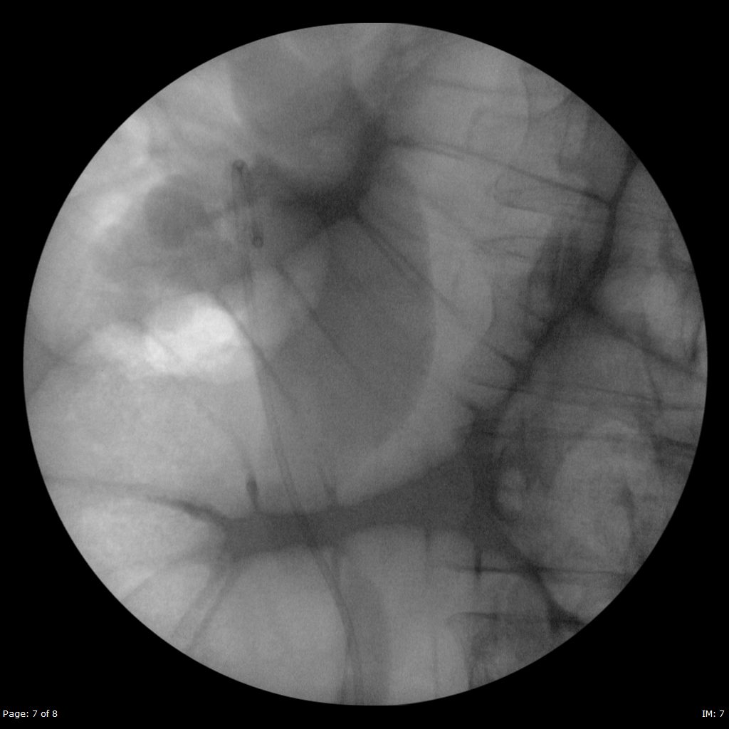
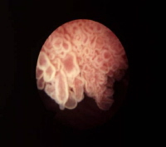
CYSTOSCOPY
  Allows direct visualization of the bladder
  All patients with gross hematuria (without evidence of glomerular disease or infection)
  All patient with microscopic hematuria (without glomerular disease, infection or known cause i.e. menstrual period, exercise)
Courtesy of Shane Daley, MD

Slide 27
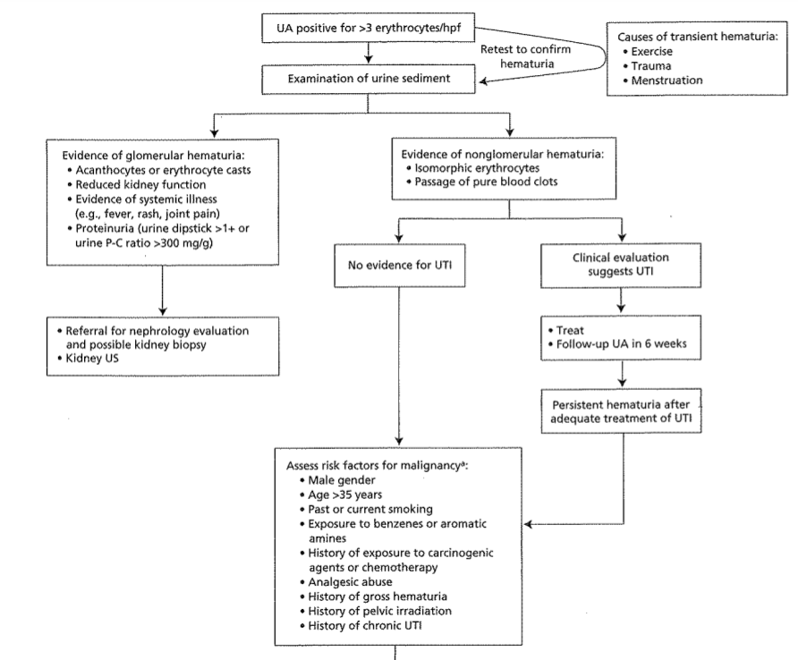
Summary: Workup of hematuria
MKSAP 19

Slide 28
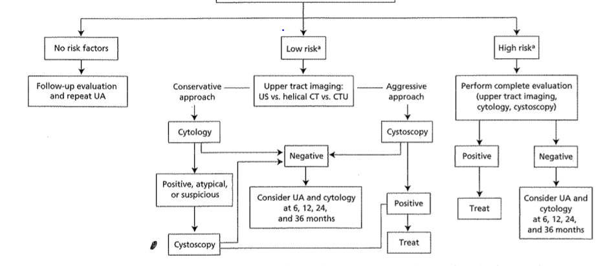
Summary: Workup of hematuria – risk stratification
MKSAP 19

Slide 29
CASE
A 25-year-old woman presents to the hospital with confusion and bruising on her arms and legs. One week prior she had a diarrheal illness.
What is her diagnosis?
Rhabdomyolysis with myoglobinuria
Thrombotic thrombocytopenic purpura
Membranoproliferative glomerulonephritis
Renal cell carcinoma
Nephrolithiasis
Test | Result | Normal range
Hemoglobin | 7.5 g/dL | 12-16 g/dL
Platelets | 16 x 10⁹/L | 150 – 450 x 10⁹/L
Peripheral smear | + schistocytes | negative
Creatine kinase | 120 U/L | 30-135 U/L
Urinalysis | 3+ blood | negative
Microscopy | No RBCs | negative

Slide 30
CASE
A 25-year-old woman presents to the hospital with confusion and bruising on her arms and legs. One week prior she had a diarrheal illness.
What is her diagnosis?
Rhabdomyolysis with myoglobinuria (No – CK would be high)
Thrombotic thrombocytopenic purpura
Membranoproliferative glomerulonephritis (No - would have RBCs on micro)
Renal cell carcinoma (No - would have RBCs on micro)
Nephrolithiasis (No - would have RBCs on micro)
Test | Result | Normal range
Hemoglobin | 7.5 g/dL | 12-16 g/dL
Platelets | 16 x 10⁹/L | 150 – 450 x 10⁹/L
Peripheral smear | + schistocytes | negative
Creatine kinase | 120 U/L | 30-135 U/L
Urinalysis | 3+ blood | negative
Microscopy | No RBCs | negative
This patient has a hemolytic anemia and TTP likely caused by an E.Coli infection. The anemia with presence of schistocytes on peripheral smear suggests hemolysis. The presence of blood on urinalysis with no RBCs on microscopy indicates that there is hemoglobin in the urine without cells. Heme pigment is toxic to the tubular cells and causes Acute Tubular Necrosis.

Slide 31
CASE
A 30-year-old man presents to the hospital with severe bilateral leg pain and bilateral flank pain after a day-long pickle ball tournament in the summer.
What is the most likely diagnosis?
Rhabdomyolysis with myoglobinuria
Consumption of too many beets
Acute renal colic from nephrolithiasis
Renal cell carcinoma
Lupus nephritis
Test | Result | Normal range
Creatinine | 5.6 mg/dL | 0.7-1.3 mg/dL
Potassium | 5.9 mEq/L | 3.5-5.2 mEq/L
Hemoglobin | 19 g/dL | 13.5-17.5 g/dL
Creatine kinase | 12,300 U/L | 30-135 U/L
Urinalysis | 3+ blood | negative
Microscopy | No RBCs | negative

Slide 32
CASE
A 30-year-old man presents to the hospital with severe bilateral leg pain and bilateral flank pain after a day-long pickle ball tournament in the summer.
What is the most likely diagnosis?
Rhabdomyolysis with myoglobinuria
Consumption of too many beets (No – urinalysis and micro would both be negative for blood)
Acute renal colic from nephrolithiasis (No – micro would be + for blood)
Renal cell carcinoma (No – micro would be + for blood)
Lupus nephritis (No – micro would be + for blood)
Test | Result | Normal range
Creatinine | 5.6 mg/dL | 0.7-1.3 mg/dL
Potassium | 5.9 mEq/L | 3.5-5.2 mEq/L
Hemoglobin | 19 g/dL | 13.5-17.5 g/dL
Creatine kinase | 12,300 U/L | 30-135 U/L
Urinalysis | 3+ blood | negative
Microscopy | No RBCs | negative
This patient has rhabdomyolysis caused by breakdown of muscle. Myoglobin gets filtered by the kidneys and causes toxicity to the renal tubules – Acute Tubular Necrosis. The high CK is diagnostic of rhabdomyolysis. The potassium is high because of the AKI and also there is cellular lysis from muscle injury, and the intracellular potassium is coming out of the cells. The presence of blood on urinalysis is because the reagent for heme crossreacts with myoglobin. Whenever you see blood on urinalysis with no RBCs on micro, think rhabdomyolysis or hemolytic anemia.

Slide 33
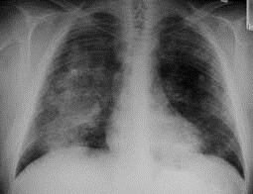
 | Patient | Normal
BUN | 25 | 7-20 mg/dl
Creatinine | 2.0 | 0.72-1.25 mg/dl
UA: blood | 1+ | none
UA: protein | 1+ | none
Micro: | RBC casts | negative
Urine protein:creatinine | 3.5g/g creat | < 0.15 g/g creat
CASE
A 70-year-old man presents with hemoptysis and leg swelling. His hypertension recently been difficult to control.
PMH: HTN, DM2 for 2 years (no retinopathy or neuropathy), atrial fibrillation
Physical Exam:
VS: afebrile, BP 160/82, HR 85, RR 25
Lungs: bibasilar rales
CV: irregular S1, S2 with 2/6 systolic murmur left lower sternal border, no gallops, no jugular venous distension, normal point of maximal impulse
Extremities: 3+ lower extremity edema bilaterally

Slide 34
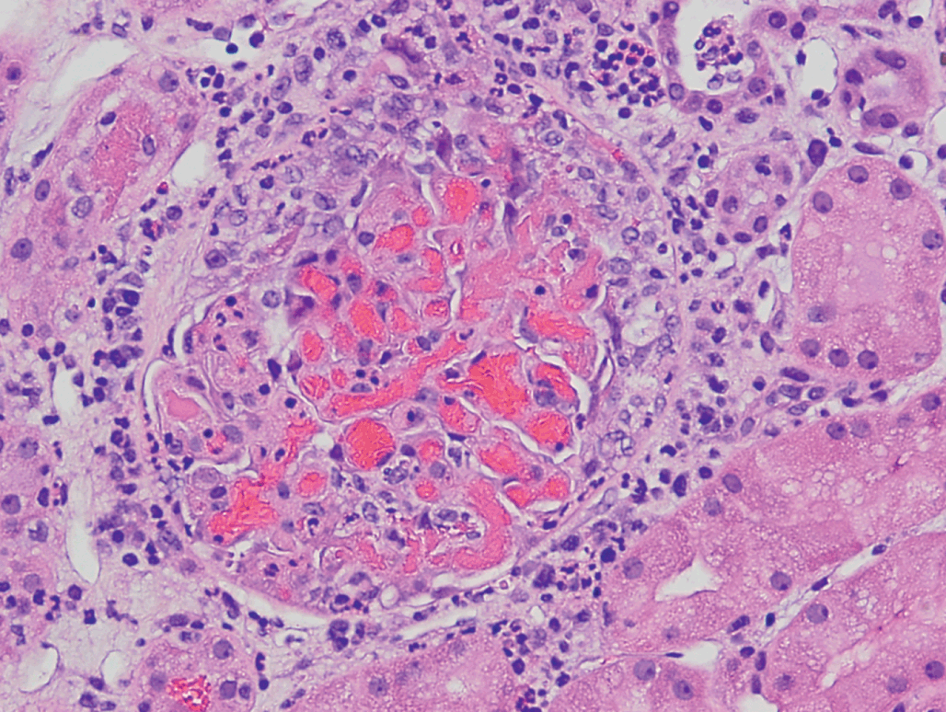
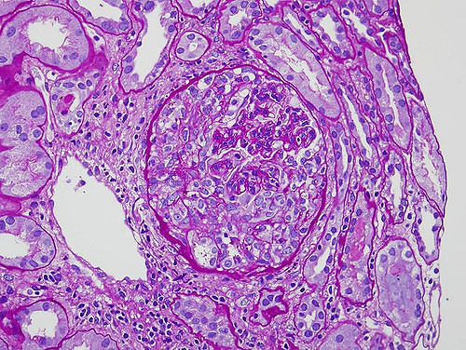
A renal biopsy is performed…
Here are the light microscopy images.
Immunofluorescence is negative.
What is the most likely diagnosis?

Slide 35
A renal biopsy is performed…
Here are the light microscopy images.
Immunofluorescence is negative.
What is the most likely diagnosis?
Granulomatosis with Polyangiitis
Light micrograph showing fresh segmental necrotizing lesions with bright red fibrin deposition
There is usually weak or absent staining on immunofluorescence.
There is usually ANCA positivity.

Slide 36
CASE
 | Patient | Normal
BUN | 10 | 7-20 mg/dl
Creatinine | 1.2 | 0.72-1.25 mg/dl
Albumin | 3.8 | 3.5-5.5g/dl
UA: blood | 2+ | none
UA: protein | 1+ | none
Micro: | 2-15 dysmorphic RBCs | negative
Urine protein:creatinine | 2.0g/g creat | < 0.150 g/g creat
33-year-old man with no significant past medical history comes for a follow-up evaluation for persistent microscopic hematuria and proteinuria. He feels well and is otherwise asymptomatic. He has no history of edema or gross hematuria. There is no family history of kidney disease.
Physical Exam:
VS: afebrile, BP 130/76, HR 72, RR 14
Lungs: CTA bilaterally
CV: normal S1, S2
Abd: soft, nontender
Ext: no edema
Skin: no rashes
What other lab tests would you like to order?

Slide 37
CASE
ANA | negative
C3 | normal
C4 | normal
Anti-double stranded DNA | normal
ANCA | negative
Serum Protein Electrophoresis | negative for monoclonal spike
Urine Protein Electrophoresis | negative for monoclonal spike
Hepatitis B Surface Antigen | negative
Hepatitis C antibody | negative
Cryoglobulins | negative
What is your differential diagnosis at this point?

Slide 38
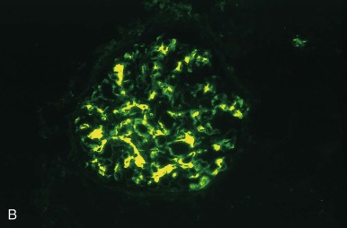
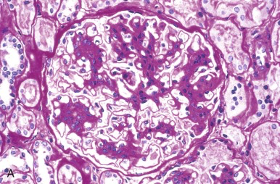
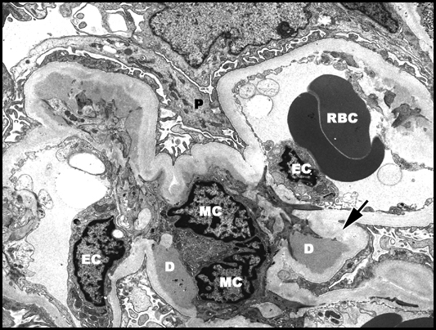
A renal biopsy is performed…
What is the most likely diagnosis?

Slide 39
A renal biopsy is performed…
What is the most likely diagnosis?
IgA Nephropathy
Immunofluorescence : large, globular mesangial IgA deposits that are diagnostic of IgA nephropathy or Henoch-Schönlein purpura. Note that the capillary walls are not outlined, since the deposits are primarily limited to the mesangium.
Light microscopy: segmental areas of increased mesangial matrix and cellularity.

Slide 40
CASE
A 58yo man who works a truck driver who has a 30-pack-year smoking history presents with urinary frequency and nocturia.
Exam: normal except enlarged prostate
Urinalysis: SpGr 1.010, pH 6.5, 1+ blood
Microscopy: 1 wbc/hpf, 7 rbcs/hpf, no squamous epithelial cells
Based on his history , symptoms, and urinalysis findings, which of the following should be done next:
Repeat urinalysis in 6 months
Obtain BMP, CT scan, and cystoscopy
Treat with antibiotic and repeat UA with micro
Inform him that his enlarged prostate is causing microscopic hematuria
Perform urine cytology

Slide 41
CASE
A 58yo man who works a truck driver who has a 30-pack-year smoking history presents with urinary frequency and nocturia.
Exam: normal except enlarged prostate
Urinalysis: SpGr 1.010, pH 6.5, 1+ blood
Microscopy: 1 wbc/hpf, 7 rbcs/hpf, no squamous epithelial cells
Based on his history , symptoms, and urinalysis findings, which of the following should be done next:
Repeat urinalysis in 6 months
Obtain BMP, CT scan, and cystoscopy
Treat with antibiotic and repeat UA with micro
Inform him that his enlarged prostate is causing microscopic hematuria
Perform urine cytology

Slide 42
CASE
A 75 year old man with no known past medical history presents to the office complaining of facial flushing, headaches, blurred vision, and left flank pain.
PE: 148/92, facial plethora present, exam otherwise normal
Labs: Hgb 18, creatinine 0.9, urinalysis: 1+ blood >60 rbc/hpf
What is the next appropriate test?
Renal biopsy
Bone marrow biopsy
Renal ultrasound
Abdominal CT scan with contrast
Cystoscopy

Slide 43
CASE
A 75 year old man with no known past medical history presents to the office complaining of facial flushing, headaches, blurred vision, and left flank pain.
PE: 148/92, facial plethora present, exam otherwise normal
Labs: Hgb 18, creatinine 0.9, urinalysis: 1+ blood >60 rbc/hpf
What is the next appropriate test?
Renal biopsy
Bone marrow biopsy
Renal ultrasound
Abdominal CT scan with contrast
Cystoscopy

Slide 44
CASE
A 57year old man with no known past medical history comes to the office for evaluation of recurrent episodes of gross hematuria over the past 4 months. He has no flank pain or bladder pain.
SH: occupation: leather worker; 30pack year tobacco
PE BP 130/70, exam otherwise normal
Labs: creatinine 1.2, urinalysis 2+ blood, >60 RBCs per HPF
You order a CT scan with contrast which is negative for renal mass.
What is the next diagnostic step?
Check urine culture
Repeat urinalysis in 3 months
Cystoscopy
Renal biopsy

Slide 45
CASE
A 57year old man with no known past medical history comes to the office for evaluation of recurrent episodes of gross hematuria over the past 4 months. He has no flank pain or bladder pain.
SH: occupation: leather worker; 30pack year tobacco
PE BP 130/70, exam otherwise normal
Labs: creatinine 1.2, urinalysis 2+ blood, >60 RBCs per HPF
You order a CT scan with contrast which is negative for renal mass.
What is the next diagnostic step?
Check urine culture
Repeat urinalysis in 3 months
Cystoscopy
Renal biopsy

Slide 46
Summary: Workup of hematuria
Evaluation of urine sediment to assess for false positives, glomerular disease, non-glomerular hematuria.
Repeat urine to r/o transitory cause (trauma, infection, menstrual period)
All unprovoked gross hematuria should be worked up even if resolves
Unprovoked microhematuria should be worked up in a patient with risk factors for malignancy
Persistent microhematuria should be worked up
CT scan with IV contrast is the most sensitive for detecting renal masses <1cm
Cystoscopy should be performed in patients over 35 years old if no other cause found

Slide 47
Nephrolithiasis

Slide 48
Epidemiology
Prevalence: 10%
20 years ago ratio 1:2 women:men, now 1:1.3
Peak age 20-30 years old
Southeastern geography (Most likely due to higher ambient temperatures rather than increased vitamin D)
Notes:
Scales ED et al j Urol 2007

Slide 49
Predisposing Conditions
METABOLIC SYNDROME
Diabetes
Obesity
Gout

Slide 50
Predisposing Conditions
Genetic factors: 15% pts in stone clinics have genetic disorders:
  Renal tubular acidosis
  Bartter syndrome
  Primary hyperoxaluria
  Cystinuria
Howles, S.A., Thakker, R.V. Genetics of kidney stone disease. Nat Rev Urol 17, 407–421 (2020).

Slide 51
Predisposing Conditions
Family history 20%
Occupational exposure – jobs with limited access to water or bathroom facilities
Intestinal disorders causing malabsorption – Crohns or bariatric surgery (increased oxalate absorption)
Urinary tract infections

Slide 52
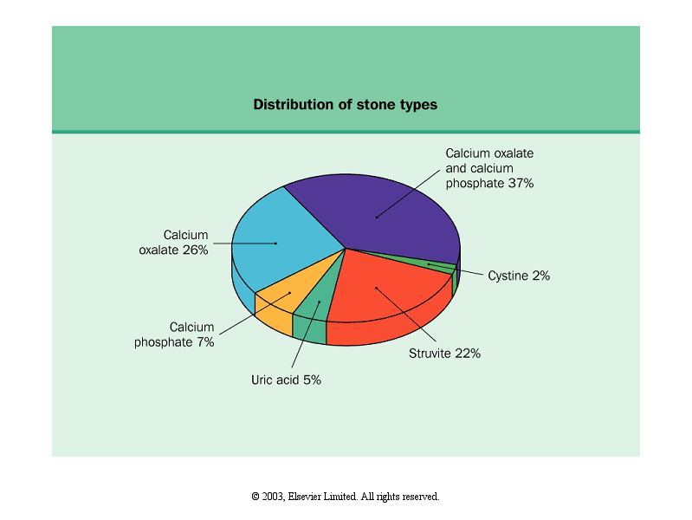
Frequency in US Population
Johnson J and Feehally J, Comprehensive Clinical Nephrology, 2nd ed.
Notes:
>70% calcium stones, less than 10% uric acid

Slide 53
Diseases Associated with Calcium Containing Renal Stones (n=1650)
Notes:
RTA – Type 1 distal RTA: stones result from hypercalciuria, hypocitraturia, and alkaline urine pH; stones are usually calcium phosphate. High urine pH increases the availability of phosphate. Metabolic acidosis, hypokalemia, and renal insufficiency decreases citrate excretion. Hypokalemia reduces urine citrate by generating an intracellular acidosis in the proximal tubular cell. (citrate binds calcium and ma increase the inhibitory activity of urine macromolecules).

Slide 54
Primary Hyperparathyroidism
Increased calcium absorption in gut
Increased distal tubular urinary absorption, but marked hypercalciuria because of
  the increased filtered load of calcium
  reduced calcium reabsorption in the thick ascending limb of the loop of henle.
Treatment: surgical removal of adenoma – most patients don’t get more stones, but up to half of them still have residual renal disease (calculi,nephrocalcinosis, uti, azotemia)

Slide 55
Idiopathic Hypercalciuria
Diagnosis of exclusion - requires no sarcoidosis, no renal tubular acidosis, no hyperparathyroidism, no malignant tumors, no rapidly progressive bone disease, no immobilization, no paget disease, cushing disease, or furosemide administration.

Slide 56
Idiopathic Hypercalciuria
Pathogenesis involves excessive intestinal calcium absorption and depressed renal tubule calcium reabsorption
Patients are in net negative calcium balance, suggesting bone loss of calcium.
Increased activity of Ca-Mg-ATPase in the intestine and distal tubule
Stone formers have decreased bone mineral density, compared to non-stone formers, suggesting bone demineralization as an etiology.

Slide 57
Hyperuricosuria
Uric acid crystals plug the lumen of renal collecting duct and act as a nucleus for calcium stone formation.
Treatment with allopurinol
  3 year prospective randomized trial of hyperuricosuric, normocalciuric calcium oxalate stone formers: 70% allopurinol patients remained stone free at 3yrs, vs. 40% placebo.

Slide 58
Type 1 Distal Renal Tubular Acidosis
Stones result from hypercalciuria, hypocitraturia, and alkaline urine pH; stones are usually calcium phosphate.
High urine pH increases the availability of phosphate.
Metabolic acidosis, hypokalemia, and renal insufficiency decreases citrate excretion.
  Hypokalemia reduces urine citrate by generating an intracellular acidosis in the proximal tubular cell.

Slide 59
Pathogenesis – Stages of Stone development
Supersaturation
Nucleation (ions join together in more stable, solid phase)
Aggregation (small crystals bond together)
Anchoring (via stone-epithelial cell interactions) facilitates aggregation in limited time
Notes:
Inhibitors – both low-molecular-weight compounds and urine macromolecules inhibit crystallization – pyrophosphate, citrate, and magnesium; Nephrocalcin, Tamm-Horsfall protein, Uropontin, Prothrombin-1 fragment, Bikunin, Calgranulin, glycosaminoglycans all inhibit crystal formation).

Slide 60
Stone Inhibitors
Pro-Stone Forces
Calcium
Uric Acid
Oxalate
Cystine
Infection
Volume (dilution)
Citrate
Alkaline urine

Slide 61
Clinical Presentations
Pain (ureteral colic, loin pain, dysuria)
Hematuria
Urinary tract infection (recurrent, chronic infection)
Asymptomatic urine abnormality (microscopic hematuria, proteinuria, sterile pyuria)
Interruption of urinary stream
Calculus anuria

Slide 62
Differential Diagnosis of Flank Pain
Appendicitis
Ovarian cysts
Peritonitis
Ectopic pregnancy
UTI
Diverticulitis

Slide 63
Basic Evaluation of Stone Formers (1st stone)
Stone history
Medical history
  Diseases leading to hypercalcemia (malignancy, hyperparathyroidism, sarcoidosis)
  Malabsorptive GI disorders (Crohn’s, celiac sprue)
  Gout
Family History
  Idiopathic hypercalciuria (multiple genes identified)
  Cystinuria (AR)
  Hyperuricosuria
  X-linked causes of calcium stones and nephrocalcinosis
  Primary hyperoxaluria (AR)
Notes:
Hyperuricosuria
Hyperuricosuria (excessive urinary uric acid) accounts for 10% of calcium stones. There is a genetic predisposition, common in men, for stone development due to high uric acid levels and excess uric acid excretion, which results in hyperuricosuria. Excessive uric acid excretion can be found in primary gout, and secondary conditions of purine overproduction including myeloproliferative disorders such as acute leukemia, glycogen storage disease, and malignancy. Hyperuricosuriais often caused by excess intake of purine in meat, fish, and poultry. This purine diet causes a low urinary pH. The features of hyperuricosuric calcium oxalate nephrolithiasis include elevated urinary uric acid (> 600 mg/day), a normal serum calcium level, normal urinary calcium and oxalate levels, normal fasting and calcium load response, and urinary pH typically < 5.5.
Primary Hyperoxaluria. Type I hyperoxaluria is a rare autosomal recessive disorder that begins in childhood in which a defect of the hepatic enzyme alanine-glyoxylate aminotransfease (AGT) causes increased urinary excretion of oxalic, glycolic, and glyoxylic acids (Danpure, 1994; Menon & Mahle, 1982; Munver & Preminger, 2001). This condition is characterized by nephrocalcinosis, oxalate deposition in tissues, and renal failure resulting in death before age 20, if untreated. Diagnosis is made through percutaneous liver biopsy and evaluation of the amount and distribution of AGT in liver specimens.

Slide 64
Basic Evaluation of Stone Formers (1st stone)
Medications
  Loop diuretics, vitamin D, glucocorticoids, antacids, theophylline, acetazolamide, amphoteracin B (calcium)
  Salicylates, probenecid (uric acid)
  Allopurinol (xanthine)
  Acyclovir, triamterene, indinavir (precipitation into stones)
Social history (jobs resulting in volume depletion)
Dietary history
Notes:
Loop diuretics promote calcium excretion

Slide 65
Dietary History
High oxalate foods
green beans
Beets
Celery
Green onions
Leeks
Leafy greens
Cocoa/chocolate
Black tea
Berries
Orange & lemon peel
Dried figs
Summer squash
Nuts, peanut butter
Tofu
High purine foods
Organ meats
Shellfish
Meat
Fish
Meat extracts
Gravies
Asparagus
Cauliflower
Peas
Spinach
Mushrooms
Beans (lima, kidney, lentils)
Notes:
Oxalate-avoid in setting of hyperoxaluria; purine-avoid in setting of hyperuricosuria

Slide 66
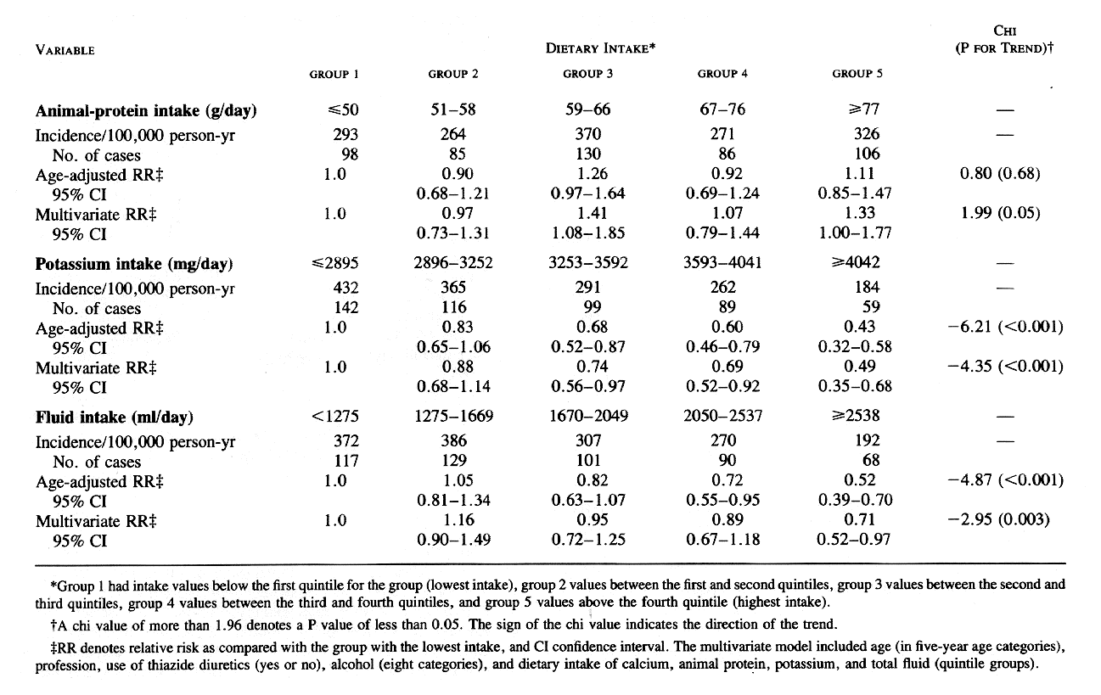
Curhan GC. Willett WC. et al. New England Journal of Medicine. 328(12):833-8, 1993 Mar 25.
Notes:
Patients with low protein intake are less likely to get stones. Patients with low potassium and fluid intake are more likely to get stones.

Slide 67
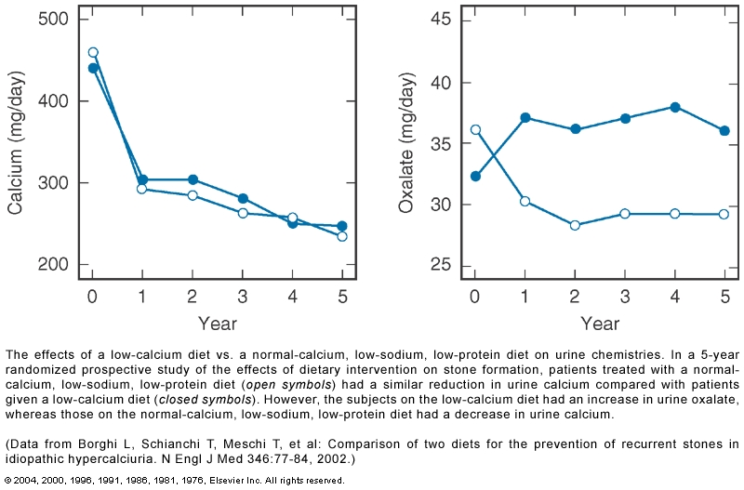
Calcium intake
Notes:
Patients with low calcium diets are more likely to form stones because they absorb more oxalate and have hyperaxaluria.

Slide 68
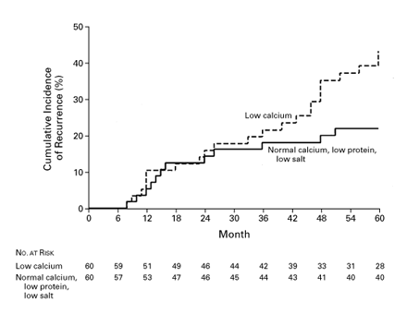
Calcium, protein, and salt intake
Borghi L. Schianchi T. et al. New England Journal of Medicine. 346(2):77-84, 2002 Jan 10.

Slide 69
Laboratory evaluation
Urinalysis
  pH
    High with struvite/calcium phosphate stones
    Low with uric acid and calcium oxalate stones
  Specific gravity to assess adequacy of fluid intake
  RBCs
  Characteristic crystals
Notes:
Low

Slide 70
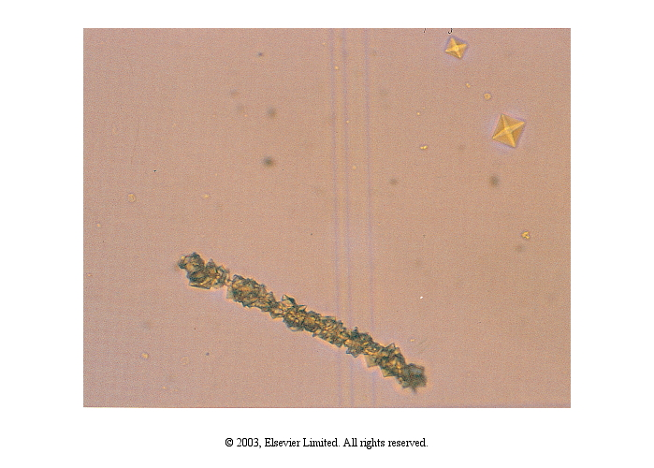
Calcium Oxalate
Johnson J and Feehally J, Comprehensive Clinical Nephrology, 2nd ed.
Notes:
1. A 1cm wide calcium oxalate stone that provoked ureteral colic and required surgical removal.
2. A pseudocast of calcium oxalate crystals accompanied by crystals of calcium oxalate dihydrate

Slide 71
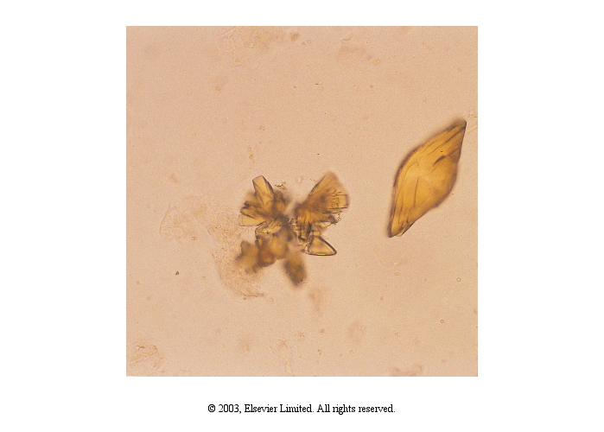
Uric Acid
Johnson J and Feehally J, Comprehensive Clinical Nephrology, 2nd ed.
Notes:
1. A 1cm wide calcium oxalate stone that provoked ureteral colic and required surgical removal.
2. A pseudocast of calcium oxalate crystals accompanied by crystals of calcium oxalate dihydrate

Slide 72
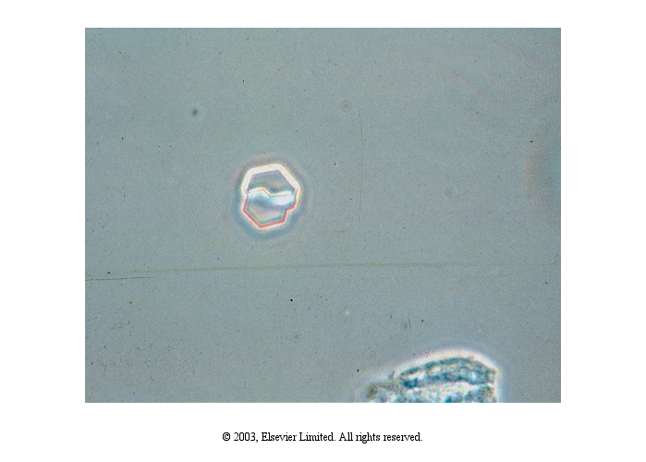
Cystine
Johnson J and Feehally J, Comprehensive Clinical Nephrology, 2nd ed.
Notes:
1. A 1cm wide calcium oxalate stone that provoked ureteral colic and required surgical removal.
2. A pseudocast of calcium oxalate crystals accompanied by crystals of calcium oxalate dihydrate

Slide 73
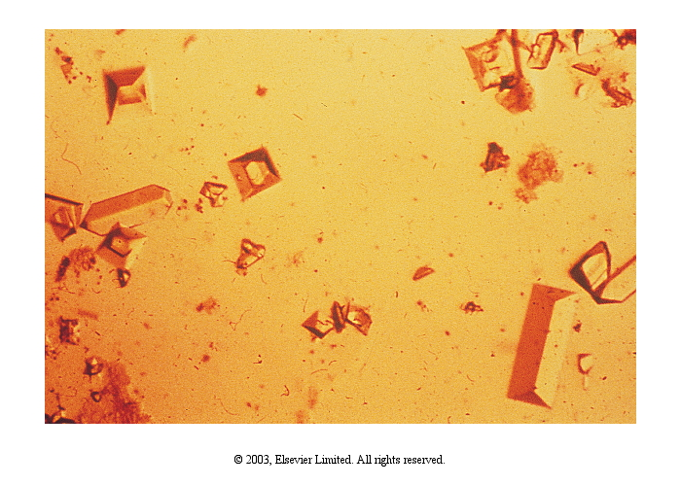
Magnesium ammonium phosphate
(struvite)
Johnson J and Feehally J, Comprehensive Clinical Nephrology, 2nd ed.
Notes:
1. A 1cm wide calcium oxalate stone that provoked ureteral colic and required surgical removal.
2. A pseudocast of calcium oxalate crystals accompanied by crystals of calcium oxalate dihydrate

Slide 74
Laboratory evaluation
Blood test (electrolytes, calcium, uric acid, phosphorus, creatinine)
Stone analysis when possible
Notes:
Low potassium or bicarbonate level may indicate a cause for hypocitraturia.

Slide 75
Evaluation
A 49-year-old man with a history of gouty arthritis comes for a follow-up evaluation. One week ago, he was evaluated in the emergency department for left-sided flank pain and hematuria.
A plain abdominal radiograph is unremarkable. After radiography is performed, the patient urinates debris and his pain is immediately relieved.
He has had no further symptoms.

Slide 76
Laboratory Data
Creatinine 1.0 mg/dL
Potassium 4.6 meq/L
Bicarbonate 26 meq/L
Calcium 10.1 mg/dL
Phosphorus 2.1 mg/dL
Uric acid 9.0 mg/dL
Urinalysis pH 5, 3+ blood, 10–15 erythrocytes/hpf

Slide 77
Which of the following is the most likely diagnosis?
Calcium oxalate stones
Uric acid stones
Calcium phosphate stones
Struvite calculi
Cystine stones
Notes:
This patient most likely has uric acid stones. The majority of kidney stones are composed of calcium, whereas uric acid, struvite, or cystine stones occur less frequently. Uric acid stones occur in 20% of patients with a history of gouty arthritis and may manifest as an acute attack of renal colic with unilateral flank pain and hematuria. Unlike calcium-containing stones, uric acid stones are radiolucent and are not visible on a plain abdominal radiograph. Therefore, spiral CT or ultrasonography of the abdomen are the imaging modalities of choice in this setting. Metabolic abnormalities such as an elevated serum uric acid level, an acidic urine with a pH <5.5, hyperuricosuria, and hypocitraturia increase the incidence of uric acid stone formation. However, crystal stone analysis definitively determines the type of kidney stone.
Although calcium oxalate stones are the most frequent type of kidney stone, uric acid stones are far more likely because of this patient's history of gout, elevated serum uric acid level, acidic urine, and lack of stone visualization on plain abdominal radiography. Calcium phosphorous stones account for 10% of all stones and typically are associated with renal tubular acidosis or primary hyperparathyroidism.
Struvite stones are more common in women and are a result of infection with urease-splitting organisms and an alkaline urine. Cystine stones are extremely uncommon and are caused by cystinuria, a heritable condition in which stones typically develop during childhood.
In patients <50 years of age with microscopic hematuria, infections and kidney diseases such as glomerulonephritis should be considered. In patients >50 years of age with microscopic hematuria and associated risk factors such as cigarette smoking, analgesic abuse, benzene exposure, or a history of voiding abnormalities, genitourinary tract malignancy is more common.

Slide 78
Which of the following is the most likely diagnosis?
Calcium oxalate stones
Uric acid stones
Calcium phosphate stones
Struvite calculi
Cystine stones
Notes:
This patient most likely has uric acid stones. The majority of kidney stones are composed of calcium, whereas uric acid, struvite, or cystine stones occur less frequently. Uric acid stones occur in 20% of patients with a history of gouty arthritis and may manifest as an acute attack of renal colic with unilateral flank pain and hematuria. Unlike calcium-containing stones, uric acid stones are radiolucent and are not visible on a plain abdominal radiograph. Therefore, spiral CT or ultrasonography of the abdomen are the imaging modalities of choice in this setting. Metabolic abnormalities such as an elevated serum uric acid level, an acidic urine with a pH <5.5, hyperuricosuria, and hypocitraturia increase the incidence of uric acid stone formation. However, crystal stone analysis definitively determines the type of kidney stone.
Although calcium oxalate stones are the most frequent type of kidney stone, uric acid stones are far more likely because of this patient's history of gout, elevated serum uric acid level, acidic urine, and lack of stone visualization on plain abdominal radiography. Calcium phosphorous stones account for 10% of all stones and typically are associated with renal tubular acidosis or primary hyperparathyroidism.
Struvite stones are more common in women and are a result of infection with urease-splitting organisms and an alkaline urine. Cystine stones are extremely uncommon and are caused by cystinuria, a heritable condition in which stones typically develop during childhood.
In patients <50 years of age with microscopic hematuria, infections and kidney diseases such as glomerulonephritis should be considered. In patients >50 years of age with microscopic hematuria and associated risk factors such as cigarette smoking, analgesic abuse, benzene exposure, or a history of voiding abnormalities, genitourinary tract malignancy is more common.

Slide 79
Radiologic evaluation
KUB (uric acid and xanthine calculi are radiolucent)
IV urogram (can show anatomic abnormalities in GU tract)
CT scan (high sensitivity and specificity) – Gold Standard
Renal ultrasound (misses ureteral stones) – use in pregnancy
Notes:
CT scan no need for contrast. Renal us for pregnant women.

Slide 80
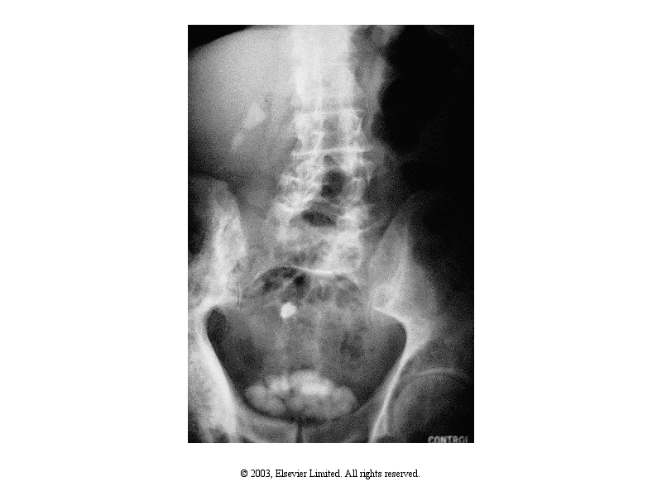
Multiple cystine stones in r kidney, ureter, and bladder
Johnson J and Feehally J, Comprehensive Clinical Nephrology, 2nd ed.

Slide 81
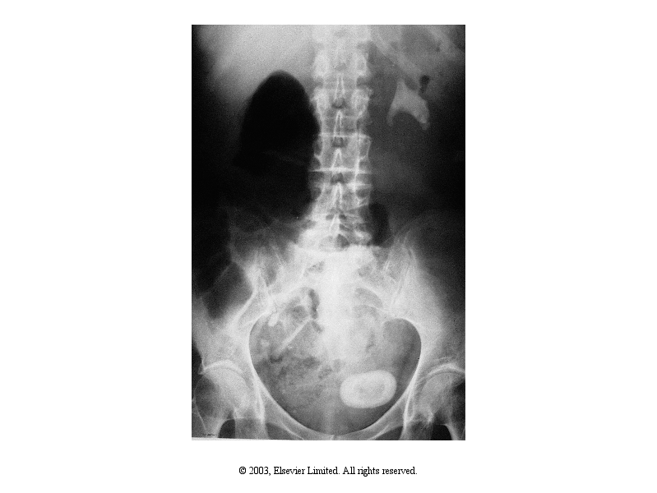
Struvite stones; L staghorn calculus; single bladder stone
Johnson J and Feehally J, Comprehensive Clinical Nephrology, 2nd ed.
Notes:
Struvite stones; l staghorn calculus; single bladder stone

Slide 82
Complete Evaluation (for >1 stone)
24 hour urine for:
Volume
pH
Calcium
Phosphate
Sodium
Uric acid
Oxalate
Citrate
Creatinine

Slide 83
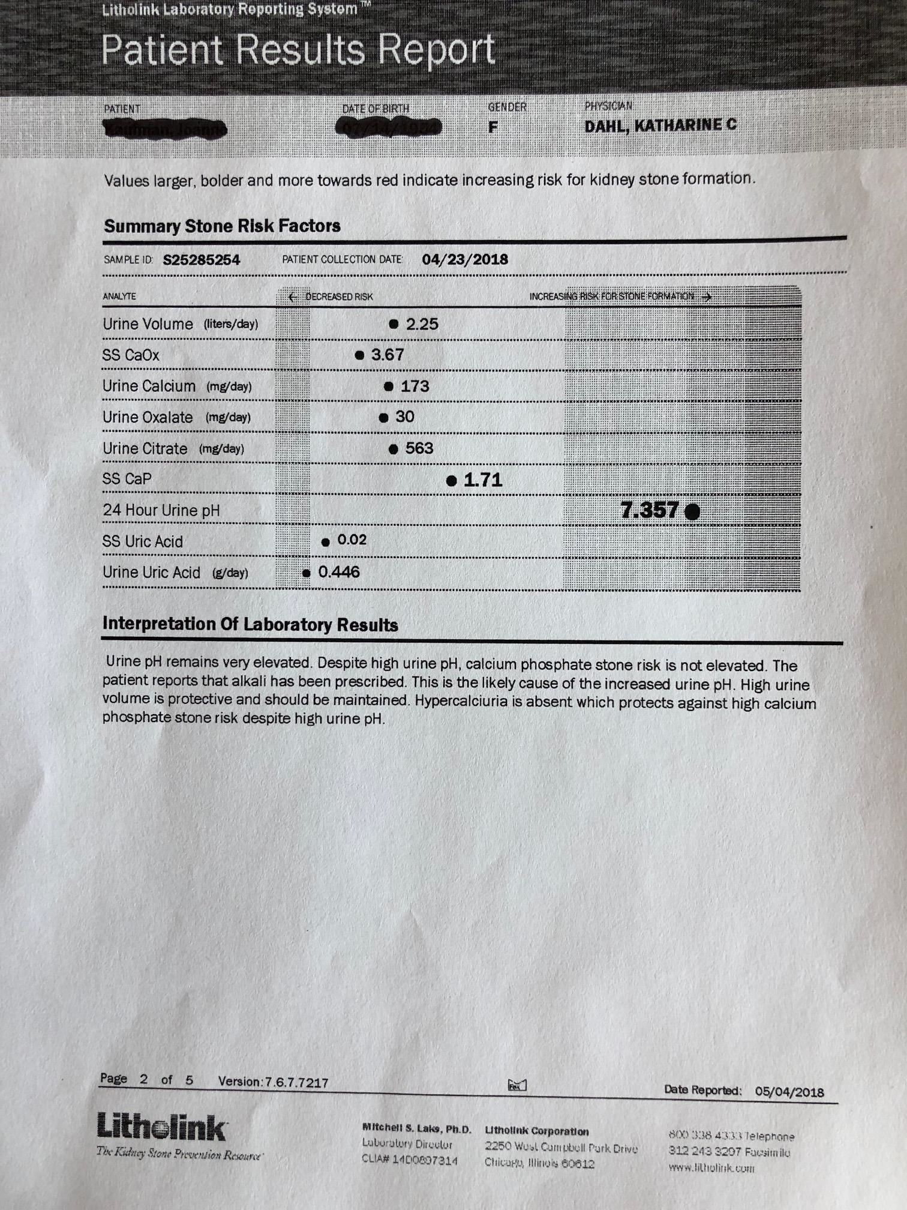
Stone Risk Profile

Slide 84
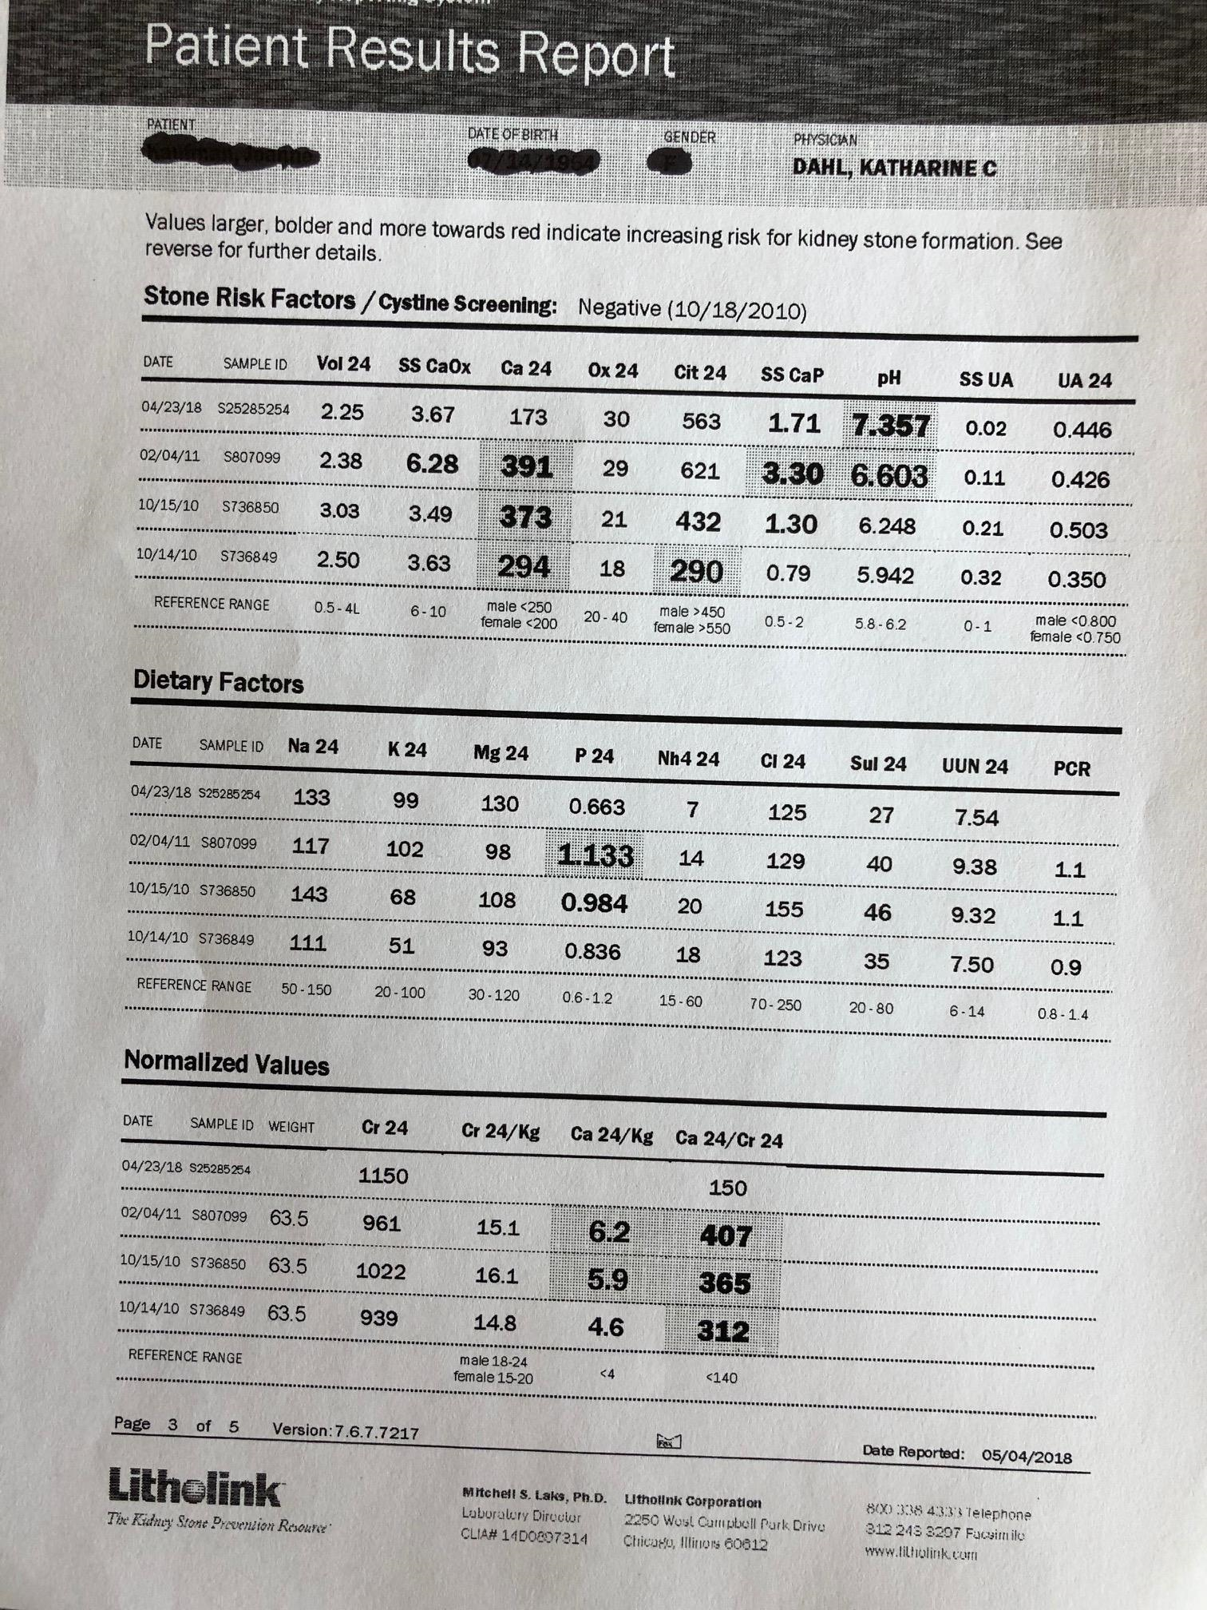
Stone Risk Profile

Slide 85
Prevention - Dietary Modifications
Fluid intake urine output > 2L/day
Calcium intake > 1gm/day
Sodium intake avoid excess (2g/day)
Protein intake moderation(0.8-1g/kg/day)
Notes:
Lg volume reduce calcium oxalate supersaturation & precipit of other crystals. Prospective randomized trial of high fluid intake (2-2.5L/day) showed 50% reduction in stone recurrence over 5yrs.
Sodium excretion by renal tubules augments urine calcium excretion. Sodium restriction results in decreased gfr, and increased distal calcium reabsorption. A high salt diet also lowers urinary citrate.
Protein generates sulfate ions which make calcium less soluble; high protein diet increases urinary calcium excretion and causes negative calcium balance; the metabolic acidosis from high protein diet leads to calcium release from bone, and decreases renal tubule calcium reabsorption, decreases citrate excretion; increases uric acid levels. However, a randomized controlled trial of protein restriction failed to show a reduction in stone formation.

Slide 86
Treatment of Specific Forms of Stone Disease: hypercalciuria
Thiazide diuretic
Potassium citrate (Urocit-K 20-40mmol daily)
Of note: both therapies have been effective in patients that are not hypercalciuric or hypocitraturic.
Notes:
Thiazide stimulates calcium reabsorption by the distal convoluted tubule. Long term trials have shown decreased stone formation, even in patients that are not hypercalciuric.

Slide 87
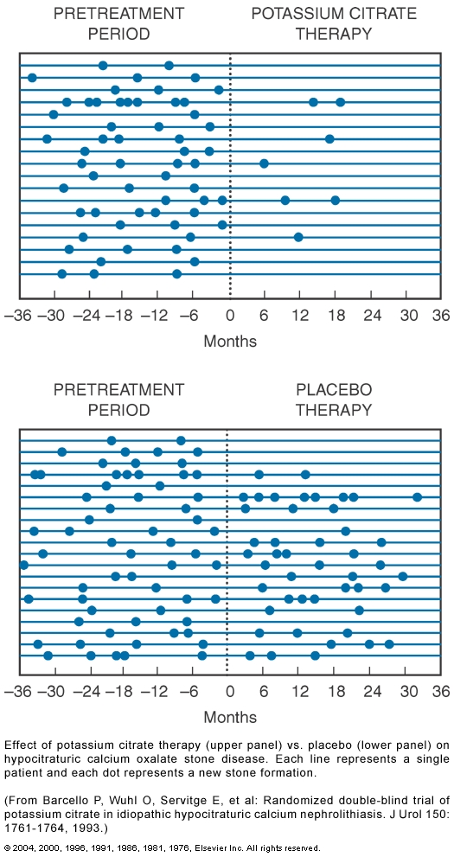
Notes:
Potassium citrate decreased stone formation rate from 1.2 to 0.1 stone/pt/year.

Slide 88
Prevention
A 25-year-old man with a history of active Crohn's disease with several small-bowel resections is evaluated for recurrent calcium oxalate kidney stones. He typically passes three to four stones each year and he becomes incapacitated during acute attacks. He requests further therapy for stone prevention.
A plain abdominal radiograph is obtained in the office and reveals no calcifications in the genitourinary tract.

Slide 89
Laboratory data
Uric acid 6.8 mg/dL
Creatinine 0.8 mg/dL
Sodium 139 meq/L
Potassium 4.3 meq/L
Bicarbonate 25 meq/L
Calcium 9.9 mg/dL
Phosphorus 2.2 mg/dL
Urinalysis pH 5.0, no blood or protein

Slide 90
In addition to increasing fluid intake, which of the following recommendations is warranted?
Calcium intake >1 g/d
A high sodium diet
A high protein diet
Furosemide, 40mg/day
Notes:
The majority of kidney stones are comprised of calcium, predominantly calcium oxalate, and the most common metabolic disturbance of calcium-containing stones is hypercalciuria. This condition results from increased gastrointestinal absorption of calcium rather than a renal leakage of calcium in the urine. Less commonly, hyperoxaluria occurs in patients with increased dietary intakes of oxalate, which is contained in nuts, chocolate, rhubarb, and spinach. Hyperoxaluria also may occur in the setting of inflammatory bowel disease or malabsorption syndromes due to excessive gastrointestinal absorption of oxalate in the colon caused by a lack of intestinal calcium available for oxalate binding. The high affinity for oxalate to bind to calcium in the urine results in insoluble precipitates that form calcium oxalate stones.
Therapy to decrease the risk for stone recurrence includes increasing dietary calcium to 1 g/d to 4 g/d, restricting oxalate-rich foods, and increasing fluid intake to >2 L/d. Calcium intake has a paradoxical effect in calcium oxalate stone disease; higher amounts of dietary calcium bind to oxalate in the gastrointestinal tract, which prevents absorption.
Increased sodium intake is believed to worsen stone disease by increasing urinary excretion of calcium and uric acid. Increasing animal protein intake worsens several types of kidney stones by acidifying the urine and increasing urinary excretion of calcium, which favors crystallization of calcium stones and contributes to hyperuricosuria in patients with uric acid stone disease.
The use of thiazide diuretics such as hydrochlorothiazide or chlorthalidone decreases urinary calcium excretion and is recommended to prevent stones in patients with hypercalciuria. However, loop diuretics such as furosemide worsen hypercalciuria and increase the risk for recurrent stone formation.

Slide 91
In addition to increasing fluid intake, which of the following recommendations is warranted?
Calcium intake >1 g/d
A high sodium diet
A high protein diet
Furosemide, 40mg/day
Notes:
The majority of kidney stones are comprised of calcium, predominantly calcium oxalate, and the most common metabolic disturbance of calcium-containing stones is hypercalciuria. This condition results from increased gastrointestinal absorption of calcium rather than a renal leakage of calcium in the urine. Less commonly, hyperoxaluria occurs in patients with increased dietary intakes of oxalate, which is contained in nuts, chocolate, rhubarb, and spinach. Hyperoxaluria also may occur in the setting of inflammatory bowel disease or malabsorption syndromes due to excessive gastrointestinal absorption of oxalate in the colon caused by a lack of intestinal calcium available for oxalate binding. The high affinity for oxalate to bind to calcium in the urine results in insoluble precipitates that form calcium oxalate stones.
Therapy to decrease the risk for stone recurrence includes increasing dietary calcium to 1 g/d to 4 g/d, restricting oxalate-rich foods, and increasing fluid intake to >2 L/d. Calcium intake has a paradoxical effect in calcium oxalate stone disease; higher amounts of dietary calcium bind to oxalate in the gastrointestinal tract, which prevents absorption.
Increased sodium intake is believed to worsen stone disease by increasing urinary excretion of calcium and uric acid. Increasing animal protein intake worsens several types of kidney stones by acidifying the urine and increasing urinary excretion of calcium, which favors crystallization of calcium stones and contributes to hyperuricosuria in patients with uric acid stone disease.
The use of thiazide diuretics such as hydrochlorothiazide or chlorthalidone decreases urinary calcium excretion and is recommended to prevent stones in patients with hypercalciuria. However, loop diuretics such as furosemide worsen hypercalciuria and increase the risk for recurrent stone formation.

Slide 92
Treatment of Specific Forms of Stone Disease: Hyperuricosuria
Hyperuricosuria contributes to calcium oxalate nephrolithiasis in 10-15% calcium stones.
Increased fluid intake
Low-purine diet
If uric acid level high, allopurinol

Slide 93
Uric Acid Stones: treatment
Increase urine volume, pH
Alkaline urine can even result in stone dissolution
Acetazolamide
Avoid pH above 7; it may result in calcium phosphate precipitation
Low-purine, low protein diet
May need allopurinol

Slide 94

Prevention
A 56-year-old woman is evaluated for recurrent urinary tract infections. Three weeks ago, she had a urinary tract infection with Klebsiella, and she has had four previous Proteus urinary tract infections over the past 6 months.
Physical examination is unremarkable. Urinalysis is significant for leukocyte esterase , 2+ blood, and coffin-shaped crystals shown below. Urine pH is 8.5. Abdominal CT reveals a 5-cm staghorn calculus in the left kidney.

Slide 95
In addition to increasing fluid intake, which of the following is the most appropriate therapy in this setting?
Potassium citrate
Allopurinol
Antibiotics
Low calcium diet
Notes:
The most appropriate therapy for this patient is initiation of antibiotics. Staghorn calculi are branched stones that fill all or part of the renal pelvis. These calculi most commonly are composed of struvite magnesium, ammonium phosphate, and/or calcium carbonate. Staghorn calculi form as a result of chronic infections with urease-splitting organisms such as Proteus and Klebsiella species that convert urea to ammonia, causing alkaline urine and struvite crystallization. Women are more likely to develop struvite stones, and imaging studies used to evaluate chronic urinary tract infections frequently identify these stones.
The initial treatment of struvite calculi consists of eliminating the infection with antibiotic therapy. However, this therapy rarely completely eliminates the stone, and referral for stone removal is indicated.
Further alkalinization of the urine with potassium citrate therapy is contraindicated in struvite stone disease because it is associated with increased struvite crystallization and stone growth. Allopurinol is indicated to decrease hyperuricosuria in uric acid stones but does not affect staghorn calculi. Dietary modifications such as increasing fluid and calcium intake prevent crystal formation and/or oxalate absorption in calcium-containing stones. However, these interventions do not appear to have the same benefits in struvite calculi.

Slide 96
In addition to increasing fluid intake, which of the following is the most appropriate therapy in this setting?
Potassium citrate
Allopurinol
Antibiotics
Low calcium diet
Notes:
The most appropriate therapy for this patient is initiation of antibiotics. Staghorn calculi are branched stones that fill all or part of the renal pelvis. These calculi most commonly are composed of struvite magnesium, ammonium phosphate, and/or calcium carbonate. Staghorn calculi form as a result of chronic infections with urease-splitting organisms such as Proteus and Klebsiella species that convert urea to ammonia, causing alkaline urine and struvite crystallization. Women are more likely to develop struvite stones, and imaging studies used to evaluate chronic urinary tract infections frequently identify these stones.
The initial treatment of struvite calculi consists of eliminating the infection with antibiotic therapy. However, this therapy rarely completely eliminates the stone, and referral for stone removal is indicated.
Further alkalinization of the urine with potassium citrate therapy is contraindicated in struvite stone disease because it is associated with increased struvite crystallization and stone growth. Allopurinol is indicated to decrease hyperuricosuria in uric acid stones but does not affect staghorn calculi. Dietary modifications such as increasing fluid and calcium intake prevent crystal formation and/or oxalate absorption in calcium-containing stones. However, these interventions do not appear to have the same benefits in struvite calculi.

Slide 97
Struvite Stones
Grow rapidly, develop staghorn calculi
Require the presence of urease-producing bacteria in the urine (proteus, e. coli, are the most common but even mycoplasma can cause)

Slide 98
Struvite Stones: treatment
Antibiotic, may need chronic suppression
Early urological intervention
Stones <2cm can try ESWL
Percutaneous nephrolithotomy for larger stones.
Urease inhibitors (acetohydroxamic acid)
Preferred treatment – surgical removal
Nephrectomy is required in 50% of untreated staghorn calculi.
Notes:
Extracorporeal shock-wave lithotripsy.
AHA – high rate of side effects, including dvt.

Slide 99
Cystine Stones
Cystinuria; rare hereditary disorder
  Prevalence: 1 in 15,000
  Accounts for 1% of stones.
  Stone recurrence common: a stone forms every 1-4yrs.
  Defect in tubular transport protein, resulting in increased cystine excretion and accumulation in the renal tubules.
Cystine is poorly soluble
Urinary tract obstruction and infection are common.

Slide 100
Cystine Stones: treatment
UOP > 4L day
Alkalinization of the urine
Low sodium diet
D-Penicillamine or tiopronin both bind cystine and reduce urinary supersaturation
Staghorn calculi common – lithotrypsy often needed.

Slide 101
Summary: Evaluation
1st stone: history, urinalysis, chemistries, imaging
Recurrent stone: 24 hour analysis of urine for risk factors
Treat based on results of 24 hour urine

Slide 102
Summary of Preventative Treatments
Dietary modification.
  Increase fluids, low sodium, low animal protein, moderate oxalate, normal calcium intake
Thiazides empirically but especially for hypercalciuria.
Potassium citrate empirically but especially for hypocitraturia.
Allopurinol for hyperuricosuria
Antibiotics for struvite stones

Slide 103
Management
A 45 year old man comes to the ER with renal colic. A CT scan shows a 5mm stone in his mid-ureter. What is the approximate likelihood that his stone will pass without intervention?
25%
50%
75%
100%

Slide 104
Management
A 45 year old man comes to the ER with renal colic. A CT scan shows a 5mm stone in his mid-ureter. What is the approximate likelihood that his stone will pass without intervention?
25%
50%
75%
100%

Slide 105
The Patient in the ER…
Indication for surgical intervention
Size
  80% of stones <4mm will pass
  50% of stones 5mm will pass
  If stone >7mm, unlikely to pass
Location
  70% distal ureteral stones will pass
  45% mid ureteral stones will pass
  25% proximal ureteral stones will pass
If active pain >72 hrs despite analgesia
Persistent obstruction with risk of renal impairment
Urinary tract sepsis

Slide 106
Management
A 45 year old man comes to the ER with renal colic. A CT scan shows a 7mm stone in his mid-ureter. What therapies have been proven effective to facilitate stone passage?
Alpha blockers
NSAIDs
IV fluids
Extracorporeal Shock Wave Lithotripsy

Slide 107
Management
A 45 year old man comes to the ER with renal colic. A CT scan shows a 7mm stone in his mid-ureter. What therapies have been proven effective to facilitate stone passage?
Alpha blockers
NSAIDs
IV fluids
Extracorporeal Shock Wave Lithotripsy

Slide 108
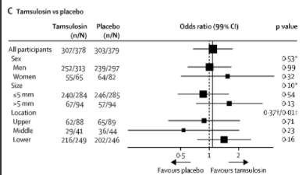
Tamsulosin
. 2015 Jul 25;386(9991):341-9.
. 2015 Jul 25;386(9991):341-9.
Picard R, et al. Lancet. 2015 Jul 25;386(9991):341-9.

Slide 109
IV fluids
. 2015 Jul 25;386(9991):341-9.
. 2015 Jul 25;386(9991):341-9.
Patients were randomized to 2L NS over 2 hours vs 20ml/hr continuous rate
No difference in analgesia requirements
No difference in stone passage
Springhart WP, et al. J Endourol. 2006 Oct;20(10):713-6.

Slide 110
Extracorporeal Shock Wave Lithotripsy
Highly effective.
Persistent stone fragments (larger/more stones).
Reversible impairment in RPF and GFR.
Permanent damage after 3 lithotripsies
Subcapsular hemorrhage and hematoma.
Hypertension?

Slide 111
Pig Kidney Post-ESWL
Willis et al., JASN, 1999.

Slide 112
Ureteroscopy with laser lithotripsy
Higher rate of stone fragmentation and passage
Don’t have the GFR impairment of ESWL
Complications of procedure (perforation, etc)

