Slide 1
Cross Cover Calls:
hypertension, pain, electrolytes
Elle Maureen Newcome, MD
Chief Resident

Slide 2
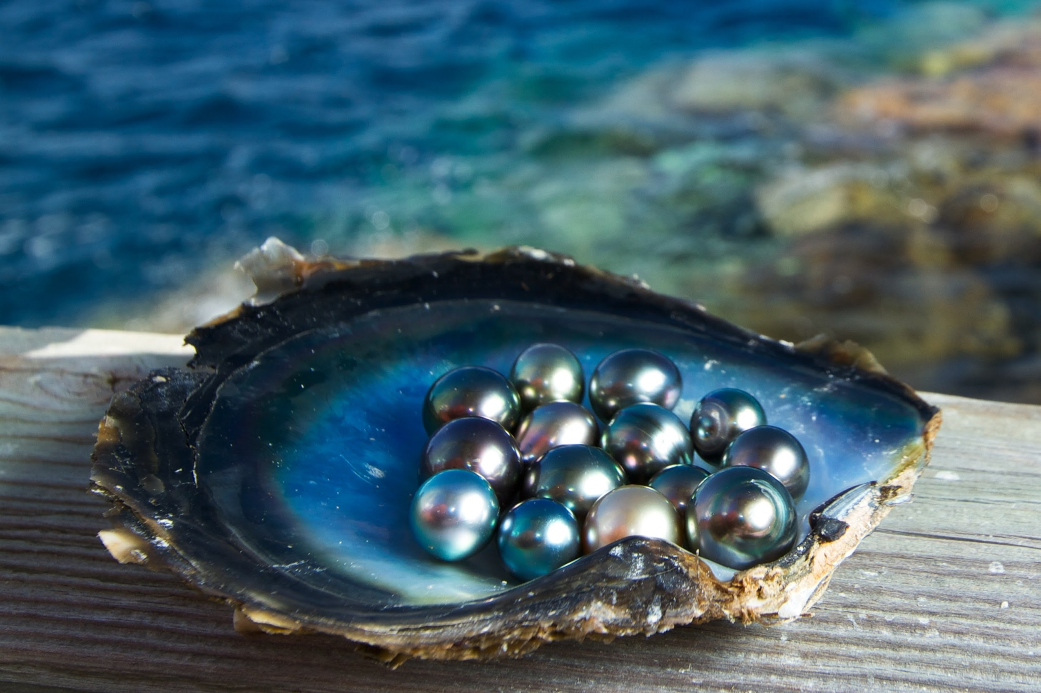
Pager pearls
Symptomatic?
Trends?
Acute or chronic
Consider 10 min re-check
Recent meds given?
Look at MAR
Notes:
General:
compare to previous VS— how are their VS trending?
What .meds are they taking that affect VS?
ARE THEY SYMPTOMATIC?
Have RN recheck in 10 min if not critical + asymptomatic.

Slide 3
hypertension

Slide 4
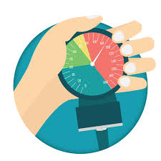
Hypertension
BP cuff (mmHg) | #Assessment
120/80
130s-170s
> 180/120 w/o symptoms
> 180/120 w/ symptoms
HTN and in pain
Notes:
Question to ask RN:
are they symptomatic (ie— en organ damage)?
are the on BP meds? If so, when was last dose given/next dose due?
Have RN check other arm
Have them recheck in 10 min

Slide 5
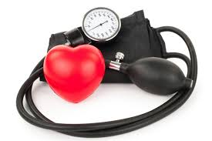
Hypertension
BP cuff (mmHg) | #Assessment
120/80 | normotension
130s-170s | HTN
> 180/120 w/o symptoms | uncontrolled HTN (= hypertensive urgency)
> 180/120 w/ symptoms | Hypertensive emergency
HTN and pheochromocytoma | HTN 2/2 underlying cause

Slide 6
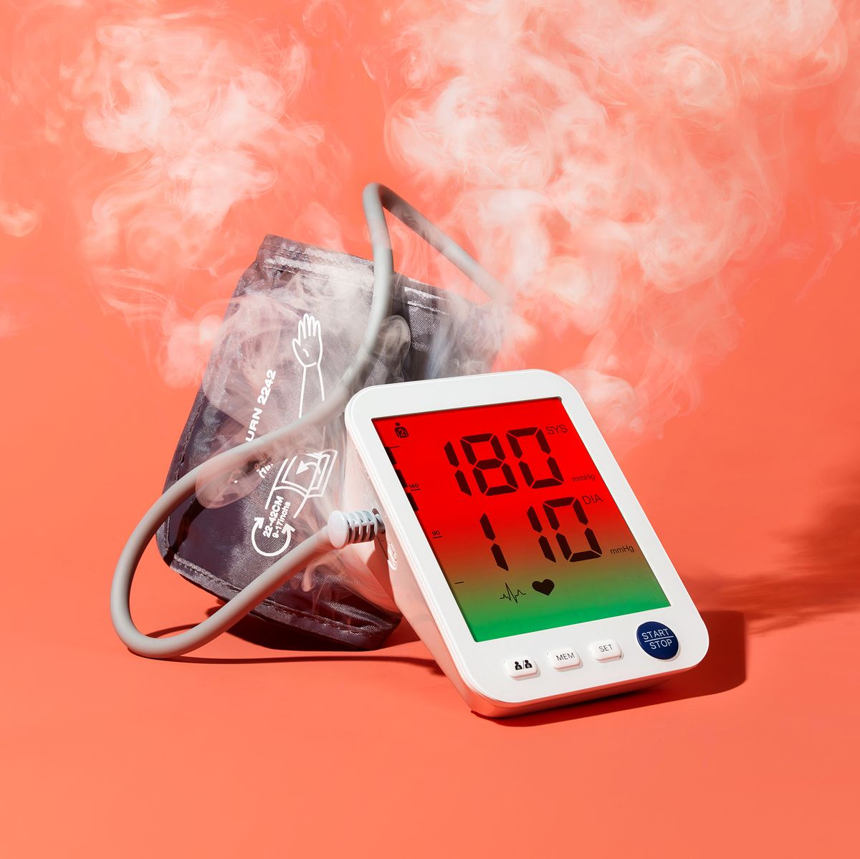
End Organ Damage
Brain: severe HA, seizure, PRES, TIA/Stroke
Eye: blurred vision (fundoscopic exam: papilledema, flame hemorrhages)
Heart/Lung: MI, pulmonary edema, +trop, Aortic dissection
Kidney: AKI, hematuria
Heme: MAHA
Notes:
Physical exam:
Brain: headache, confusion, lethargy, stroke (Perform focused neurologic exam).
Eye: blurred vision (fundoscopic exam: papilledema, flame hemorrhages).
Heart: chest pain, dyspnea, S3, S4, pulses.
Kidney: low urine output, edema.

Slide 7
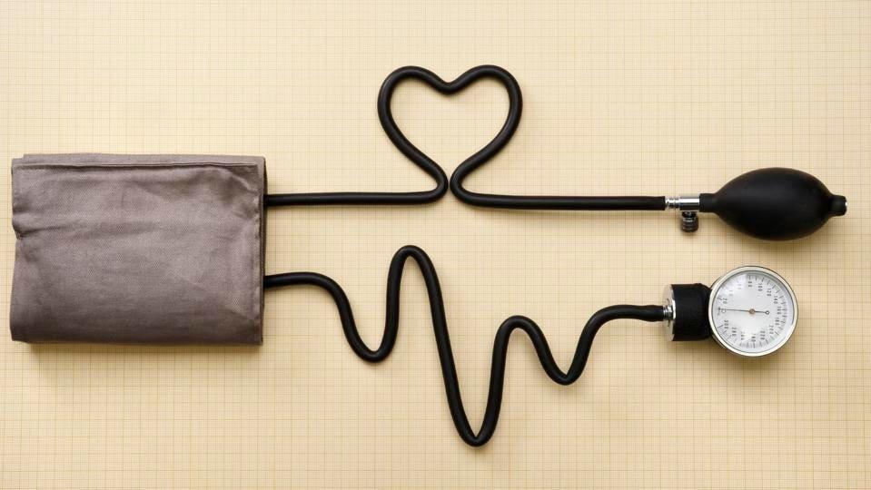
Tx
#Assessment | Plan
normotension
HTN
uncontrolled HTN = Hypertensive urgency
Hypertensive emergency
HTN 2/2 underlying cause
Notes:
Your options are: nothing, PO, IV, treat underlying cause

Slide 8
Tx
#Assessment | Plan
normotension | continue to monitor
HTN | PO BP meds
uncontrolled HTN = Hypertensive urgency | PO BP meds
Hypertensive emergency | Gtt (IV BP meds) → ICU UPGRADE
HTN 2/2 underlying cause | treat underlying cause

Slide 9
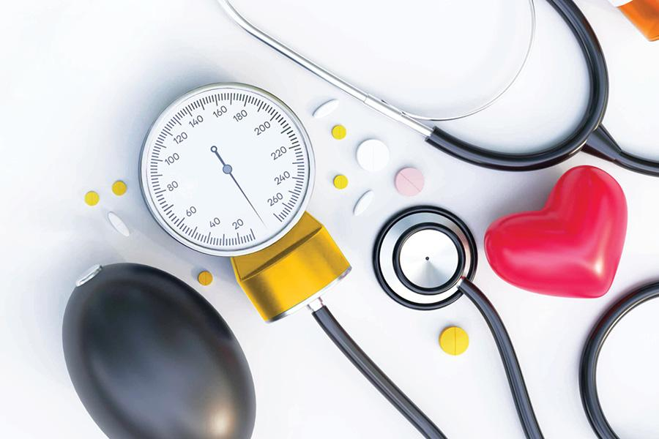
Tx HTN
Restart (or increase) home anti-HTN
Try amlodipine or lisinopril
Include holding parameters
“Hold for SBP < 110”
Quicker-acting PO: captopril
Avoid clonidine → rebound HTN
Avoid hydralazine → reflex tachycardia
AVOID IV PRNS (unless HTN emergency):
Rapid lowering of BP causes MI, stroke
Notes:
First: restart any home BP meds
If not on home meds: try
Amlodipine 5-10 mg PO daily
Lisinopril 10-20 mg PO daily or Losartan 25-50 mg daily
If need more rapid lowering of BP, (ie hypertensive urgency) try:
Captopril 6.25-25 mg PO TID; you can titrate up after each dose if not having an adequate effect.
(Try to avoid) Clonidine 0.1 mg PO BID. Can titrate up to TID. Due to the risk of rebound hypertension, clonidine is often reserved for resistant hypertension.
(Try to avoid) Hydralazine 10 mg PO q8h, can increase to q6h - use with caution due to unpredictable effect and reflex tachycardia.

Slide 10
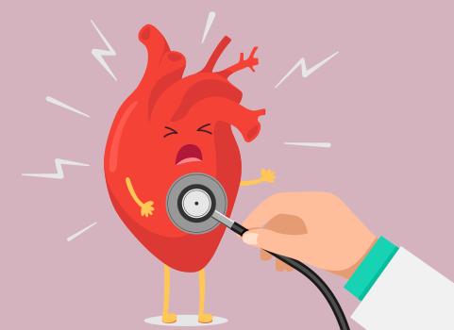
Tx HTN EMERGENCY
ICU for gtt
Nicardipine (“cardene”)
Interim: IV labetalol push
(If not bradycardic)
Notes:
If HTN emergency: upgrade to ICU, need art line!
AVOID hydralazine or nitropaste (can have unpredictable effects) and nifedipine (associated with increased mortality).
Ask ICU what they prefer to give in the interim
Options include labetalol 10-20mgIV (not for people with CHF) – then ICU will manage with gtt
Esmolol: 0.5mg/kg loading dose

Slide 11
pain

Slide 12
Pager pearls
Symptomatic?
Trends?
Acute or chronic
Consider 10 min re-check
Recent meds given?
Look at MAR
Notes:
General:
compare to previous VS— how are their VS trending?
What .meds are they taking that affect VS?
ARE THEY SYMPTOMATIC?
Have RN recheck in 10 min if not critical + asymptomatic.

Slide 13
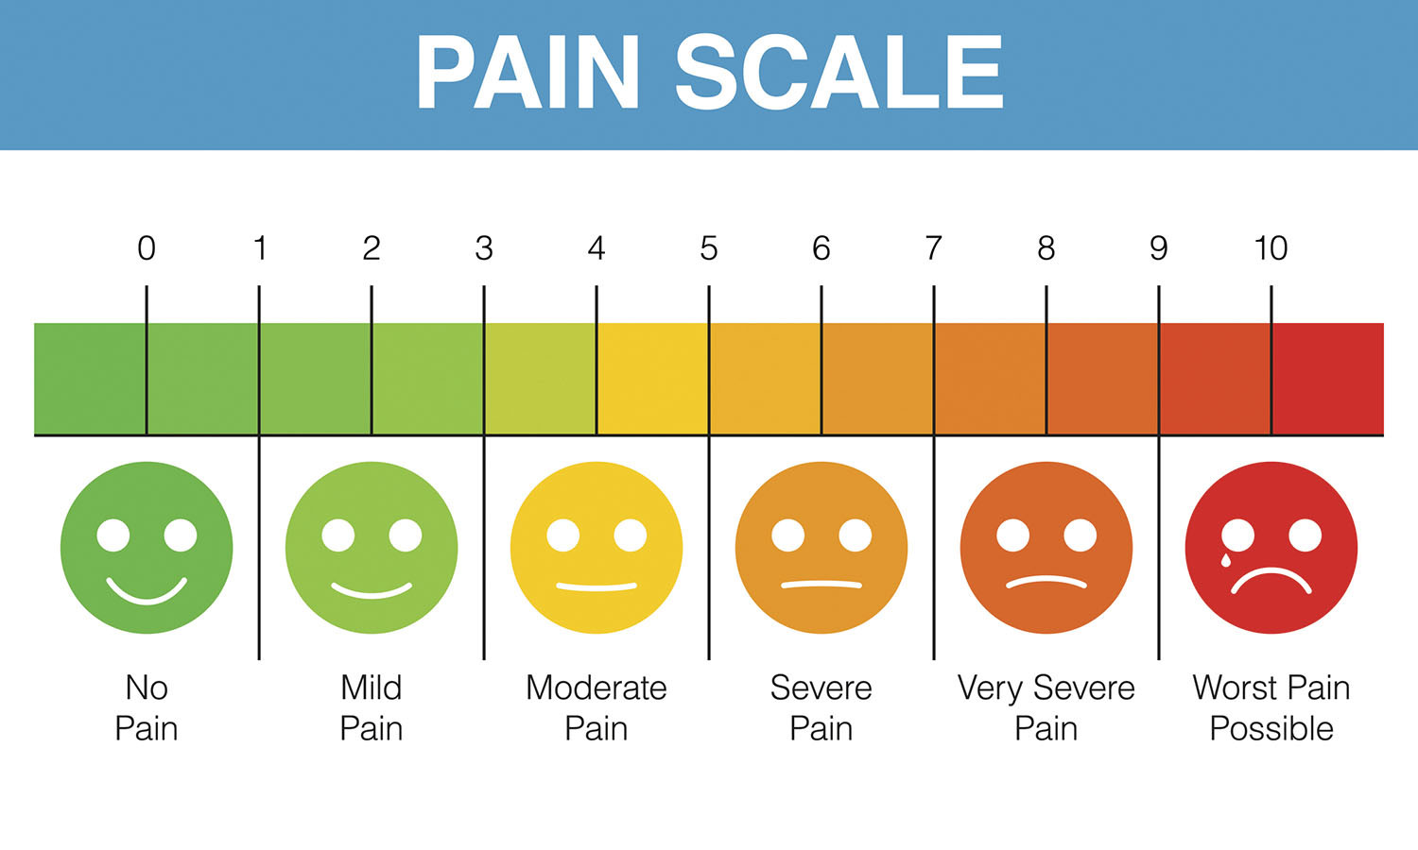
Quantifying pain
Notes:
Pain is subjective, despite our best efforts to quantify it
Pain is always a symptom of SOMETHING, be it meds or otherwise
Take patient pain seriously
Some patients cannot communicate when they are in pain. It is our responsibility to find out.
Clues: furrowed brow, tachycardia/HTN/tachypnea. Medical reason for pain

Slide 14
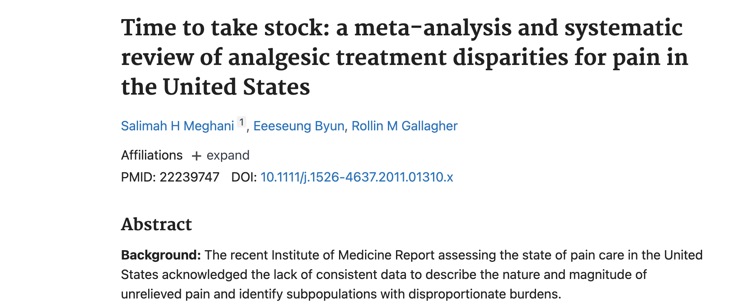
Social Determinants of Health and Pain
Notes:
Our healthcare system systematically undertreats pain based on race and ethnicity
People who are Black experienced both a higher number and magnitude of disparities than any other group in the analyses.
Opioid treatment disparities were ameliorated for Hispanics/Latinos for "traumatic/surgical" pain (P = 0.293) but remained for "non-traumatic/nonsurgical" pain (odds ratio [OR] = 0.70, 95% confidence interval [CI] = 0.64-0.77, P = 0.000).
For Blacks/African Americans, opioid prescription disparities were present for both types of pain and were starker for "non-traumatic/nonsurgical" pain (OR = 0.66, 95% CI = 0.59-0.75, P = 0.000).
In subanalyses, opioid treatment disparities for Blacks/African Americans remained consistent across pain types, settings, study quality, and data collection periods.
A 2016 survey of 222 white medical students and residents published in The Proceedings of the National Academy of Sciences
half of them endorsed at least one myth about physiological differences between black people and white people, including that black people’s nerve endings are less sensitive than white people’s.
When asked to imagine how much pain white or black patients experienced in hypothetical situations, the medical students and residents insisted that black people felt less pain.
This made the providers less likely to recommend appropriate treatment
A third of these doctors to be also still believed the lie that Thomas Hamilton tortured John Brown to prove nearly two centuries ago: that black skin is thicker than white skin.

Slide 15
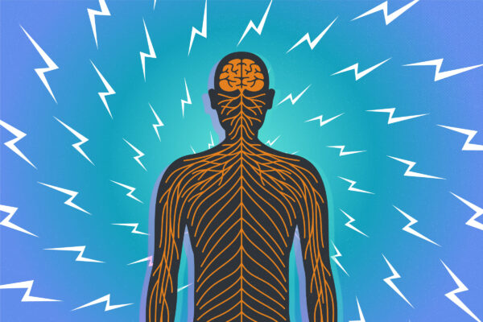
Pain
Rating | IV or PO
mild
moderate
severe
breakthrough

Slide 16
Pain
Rating | IV or PO
mild | PO
moderate | PO
severe | IV
breakthrough | IV
Notes:
Order commetns: add pain scale on there for objective administration of pain meds

Slide 17
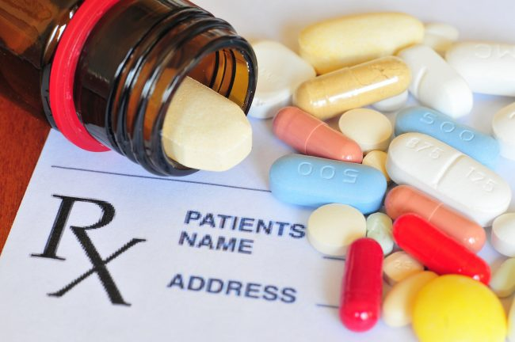
Pain Options
Notes:
What pain classes come to mind when you think of options?
Order comments: add pain scale on there for objective administration of pain meds

Slide 18
Pain Options
NSAIDS | Ibuprofen, toradol (IM)
ACETAMINOPHEN | <3
OPIOIDS | Good for AKI: oxycodone, dilaudid/hydromorphone Avoid in renal failure: morphine, codeine, (NSAIDS)
TOPICAL | Capsaicin, Diclofenac, Lidocaine, Ice/heat pack
NEUROPATHIC | Gabapentin, pregabalin
ANTIDEPRESSANTS | TCA and SNRI (Duloxetine)
MUSCLE RELAXANT | Baclofen, cyclobenzaprine
Notes:
Start with prescribed PRNs, can add an additional dose of the medication they are taking
If next dose due within 1ish hours, can give early
If need to order PRN pain med:
Oral over IV always unless cannot tolerate/absorb P.O. intake
start with non-opioid methods: heat/cold packs, lidocaine patches, capsaicin cream, Tylenol

Slide 19
electrolytes
Notes:
Which electrolytes do we lower?

Slide 20
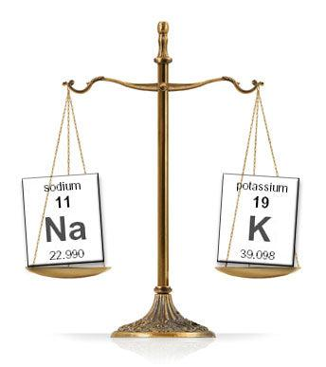
Which electrolytes do we lower?
Notes:
Hypernatremia – free water deficit. Calculate rate and correct slowly.
Phos high – usually other reason (renal failure)
Which lytes do we replete?

Slide 21
Which electrolytes do we replace?
Notes:
Hyponatremia is MCC electrolyte abnormality: Na+ and Cl- involve water balance – treatment varies by cause
HC03 we do not replace b/c involved acid-base balance. Give for metabolic acidosis with pH < 7.15. ICU (sometimes renal on floor or PO home med)

Slide 22
High lytes

Slide 23
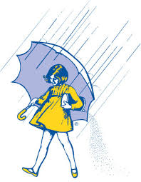
HYPERNATREMIA
Calculate free water deficit
Calculate fluid rate (given fluid tonicity)
Expected ↓ Na/L fluid = (Na serum – Na fluid) / (TBW +1); however, actual response is variable
REMEMBER
Correct no faster than 1-2 mEq/L/h to prevent cerebral edema Ideal: PO free water, NGT free water boluses (200-400mL Q6-8h), or IV D5W
may also need DDAVP for DI (in conjunction with Endocrine consult)

Slide 24
HYPERKALEMIA
EKG +/- Ca+ gluconate to stabilize cardiac membrane
MEDS
10U insulin + D50 ( for glc < 250)
Albuterol nebs
Lasix
kayexelate , lokelma, patiromer
Consult: renal stat for guidance +/- if patient will need dialysis
Watch: muscle weak/paralysis, cardiac arrythmias
Notes:
Hyperkalemia (K+>5.0…severe if K+>6.5 OR > 5.5 with ARF)
Ask: symptomatic? tell to get EKG stat.
Order:
EKG stat, start telemetry
You only need Ca+ gluconate 10mL of 10% solution (1g) IF there are EKG changes
Lokelma 10g TID for up to 48H
Consider 10U regular insulin (w/ 50mL [25g] 50% dextrose if serum glc < 250) w/ Q1 glc checks for 5-6 hours
Consider IV LASIX 20-40g Q12h if preserved renal function
Consult: renal stat for guidance on above steps + if patient will need dialysis
Watch: muscle weak/paralysis, cardiac arrythmias

Slide 25
Low lytes

Slide 26
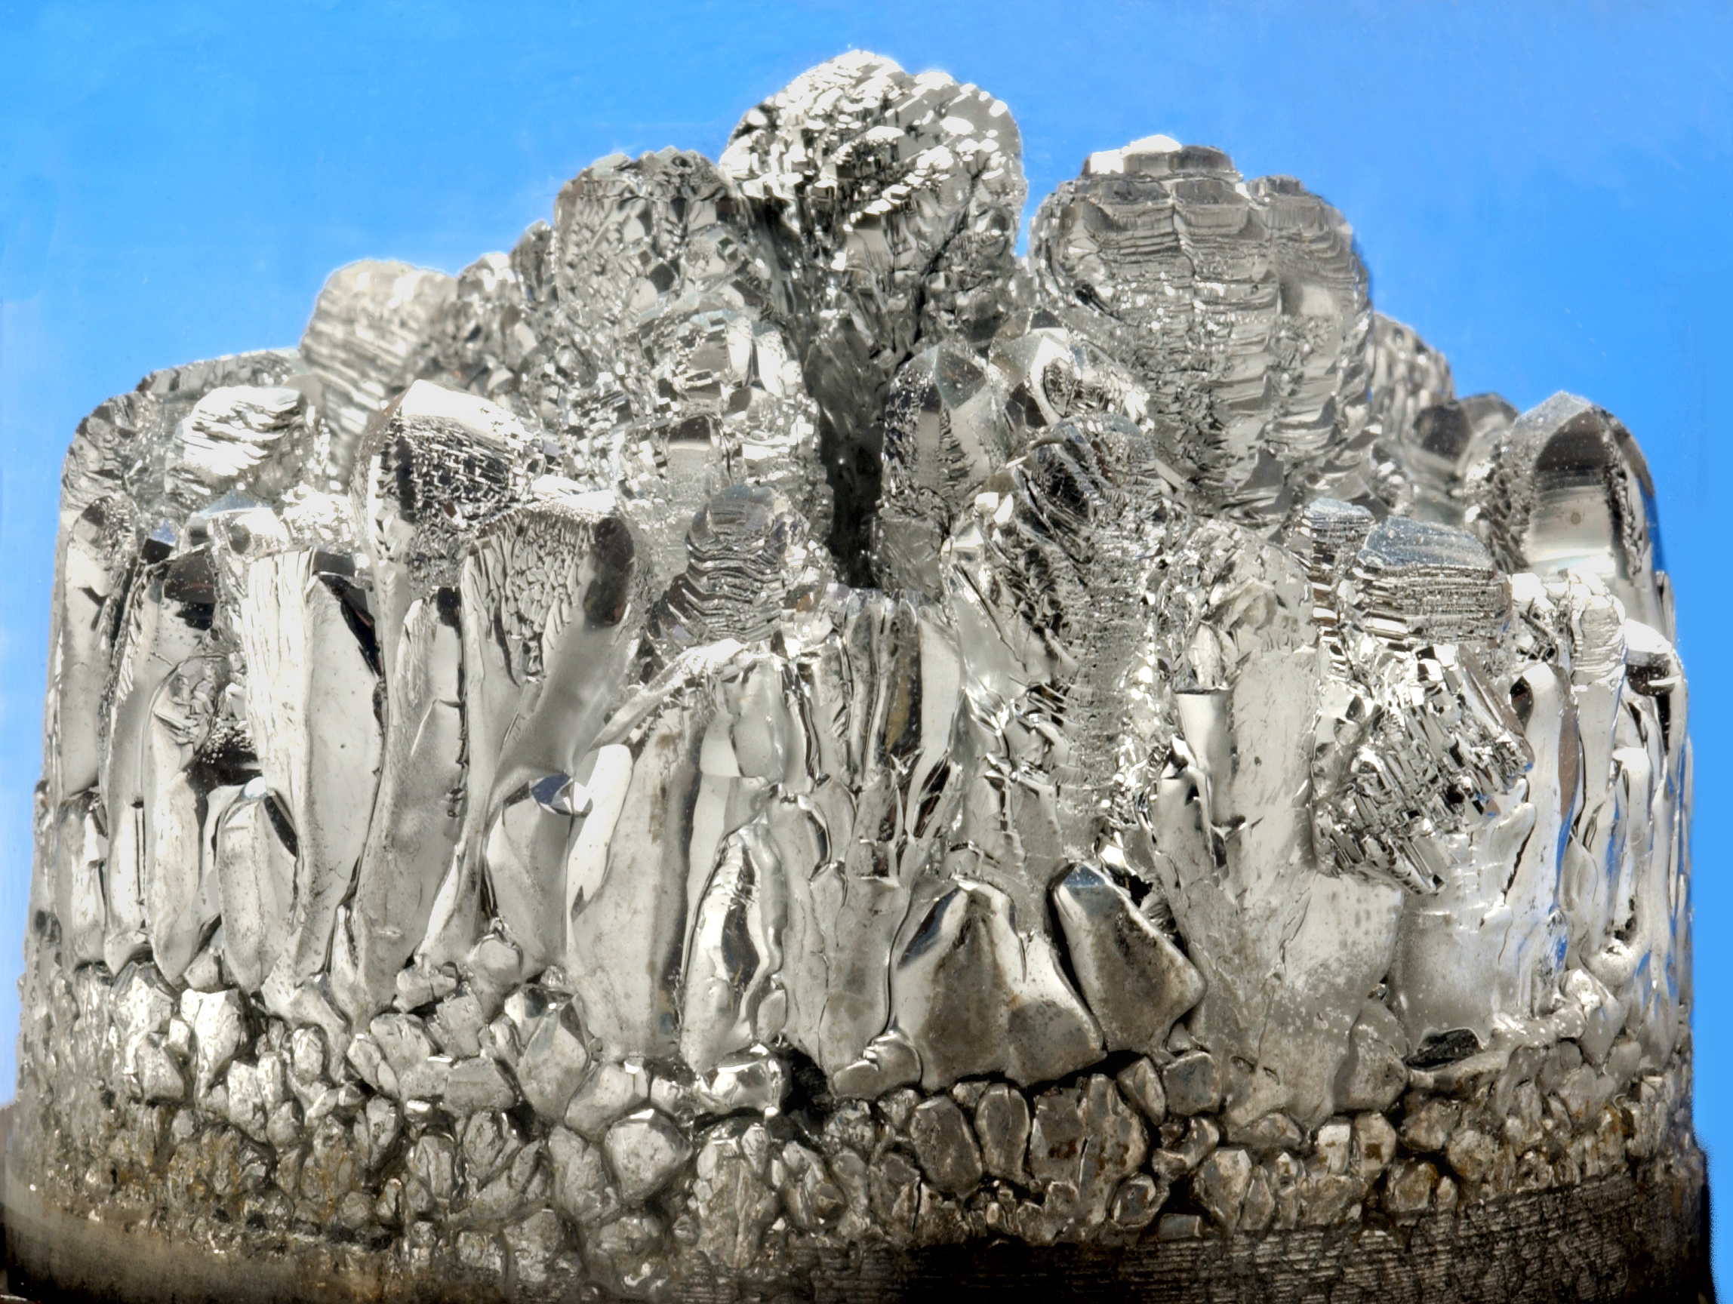
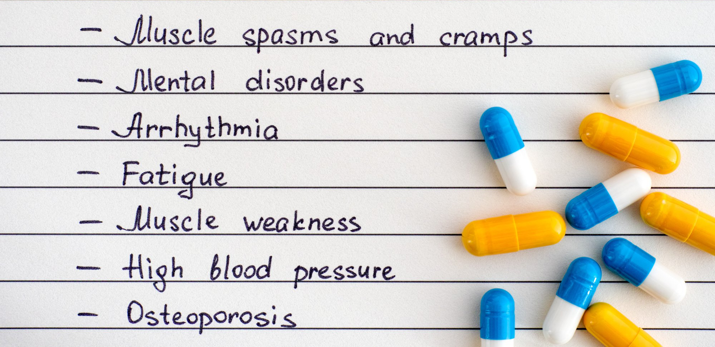
MAGNESIUM
Hypomagnesemia = Mg2+ < 1.8
Cardiac patients, goal Mg 2+ > 2
Notes:
Fun fact: oral Mg+ has been used as an oral laxative since the 17th century. Drinking Mg+ sulfate lead to diarrhea. Called “Epsom Salt” – named after British town in which it was discovered.

Slide 27
Logistics: replace IV when possible. Oral leads to diarrhea.
Mg2+ helps keep K+ in cells by decreasing membrane permeability and/or inhibiting Na+-K+ ATPase
Notes:
DO NOT SKIP

Slide 28
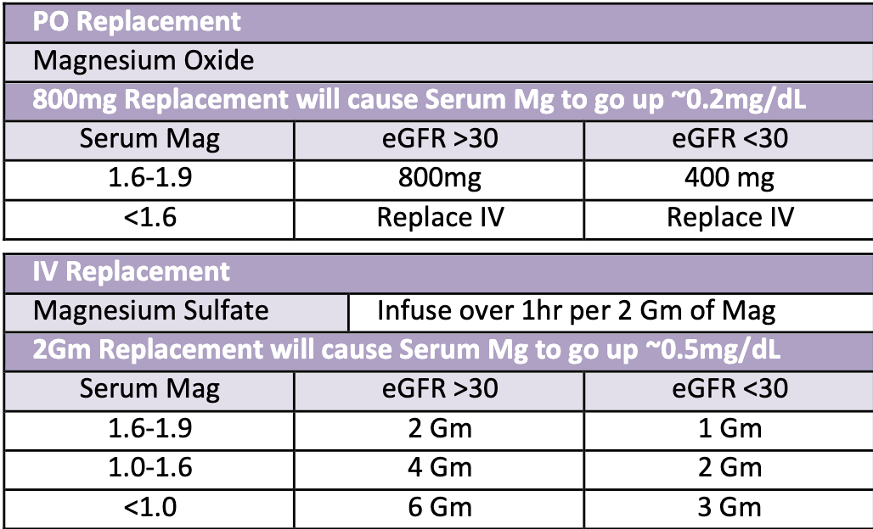
Practice Case
X is a 70F with pmh hyperparathyroidism, HFrEF, and CKD (eGFR 32) who is found to have Mg2+ 1.7 on am labs. How would you replace her Mg2+?
800 mg PO
400mg PO
2 gm IV
1gm IV
Notes:
Answer: C b/c want to avoid diarrhea and because egfr > 30.
What about if she endorses 7 days of constipation? Give PO!
SKIP

Slide 29
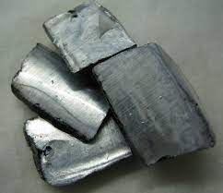
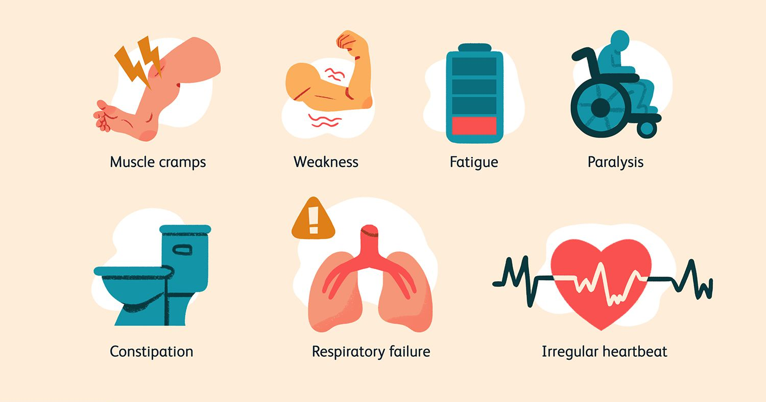
POTASSIUM
Hypokalemia = K+ < 3.5
cardiac patients, goal K + > 4
caution replacing in renal disease
Notes:
Hypokalemia (K+ < 3.5… severe if < 3.0)
Ask: symptomatic?
Order: replace K+ AND Mg+ (goal >2). Get EKG
Watch: arrhythmia, muscle weakness, rhabdomyolysis
Reflect: why did it happen? Most common: GI losses or diuretics.

Slide 30
be kind: replace oral when possible, IV causes burning. If IV, add 500L NS/LR for comfort. However, oral pill is huge, powder tastes terrible.
math: every 10mEq K+ replaced increases serum K+ by ~0.1
rate: no more than 10mEq/hr through peripheral IV; 20mEq/hr though central is ok
absorb: body cannot absorb > 40meq Q4-6H in IR formulation
Notes:
IV KCL is used in lethal injection – giving too fast can stop the heart. Use the protocols. If in doubt, call pharmacy.

Slide 31
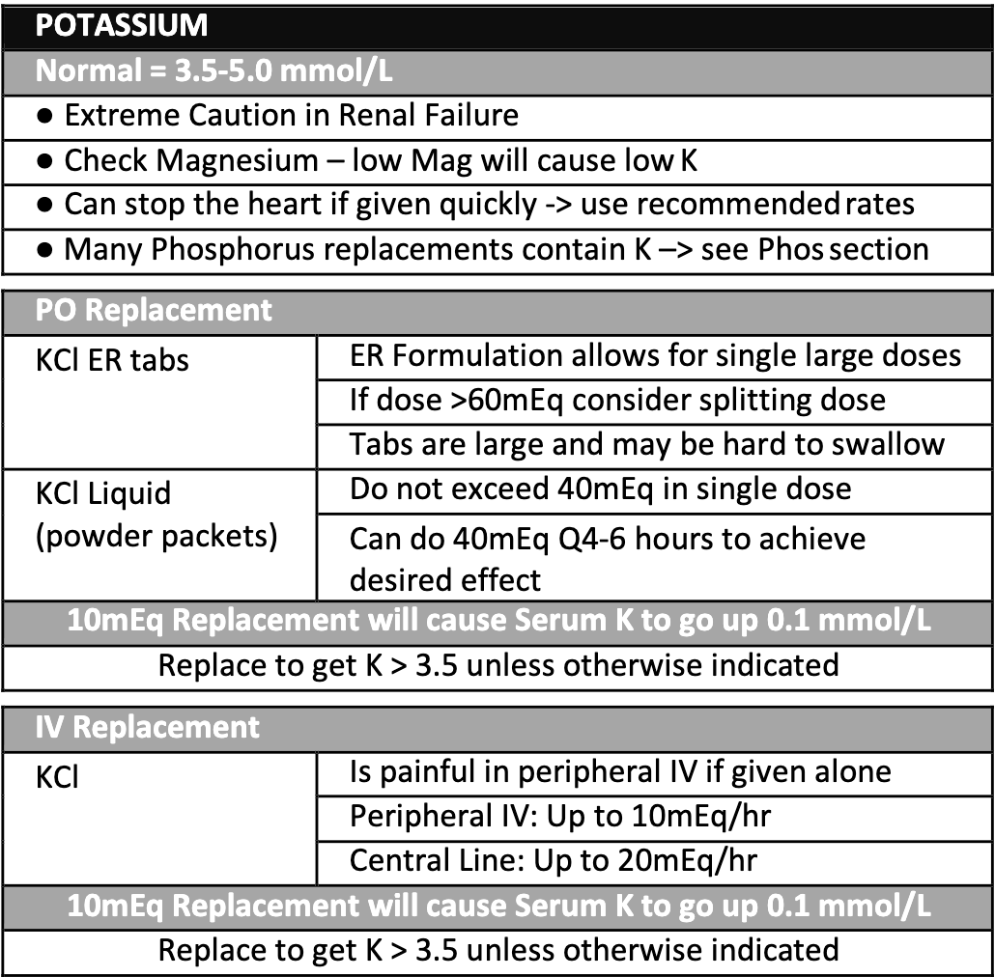
Practice Case
X is a 70F with pmh hyperparathyroidism and HFrEF who is found to have K+ 2.9 on am labs. How many Meq of K+ would you give her?
110 mEq
1.1 mEq
0.6mEq
60 mEq
Notes:
Answer: A. 110mEq. She is a cardiac patient, so goal K+ 4.0.
Follow up: How would you give her this? IV, PO, or both? → BOTH (!!) it is a lot.
Follow up answer: 40meq IR now + 40meq IV = 4 hours; 20 to 40 mEq IR in 4-6 hours.
Follow up part 2: How long would it take her to be replaced to goal? 4-6 hours!

Slide 32
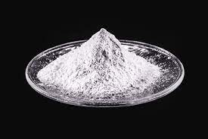
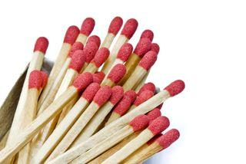
PHOSPHORUS
Symptoms: weakness, rhabdo, paresthesia, seizure, stupor, impaired muscle contractility (smooth and muscular)
Hypophosphatemia = Phos < 2.5
cardiac patients, goal phos > 3

Slide 33
logistics: phos replacement often has K+ in it. Include this in calculations of replacement.
Route: Replete Phos < 1.0 via IV; all else PO
Caution: with hypocalcemia, as increased phos increased bone remodeling, decreasing ionized Ca+
If no etiology discerned from clinical picture:
consider Vit D deficiency, Ca+ deficiency, PTH deficiency

Slide 34
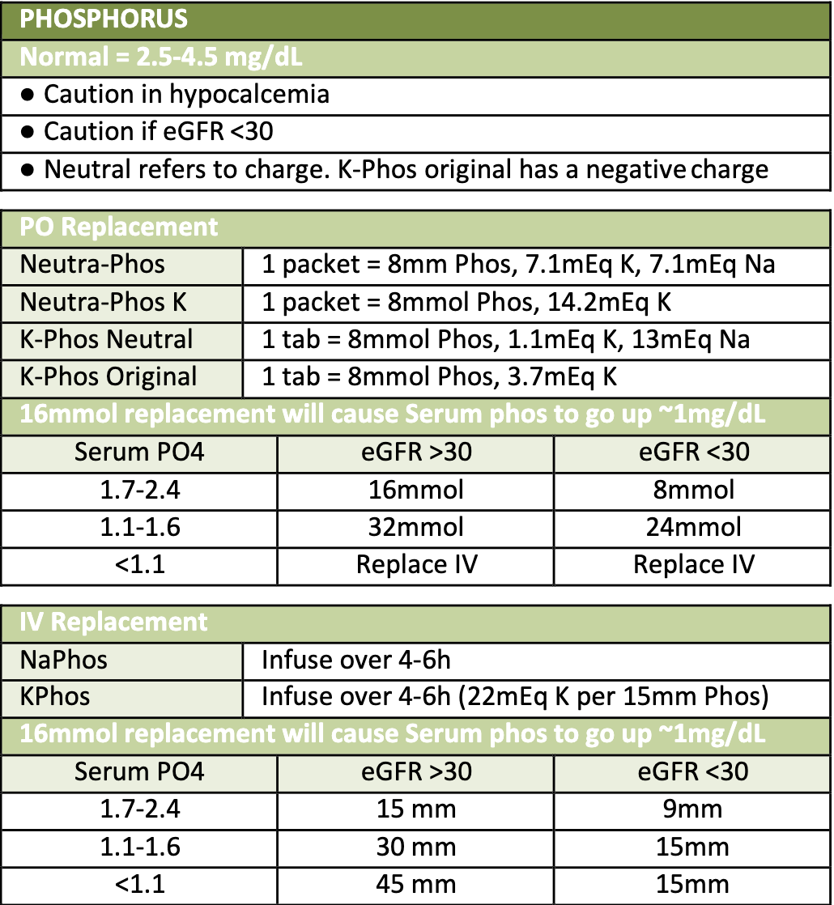
Practice Case
X is a 70F with pmh HFrEF (EF 40%) who is found to have Phos 1.9 and K+ 3.3 on am labs. How would you replace her phos?
K-phos Neutral 2 packets
Neutra-Phos K 2 packets
Neutra-Phos 2 packets
K-Phos Original 2 packes
Notes:
Answer: B. All answers work for the phos. But we want to increase K+ as well to 3.5. So formulation with most potassium is the way to go
Follow up questions: What would her K+ be after replacement with Neutra-Phos K 2 packets?
Follow up answer: ~3.6 because 14+14 = 28 = 2.8 increase!

Slide 35
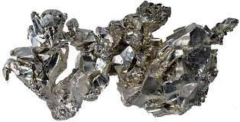
CALCIUM
Hypocalcemia = Ca2+ < 8.5
Ionized Ca2+ < 1.15

Slide 36
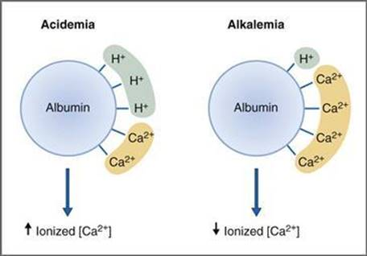
Albumin: Correct Ca2+ for albumin!
-If Albumin < 2, order ical.
-If corrected Ca+ still low, order ical
Math: (albumin)*0.8 + serum Ca2+ = corrected Ca2+

Slide 37
Math: 1g Ca2+ Glc causes serum iCa2+ to increase by 1mg/dL
Critical care: If patient tanking, or has received a lot of blood product, or persistently hypotensive; check an ical!

Slide 38
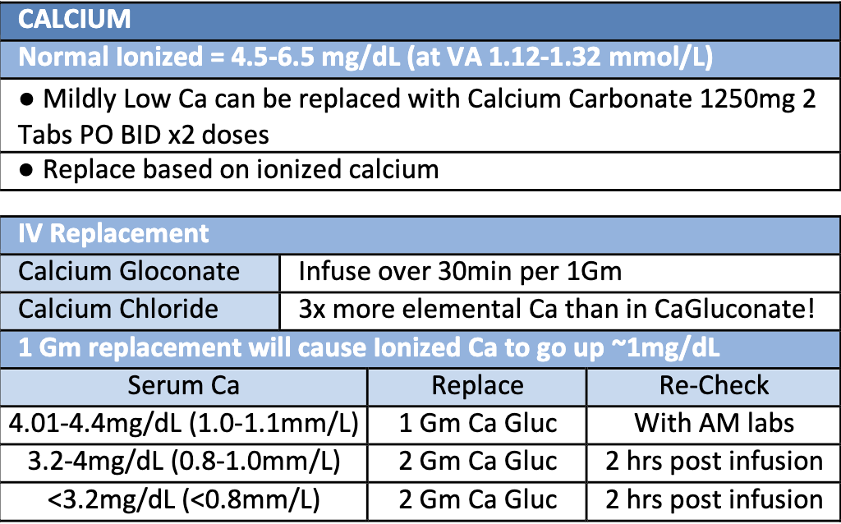
Practice Case
X is a 70F with pmh hyperparathyroidism and HFrEF who is found to have iCal to be 3.3mg/dL. How would you replace her Ca2+?
Ca2+ carbonate PO 1250mg PO BID
1gm Ca2+ gluconate
2gm Ca2+ gluconate
Notes:
Answer: C – you already have ical
Follow up question: when do you recheck?
Follow up answer: 2 hours post-transfusion

Slide 39
Low Lytes Recap
Electrolyte | Goal | Caution with | Preferred formulation
Mg2+ | >2+ for cardiac | Renal | IV
K+ | >4+ for cardiac | Renal, low Mg+ | PO
Phos | >3+ for cardiac | K+ abnormalities (calcuate), low Ca+ | PO
Ca2+ | wnl | NA | IV
-check orders before replacing (so as to not double dip)
-keep track of what you are replacing regularly/daily
-caution in fluid overload
-through people on telemetry for hypokalemia!

Slide 40
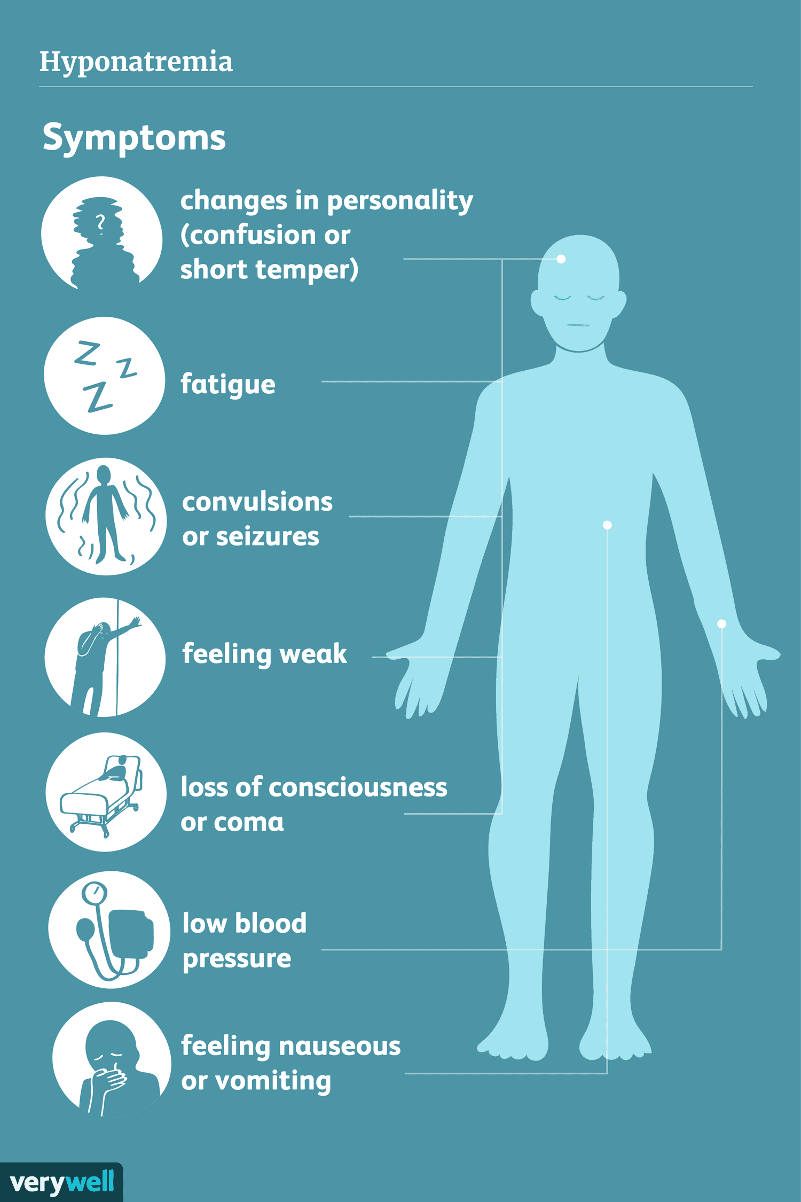
SODIUM
Hyponatremia = Na+ < 135
Notes:
Cirrhotic patient baseline may be lower

Slide 41
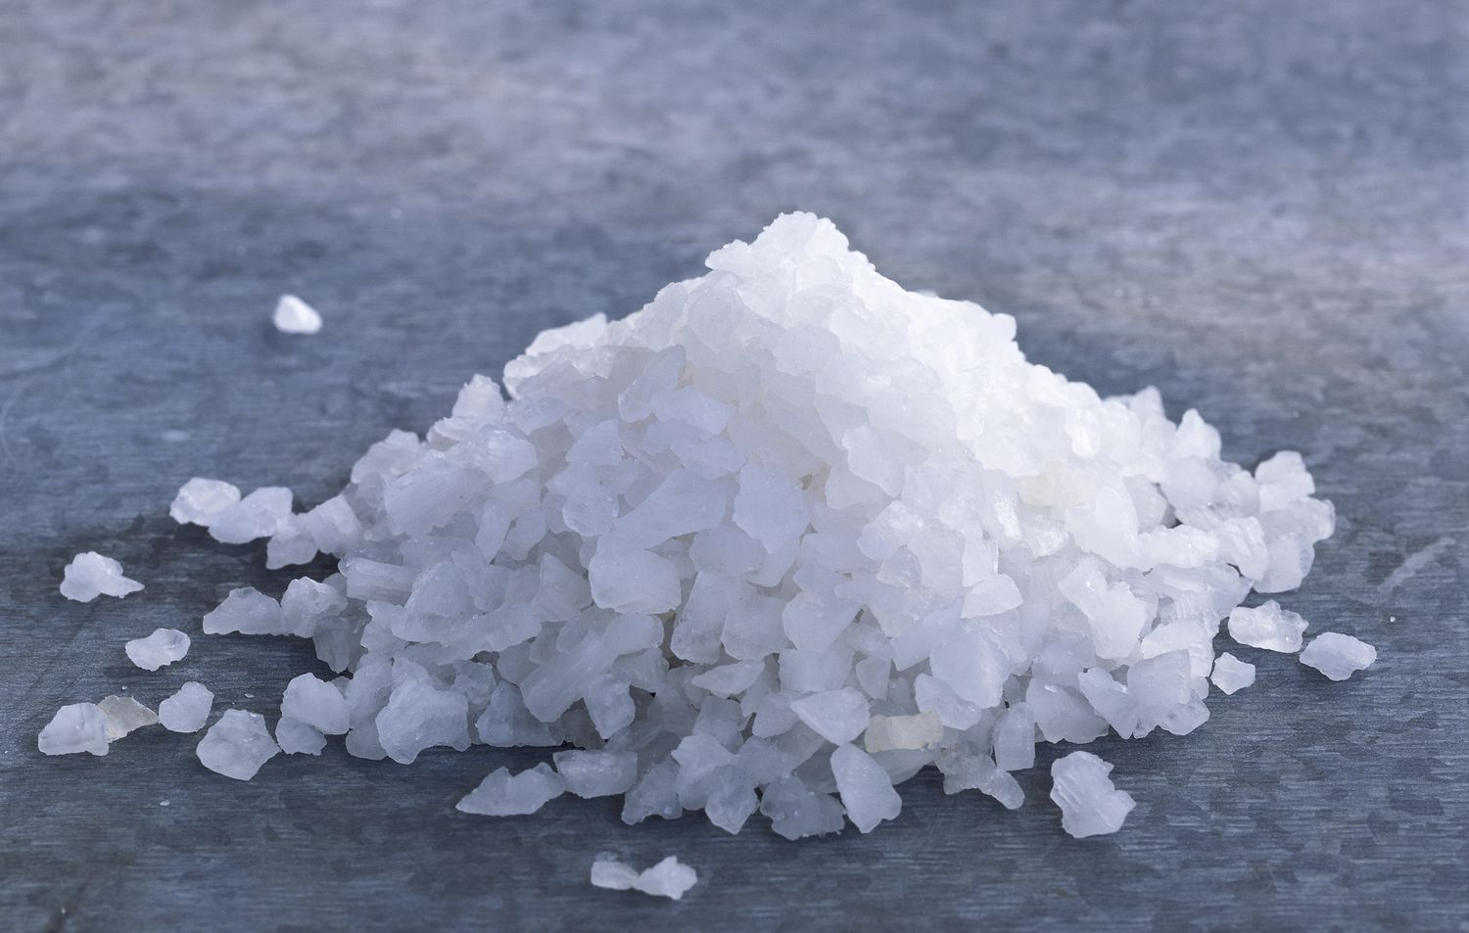
HYPONATREMIA
Order Labs: Serum Osm, Urine Osm, Urine Na+, correct Na+ for glc
Analyze labs: Determine TONICITY, if ADH is present, and if ADH is appropriately elevated
Serum Osm > 300 = HYPERTONIC
U Osm > 100 = ADH present
U Na+ < 30 = RAAS present
REMEMBER
Increase Na by 4-6 mEq/L in 24h to prevent osmotic demyelination
if severe or symptomatic hypoNa
achieve goal Na in <6 hrs and maintain steady Na level for rest of 24h
consider 3% NaCl (100 ml x3 prn until sx resolve)

Slide 42
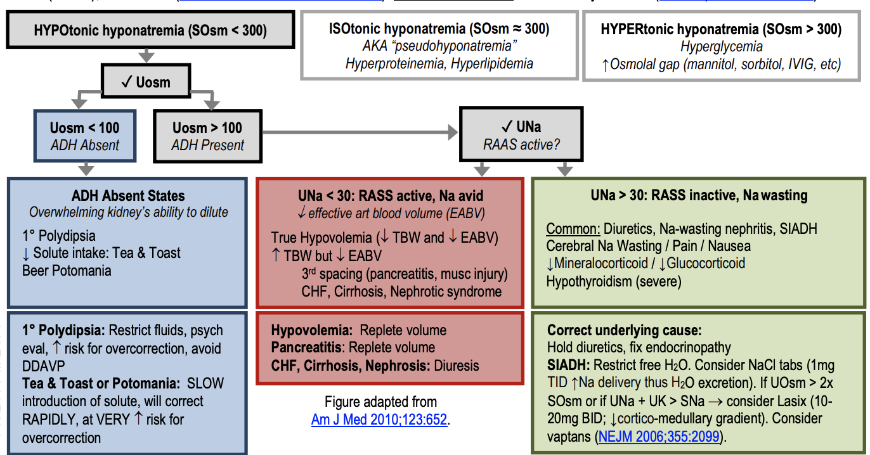
HYPONATREMIA

Slide 43
Thank you! Questions?

